Slide 1
Hospital Pricing & Network Affordability
What the same care costs across 3,236 hospitals — and what a health plan can do about it
Medicare hospital cost data · an AI-enabled analysis

Slide 2
THE BOTTOM LINE
The same care can cost up to 16× more — and the gap is mostly pricing, not better care
■ Wildly different prices. The same hospital treatment can cost up to 16× more at one hospital than another.
■ It's how they price, not what care costs. For-profit hospitals charge ~45% more — yet Medicare pays them slightly less. So it's a pricing choice, not higher costs.
■ Paying more doesn't buy better care. Price and hospital quality ratings have no relationship — and the most expensive hospitals tend to rate the worst.
■ The opportunity. Guide members to hospitals that are both cheaper and higher-quality (738 qualify).
■ The size. On for-profit hospitals alone, the overcharge is roughly $6–26 billion.
RECOMMENDATION: build the network around hospitals that are both affordable and high-quality — start where a cheaper, better option is already nearby.

Slide 3
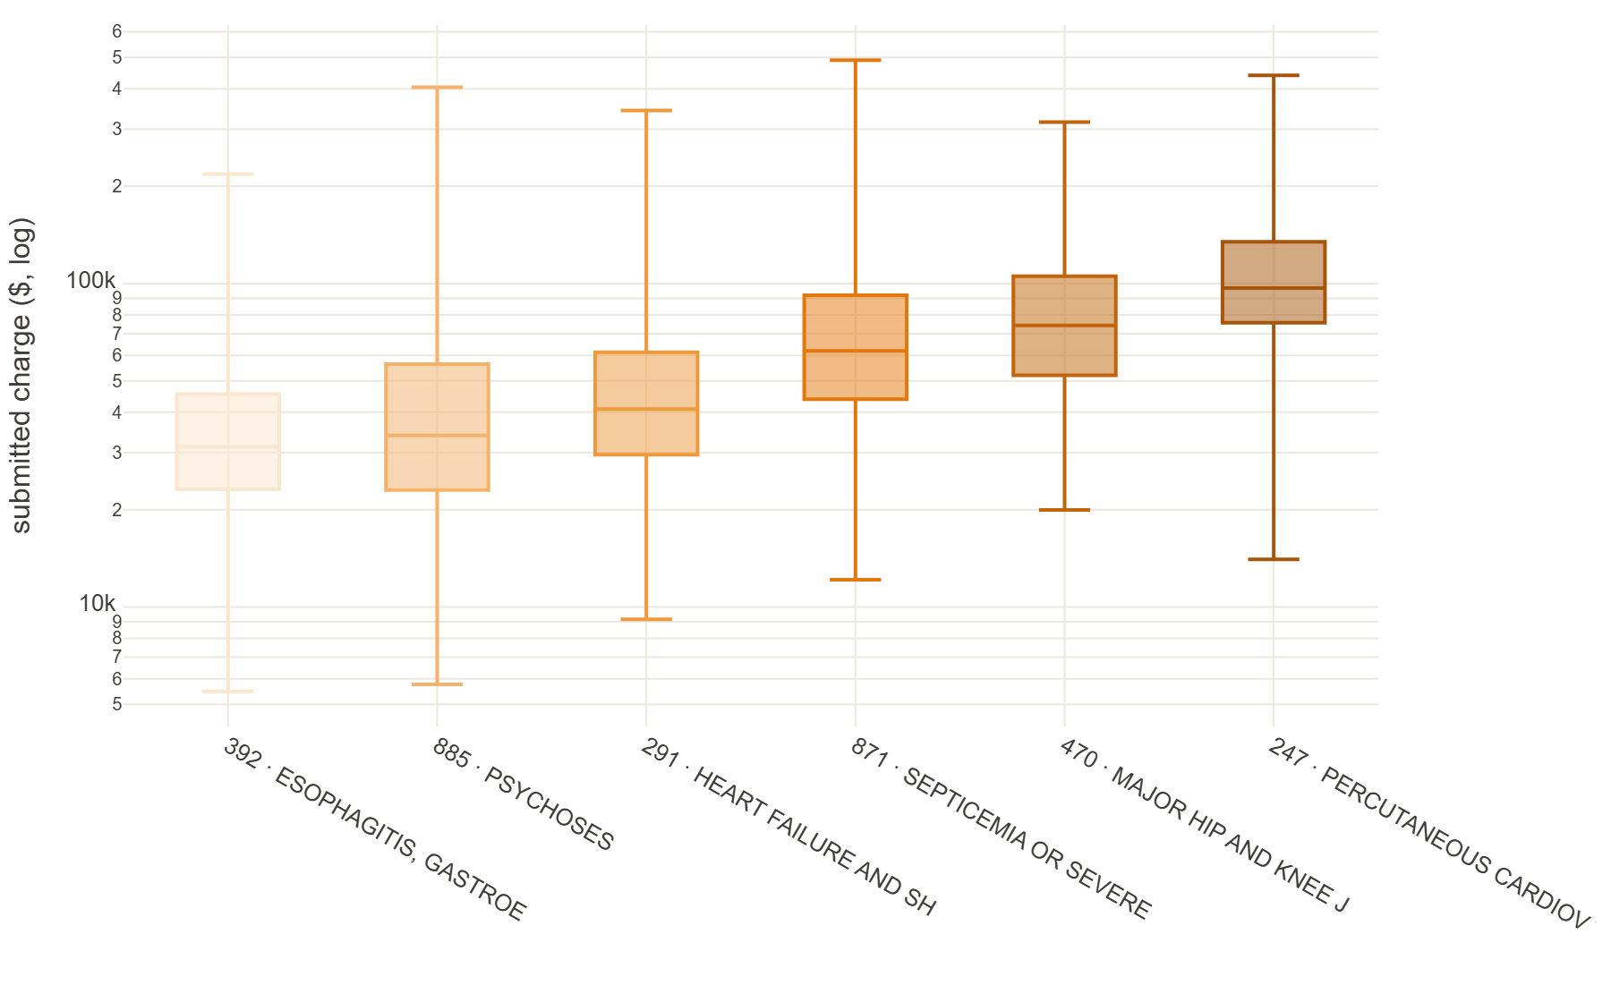
FINDING 1 · PRICE VARIES WILDLY
The same procedure, very different price
■ The question: which treatments vary most in price between hospitals?
■ For the same treatment, the priciest hospitals charge at least 3× more than the cheapest — true for 94% of common treatments.
■ The most extreme: a hip/knee replacement ran from about $20k to $316k — same surgery.
■ It's the hospital you walk into, not the care, that drives the difference.

Slide 4
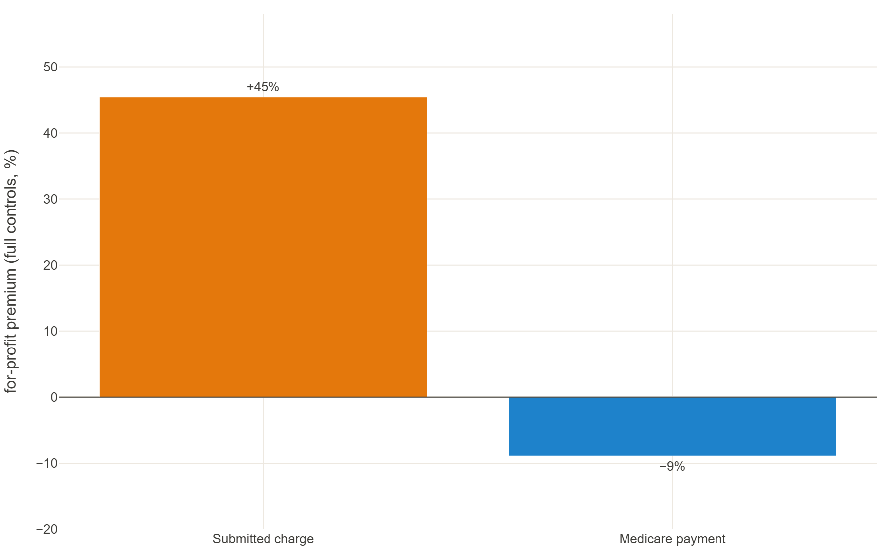
WHY — THE MECHANISM
It's a pricing choice, not a cost difference
■ For-profit hospitals charge about 45% more than others for comparable care — even after accounting for how sick patients are, where the hospital is, and what kind of hospital it is.
■ The tell: Medicare pays those same hospitals slightly LESS, not more.
■ Medicare's payment already adjusts for local labor costs — so 'things just cost more here' can't explain the gap.
■ This only hurts an insurer that pays a share of the hospital's list price.

Slide 5
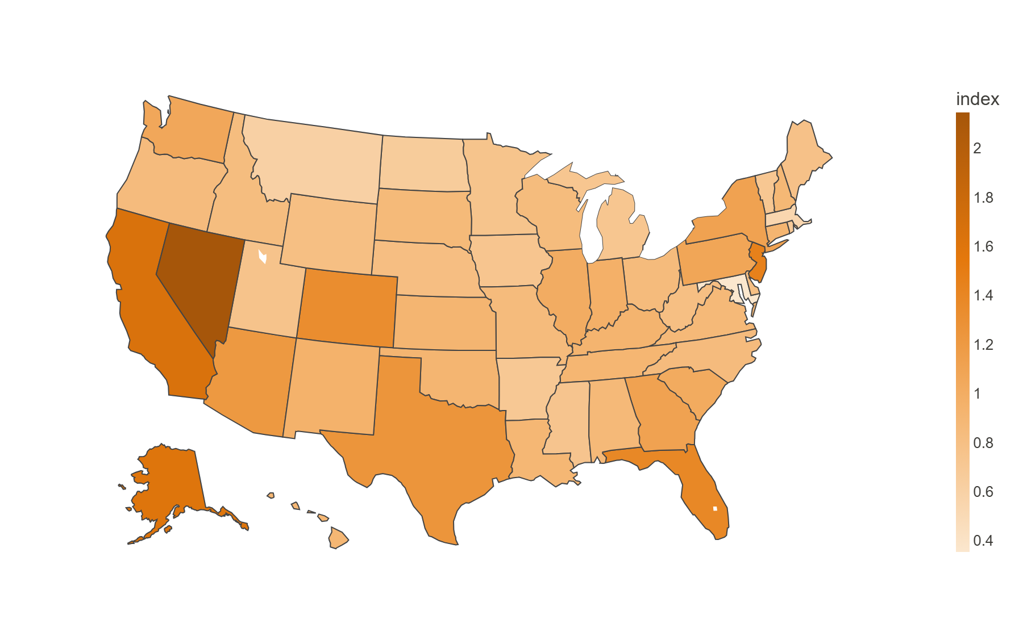
FINDING 2 · GEOGRAPHY
Where you are matters — a lot
■ The question: do prices follow a regional pattern?
■ Yes — the most expensive states charge about 6× more than the cheapest for the same care.
■ Maryland, which regulates hospital rates, is the cheapest; Nevada, California, New Jersey and Florida are the priciest.
■ Same treatment, very different price depending on the market.

Slide 6
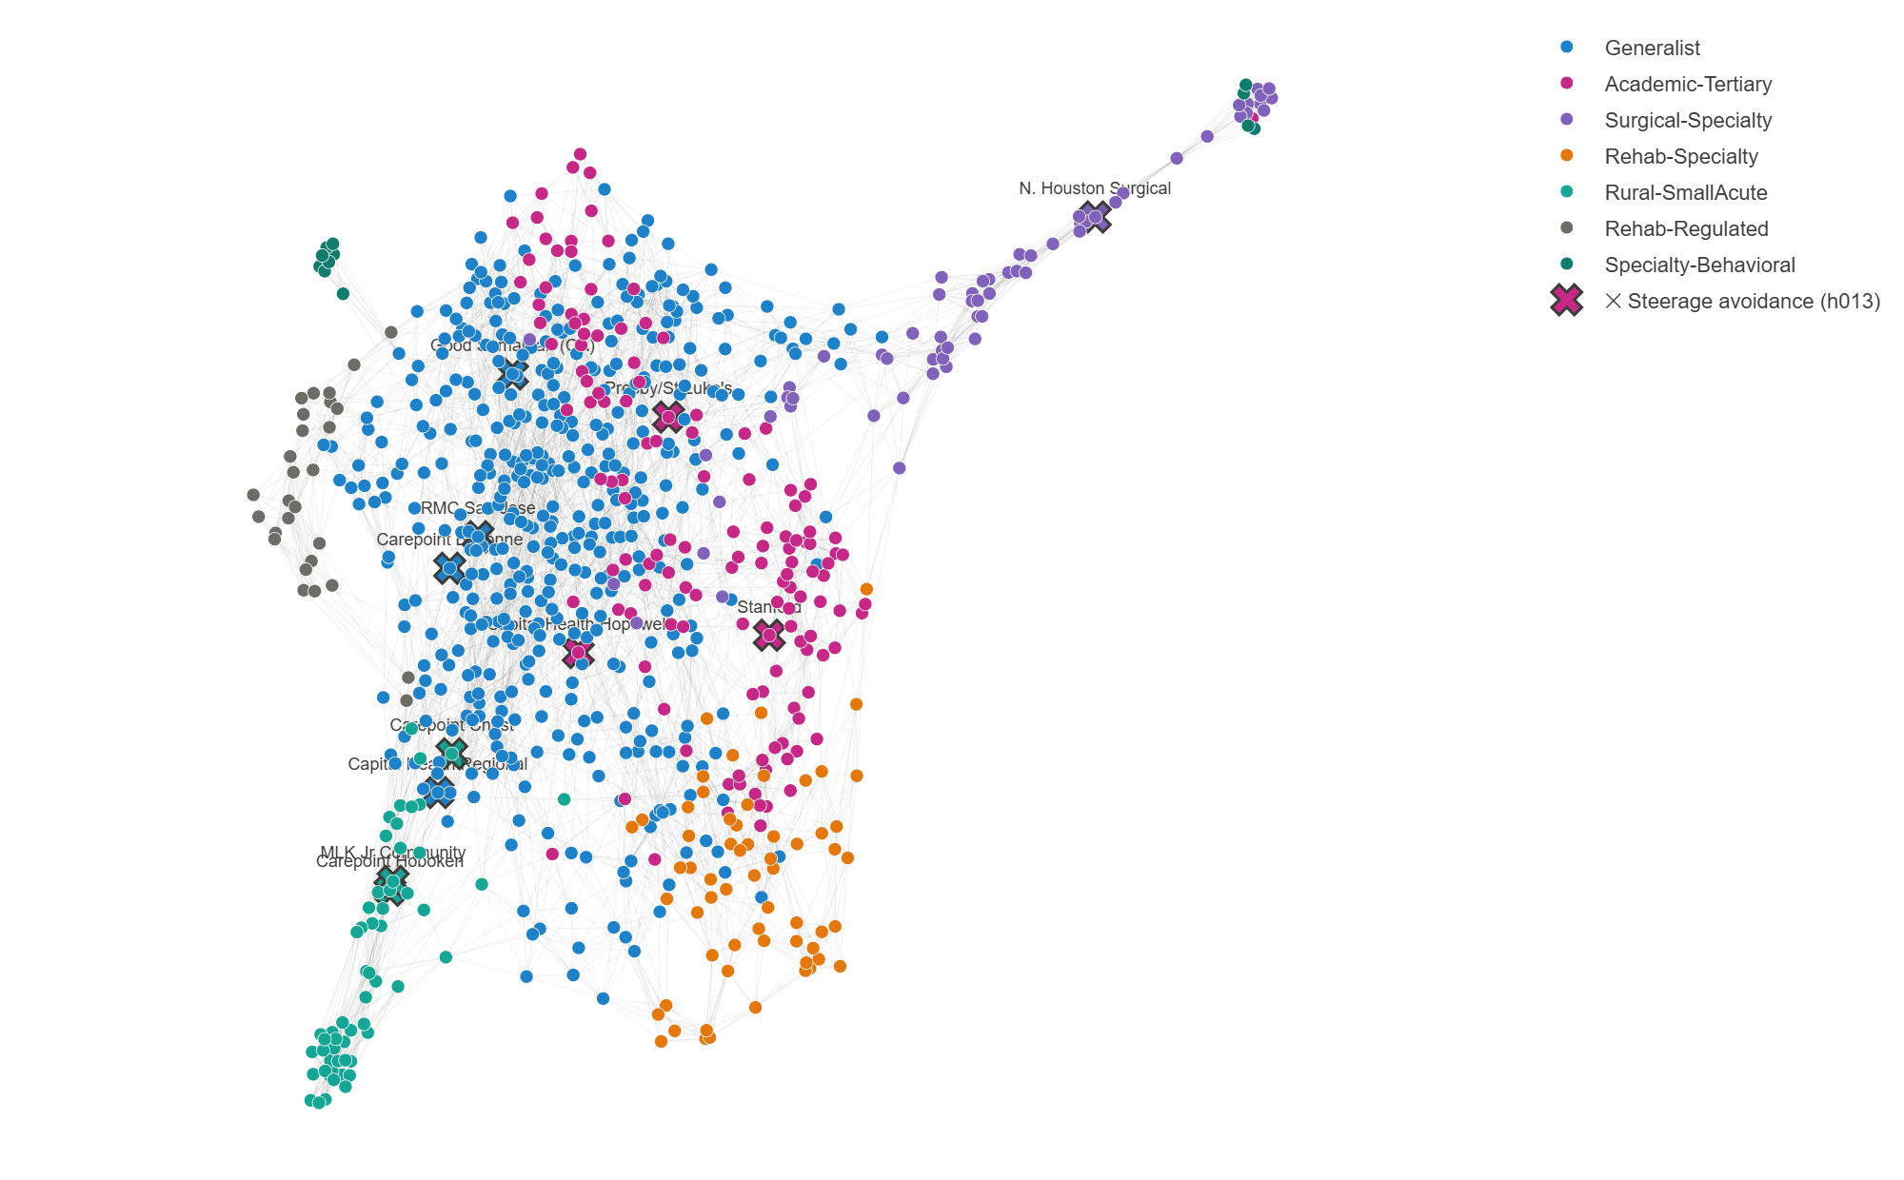
COMPARING FAIRLY
I group hospitals by the kind of care they actually do
■ I sorted all 3,236 hospitals into families by the mix of care they deliver — academic medical centers, community hospitals, surgical specialty centers, rural hospitals, and so on.
■ The groups came out of the data automatically — not hand-picked.
■ Why it matters: I compare each hospital only to its true peers, so 'our patients are just sicker' doesn't hold up.
■ ▶ Live demo — switch to the dashboard: pick a hospital type; toggle the ✕ avoidances on/off.

Slide 7
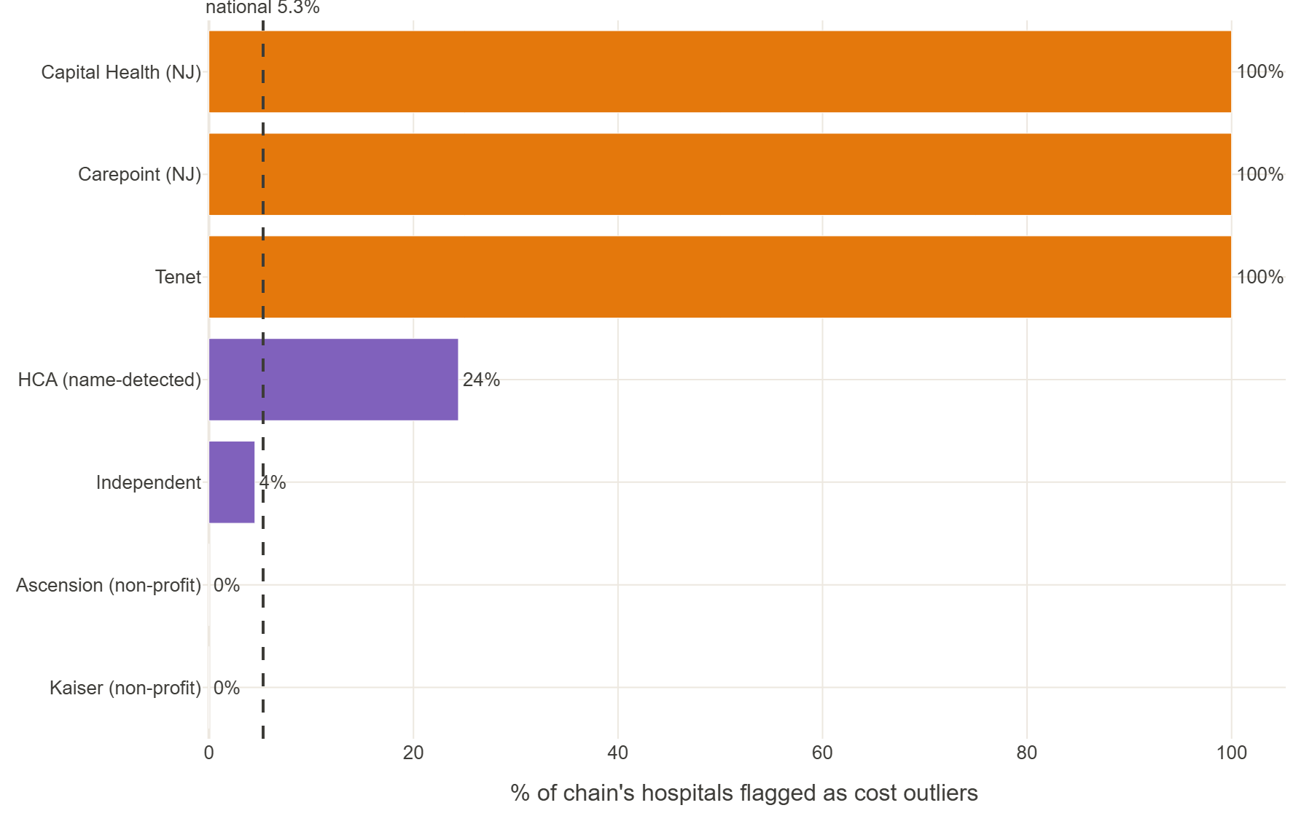
THE OVERCHARGERS
Which hospitals charge far more than their peers
■ I flagged hospitals that charge far above their true peers — in both hospital stays and outpatient care.
■ The same names show up in both: a handful of for-profit chains, plus a few high-end academic centers.
■ They cluster: a couple of for-profit chains are flagged ~100% of the time; non-profits almost never are.
■ It's a whole-hospital habit — flagged hospitals overcharge across nearly all their services, not just a few.

Slide 8
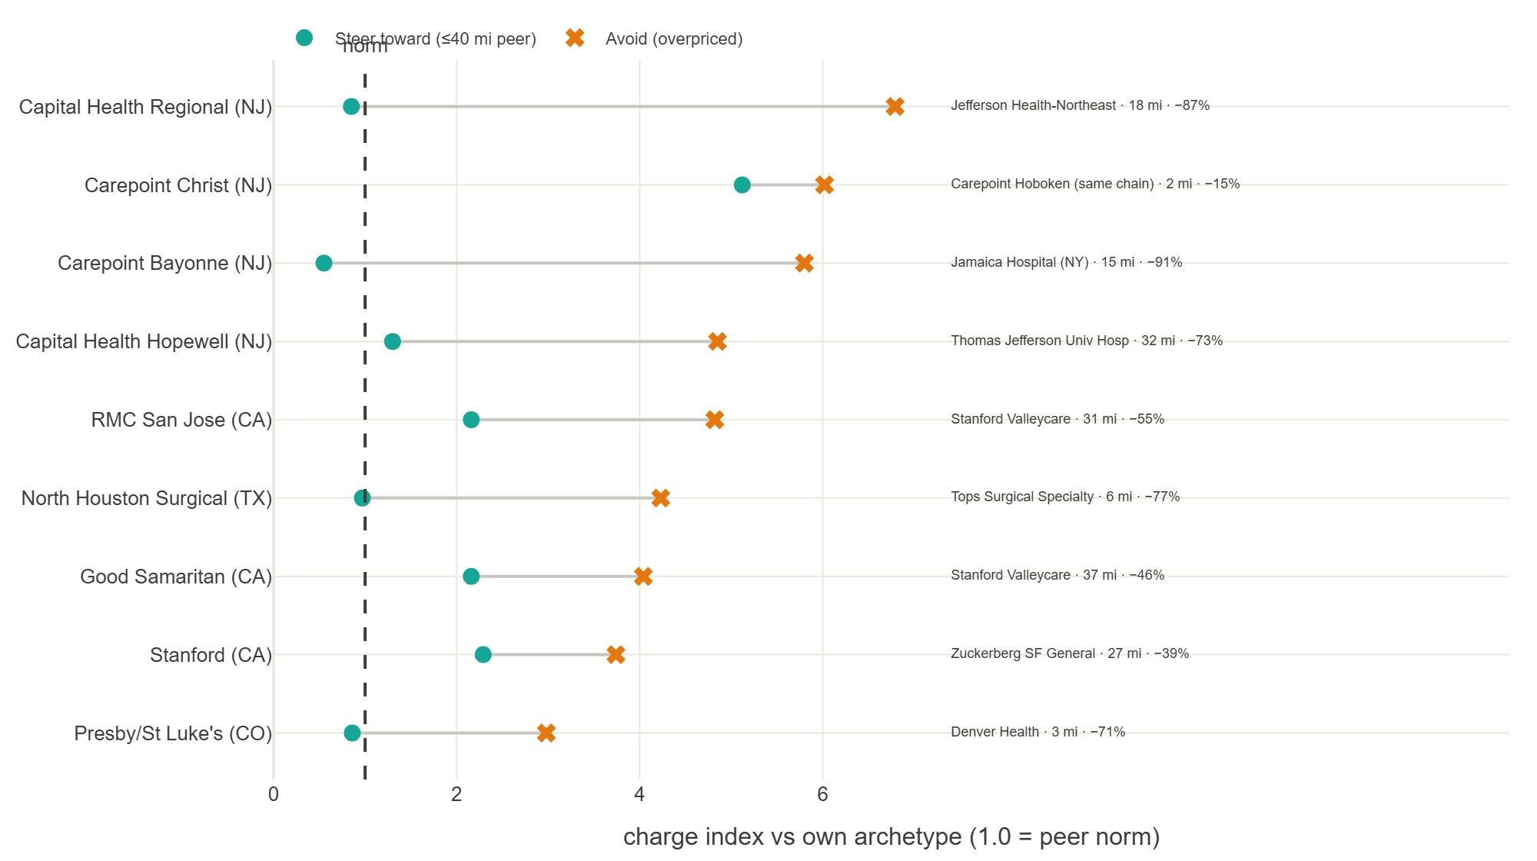
THE ACTION
Guide members to a cheaper, comparable hospital nearby
■ 'Steering' means pointing members to a cheaper, comparable hospital — and it has to be realistically close.
■ For 9 of the 11 worst offenders, there's a cheaper, comparable hospital within ~40 miles (one saves 87%).
■ For 2, there's no nearby alternative — steering can't help there; you negotiate rates instead.

Slide 9
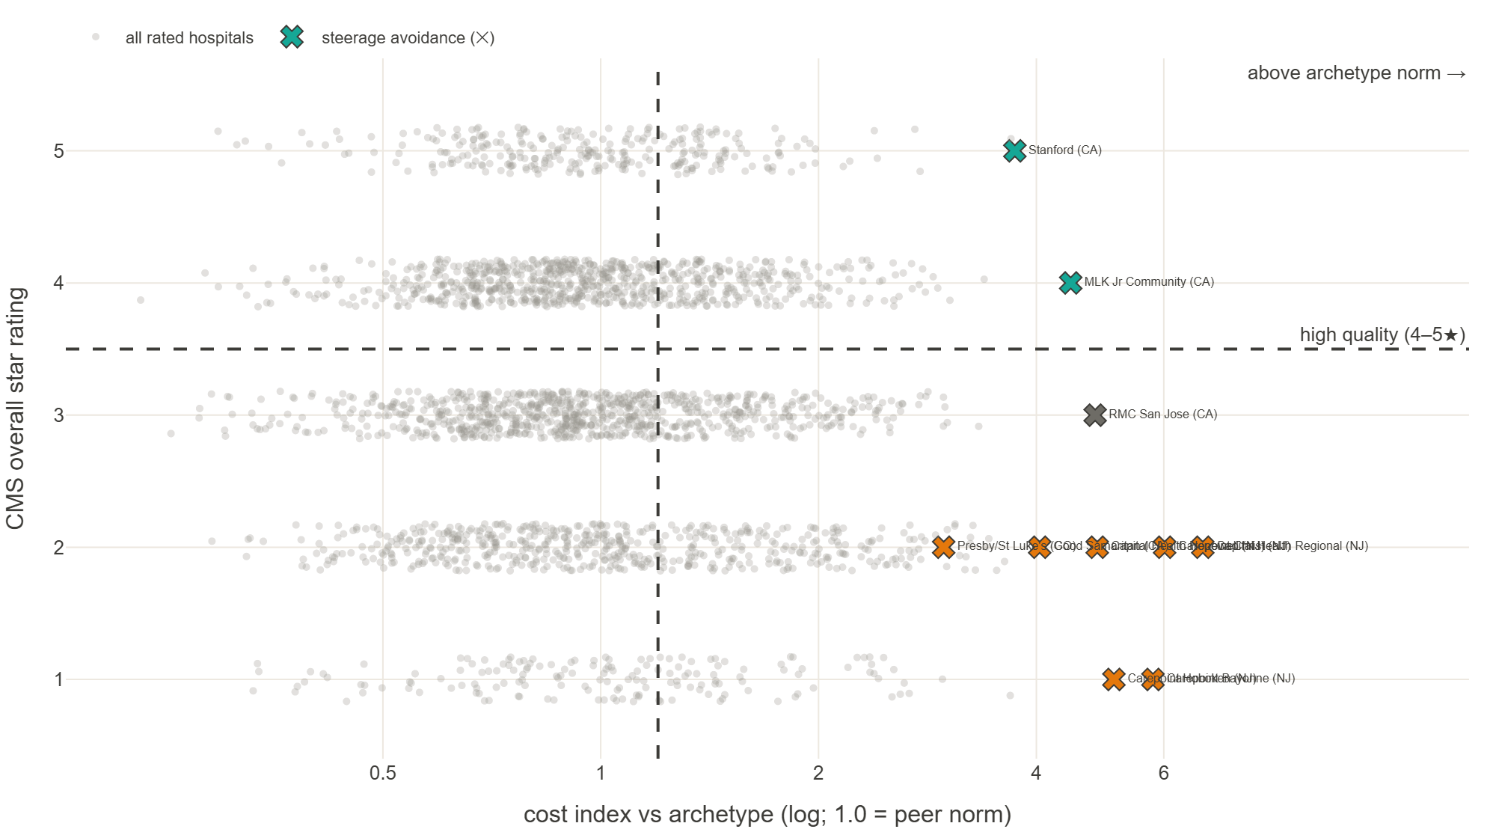
THE QUALITY CHECK
Paying more doesn't buy better care
■ I added the government's hospital quality star ratings (public data).
■ Price and quality are unrelated — and the most expensive hospitals actually rate the worst.
■ Most of our flagged hospitals are both expensive AND low-rated — steering away wins twice.
■ Two are expensive but genuinely excellent (Stanford, MLK) — the quality check keeps them off the avoid list.

Slide 10
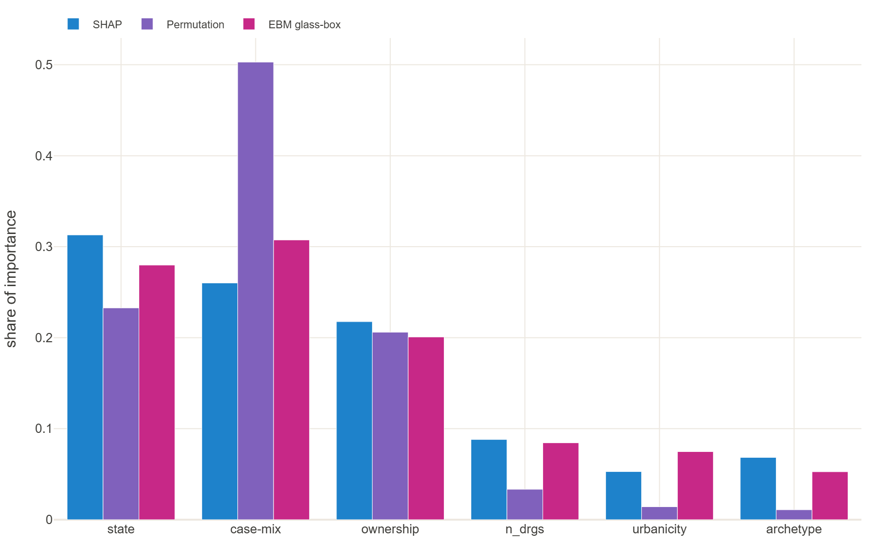
BONUS · WHAT DRIVES PRICE
Location, type of care, and ownership — not size
■ What actually predicts a hospital's price: where it is, the type and complexity of care, and who owns it.
■ Hospital size doesn't matter — bigger isn't cheaper per service.
■ Three independent methods all agree on the top drivers, so we trust the ranking.
■ The model predicts a hospital's cost to within about $11k (roughly 22%).

Slide 11
HOW IT WAS DONE
Two datasets, combined by the question — then supplemented
■ The core (the assignment): two public datasets — every hospital's inpatient (hospital-stay) and outpatient costs. I used both, throughout.
■ Explored & cleaned first: I profiled every table up front — distributions, missing values, outliers — fixed file-format/encoding issues, dropped CMS-suppressed and unreliable rows, and caught a data artifact before it could mislead.
■ Combined several ways, depending on the question: side-by-side per hospital (are hospitals pricey for stays also pricey outpatient? yes), pooled together for overall patterns, and blended into each hospital's 'care fingerprint' that defines the hospital families.
■ Then supplemented with more government data to answer the harder, more interesting questions: ownership, rural-vs-urban, location/distance, and quality ratings.
■ Assumption + check: list price as the affordability signal; and every headline finding repeats in the prior year — real patterns, not a one-year fluke.

Slide 12
HOW IT WAS BUILT
AI-enabled analysis — a custom MCP server + an analyst skill
■ I built an MCP server (databench-mcp): a guard-railed tool surface the AI operates — ingest, profile, explore, model, network-analyze, visualize — with discipline built in (profile before modeling, no leakage).
■ An analyst skill defined and required the process below: nothing skipped or hand-waved; I set the hypotheses and corrected the approach when it was wrong.
■ Adversarially verified: findings stay 'suspect' until they survive a refutation check — this caught a self-prediction (data-leakage) bug and a data artifact before either reached a conclusion.
■ Evidence-tracked & self-improving: 18 of 18 conclusions trace to a logged result; the corrections become the tool's own to-do list.
The process the skill enforced, every time:
Understand
›
Get & clean data
›
Explore
›
Test each idea
›
Verify
›
Recommend

Slide 13
FUTURE IMPROVEMENTS
Where this goes next — with real plan data
Analysis & data
Strengthen the AI platform
■ Care quality: do the factors that raise price also affect quality? Model both together.
■ Prove cause, not just correlation.
■ Network-aware steering: reachable, in-network, right service line, has capacity.
■ Real prices: negotiated insurer rates and member claims (we used Medicare list prices).
■ Access & equity: don't steer a community away from its only nearby hospital.
■ Automate & refresh: rebuild each year on fresher location and ownership data.
■ Expand the model set — plus a skill that picks the right method(s) for each question.
■ Prevent repeat mistakes: turn each correction into a guardrail.
■ Privacy & compliance guardrails (HIPAA / PHI, GDPR) built into the platform.
■ A shared knowledge base (wiki) so the method and evidence are reusable.

Slide 14
RECOMMENDATION
What we can do
■ Build the network on cost AND quality, not cost alone
■ Start where a cheaper, better hospital already exists nearby
■ Where there's no nearby option, negotiate rates instead
Interactive leave-behind: bitsandbeakers.github.io/databench-mcp/uhc-affordability/

Slide 15
APPENDIX
Appendix — methods & detail
Technical backup — the same detail is also in the live dashboard's methods appendix.

Slide 16
APPENDIX · DATA & PREPARATION
Datasets, cleaning, integration
■ Core: CMS Medicare Inpatient 146,427 provider×DRG + Outpatient 116,799 provider×APC; joined on CCN.
■ Combined four ways: (1) separately at natural grain (within-DRG / within-APC outlier detection); (2) stacked long, ~210k rows (pooled cost-index, markup); (3) merged per-hospital, both settings (pricing-culture ρ=0.82, driver model); (4) a DRG+APC service-mix matrix (archetype network).
■ Cleaning: Latin-1→UTF-8 re-encode, DECIMAL coercion, CCN zero-pad, RUCA=99 excluded, CMS cell-suppression noted, HCRIS total-margin artifact corrected.
■ Supplements (all CMS): HCRIS cost report (ownership, margins), RUCA (urbanicity), public ZIP centroids (distance), Hospital Compare (quality stars).
■ Distribution: submitted charge skew 12.5, kurtosis 535 → medians, logs and rank statistics throughout; never means/SD on raw dollars.

Slide 17
APPENDIX · OUTLIER DETECTION
Peer-relative, archetype-adjusted — in both settings
■ Service-grain: flag providers in the top 5% of submitted charge within each DRG (inpatient) and APC (outpatient); rank by number of services flagged.
■ Defensible list: normalize each charge to the national median for that service, then a within-archetype robust modified-z (median + MAD) ≥ 3.5.
■ Why archetype-adjusted: raw within-service detection over-flags academic centers (genuine case-mix); archetype-relative drops Cedars-Sinai, keeps Stanford + the for-profit chains.
■ Repeat-offenders: high-confidence outliers price ~95% of their service lines above the national 90th percentile — a hospital-wide posture.
Cut | Flagged
within-archetype p95 | 153
robust z ≥ 3.5 (high-conf) | 11
plain-z ≥ 2 (foil) | 83
chain: Capital Health / Carepoint | 100%
chain: HCA | 24%
independents | 4.5%

Slide 18
APPENDIX · SERVICE-MIX NETWORK
Archetypes from how hospitals actually deliver care
■ Construction: each hospital = its DRG/APC service-mix vector (3,236 hospitals × 602 codes); cosine similarity → k-nearest-neighbour graph (k=10).
■ Communities: Louvain detection → 14 communities at modularity 0.704 (strong separation); signature-service lift names them — academic/tertiary, generalist, surgical-specialty, rural, behavioral, rehab.
■ Cross-checks: PCA (variance spread across many components) and k-means independently recover the coarse generalist-core / specialty-periphery structure — not a Louvain artifact.
■ Use: archetype membership defines the peer set for the outlier and steerage analysis.

Slide 19
APPENDIX · COST-DRIVER MODEL
Leakage-free, triangulated, decision-relevant metrics
■ Design: provider grain (n=2,933); a discharge-weighted case-mix index preserves the DRG signal without service-grain leakage.
■ Importance: interventional SHAP + permutation + glass-box EBM agree and are seed-stable across 5 seeds: state > case-mix > ownership; volume negligible.
■ Metrics: 5-fold CV, reported as MAE + back-transformed dollar error — not R² alone (R² on a log target flatters fit).
Model (5-fold CV) | R²(log) | MAE(log) | $ median err | $ MdAPE
EBM (glass-box) | 0.704 ± .015 | 0.270 | $11,090 | 22%
LightGBM | 0.678 ± .029 | 0.281 | $11,503 | 22%
Lasso | 0.584 ± .014 | 0.324 | $13,592 | 27%
Variance decomposition (η²): log charge — DRG 0.578, state 0.180, urbanicity 0.040; log Medicare payment — DRG 0.869, state 0.054. Geography loads ~3× more on charges than on cost-based payment — the pricing-discretion signal.

Slide 20
APPENDIX · FALSIFICATION & QUALITY
Pricing-not-cost, and cost vs quality uncorrelated
■ For-profit premium (nested OLS on log charge): +62.5% raw → +46.3% under full controls (case-mix, archetype, urbanicity, state); nonprofit −33%, government −34% vs for-profit.
■ Falsification: under identical controls, +45% on submitted charge but −9% on wage-index-adjusted Medicare payment → markup, not cost. Pricing culture transfers IP↔OP (Spearman 0.82).
■ Cost × quality (CMS Hospital Compare, n=2,616 rated): Spearman(cost, star) = −0.03; mean star by cost band 3.15 / 3.26 / 3.22 / 2.74 — the very-pricey tier is only 25% 4–5★.
■ The 11 avoidances: 7 of 10 rated are 1–2★ (steer-away doubly justified); Stanford 5★ and MLK 4★ are the quality-gate exceptions.

Slide 21
APPENDIX · ROBUSTNESS & LIMITATIONS
Holds out-of-year (2022); honest limits
Finding | 2022 | 2023
Inpatient charge skew | 11.4 | 12.5
Within-DRG dispersion (p90/p10) | 3.63× | 3.67×
Median markup — IP / OP | 5.37× / 7.38× | 5.52× / 7.62×
Non-metro vs metro (case-mix adj.) | −27.6% | −26.6%
IP↔OP pricing-culture (Spearman) | 0.83 | 0.82
For-profit charge premium (median) | +43% | +49%
■ Limits: submitted charges, not negotiated commercial rates; Medicare data (commercial-to-Medicare ratios vary); 2013 ZIP vintage (93.6% geocoded); chain detection undercounts HCA (the effect is a lower bound); all effects associational (causal design framed, not run).

