Slide 1
What is Ethereum?
World computer
Decentralized platform that runs smart contracts
Applications that run exactly as programmed without any possibility of downtime, censorship, fraud or third-party interference

Slide 2
What is Solidity?
Contract-oriented, high-level language for implementing smart contracts.
Statically typed, supports inheritance, libraries and complex user-defined types
Compiler generates bytecode targeted for Ethereum Virtual Machine (EVM).
EVM runs the bytecode when a transaction is sent to it

Slide 3
Ethereum Virtual Machine
Runtime environment for smart contracts in Ethereum
Sandboxed :no access to network, filesystem or other processes
Two kind of accounts :
Externally Owned Account managed by public-private key,
Contract account that represents the contract
Every account has storage to store state
Transaction is a message that is sent from one account to another account
Send ether from an account in my wallet to your wallet (EOA)
If target account is zero account ( address 0) a new contract is deployed. Payload is EVM bytecode and its executed.
If target account contains code, it is executed with payload as input data

Slide 4
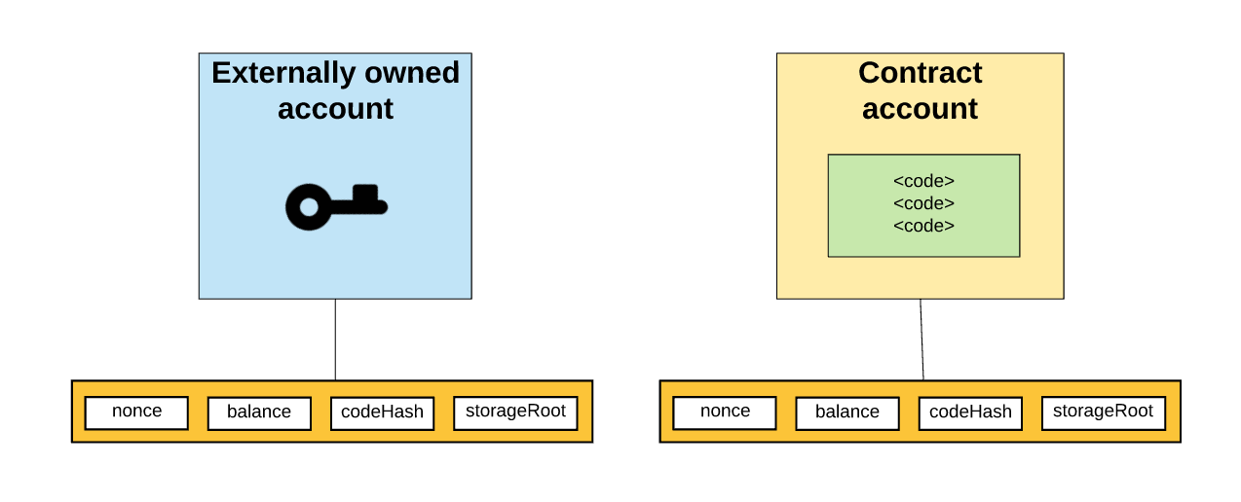
Accounts

Slide 5
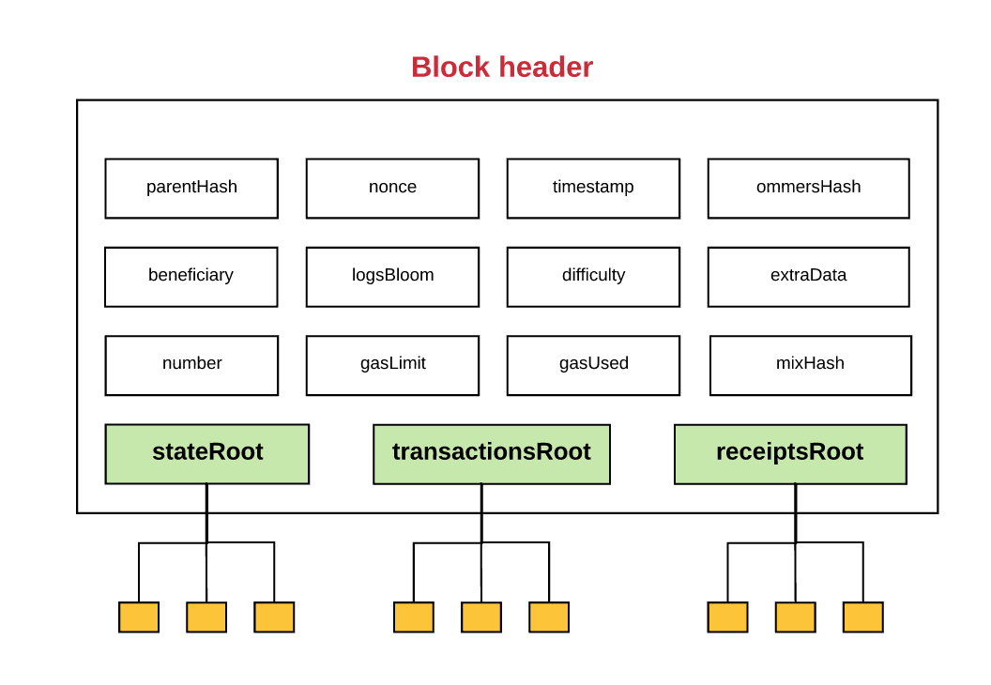
Merkle Tree Everywhere

Slide 6
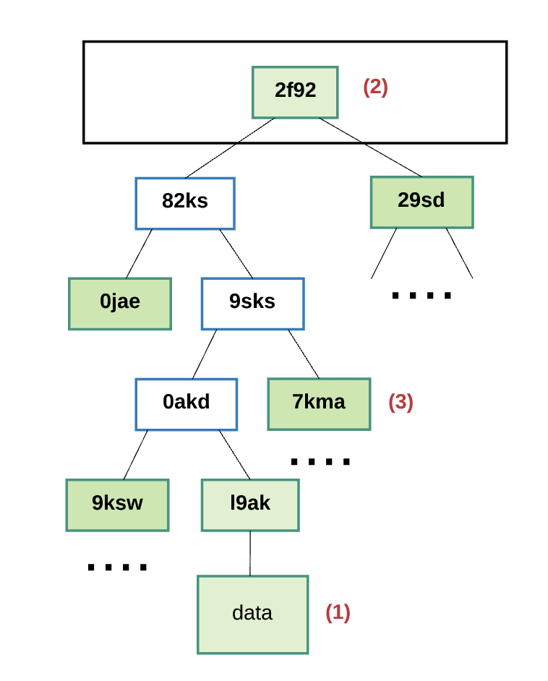
Merkle Proof

Slide 7
Simple contract
Use http://remix.ethereum.org/ as IDE
Use Ganache (javasript personal ethereum local blockchain)
http://solidity.readthedocs.io/en/develop/introduction-to-smart-contracts.html
Deploy on Ganache and interact
Deploy on Ropesten using metamask wallet

Slide 8
Simple contract
pragma solidity ^0.4.19;
contract SimpleStorage {
uint storedData;
function set(uint x) public {
storedData = x;
}
function get() public constant returns (uint) {
return storedData;
}
}

Slide 9
Launch Ganache
Configure remix to connect o Ganache
Under Run -> Environment select web3 provider
Endpoint http://localhost:7545
Should see the 10 EOA wallets on Ganache
Copy contract to IDE
Create to deploy contract on Ganace
Function call on contracts – Get / Set
Set is transaction and costs gas – state change
Get is free – no stage change

Slide 10
Contract deployed using an EOA and needs ether to pay for the gas
Sign a transaction with private key
Hash of signed txn is transaction id
Cost of deploying a contract depends on the amount of storage used by the contract.
Contract deployed on the blockchain by sending a transaction with bytecode to the empty address
Contract represented by an address in blockchain

