Slide 1

File Formats
Johan van der Knijff
Digital Access to Cultural Heritage

Slide 2
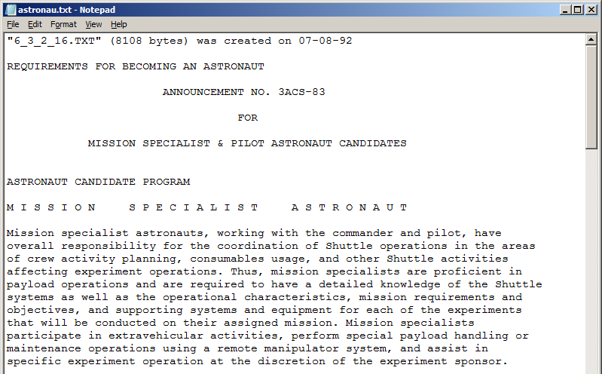
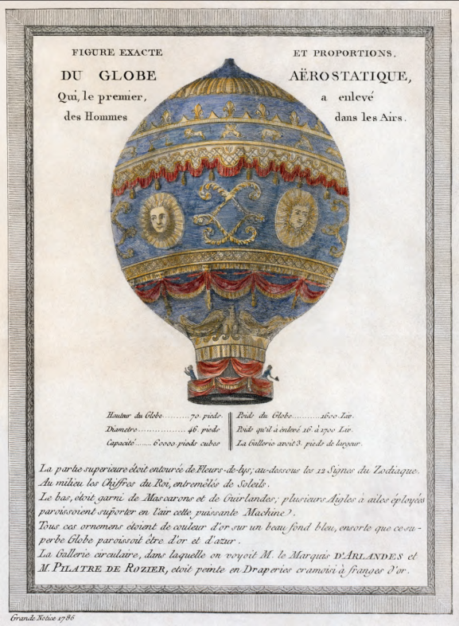
Digital data: bits & bytes
0
1
0
0
1
0
1
1
0
1
0
0
0
0
1
0
…

Slide 3
0
1
0
0
1
0
1
1
0
1
0
0
0
0
1
0
…
Bit: 1/0

Slide 4
Byte
Group of (usually 8) bits:
0
1
0
0
1
0
1
1
0
1
0
0
0
0
1
0
…
Byte
Byte

Slide 5
Decimal
10 symbols: 0, 1, 2, 3, 4, 5, 6, 7, 8, 9
Binary
2 symbols: 0, 1

Slide 6
75, decimal
10¹ | 10⁰
7 | 5

Slide 7
75, decimal
10¹ | 10⁰
7 | 5
least significant
digit, multiples of
10⁰ = 1

Slide 8
75, decimal
10¹ | 10⁰
7 | 5
highest significant
digit, multiples of
10¹ = 10

Slide 9
75, decimal
10¹ | 10⁰
7 | 5
7 x 10¹ + 5 x 10⁰
= 70 + 5 = 75

Slide 10
75, binary
2⁷ | 2⁶ | 2⁵ | 2⁴ | 2³ | 2² | 2¹ | 2⁰
0 | 1 | 0 | 0 | 1 | 0 | 1 | 1

Slide 11
75, binary
2⁷ | 2⁶ | 2⁵ | 2⁴ | 2³ | 2² | 2¹ | 2⁰
0 | 1 | 0 | 0 | 1 | 0 | 1 | 1
least significant
digit, multiples of
2⁰ = 1

Slide 12
75, binary
2⁷ | 2⁶ | 2⁵ | 2⁴ | 2³ | 2² | 2¹ | 2⁰
0 | 1 | 0 | 0 | 1 | 0 | 1 | 1
highest significant
digit, multiples of
2⁷ = 128

Slide 13
75, binary
2⁷ | 2⁶ | 2⁵ | 2⁴ | 2³ | 2² | 2¹ | 2⁰
0 | 1 | 0 | 0 | 1 | 0 | 1 | 1
0 x 2⁷ + 1 x 2⁶ + 0 x 2⁵ + 0 x 2⁴ +
1 x 2³ + 0 x 2² + 1 x 2¹ + 1 x 2⁰
= 0 + 64 + 0 + 0 + 8 + 0 + 2 + 1
= 75

Slide 14
8 bits: 256 (2⁸) possible values
2⁷ | 2⁶ | 2⁵ | 2⁴ | 2³ | 2² | 2¹ | 2⁰
0 | 0 | 0 | 0 | 0 | 0 | 0 | 0
0
2⁷ | 2⁶ | 2⁵ | 2⁴ | 2³ | 2² | 2¹ | 2⁰
1 | 1 | 1 | 1 | 1 | 1 | 1 | 1
255
(2⁷ + 2⁶ + 2⁵ + 2⁴ + 2³ + 2² + 2¹ + 2⁰ =128 + 64 + 32 + 16 + 8 + 4 +2 +1)

Slide 15
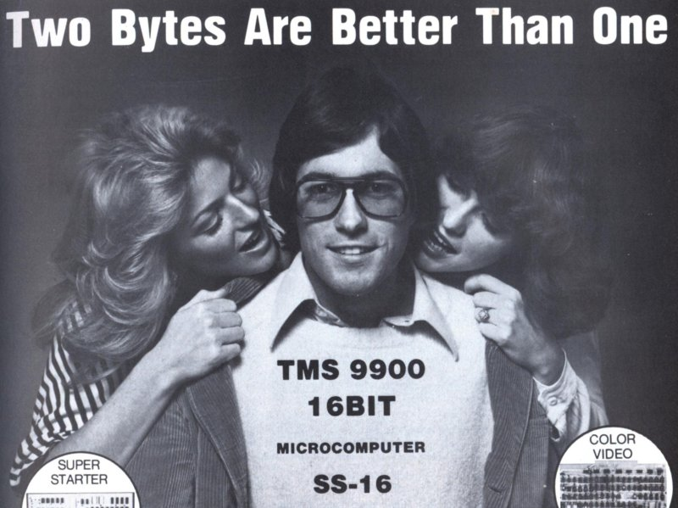
Larger numbers?
More bytes!

Slide 16
- 1 byte: 2⁸ values
[0 - 255]
- 2 bytes: 2¹⁶ values
[0 – 65,535]
- 4 bytes: 2³² values
[0 - 4,294,967,295]

Slide 17
Representing text
Map numbers to text characters

Slide 18
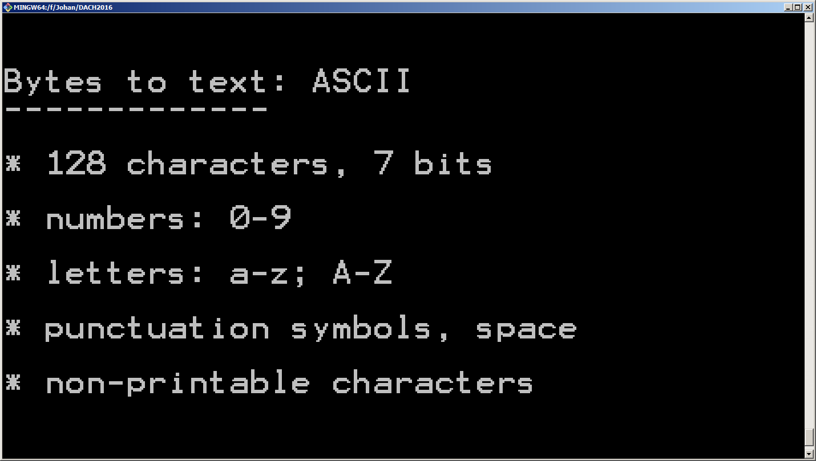

Slide 19
ASCII Table
Bin | Dec | Char
:: | :: | ::
01000001 | 65 | A
01000010 | 66 | B
01000011 | 67 | C
01000100 | 68 | D
01000101 | 69 | E
01000110 | 70 | F
01000111 | 71 | G
01001000 | 72 | H
01001001 | 73 | I
01001010 | 74 | J
01001011 | 75 | K
01001100 | 76 | L
:: | :: | ::

Slide 20
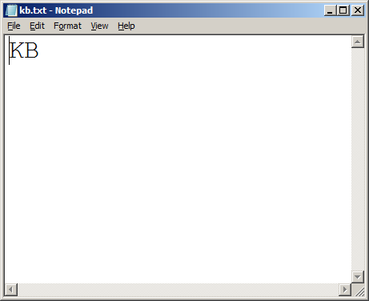

Slide 21
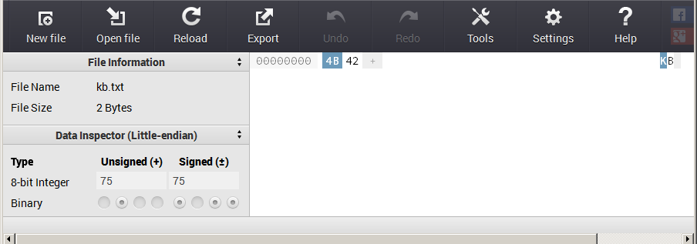
75
K
https://hexed.it/
01001011

Slide 22
ASCII Table
Bin | Dec | Char
:: | :: | ::
01000001 | 65 | A
01000010 | 66 | B
01000011 | 67 | C
01000100 | 68 | D
01000101 | 69 | E
01000110 | 70 | F
01000111 | 71 | G
01001000 | 72 | H
01001001 | 73 | I
01001010 | 74 | J
01001011 | 75 | K
01001100 | 76 | L
:: | :: | ::

Slide 23
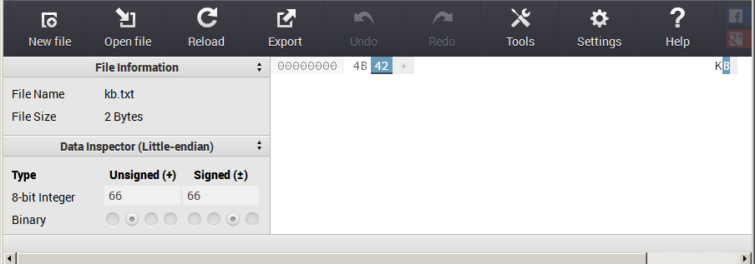
66
B
https://hexed.it/
01000010

Slide 24
ASCII Table
Bin | Dec | Char
:: | :: | ::
01000001 | 65 | A
01000010 | 66 | B
01000011 | 67 | C
01000100 | 68 | D
01000101 | 69 | E
01000110 | 70 | F
01000111 | 71 | G
01001000 | 72 | H
01001001 | 73 | I
01001010 | 74 | J
01001011 | 75 | K
01001100 | 76 | L
:: | :: | ::

Slide 25
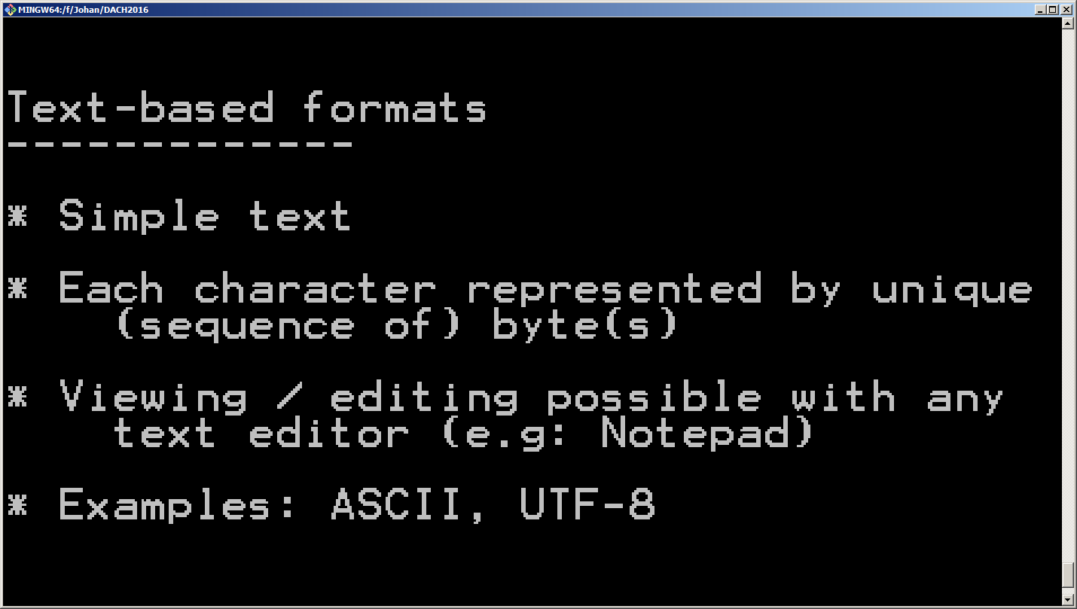

Slide 26
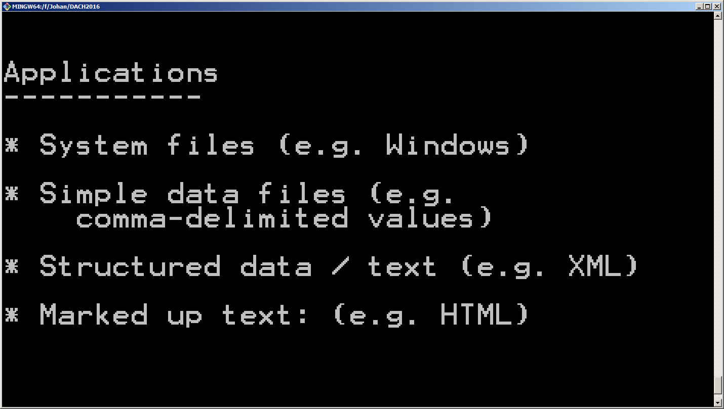

Slide 27

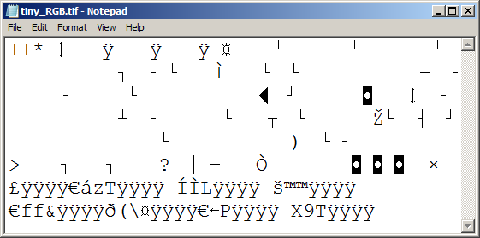
Binary formats
TIFF image

Slide 28
- Pixel: Red, Green, Blue component
- Each component: 8 bits
Adapted from Ange Albertini: https://github.com/corkami

Slide 29
Applications

Slide 30
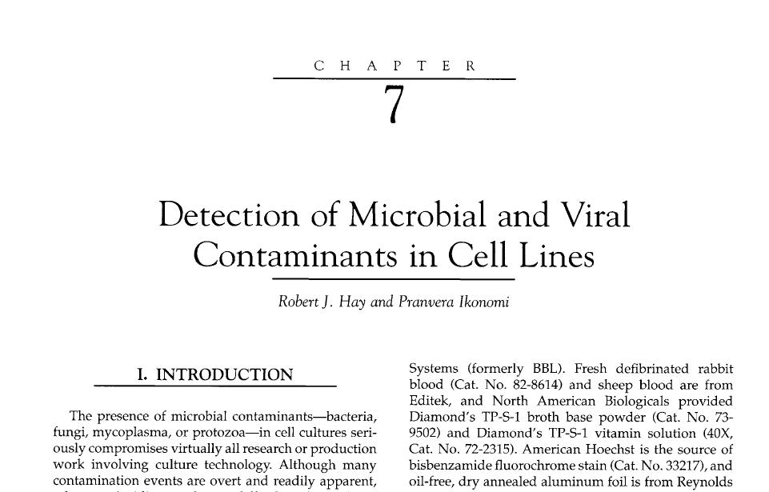
Mixed binary / text content

Slide 31
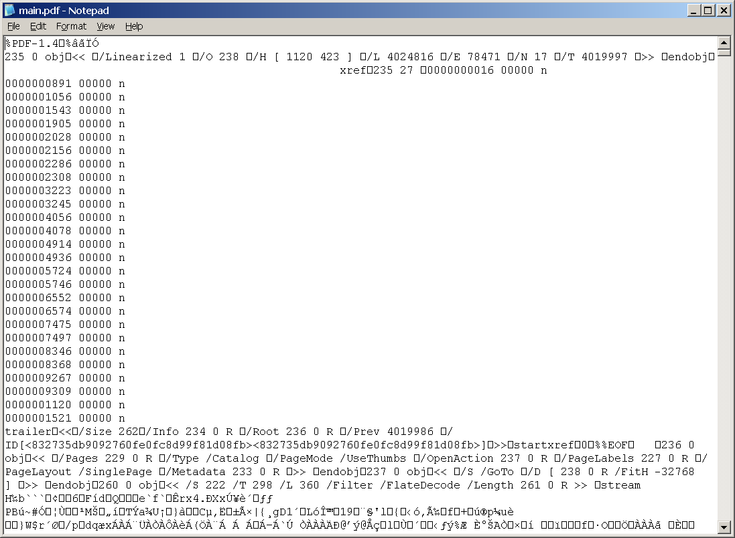
Same PDF in Notepad

Slide 32
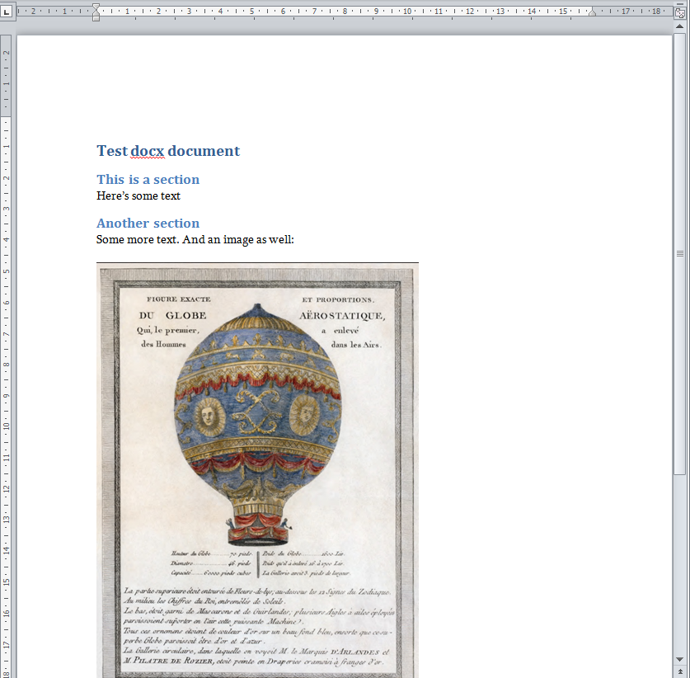
MS Word (docx)
=
[folder link]

Slide 33
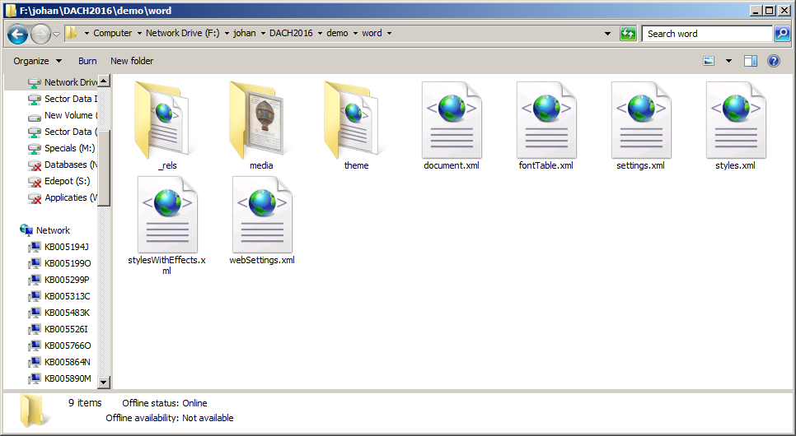

Slide 34
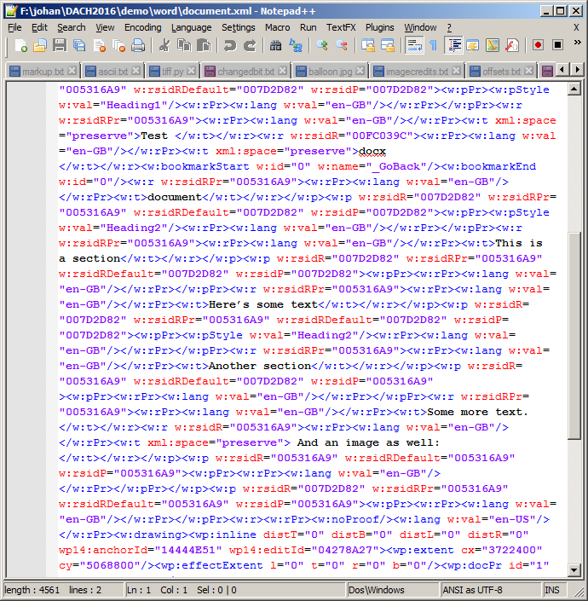

Slide 35
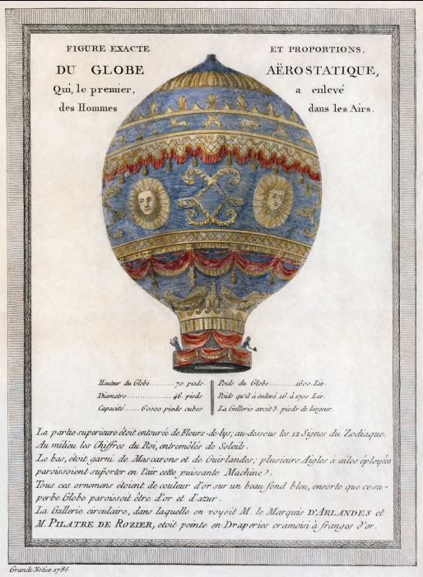

Slide 36
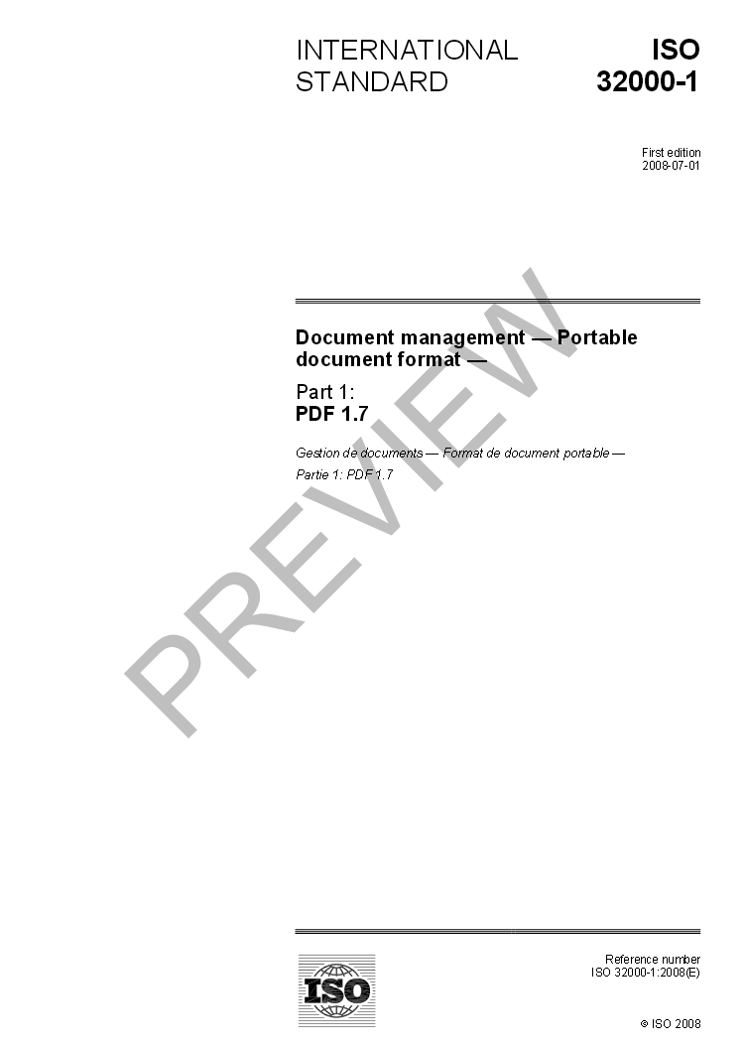
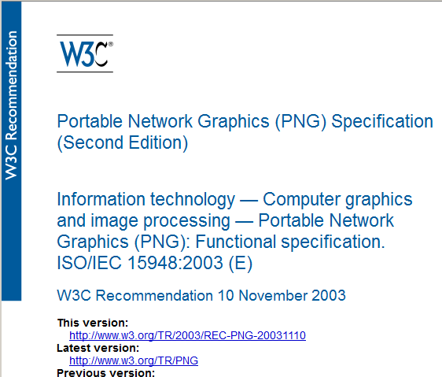
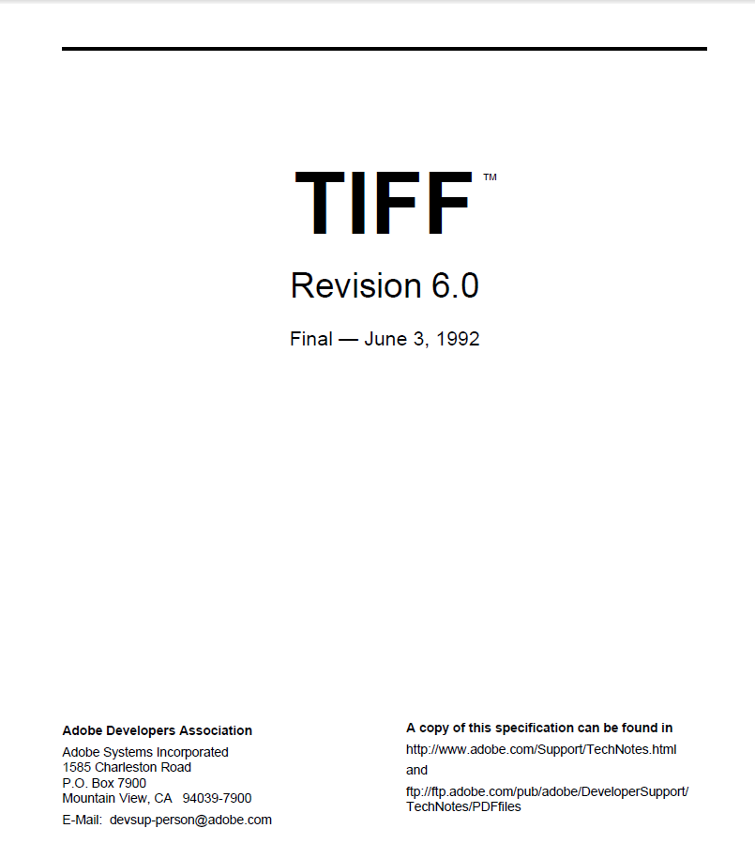
Format specifications

Slide 37

Open vs closed formats

Slide 38
Open formats
- Specifications published and accessible (not always free!)
- Often published by standards body (ISO, ITU, W3C)
- Specs contain all info needed to build reader

Slide 39

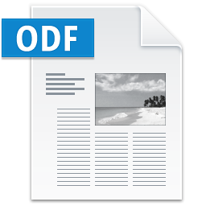





Slide 40


- Dependency on owner format
- Owner may stop offering reader software
- Long-term accessibility uncertain

Slide 41





Slide 42

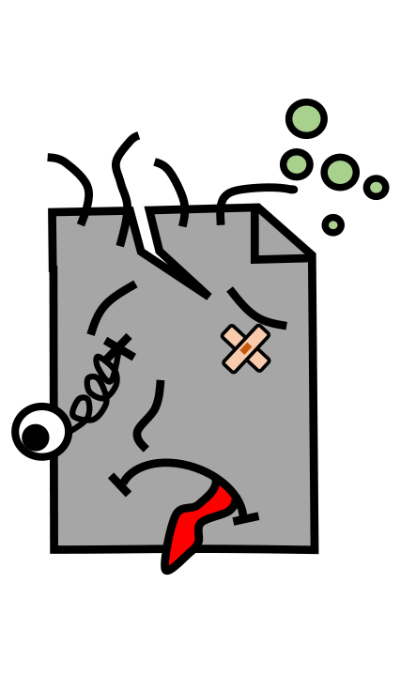
Effects of damage and corruption

Slide 43
JPEG

Slide 44
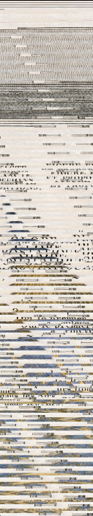
Same JPEG,
1 bit changed!

Slide 45
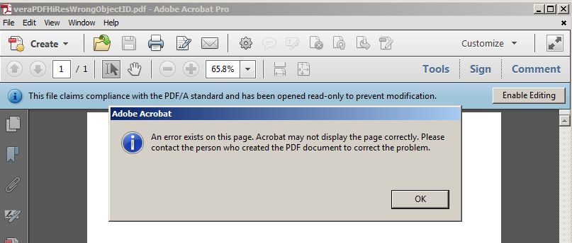
PDF

Slide 46
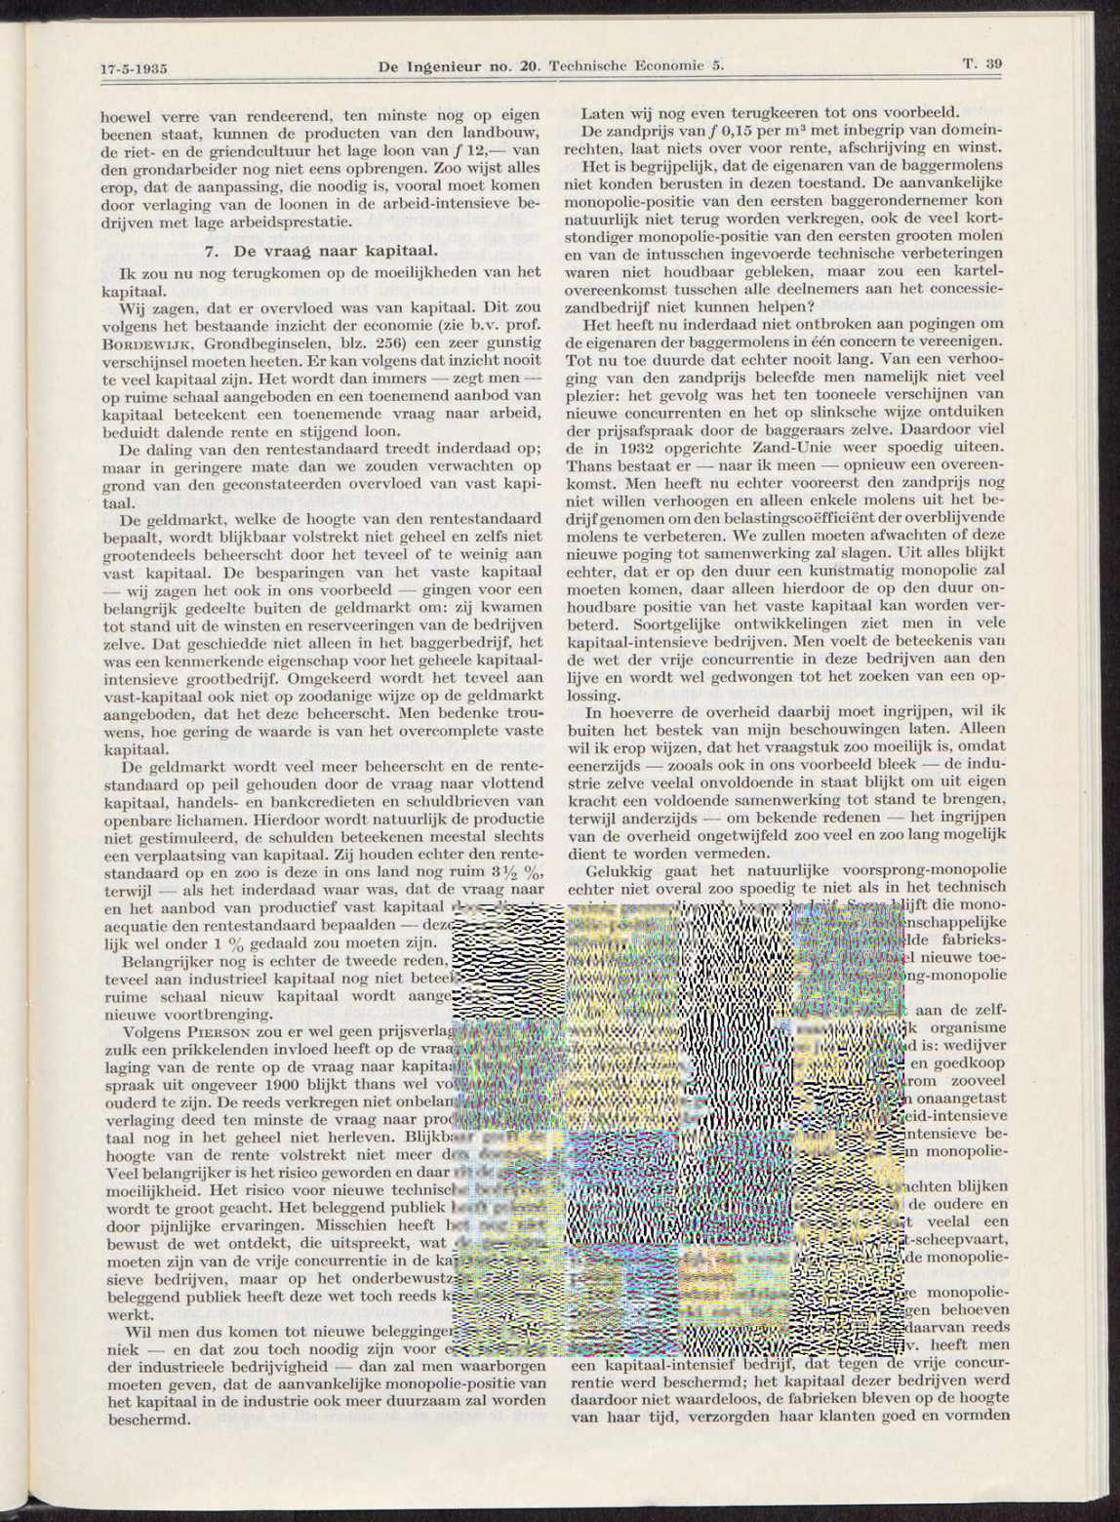
JP2
(JPEG 2000)

Slide 47




Format validation

Slide 48
Information on formats
- http://fileformats.archiveteam.org/
- http://www.digitalpreservation.gov/formats/index.shtml
More links / resources:
- https://github.com/bitsgalore/DACHFF

Slide 49
Image credits
Music icon created by Piotrek Chuchla
Video icon created by Arthur Shlain
Image icon created by BenPixels
Compress icon created by Mister Pixel
Zip file icon created by Arthur Shlain
TIFF icon created by To Uyen
All from the Noun Project: https://thenounproject.com/
Top Secret by BP22Heber (Own work) [CC BY-SA 3.0],
via Wikimedia Commons

