Slide 1
Chris Page / AI Engineering Lab
From Horizon Scanning
to Horizon Walking
AI Engineer Lab
Chris Page
Supporting
Nick Briggs
DCMS (BDUK) + Warwickshire CC
Lead Technical Architect
AI Research Engineer
DWP
30 September 2026
Independent experimental demonstration • Public sources
Chris Page / AI Engineering Lab
01
Notes:
SLIDE 1: From Horizon Scanning to Horizon Walking
Presenter: Nick
Suggested time: 1 minutes
Open with the title: “I have been horizon scanning; Chris has been horizon walking.” Introduce the session as a joint exploration, with Nick leading and Chris supporting the demonstration. The talk is about public guidance and inspectable workflows, not a deployed DWP service. Presenter titles and affiliations are exactly as supplied; no security classification, official logo, office address or telephone number is included.
Title and framing: presentation-structure.md. Presenter details: explicit user instructions in this conversation. Nick’s background text is a supplied biography, not independently revalidated employment history.
Editable text and shapes. Source screenshots are intentionally images; their content has not been rewritten. Research checks: 29 September 2026. Presentation date: 30 September 2026 (editable).

Slide 2
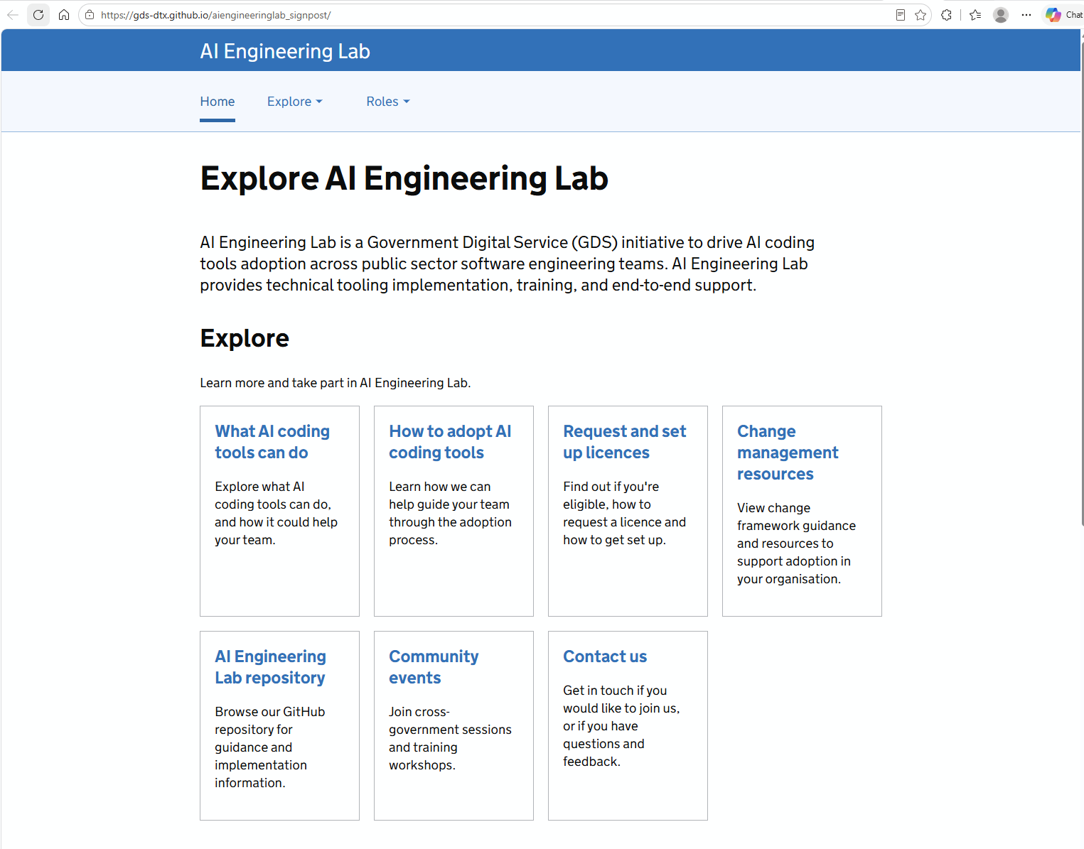
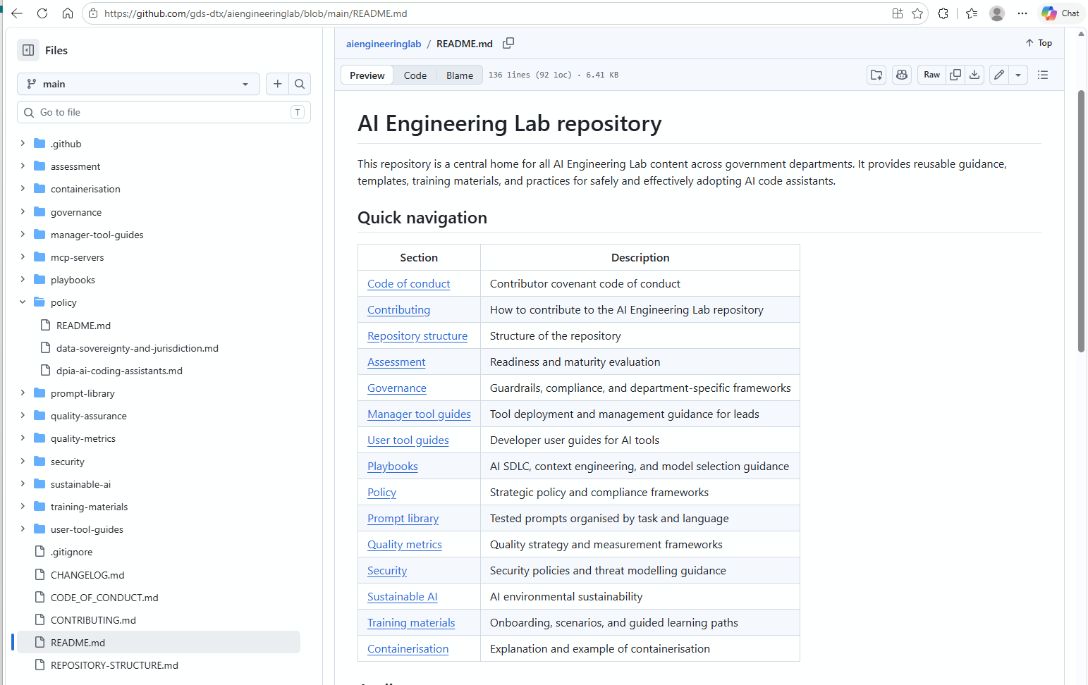
Government Backbone / AI Engineering Lab
Cross Government Collaboration
Supporting
Pooled Resources.
Shared Knowledge.
Why this matters
02
Notes:
SLIDE 2: Life is messy. Guidance has to meet that reality.
Presenter: Nick
Suggested time: 2 minutes
Use the human context in the original outline without introducing personal claimant stories. Complicated circumstances make guidance difficult to navigate. The question for the session is whether AI-assisted workflows can help people see the relevant material and its qualifications more clearly. Keep the focus on how decision-makers apply guidance and how business analysts understand a service. Nick can briefly draw on his supplied background in commercial software, architecture and work across engineering, policy and legal colleagues; do not treat the older “About” section as a new claim about his current portfolio.
Source: presentation-structure.md, especially ethos/pathos/logos and the non-coding focus; Nick’s background supplied in the conversation. This is the presenters’ framing, not an empirical claim that every reader has the same experience.
Editable text and shapes. Source screenshots are intentionally images; their content has not been rewritten. Research checks: 29 September 2026. Presentation date: 30 September 2026 (editable).

Slide 3
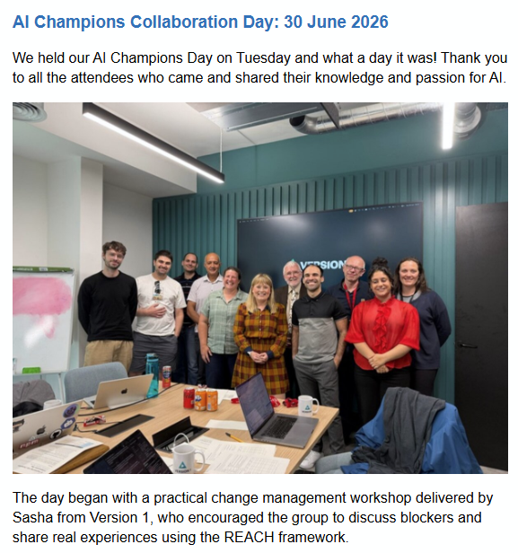
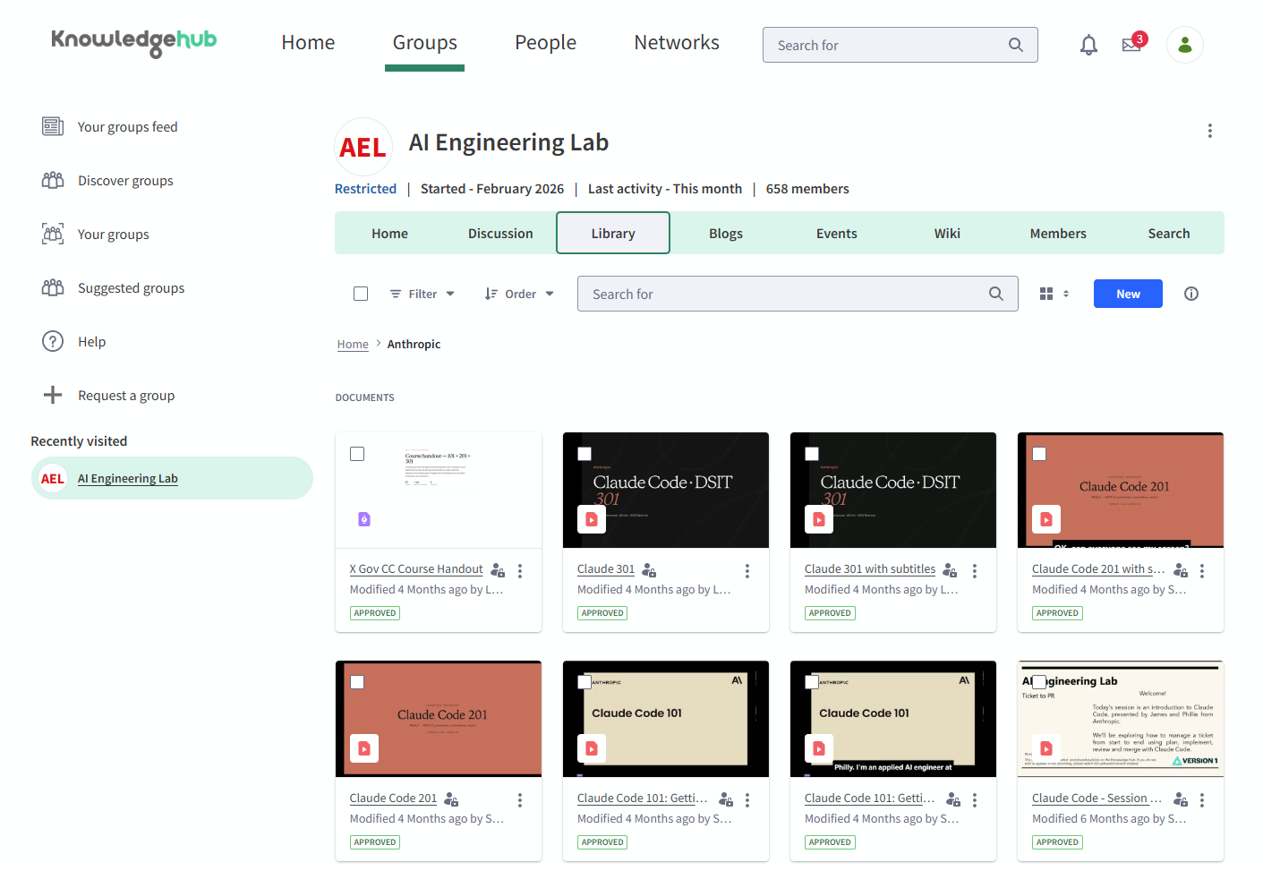
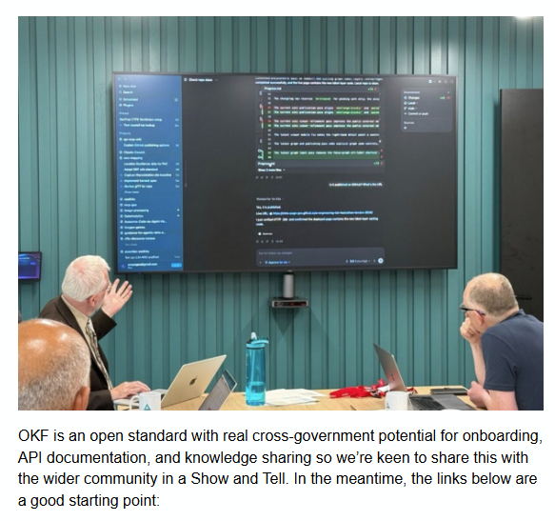
Government Backbone / AI Engineering Lab
Cross Government Collaboration
Independent experimental demonstration • Public sources
Why this matters
02
Notes:
SLIDE 2: Life is messy. Guidance has to meet that reality.
Presenter: Nick
Suggested time: 2 minutes
Use the human context in the original outline without introducing personal claimant stories. Complicated circumstances make guidance difficult to navigate. The question for the session is whether AI-assisted workflows can help people see the relevant material and its qualifications more clearly. Keep the focus on how decision-makers apply guidance and how business analysts understand a service. Nick can briefly draw on his supplied background in commercial software, architecture and work across engineering, policy and legal colleagues; do not treat the older “About” section as a new claim about his current portfolio.
Source: presentation-structure.md, especially ethos/pathos/logos and the non-coding focus; Nick’s background supplied in the conversation. This is the presenters’ framing, not an empirical claim that every reader has the same experience.
Editable text and shapes. Source screenshots are intentionally images; their content has not been rewritten. Research checks: 29 September 2026. Presentation date: 30 September 2026 (editable).

Slide 4
TODAY’S EXPERIMENT
Three ideas for a DWP demonstration
Demo 01
Demo 02
Demo 03
OKF Bundle
Site with WebMCP
Rules Engine
Build on OKF Bundle for DWP Decision Makers Guide: staff guide.
Build a website for a DWP Benefit Application which includes support for WebMCP.
Use the OKF Bundle for DWP Decision Makers Guide: staff guide to create a rules engine.
Public information only
No claimant data. No individual award decision.
No operational benefits calculator.
Independent experimental demonstration • Public sources
Today’s experiment
03
Notes:
SLIDE 3: Three ways to make the work inspectable
Presenter: Nick
Suggested time: 2 minutes
Explain the three presentation acts. They organise the supplied captures; they do not rename historical repository “Demo 1” or “Demo 2”. The separate CASA/application concept is not demonstrated here. The session uses public material, and the screenshots are the complete fallback if a live page cannot be reached. Take questions at the end, with short clarification during the demonstrations as needed.
Sources: presentation-structure.md and supplied screenshot pack README/captions. Public-only and no award-calculation boundaries are preserved.
Editable text and shapes. Source screenshots are intentionally images; their content has not been rewritten. Research checks: 29 September 2026. Presentation date: 30 September 2026 (editable).

Slide 5
WHY THIS MATTERS
Life is messy. Guidance has to meet that reality.
Health
Income
Home
Relationships
The practical question
Can we make the guidance easier to inspect
without hiding its conditions and exceptions?
Independent experimental demonstration • Public sources
Why this matters
02
Notes:
SLIDE 2: Life is messy. Guidance has to meet that reality.
Presenter: Nick
Suggested time: 2 minutes
Use the human context in the original outline without introducing personal claimant stories. Complicated circumstances make guidance difficult to navigate. The question for the session is whether AI-assisted workflows can help people see the relevant material and its qualifications more clearly. Keep the focus on how decision-makers apply guidance and how business analysts understand a service. Nick can briefly draw on his supplied background in commercial software, architecture and work across engineering, policy and legal colleagues; do not treat the older “About” section as a new claim about his current portfolio.
Source: presentation-structure.md, especially ethos/pathos/logos and the non-coding focus; Nick’s background supplied in the conversation. This is the presenters’ framing, not an empirical claim that every reader has the same experience.
Editable text and shapes. Source screenshots are intentionally images; their content has not been rewritten. Research checks: 29 September 2026. Presentation date: 30 September 2026 (editable).

Slide 6
HOW GUIDANCE EVOLVES
New rules reach the ADM & DMG through a stages
01
TRIGGER
Legislation / case law / policy change
02
IMMEDIATE RESPONSE
DMG Memo
Interim or new guidance
03
FORMAL UPDATE
Later DMG amendment
04
END STATE
Guidance incorporated into DMG chapter
513 Documents
The Decision Makers' Guide (DMG) continues to cover a number of older or legacy benefit systems and Pension Credit.
The Advice for Decision Making (ADM) is used for benefits including Universal Credit and Personal Independence Payment and certain other newer benefit regimes.
Guidance lifecycle
02

Slide 7
02 / HELP ME INVESTIGATE
Example Question for Decision Maker.
“Where a child is awarded he highest-rate care component of DLA from 26 January 2025, but the change is reported to Universal Credit on 28 March 2026, what’s the effective date of the higher disabled-child addition, and from which assessment period should it be paid?”
26 January 2025
28 March 2026
Late Reporting ?
DLA entitlement date stated
in the question
Change reported to
Universal Credit
Independent experimental demonstration • Public sources
02 / Help me investigate
13
Notes:
SLIDE 13: Two dates. One important missing boundary.
Presenter: Nick
Suggested time: 0.75 minutes
Read the question as supplied, with the two dates unchanged. DLA means Disability Living Allowance; UC means Universal Credit. An assessment period is the monthly window used for UC. Do not fill “Answer 1” with a final award decision. The case does not provide the assessment-period boundaries or establish all the circumstances needed for a legal applicability decision.
SOURCES
UC: Frozen UC out-of-sample follow-up and retained diagnostic
https://github.com/chris-page-gov/okf-dwp/blob/77ef16047415ee48dcb93b80adf1ba057ea00d9b/docs/uc-disabled-child-supersession-follow-up.md
The question is from presentation-structure.md and the retained out-of-sample case. The text is editable. Original-question screenshot: S05-question in the supplied pack, not used as an answer.
Editable text and shapes. Source screenshots are intentionally images; their content has not been rewritten. Research checks: 29 September 2026. Presentation date: 30 September 2026 (editable).

Slide 8
02 / HELP ME INVESTIGATE
Answer for Decision Maker.
https://assets.publishing.service.gov.uk/media/6a2172db56e988a798b38645/adm-ch-a4.pdf
UC and award of other benefits
A4361 In the case of UC where the claimant or a member of their family becomes entitled to another
relevant benefit, ceases to be entitled or the rate of another such benefit alters then the superseding
decision takes effect1 from the first day of the assessment period in which entitlement to the other
benefit or an alteration in its rate arises or entitlement ends.
26 January 2025
Supersession : Yes
Late Reporting :No
DLA entitlement date stated
in the question (well the associated assessment period
Independent experimental demonstration • Public sources
02 / Help me investigate
13
Notes:
SLIDE 13: Two dates. One important missing boundary.
Presenter: Nick
Suggested time: 0.75 minutes
Read the question as supplied, with the two dates unchanged. DLA means Disability Living Allowance; UC means Universal Credit. An assessment period is the monthly window used for UC. Do not fill “Answer 1” with a final award decision. The case does not provide the assessment-period boundaries or establish all the circumstances needed for a legal applicability decision.
SOURCES
UC: Frozen UC out-of-sample follow-up and retained diagnostic
https://github.com/chris-page-gov/okf-dwp/blob/77ef16047415ee48dcb93b80adf1ba057ea00d9b/docs/uc-disabled-child-supersession-follow-up.md
The question is from presentation-structure.md and the retained out-of-sample case. The text is editable. Original-question screenshot: S05-question in the supplied pack, not used as an answer.
Editable text and shapes. Source screenshots are intentionally images; their content has not been rewritten. Research checks: 29 September 2026. Presentation date: 30 September 2026 (editable).

Slide 9
OPEN KNOWLEDGE FORMAT / GOOGLE CLOUD
OKF turns AI context into portable, inspectable files
An open, vendor-neutral specification for packaging the context around data and systems as plain files.
1 / PACKAGE KNOWLEDGE
2 / CARRY TRUST SIGNALS
3 / REUSE ANYWHERE
Markdown
v0.2 adds explicit trust signals
No required SDK
+ YAML frontmatter
Provenance
Created from what?
PEOPLE
Trust
How much confidence?
Read in any editor
Data definitions
Policy and guidance
Runbooks and curated insight
Concepts and relationships
Freshness
Is it still true?
AGENTS
Consume without bespoke tooling
Lifecycle
Is this the current version?
Verification
Was it produced as required?
ORGANISATIONS
Human-readable • agent-parseable • Git-diffable
Exchange through Git, filesystems or archives
Government value
Share context across departments and suppliers without binding knowledge to one platform.
Guardrail
OKF describes knowledge; it does not enforce access, identity or assurance.
Sources: Google Cloud introduction (12 Jun 2026) • v0.2 trust signals (24 Jul 2026) • OKF v0.2 specification • accessed 29 Sep 2026
Independent experimental demonstration • Public sources
Open Knowledge Format
02
Notes:
SLIDE 2: Life is messy. Guidance has to meet that reality.
Presenter: Nick
Suggested time: 2 minutes
Use the human context in the original outline without introducing personal claimant stories. Complicated circumstances make guidance difficult to navigate. The question for the session is whether AI-assisted workflows can help people see the relevant material and its qualifications more clearly. Keep the focus on how decision-makers apply guidance and how business analysts understand a service. Nick can briefly draw on his supplied background in commercial software, architecture and work across engineering, policy and legal colleagues; do not treat the older “About” section as a new claim about his current portfolio.
Source: presentation-structure.md, especially ethos/pathos/logos and the non-coding focus; Nick’s background supplied in the conversation. This is the presenters’ framing, not an empirical claim that every reader has the same experience.
Editable text and shapes. Source screenshots are intentionally images; their content has not been rewritten. Research checks: 29 September 2026. Presentation date: 30 September 2026 (editable).

Slide 10
WEBMCP / EMERGING WEB STANDARD
WebMCP lets agents call structured, page-controlled tools
A proposed browser API: the page declares tools, the browser agent calls them, and the page performs the action in the user’s active session.
01
DECLARE
02
DISCOVER + CALL
03
EXECUTE IN PAGE
The page declares a tool
The agent calls a declared tool
The application remains in control
DECLARATIVE
Annotate an HTML form
Reads the declared purpose and parameters
Runs inside the current page and authenticated session
IMPERATIVE
Calls structured functionality instead of guessing through DOM scraping, clicks and keystrokes
Updates page state visibly and returns a structured result to the agent
Register a JavaScript callback with a name, description and input schema
MCP-inspired tools • browser-mediated
Useful for complex forms, bookings and diagnostics
STATUS
Draft Community Group Report — not a W3C Standard. Chrome origin trial; Firefox/WebKit have no signal.
GUARDRAIL
Prompt injection and malicious tool metadata remain risks; consequential actions need explicit consent and least privilege.
Sources: WebMCP draft (28 Sep 2026) • Chrome overview • Chrome status • security guidance • accessed 29 Sep 2026
Independent experimental demonstration • Public sources
WebMCP
02

Slide 11
TODAY’S EXPERIMENT
Three ways to make the work inspectable
01
02
03
Help me read
Help me investigate
Help me challenge
Keep explanations beside
the source.
See selected evidence —
and the missing branch.
Inspect relationships,
requirements and limits.
Public information only
No claimant data. No individual award decision.
No operational benefits calculator.
Independent experimental demonstration • Public sources
Today’s experiment
03
Notes:
SLIDE 3: Three ways to make the work inspectable
Presenter: Nick
Suggested time: 2 minutes
Explain the three presentation acts. They organise the supplied captures; they do not rename historical repository “Demo 1” or “Demo 2”. The separate CASA/application concept is not demonstrated here. The session uses public material, and the screenshots are the complete fallback if a live page cannot be reached. Take questions at the end, with short clarification during the demonstrations as needed.
Sources: presentation-structure.md and supplied screenshot pack README/captions. Public-only and no award-calculation boundaries are preserved.
Editable text and shapes. Source screenshots are intentionally images; their content has not been rewritten. Research checks: 29 September 2026. Presentation date: 30 September 2026 (editable).

Slide 12
CAPABILITY IS NOT ASSURANCE
ARC asks: can a system adapt to unfamiliar tasks?
2019
2024
2025
2026
ARC introduced
The o3 breakthrough
ARC-AGI-2
ARC-AGI-3
Infer a new rule from
a few examples.
GPT-4o: 5%
o3-preview: 75.7% / 87.5%
Harder symbolic and
compositional tasks.
Interactive exploration,
learning and action.
The 2024 scores are ARC-AGI-1 semi-private results.
The higher o3 configuration used about 172× the compute.
Different generations do not share one interchangeable percentage scale.
Chollet (2019); ARC Prize launch reports and o3 evaluation • detailed costs and dates in appendix
Independent experimental demonstration • Public sources
Capability is not assurance
04
Notes:
SLIDE 4: ARC asks: can a system adapt to unfamiliar tasks?
Presenter: Nick
Suggested time: 1.25 minutes
ARC was introduced in 2019 to probe efficient generalisation, not to target a particular OpenAI model. These dated milestones use different tests and configurations. ARC-AGI-2 was already under development before the o3 announcement; ARC-AGI-3 expanded the task into interaction. Avoid narrating the sequence as “they kept moving the goalposts”. The o3 cost qualification is in the appendix. These benchmarks do not validate benefits advice.
SOURCES
ARC1: François Chollet, On the Measure of Intelligence (2019)
https://arxiv.org/abs/1911.01547
O1: ARC Prize: OpenAI o1 results, 13 September 2024
https://arcprize.org/blog/openai-o1-results-arc-prize
O3: ARC Prize: o3-preview, 20 December 2024; costs repriced 10 December 2025
https://arcprize.org/blog/oai-o3-pub-breakthrough
ARC2: ARC Prize: ARC-AGI-2 launch, 24 March 2025
https://arcprize.org/blog/announcing-arc-agi-2-and-arc-prize-2025
ARC3: ARC Prize: ARC-AGI-3 launch, 25 March 2026
https://arcprize.org/blog/arc-agi-3-launch
PRE2: ARC Prize: 2024 winners and technical report, 6 December 2024
https://arcprize.org/blog/arc-prize-2024-winners-technical-report
Editable text and shapes. Source screenshots are intentionally images; their content has not been rewritten. Research checks: 29 September 2026. Presentation date: 30 September 2026 (editable).

Slide 13
A DATED ARC-AGI-3 COMPARISON
The surrounding system changes the result
GPT-6 Astra • high reasoning effort • semi-private evaluation • 3 September 2026
Standard harness
Provider Adapter harness
54.8%
99.9%
Visible notes carried forward
Reasoning state retained + context compaction
A benchmark result describes an evaluated system — not just a model name.
Retaining internal reasoning state is not the same as an inspectable evidence trail.
ARC Prize, 3 September 2026 • not a current leaderboard claim or proof of AGI
Independent experimental demonstration • Public sources
A dated ARC-AGI-3 comparison
05
Notes:
SLIDE 5: The surrounding system changes the result
Presenter: Nick
Suggested time: 0.75 minutes
A harness is the software around the model. ARC Prize reports 54.8% with its Standard harness and 99.9% with its Provider Adapter at the same “high” effort setting. The adapter preserves opaque reasoning state and uses compaction. This is a dated, bounded evaluation, not proof of AGI. Our presentation inference is that application design deserves evaluation too. Do not equate the hidden state retained here with the public source evidence in OKF-DWP.
SOURCES
ASTRA: ARC Prize: GPT-6 Astra on ARC-AGI-3, 3 September 2026
https://arcprize.org/blog/astra
Editable text and shapes. Source screenshots are intentionally images; their content has not been rewritten. Research checks: 29 September 2026. Presentation date: 30 September 2026 (editable).

Slide 14
FRANÇOIS CHOLLET’S WORKFLOW ARGUMENT
New ways to retain understanding and control
“not because LRMs got perfect but because they’re
so fast at doing things that you can develop
new workflows around them”
François Chollet • excerpt from the post supplied for this presentation
Test
Audit
Visualise
Challenge
Our application: make the evidence, interpretations and unanswered questions visible.
LRM = large reasoning model • supplied quotation; original X post was not independently retrieved
Independent experimental demonstration • Public sources
François Chollet’s workflow argument
06
Notes:
SLIDE 6: New ways to retain understanding and control
Presenter: Nick
Suggested time: 1 minutes
Chollet is describing his own working practice, not a controlled productivity experiment or a guarantee of correct code. He explicitly acknowledges imperfect outputs and imperfect instruction-following. Transfer the workflow idea to guidance: reading help, source navigation, review and challenge. Checking by the same model is not automatically independent assurance. The quotation is taken from the full text supplied by Chris; X retrieval failed during this build. The curly apostrophe on the slide is typographic, not a change of wording.
SOURCES
CHOLLET: François Chollet: post text supplied by Chris; X retrieval unavailable
https://x.com/fchollet/status/2104598248501699067
Editable text and shapes. Source screenshots are intentionally images; their content has not been rewritten. Research checks: 29 September 2026. Presentation date: 30 September 2026 (editable).

Slide 15
HOW THE CORPUS WAS PREPARED
From documents to evidence people can inspect
513
19,090
893
captured DMG and
ADM documents
pages in the
processing ledger
pages with no usable
extracted text
OKF = Open Knowledge Format • OKF+ = the project’s additional profiles and conventions
Preserve
Extract
Structure
Assemble
Inspect
PDFs + hashes
Text + locators
Units + proposals
Bounded evidence
Sources + gaps
Source text ≠ extracted text ≠ proposed meaning ≠ reviewed conclusion
27 September 2026 release record • processing coverage is not completeness or specialist review
Independent experimental demonstration • Public sources
How the corpus was prepared
07
Notes:
SLIDE 7: From documents to evidence people can inspect
Presenter: Nick
Suggested time: 1 minutes
DMG means Decision makers’ guide; ADM means Advice for decision making. The counts describe the captured corpus in the release, not the number of reviewed rules. No usable extracted text is not evidence that the PDF page is blank. Explain the separation between preserved source, extraction, proposed structure and the bounded package supplied for inspection. OKF is a portable knowledge format; the project’s OKF+ profiles and workbench add source-linked requirements, review status and explicit gaps. Do not attribute every project extension to the base OKF specification.
SOURCES
RELEASE: Frozen DWP reading-help release record, 27 September 2026
https://github.com/chris-page-gov/okf-dwp/blob/77ef16047415ee48dcb93b80adf1ba057ea00d9b/docs/reading-help-release-2026-09-27.md
OKF: Open Knowledge Format: official project README and v0.2 specification
https://github.com/GoogleCloudPlatform/open-knowledge-format
Editable text and shapes. Source screenshots are intentionally images; their content has not been rewritten. Research checks: 29 September 2026. Presentation date: 30 September 2026 (editable).

Slide 16
CONCEPTUAL ARCHITECTURE
Permission-aware AI: architecture and access
Authorise before exposure — not only before answering
Policy and governance
Permission-aware flow
6
Principles, standards and accountability
Federation control
1
Bind identity, delegation, workload and purpose
5
Cross-organisational trust and usage contracts
2
Discover only permitted metadata
4
Agent orchestration
3
Authorise retrieval and assembly
Workflows, context assembly and model visibility
4
Re-check permissions at each material hop
3
Zero-trust security and identity
Identity, authorisation and continuous verification
5
Assemble minimal, authorised model context
2
Local execution and tools
6
Authorise output disclosure
Sources, connectors and trusted environments
7
Authorise actions separately
1
Decentralised data stores
Distributed data, provenance and lifecycle
OKF: knowledge, not access enforcement
Context assembly and authorisation span layers 2–4.
Primary home: L2 • Supports L4 and L5
No live access-control truth, credentials or allow/deny decisions.
Blocking an answer cannot undo earlier disclosure to a model, processor, cache or log.
Editable adaptation of the supplied six-layer diagram and notes • thinking aid, not implemented-control evidence
Independent experimental demonstration • Public sources
Conceptual architecture
08
Notes:
SLIDE 8: Permission-aware AI: architecture and access
Presenter: Nick
Suggested time: 2 minutes
Read the stack bottom to top only briefly. OKF’s conceptual home is layer 2; it supports source selection and provenance at layer 4 and discovery/trust evidence at layer 5. Enforcement remains separate. The bracket spans layers 2–4 and authorisation must be checked at relevant transitions. Discovery metadata can itself be restricted. Output disclosure and actions are separate checks, not substitutes for controlling earlier exposure. Our DWP material is public: the demonstration does not establish that this entire architecture is implemented.
Source: user-supplied 6-layer-okf-20260929.md and metadata JSON. This is a new editable interpretation of the supplied concept, not the original image. Its claimed original-image hash did not match the uploaded PNG; that discrepancy remains recorded in the build notes. No diagram element claims official policy, endorsement or implemented permissions.
Editable text and shapes. Source screenshots are intentionally images; their content has not been rewritten. Research checks: 29 September 2026. Presentation date: 30 September 2026 (editable).

Slide 17
KNOWLEDGE INFORMS. CONTROLS ENFORCE. TOOLS EXECUTE.
Trust meets execution
Policy, identity and authorisation
Enforced by the runtime and services — not by OKF
OKF / OKF+
Context assembly
MCP tools
What is this evidence?
What may enter the model?
What can be called, and how?
Structure and metadata
Provenance and relationships
Review status and gaps
Select relevant evidence
Apply authorised scope
Keep limits and provenance
Discover tool contracts
Invoke tools and exchange context
Return observable results
WebMCP
Page-defined tools for a shared browser interface • draft API; actual host support must be tested
Knowledge can inform a permission decision. It cannot grant permission.
Supplied architecture, updated synthesis • official OKF, MCP and WebMCP sources in notes
Independent experimental demonstration • Public sources
Knowledge informs. Controls enforce. Tools execute.
09
Notes:
SLIDE 9: Trust meets execution
Presenter: Nick
Suggested time: 1 minutes
This redraw replaces the old assertion that OKF itself restricts what agents are permitted to execute. OKF carries knowledge and provenance; services and runtimes enforce policy. MCP also supports capability and tool discovery, so discovery is not exclusively an OKF function. WebMCP exposes page functionality to agents; it is not evidence that every sidebar can call those tools. The horizontal control band is conceptual, not a claim that one gateway product is installed. Authorisation applies before retrieval and again where needed, not just in a final answer filter.
SOURCES
OKF: Open Knowledge Format: official project README and v0.2 specification
https://github.com/GoogleCloudPlatform/open-knowledge-format
MCP: MCP architecture overview, version 2026-07-28
https://modelcontextprotocol.io/docs/2026-07-28/learn/architecture
WEBMCP: WebMCP: Draft Community Group Report, 28 September 2026
https://webmachinelearning.github.io/webmcp/
Derived from the user-supplied “The Synthesis: Trust meets Execution” image and the newer six-layer notes. Old text about governance, stateless routing and authorisation has been replaced by scoped wording; these are editable native shapes and text. WebMCP source is a Draft Community Group Report, not a W3C Standard.
Editable text and shapes. Source screenshots are intentionally images; their content has not been rewritten. Research checks: 29 September 2026. Presentation date: 30 September 2026 (editable).

Slide 18
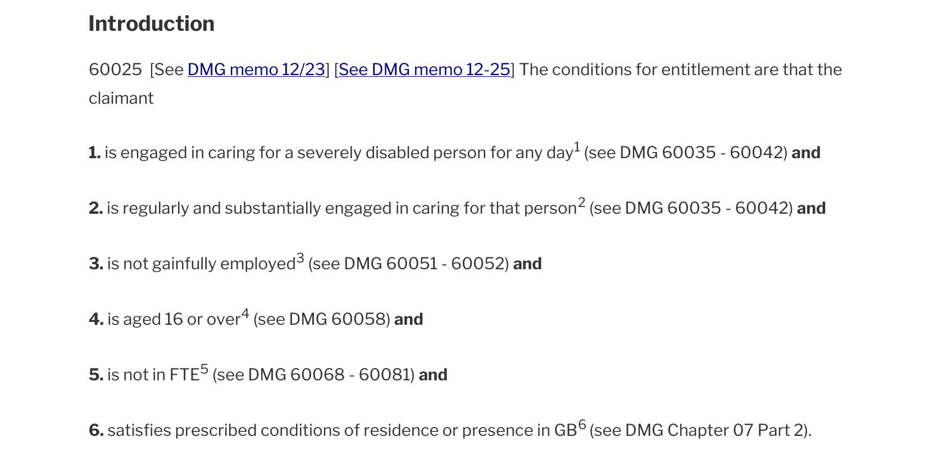
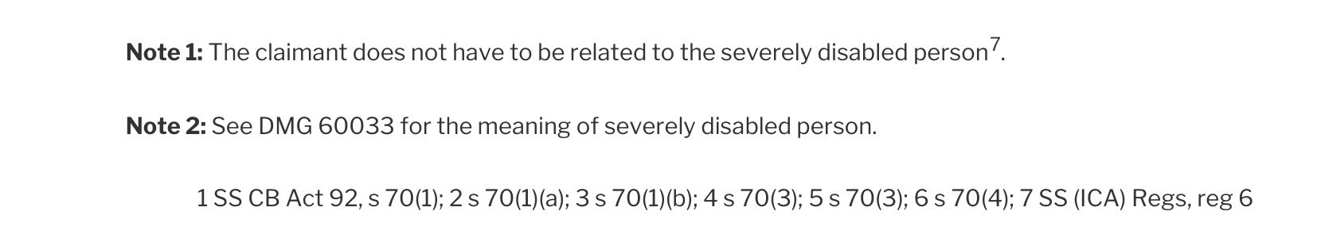
01 / HELP ME READ
Start with the source, not the assistant’s answer
RETAINED SOURCE • DMG 60025 • PDF pages 3–4
Six conditions
Abbreviations, cross-references and qualifications have to be read together.
The notes and printed
references continue
on the next page.
The following reading help is separate from the preserved source.
S01 • exact retained PDF typography; source capture is not a new legal-applicability check
Independent experimental demonstration • Public sources
01 / Help me read
10
Notes:
SLIDE 10: Start with the source, not the assistant’s answer
Presenter: Nick narrates; Chris may drive the reader
Suggested time: 1.5 minutes
Show the whole six-condition passage for orientation; do not try to read every word from the projection. The source uses abbreviations, numbered conditions, paragraph pointers and raised reference markers, and the notes continue onto page 4. This is the original preserved PDF, not an AI-generated mock-up or evidence that every reader finds it difficult. Move to the enlarged just-in-time help next. The full pages are in the appendix.
CAPTURE EVIDENCE — genuine source pixels, not a new live test
S01-conditions: Actual PDF crop, page 3. Read with the notes and printed references on page 4.
Capture: 2026-09-28T22:24:54.956Z; classification: human inspection of retained original PDF; outcome: captured.
Original: raw/S01-p3.png; original SHA-256: fc6fa8017e8fda02db464002d03418f1d93e1a377e8a847f4cca955c3a3c90af.
Crop: {"x":0,"y":1390,"width":1654,"height":820}.
Source/launch URL: https://assets.publishing.service.gov.uk/media/69e0fdcbb5e95ca5017ed9da/dmg-Chap-60.pdf#page=3
Receipt in supplied pack: receipts/S01.json
S01-notes: Actual PDF crop, page 4. No substantive text has been changed.
Capture: 2026-09-28T22:24:55.280Z; classification: human inspection of retained original PDF; outcome: captured.
Original: raw/S01-p4.png; original SHA-256: a33f7d83d5f013d26f18e3597ce99b7eecb9d807c69be5ce6b7fc50d370eeb05.
Crop: {"x":0,"y":40,"width":1654,"height":300}.
Source/launch URL: https://assets.publishing.service.gov.uk/media/69e0fdcbb5e95ca5017ed9da/dmg-Chap-60.pdf#page=4
Receipt in supplied pack: receipts/S01.json
Live cue: open the source from its link only if useful. Screenshot fallback is complete. No fresh PDF acquisition was performed for this deck.
Editable text and shapes. Source screenshots are intentionally images; their content has not been rewritten. Research checks: 29 September 2026. Presentation date: 30 September 2026 (editable).

Slide 19
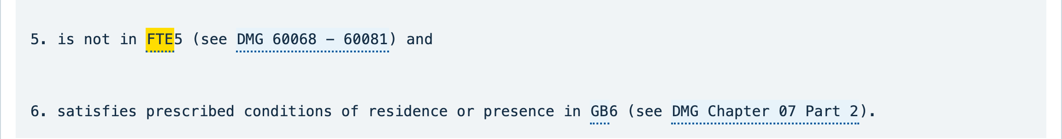
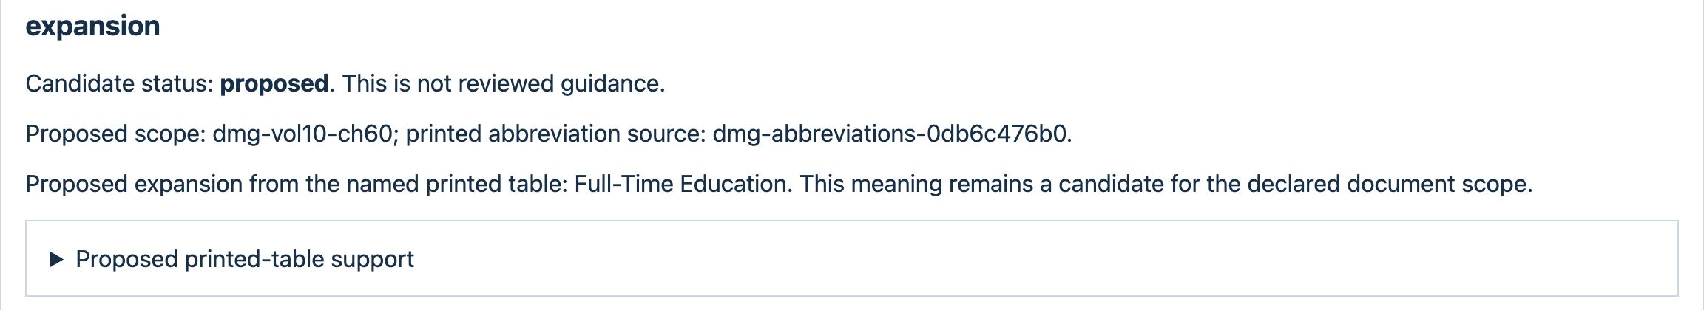
01 / HELP ME READ
Help beside the passage — not a substitute for it
SOURCE-BOUND READING HELP • PROPOSED, NOT REVIEWED
Exact source occurrence above. Separately proposed help below.
S02 • real FTE help-card interaction • candidate help is not official guidance
Independent experimental demonstration • Public sources
01 / Help me read
11
Notes:
SLIDE 11: Help beside the passage — not a substitute for it
Presenter: Nick narrates; Chris supports the demonstration
Suggested time: 1.5 minutes
Point to FTE in the unchanged extracted passage and then the separate card. The card offers “Full-Time Education” with its source scope and candidate status. The selected occurrence can be traced, but the proposed meaning is not thereby a reviewed definition. The visible crop is an excerpt of the passage, not all six conditions. Ask the audience what evidence they would need to accept the expansion in this particular scope.
CAPTURE EVIDENCE — genuine source pixels, not a new live test
S02-condition-focus: Enlarged excerpt of the unchanged passage. Full six-condition passage remains in the raw master.
Capture: 2026-09-28T22:24:57.289Z; classification: source-bound candidate reading help; outcome: captured.
Original: raw/S02.png; original SHA-256: fc961957123dac7eee684f029cbbb2e02f95a62a6458ce6b3a9fb84fcb134eb5.
Crop: {"x":768,"y":4395,"width":2304,"height":305}.
Source/launch URL: https://chris-page-gov.github.io/okf-explorer/reading-help/corpus/?catalogue=https%3A%2F%2Fraw.githubusercontent.com%2Fchris-page-gov%2Fokf-dwp%2Fcbada7bf544106bdceb2445fc379c8b3e5b73ee4%2Freading-help-corpus%2Fmanifest.json&catalogue_sha256=6c53b659b519aa4cbf7529e7e10eb4ad3bfe8efcac18055ec2a5ade724998b46&catalogue_bytes=260797&family=dmg&document=dmg-vol10-ch60&unit=https%3A%2F%2Fchris-page-gov.github.io%2Fokf-dwp%2Fid%2Funit%2Fdmg%2Fdmg-vol10-ch60%2Fmanual-structure-v1%2Fsource-0000002117-000-5fac0d6d5c5e&occurrence=94559367fa0c7f64933daf8c
Receipt in supplied pack: receipts/S02.json
S02-help-expansion-focus: Exact help-card excerpt: proposed expansion, scope and unreviewed status preserved.
Capture: 2026-09-28T22:24:57.289Z; classification: source-bound candidate reading help; outcome: captured.
Original: raw/S02.png; original SHA-256: fc961957123dac7eee684f029cbbb2e02f95a62a6458ce6b3a9fb84fcb134eb5.
Crop: {"x":768,"y":6310,"width":2304,"height":420}.
Source/launch URL: https://chris-page-gov.github.io/okf-explorer/reading-help/corpus/?catalogue=https%3A%2F%2Fraw.githubusercontent.com%2Fchris-page-gov%2Fokf-dwp%2Fcbada7bf544106bdceb2445fc379c8b3e5b73ee4%2Freading-help-corpus%2Fmanifest.json&catalogue_sha256=6c53b659b519aa4cbf7529e7e10eb4ad3bfe8efcac18055ec2a5ade724998b46&catalogue_bytes=260797&family=dmg&document=dmg-vol10-ch60&unit=https%3A%2F%2Fchris-page-gov.github.io%2Fokf-dwp%2Fid%2Funit%2Fdmg%2Fdmg-vol10-ch60%2Fmanual-structure-v1%2Fsource-0000002117-000-5fac0d6d5c5e&occurrence=94559367fa0c7f64933daf8c
Receipt in supplied pack: receipts/S02.json
S02-occurrence: Enlarged excerpt of the unchanged passage. Full six-condition passage remains in the raw master.
Capture: 2026-09-28T22:24:57.289Z; classification: source-bound candidate reading help; outcome: captured.
Original: raw/S02.png; original SHA-256: fc961957123dac7eee684f029cbbb2e02f95a62a6458ce6b3a9fb84fcb134eb5.
Crop: {"x":768,"y":4350,"width":2304,"height":1240}.
Source/launch URL: https://chris-page-gov.github.io/okf-explorer/reading-help/corpus/?catalogue=https%3A%2F%2Fraw.githubusercontent.com%2Fchris-page-gov%2Fokf-dwp%2Fcbada7bf544106bdceb2445fc379c8b3e5b73ee4%2Freading-help-corpus%2Fmanifest.json&catalogue_sha256=6c53b659b519aa4cbf7529e7e10eb4ad3bfe8efcac18055ec2a5ade724998b46&catalogue_bytes=260797&family=dmg&document=dmg-vol10-ch60&unit=https%3A%2F%2Fchris-page-gov.github.io%2Fokf-dwp%2Fid%2Funit%2Fdmg%2Fdmg-vol10-ch60%2Fmanual-structure-v1%2Fsource-0000002117-000-5fac0d6d5c5e&occurrence=94559367fa0c7f64933daf8c
Receipt in supplied pack: receipts/S02.json
S02-help: The native help card says proposed and not reviewed guidance. This is a candidate, not an official interpretation.
Capture: 2026-09-28T22:24:57.289Z; classification: source-bound candidate reading help; outcome: captured.
Original: raw/S02.png; original SHA-256: fc961957123dac7eee684f029cbbb2e02f95a62a6458ce6b3a9fb84fcb134eb5.
Crop: {"x":768,"y":5910,"width":2304,"height":868}.
Source/launch URL: https://chris-page-gov.github.io/okf-explorer/reading-help/corpus/?catalogue=https%3A%2F%2Fraw.githubusercontent.com%2Fchris-page-gov%2Fokf-dwp%2Fcbada7bf544106bdceb2445fc379c8b3e5b73ee4%2Freading-help-corpus%2Fmanifest.json&catalogue_sha256=6c53b659b519aa4cbf7529e7e10eb4ad3bfe8efcac18055ec2a5ade724998b46&catalogue_bytes=260797&family=dmg&document=dmg-vol10-ch60&unit=https%3A%2F%2Fchris-page-gov.github.io%2Fokf-dwp%2Fid%2Funit%2Fdmg%2Fdmg-vol10-ch60%2Fmanual-structure-v1%2Fsource-0000002117-000-5fac0d6d5c5e&occurrence=94559367fa0c7f64933daf8c
Receipt in supplied pack: receipts/S02.json
Live cue: select the FTE occurrence in paragraph 60025. Fallback: advance between the paired source and help images already on this slide. Do not remove the candidate warning.
Editable text and shapes. Source screenshots are intentionally images; their content has not been rewritten. Research checks: 29 September 2026. Presentation date: 30 September 2026 (editable).

Slide 20
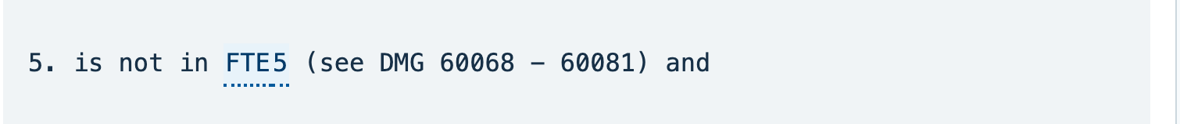
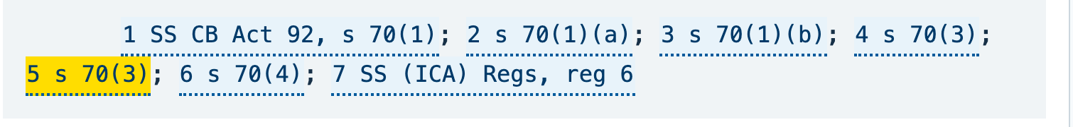
01 / HELP ME READ
Follow this reference — not just this number
OCCURRENCE-SPECIFIC NAVIGATION • NOT A LEGAL FINDING
Body marker · source page 3
Three different things
Condition 5
Raised marker 5
Paired printed reference · source page 4
Reference: s 70(3)
A dated link resolves navigation, not legal applicability or dependency completeness.
S03 • actual marker-to-footer navigation; dated target retained in receipt
Independent experimental demonstration • Public sources
01 / Help me read
12
Notes:
SLIDE 12: Follow this reference — not just this number
Presenter: Nick narrates; Chris supports the demonstration
Suggested time: 2 minutes
Distinguish the numbered condition, the raised source marker and the printed reference. The system binds the marker to its particular footer occurrence instead of matching every “5”. The separate help card offers a dated navigation target, 20 September 2026. It remains unreviewed navigation. Linking a provision does not itself include its body in the selected evidence or resolve territory, dates, exceptions and applicability. The complete candidate card is retained in the supplied pack; it is not rewritten as official guidance.
CAPTURE EVIDENCE — genuine source pixels, not a new live test
S03-marker-focus: Actual passage crop: condition 5 is not the same thing as source marker 5.
Capture: 2026-09-28T22:29:58.002Z; classification: occurrence-bound citation navigation; outcome: captured.
Original: raw/S03-r1.png; original SHA-256: 752c3435186be58c54ef1bd80ea7a2ae5beca74cb05c96e4a1e854274aeacd75.
Crop: {"x":1030,"y":2070,"width":1510,"height":160}.
Source/launch URL: https://chris-page-gov.github.io/okf-explorer/reading-help/?manifest=https%3A%2F%2Fraw.githubusercontent.com%2Fchris-page-gov%2Fokf-dwp%2F2ad33add6d8660fec98bf34fb98480a9d0de9e27%2Freading-help-ch60-law.json&passage=dmg-60025
Receipt in supplied pack: receipts/S03.json
S03-footer-focus: Actual passage crop: condition 5 is not the same thing as source marker 5.
Capture: 2026-09-28T22:29:58.002Z; classification: occurrence-bound citation navigation; outcome: captured.
Original: raw/S03-r1.png; original SHA-256: 752c3435186be58c54ef1bd80ea7a2ae5beca74cb05c96e4a1e854274aeacd75.
Crop: {"x":1030,"y":3220,"width":1510,"height":180}.
Source/launch URL: https://chris-page-gov.github.io/okf-explorer/reading-help/?manifest=https%3A%2F%2Fraw.githubusercontent.com%2Fchris-page-gov%2Fokf-dwp%2F2ad33add6d8660fec98bf34fb98480a9d0de9e27%2Freading-help-ch60-law.json&passage=dmg-60025
Receipt in supplied pack: receipts/S03.json
S03-paired-reference: Actual passage crop: condition 5 is not the same thing as source marker 5.
Capture: 2026-09-28T22:29:58.002Z; classification: occurrence-bound citation navigation; outcome: captured.
Original: raw/S03-r1.png; original SHA-256: 752c3435186be58c54ef1bd80ea7a2ae5beca74cb05c96e4a1e854274aeacd75.
Crop: {"x":1030,"y":2070,"width":1510,"height":1460}.
Source/launch URL: https://chris-page-gov.github.io/okf-explorer/reading-help/?manifest=https%3A%2F%2Fraw.githubusercontent.com%2Fchris-page-gov%2Fokf-dwp%2F2ad33add6d8660fec98bf34fb98480a9d0de9e27%2Freading-help-ch60-law.json&passage=dmg-60025
Receipt in supplied pack: receipts/S03.json
S03-reference-card: Unreviewed project help. The dated link does not put the statutory text into the evidence package.
Capture: 2026-09-28T22:29:58.002Z; classification: occurrence-bound citation navigation; outcome: captured.
Original: raw/S03-r1.png; original SHA-256: 752c3435186be58c54ef1bd80ea7a2ae5beca74cb05c96e4a1e854274aeacd75.
Crop: {"x":2565,"y":1750,"width":707,"height":1580}.
Source/launch URL: https://chris-page-gov.github.io/okf-explorer/reading-help/?manifest=https%3A%2F%2Fraw.githubusercontent.com%2Fchris-page-gov%2Fokf-dwp%2F2ad33add6d8660fec98bf34fb98480a9d0de9e27%2Freading-help-ch60-law.json&passage=dmg-60025
Receipt in supplied pack: receipts/S03.json
Live cue: follow raised marker 5 and return to its source occurrence. The visible slide is the saved capture of that interaction, not proof of present browser availability.
Editable text and shapes. Source screenshots are intentionally images; their content has not been rewritten. Research checks: 29 September 2026. Presentation date: 30 September 2026 (editable).

Slide 21
02 / HELP ME INVESTIGATE
Two dates. One important missing boundary.
“Where a child is awarded the highest-rate care component of DLA from 26 January 2025, but the change is reported to Universal Credit on 28 March 2026, what’s the effective date of the higher disabled-child addition, and from which assessment period should it be paid?”
26 January 2025
28 March 2026
Not supplied
DLA entitlement date stated
in the question
Change reported to
Universal Credit
Assessment-period
start and end dates
Investigate the rule branch before attempting an answer.
Nick’s original question • DLA = Disability Living Allowance • no assessment-period dates have been invented
Independent experimental demonstration • Public sources
02 / Help me investigate
13
Notes:
SLIDE 13: Two dates. One important missing boundary.
Presenter: Nick
Suggested time: 0.75 minutes
Read the question as supplied, with the two dates unchanged. DLA means Disability Living Allowance; UC means Universal Credit. An assessment period is the monthly window used for UC. Do not fill “Answer 1” with a final award decision. The case does not provide the assessment-period boundaries or establish all the circumstances needed for a legal applicability decision.
SOURCES
UC: Frozen UC out-of-sample follow-up and retained diagnostic
https://github.com/chris-page-gov/okf-dwp/blob/77ef16047415ee48dcb93b80adf1ba057ea00d9b/docs/uc-disabled-child-supersession-follow-up.md
The question is from presentation-structure.md and the retained out-of-sample case. The text is editable. Original-question screenshot: S05-question in the supplied pack, not used as an answer.
Editable text and shapes. Source screenshots are intentionally images; their content has not been rewritten. Research checks: 29 September 2026. Presentation date: 30 September 2026 (editable).

Slide 22
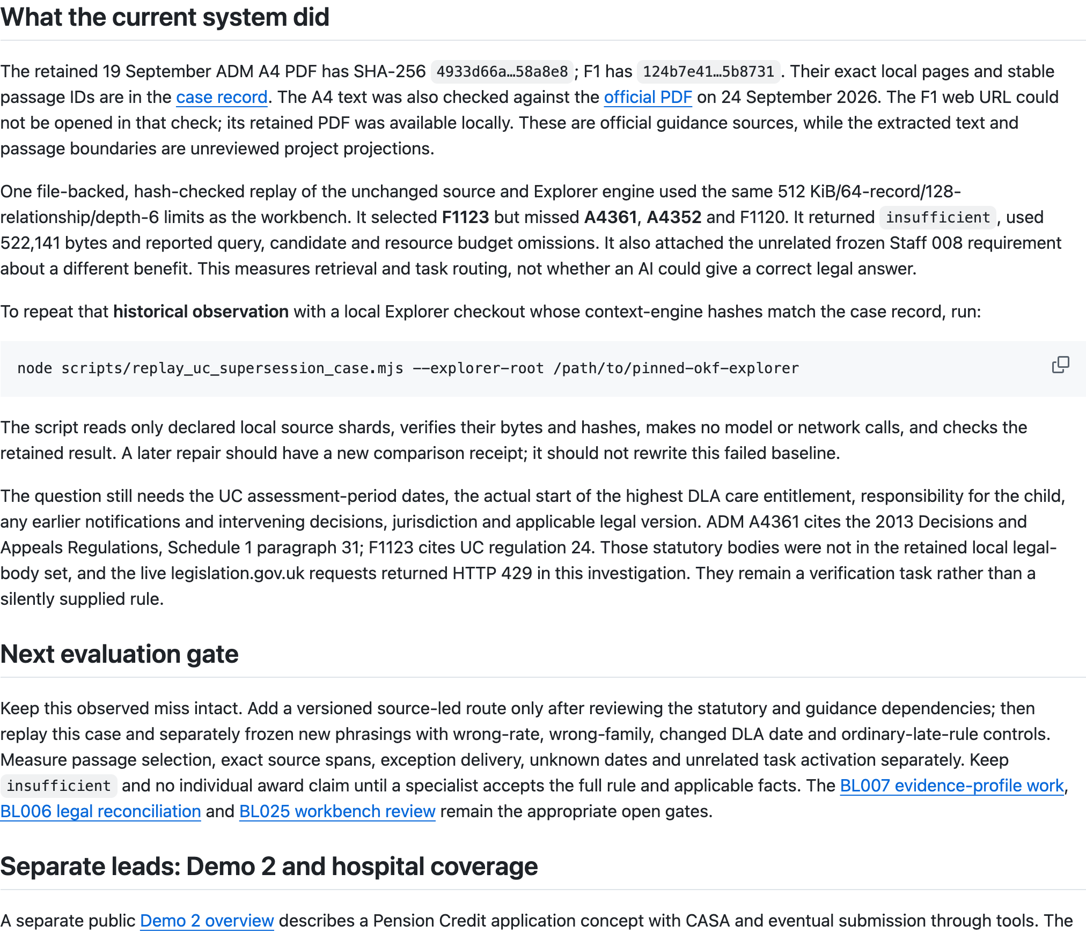
02 / A DIAGNOSTIC, NOT A SUCCESSFUL ANSWER
The retained retrieval missed the relevant branch
HISTORICAL OBSERVATION • OUTSIDE THE FROZEN 40 • NOT RERUN
Selected
F1123
Not selected
A4361, A4352 and F1120
Also activated an unrelated Staff 008 requirement.
Result remained insufficient.
S05 • screenshot of a retained repository diagnostic • retrieval/routing evidence, not an answer-accuracy trial
Independent experimental demonstration • Public sources
02 / A diagnostic, not a successful answer
14
Notes:
SLIDE 14: The retained retrieval missed the relevant branch
Presenter: Nick narrates; Chris supports the evidence inspection
Suggested time: 1.5 minutes
This screen records what the unchanged source and engine selected in the historical replay. It selected F1123, missed A4361/A4352/F1120 and attached an unrelated Staff 008 requirement. That is a retrieval and task-routing failure, not a measurement of what a reasoning model knows. It is outside the frozen forty cases and was not rerun for these screenshots. The next slide is a deliberate source lookup, not a continuation that magically repairs this result.
CAPTURE EVIDENCE — genuine source pixels, not a new live test
S05b: F1123 selected; A4361/A4352/F1120 missed; unrelated Staff 008 requirement; insufficient.
Capture: 2026-09-28T22:25:01.388Z; classification: fresh capture of retained historical diagnostic; outcome: captured.
Original: raw/S05b.png; original SHA-256: 45611f9876c3e53d519b75046536b82b510239036975f1aefc9facd95b1fea52.
Crop: {"x":1229,"y":2070,"width":2024,"height":1740}.
Source/launch URL: https://github.com/chris-page-gov/okf-dwp/blob/77ef16047415ee48dcb93b80adf1ba057ea00d9b/docs/uc-disabled-child-supersession-follow-up.md
Receipt in supplied pack: receipts/S05.json
SOURCES
UC: Frozen UC out-of-sample follow-up and retained diagnostic
https://github.com/chris-page-gov/okf-dwp/blob/77ef16047415ee48dcb93b80adf1ba057ea00d9b/docs/uc-disabled-child-supersession-follow-up.md
Preserve the failed baseline. Do not present source availability somewhere in the corpus as proof that the needed source reached the model.
Editable text and shapes. Source screenshots are intentionally images; their content has not been rewritten. Research checks: 29 September 2026. Presentation date: 30 September 2026 (editable).

Slide 23
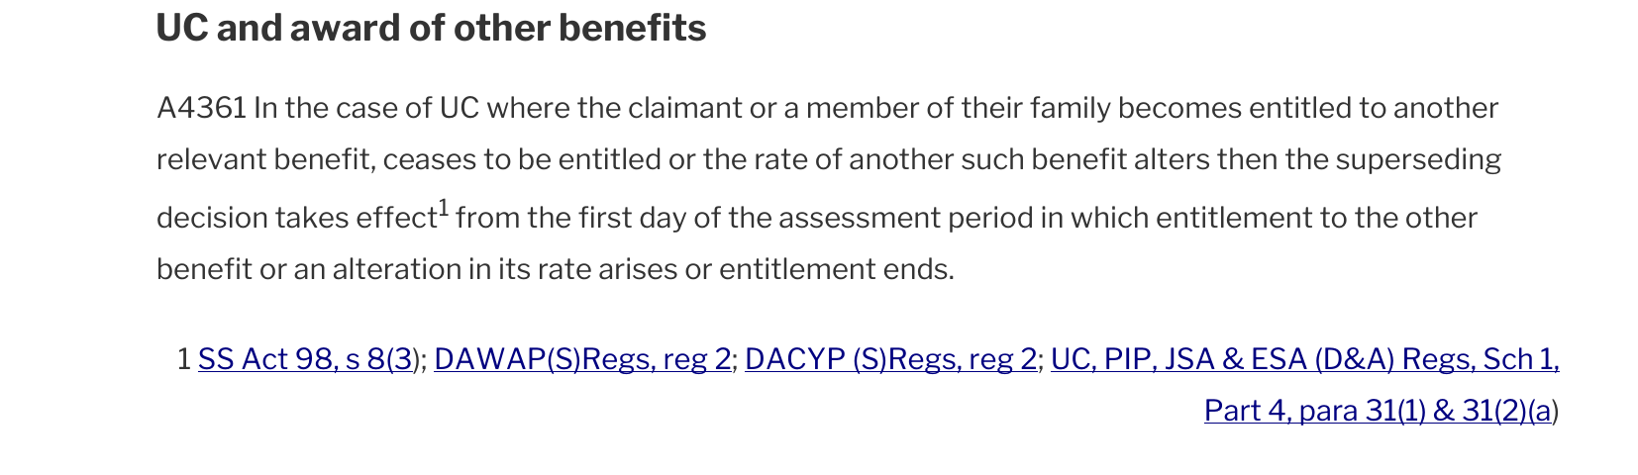
02 / SEPARATE SOURCE INSPECTION
Open the missing source — and keep the exception
HUMAN / SOURCE INSPECTION • NOT SELECTED BY THE PRECEDING REPLAY
A4352 explicitly points to A4360–A4361. Read the exception with the ordinary late-notification rule.
Still needed: assessment-period boundaries, relevant facts and a reviewed applicability determination.
S06 • retained ADM A4, PDF pages 36 and 34 • printed references preserved
Independent experimental demonstration • Public sources
02 / Separate source inspection
15
Notes:
SLIDE 15: Open the missing source — and keep the exception
Presenter: Nick, with Chris supporting source navigation
Suggested time: 2.25 minutes
We are now separately opening the retained source. A4361 describes a UC branch involving entitlement to another relevant benefit or a change in its rate. A4352 explicitly points to A4360–A4361 as an exception to the ordinary late-notification route. Keep the printed citations attached. The repository offers only a conditional reading; the legal bodies and facts were not all verified. The A4361 DLA example is about the carer element, not a determination of this addition. Do not invent assessment-period dates or calculate a payment. Ask: would our evidence package have preserved this exception?
CAPTURE EVIDENCE — genuine source pixels, not a new live test
S06-A4361: Human inspection of retained ADM A4 page 36; historical retrieval did not select this branch.
Capture: 2026-09-28T22:25:01.882Z; classification: human inspection of retained original PDF; outcome: captured.
Original: raw/S06-p36.png; original SHA-256: c2cba838473a83ad6c24de3821c5fe7bbda576a36b9d71ff8c9d05bfcd282ad2.
Crop: {"x":0,"y":675,"width":1654,"height":480}.
Source/launch URL: https://assets.publishing.service.gov.uk/media/6a2172db56e988a798b38645/adm-ch-a4.pdf#page=36
Receipt in supplied pack: receipts/S06.json
S06-A4352: Retained ADM A4 page 34, including “but see A4360 - A4361”. No assessment-period dates are invented.
Capture: 2026-09-28T22:25:02.485Z; classification: human inspection of retained original PDF; outcome: captured.
Original: raw/S06-p34.png; original SHA-256: 074ef150e90484bb28ecb721f967945e5e826a2f06e1cfa64389adab7bb5cb0b.
Crop: {"x":0,"y":1250,"width":1654,"height":705}.
Source/launch URL: https://assets.publishing.service.gov.uk/media/6a2172db56e988a798b38645/adm-ch-a4.pdf#page=34
Receipt in supplied pack: receipts/S06.json
SOURCES
UC: Frozen UC out-of-sample follow-up and retained diagnostic
https://github.com/chris-page-gov/okf-dwp/blob/77ef16047415ee48dcb93b80adf1ba057ea00d9b/docs/uc-disabled-child-supersession-follow-up.md
No new legal conclusion or statutory acquisition was undertaken in deck assembly. The screenshots are of the retained PDFs supplied through the capture pack.
Editable text and shapes. Source screenshots are intentionally images; their content has not been rewritten. Research checks: 29 September 2026. Presentation date: 30 September 2026 (editable).

Slide 24
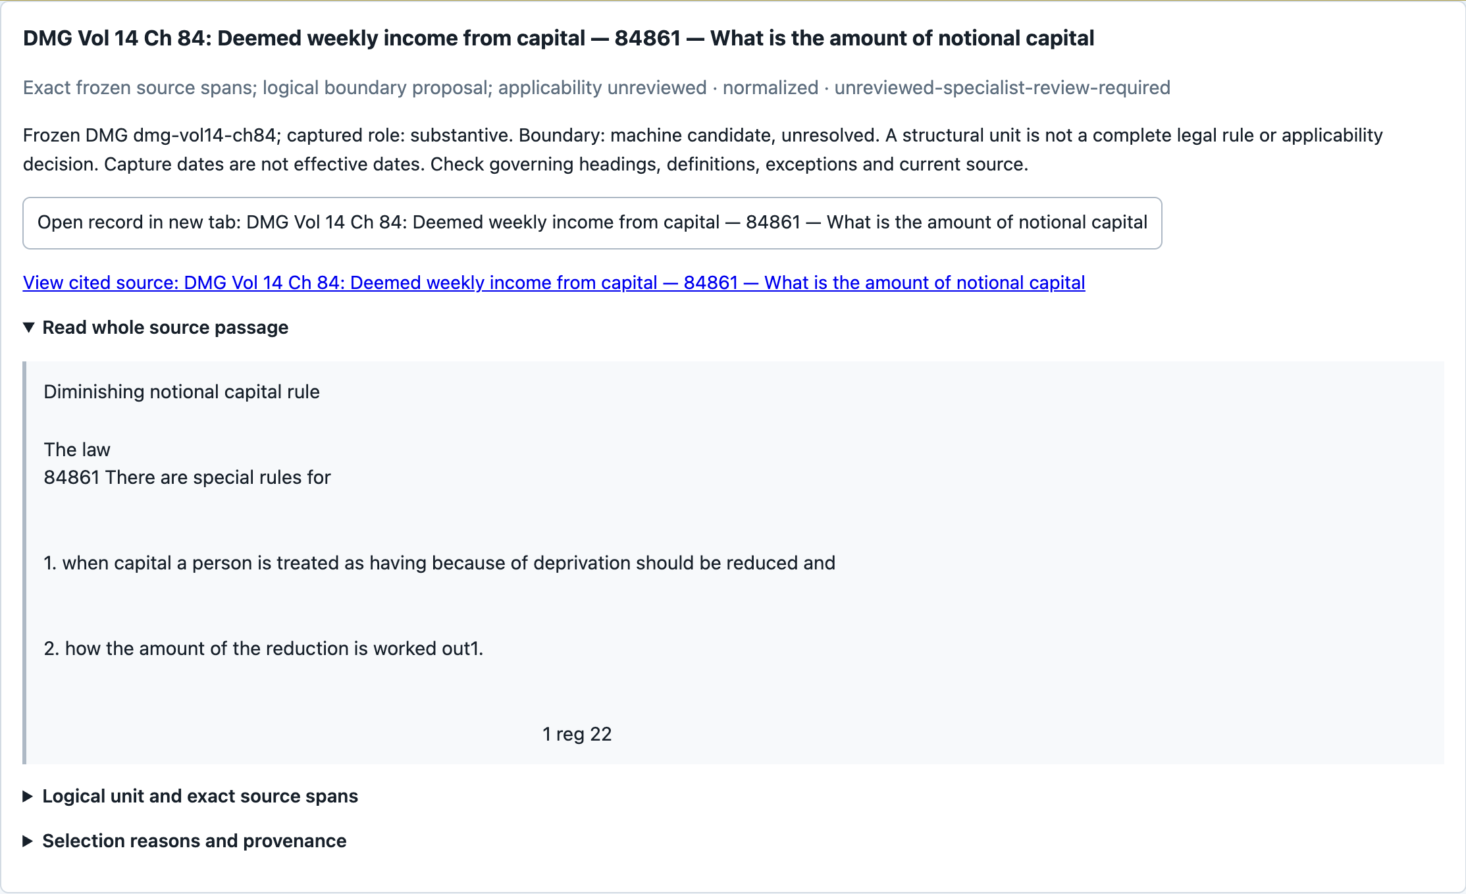
02 / FRESH CAPITAL ASSEMBLY
A fresh question can expose a useful evidence path
“Can Pension Credit treat capital as still held after someone
has got rid of it, and are there exceptions?”
FRESH ASSEMBLY IN THE CAPTURE RUN
U07 + DMG 84861
were selected
44 records
68 relationships
INSUFFICIENT + TRUNCATED
S07 • deterministic evidence assembly, not an AI answer • complete limits in appendix
Independent experimental demonstration • Public sources
02 / Fresh capital assembly
16
Notes:
SLIDE 16: A fresh question can expose a useful evidence path
Presenter: Nick narrates; Chris may operate Ask OKF
Suggested time: 1.5 minutes
Unlike the preceding historical UC diagnostic, this was a fresh deterministic assembly during the capture run. The exact question selected U07 and DMG 84861. The returned package contained 44 records and 68 relationships, used 522,995 bytes and remained insufficient and truncated. This is evidence assembly, not a generated benefits answer. Requested limits were 64 records, 128 relationships, depth six and 524,288 bytes; reached depth was three. The technical capture retry preserved identical package bytes. Do not interpret relevance or record count as completeness.
CAPTURE EVIDENCE — genuine source pixels, not a new live test
S07a-r1: Fresh assembly, not an AI answer. Insufficient and bounded; no claim of legal completeness.
Capture: 2026-09-28T22:30:01.456Z; classification: fresh deterministic evidence assembly; no AI answer; outcome: captured.
Original: raw/S07a-r1.png; original SHA-256: 927634838824911b5b41c5f46d00baea8e528dcbcd21ba7f06c64791431b06bc.
Crop: {"x":1082,"y":314,"width":2227,"height":1640}.
Source/launch URL: https://chris-page-gov.github.io/okf-explorer/explore/?bundle=https%3A%2F%2Fraw.githubusercontent.com%2Fchris-page-gov%2Fokf-dwp%2F7eeded763042ddd0070f4fed834c6074149e8e2f%2Fstructured-context%2Fevidence-connect-explorer.json#overview
Receipt in supplied pack: receipts/S07.json
S07b-r1: DMG 84861 selection is observed now; it does not establish that every exception was retrieved.
Capture: 2026-09-28T22:30:01.754Z; classification: fresh deterministic evidence assembly; no AI answer; outcome: captured.
Original: raw/S07b-r1.png; original SHA-256: d14f2ee56df649203a17404bb3f2feb6da3ccb97e18d3f071cd1756f91c248ee.
Crop: {"x":1082,"y":313,"width":2227,"height":1358}.
Source/launch URL: https://chris-page-gov.github.io/okf-explorer/explore/?bundle=https%3A%2F%2Fraw.githubusercontent.com%2Fchris-page-gov%2Fokf-dwp%2F7eeded763042ddd0070f4fed834c6074149e8e2f%2Fstructured-context%2Fevidence-connect-explorer.json#overview
Receipt in supplied pack: receipts/S07.json
S07c-r1: 32,768-byte delivery parts are separate from the 524,288-byte assembly budget.
Capture: 2026-09-28T22:30:02.036Z; classification: fresh deterministic evidence assembly; no AI answer; outcome: captured.
Original: raw/S07c-r1.png; original SHA-256: 1d4e01f6c7a324a3d813aef9e164d2d4a9682d1e6415e66e0d026d80bdacdf9d.
Crop: {"x":1082,"y":635,"width":2227,"height":1400}.
Source/launch URL: https://chris-page-gov.github.io/okf-explorer/explore/?bundle=https%3A%2F%2Fraw.githubusercontent.com%2Fchris-page-gov%2Fokf-dwp%2F7eeded763042ddd0070f4fed834c6074149e8e2f%2Fstructured-context%2Fevidence-connect-explorer.json#overview
Receipt in supplied pack: receipts/S07.json
Fresh means fresh at the timestamp in the capture receipt, not newly executed while building these slides. Next slide explicitly switches to a different saved package.
Editable text and shapes. Source screenshots are intentionally images; their content has not been rewritten. Research checks: 29 September 2026. Presentation date: 30 September 2026 (editable).

Slide 25
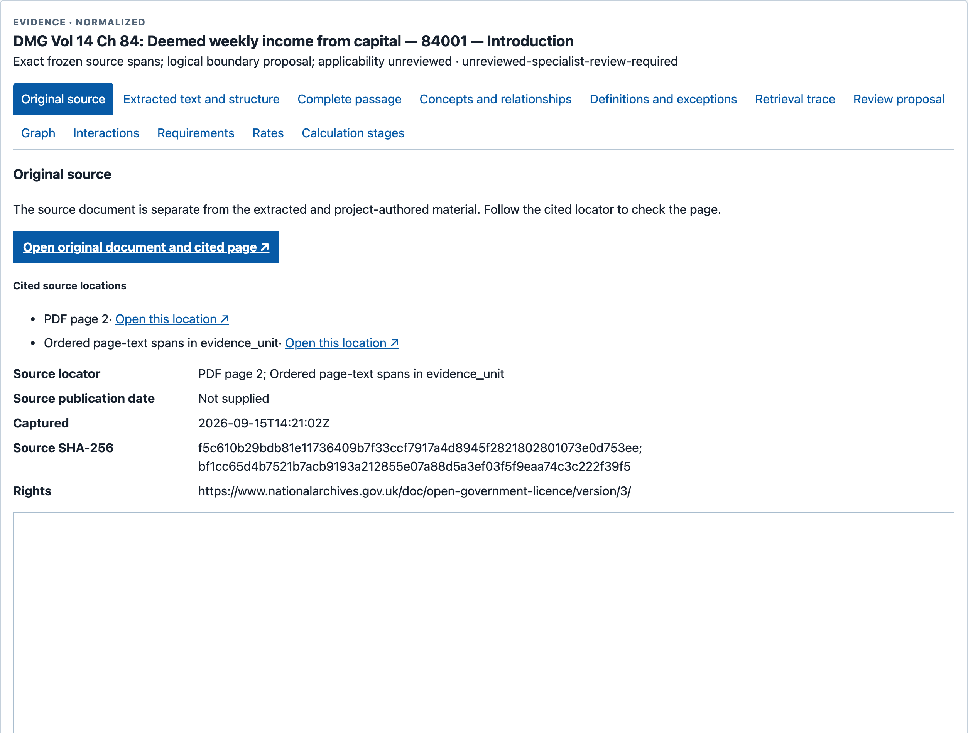
02 / SAVED WORKBENCH EVIDENCE
Switch to a saved package to inspect provenance
EXPLICIT SWITCH • STAFF-006 • NOT THE FRESH S07 PACKAGE
Saved DMG 84001
The saved manifest has no selected U07 / 84861 route. This is a labelled capital-related fallback.
Check the source URL,
page, captured bytes
and review status.
Identity is not correctness.
S08 • saved staff-006: 30 records, 47 relationships; insufficient and truncated
Independent experimental demonstration • Public sources
02 / Saved workbench evidence
17
Notes:
SLIDE 17: Switch to a saved package to inspect provenance
Presenter: Nick narrates; Chris supports workbench inspection
Suggested time: 2 minutes
Announce the change of evidence identity. We are now using a saved forty-question manifest and its staff-006 package. It does not expose the U07/84861 path from the fresh result, so the capture uses DMG 84001 as a capital-related fallback. Show the source URL, PDF locator and source hash. A hash identifies a specific set of bytes; it does not certify interpretation or current legal applicability. The saved package has 30 records and 47 relationships and is still insufficient and truncated. The following relationship and requirement views belong to this saved package.
CAPTURE EVIDENCE — genuine source pixels, not a new live test
S08a: Saved capital-related package; U07/84861 absent here. This is not the fresh S07 result.
Capture: 2026-09-28T22:25:23.899Z; classification: inspection of saved package, not S07 fresh assembly; outcome: fallback.
Original: raw/S08a.png; original SHA-256: 6144bd9ddcb88b1eafd085f169a6a4eaa84179eeceddf86fbb663335bf400747.
Crop: {"x":1290,"y":1772,"width":2509,"height":1556}.
Source/launch URL: https://chris-page-gov.github.io/okf-explorer/evidence/?manifest=https%3A%2F%2Fraw.githubusercontent.com%2Fchris-page-gov%2Fokf-dwp%2Fd31f16fb7143d04b9de73e14cd493cfb832ae83e%2Fevaluation%2Fevidence-workbench%2Ftools-manifest.json&case=staff-006&record=https%3A%2F%2Fchris-page-gov.github.io%2Fokf-dwp%2Fid%2Funit%2Fdmg%2Fdmg-vol14-ch84%2Fmanual-structure-v1%2Fsource-0000001157-000-d863e5f8aafb&tab=passage
Receipt in supplied pack: receipts/S08.json
S08b: Source PDF locator and recorded capture hash; hashes establish identity, not interpretation.
Capture: 2026-09-28T22:25:24.290Z; classification: inspection of saved package, not S07 fresh assembly; outcome: fallback.
Original: raw/S08b.png; original SHA-256: 95c556c7768d099990213786fb6b78fac7628ffce3da3a7ec99ba0c5a672a5c8.
Crop: {"x":1290,"y":1772,"width":2509,"height":1900}.
Source/launch URL: https://chris-page-gov.github.io/okf-explorer/evidence/?manifest=https%3A%2F%2Fraw.githubusercontent.com%2Fchris-page-gov%2Fokf-dwp%2Fd31f16fb7143d04b9de73e14cd493cfb832ae83e%2Fevaluation%2Fevidence-workbench%2Ftools-manifest.json&case=staff-006&record=https%3A%2F%2Fchris-page-gov.github.io%2Fokf-dwp%2Fid%2Funit%2Fdmg%2Fdmg-vol14-ch84%2Fmanual-structure-v1%2Fsource-0000001157-000-d863e5f8aafb&tab=source
Receipt in supplied pack: receipts/S08.json
Do not present S07–S09 as one continuous inspection of the same assembled package. That distinction is visible in the slide and in the capture records.
Editable text and shapes. Source screenshots are intentionally images; their content has not been rewritten. Research checks: 29 September 2026. Presentation date: 30 September 2026 (editable).

Slide 26
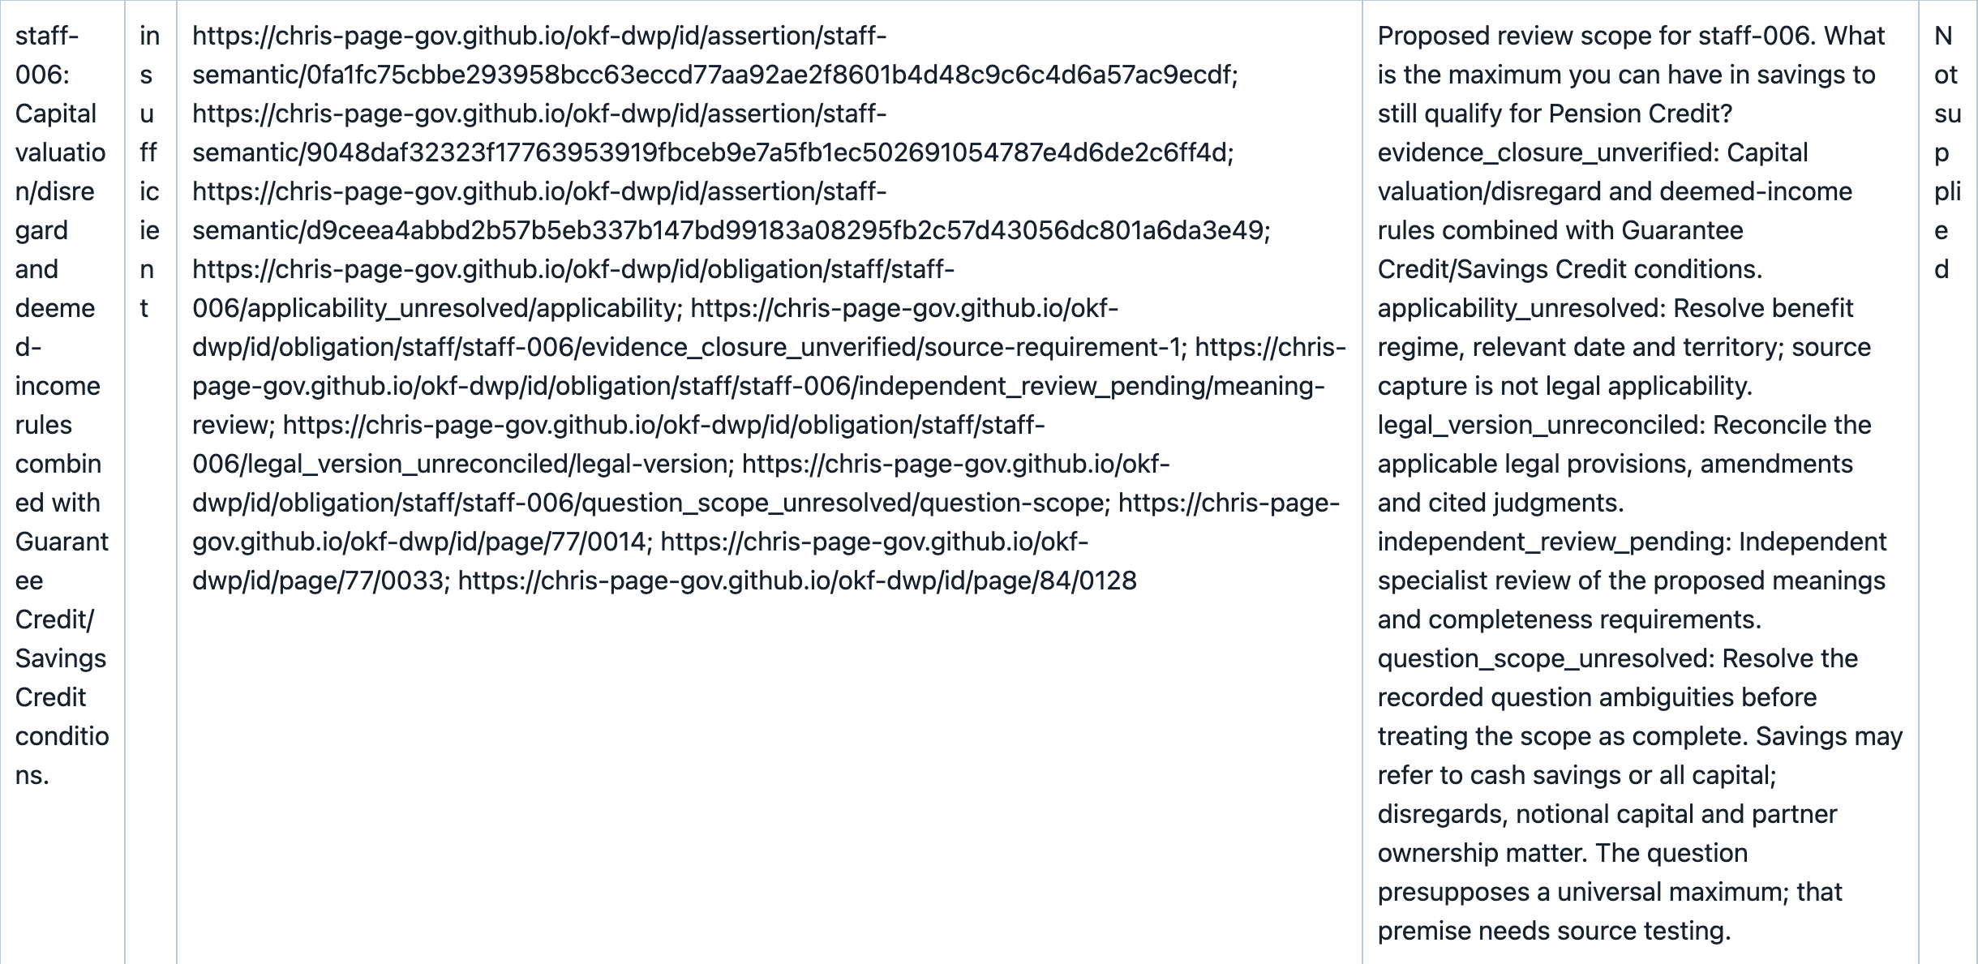
02 / INSPECT THE CONNECTION AND THE GAP
A relationship is not an approved rule
SAVED STAFF-006 • MODEL-DERIVED RELATIONSHIP • PARTIAL REQUIREMENTS
What remains open?
Capital valuation, disregards, deemed income, applicability and review.
Requirements view:
rows 1–3 of 7
Unknown dates
Insufficient evidence
S09 • actual directed relationship and unresolved requirement • not a complete legal dependency set
Independent experimental demonstration • Public sources
02 / Inspect the connection and the gap
18
Notes:
SLIDE 18: A relationship is not an approved rule
Presenter: Nick
Suggested time: 2 minutes
The displayed row runs from State Pension Credit to Capital, with valuation and disregards still dependencies. It is model-derived. The Requirements view does not make those dependencies disappear: it shows a partial range, unknown dates and missing source references in the returned requirements data. A graph edge is not automatically an approved legal rule. Distinguish the bounded 37 graph rows from all 47 package relationships. The important review question is what evidence would close each gap, not whether a connected graph looks convincing.
CAPTURE EVIDENCE — genuine source pixels, not a new live test
S09-connection: Model-derived connection; valuation and disregards remain dependencies. Saved staff-006 is insufficient.
Capture: 2026-09-28T22:34:57.210Z; classification: inspection of saved package, not S07 fresh assembly; outcome: fallback.
Original: raw/S09-connection.png; original SHA-256: d1ae31e1121b361307e06b2cb29fab64f5ee52fdbec4c56feca7a3ef60ea7c71.
Crop: {"x":1325,"y":14395,"width":2439,"height":229}.
Source/launch URL: https://chris-page-gov.github.io/okf-explorer/evidence/?manifest=https%3A%2F%2Fraw.githubusercontent.com%2Fchris-page-gov%2Fokf-dwp%2Fd31f16fb7143d04b9de73e14cd493cfb832ae83e%2Fevaluation%2Fevidence-workbench%2Ftools-manifest.json&case=staff-006&record=https%3A%2F%2Fchris-page-gov.github.io%2Fokf-dwp%2Fid%2Funit%2Fdmg%2Fdmg-vol14-ch84%2Fmanual-structure-v1%2Fsource-0000001157-000-d863e5f8aafb&tab=graph
Receipt in supplied pack: receipts/S09.json
S09-requirement: Single native row excerpt. Insufficient; dates unknown; table rows 1–3 of 7 only. See S09b for warnings.
Capture: 2026-09-28T22:48:06.010Z; classification: inspection of saved package, not S07 fresh assembly; outcome: fallback.
Original: raw/S09-requirement.png; original SHA-256: f99983a9ff806a190546b05f2e52fd66022e940543be77e07fcc5e58c522adc9.
Crop: {"x":1325,"y":3811,"width":2439,"height":1189}.
Source/launch URL: https://chris-page-gov.github.io/okf-explorer/evidence/?manifest=https%3A%2F%2Fraw.githubusercontent.com%2Fchris-page-gov%2Fokf-dwp%2Fd31f16fb7143d04b9de73e14cd493cfb832ae83e%2Fevaluation%2Fevidence-workbench%2Ftools-manifest.json&case=staff-006&record=https%3A%2F%2Fchris-page-gov.github.io%2Fokf-dwp%2Fid%2Funit%2Fdmg%2Fdmg-vol14-ch84%2Fmanual-structure-v1%2Fsource-0000001157-000-d863e5f8aafb&tab=requirements
Receipt in supplied pack: receipts/S09.json
S09b: Missing requirements and omissions remain explicit; read together with the directed connections.
Capture: 2026-09-28T22:25:57.663Z; classification: inspection of saved package, not S07 fresh assembly; outcome: fallback.
Original: raw/S09b.png; original SHA-256: f99983a9ff806a190546b05f2e52fd66022e940543be77e07fcc5e58c522adc9.
Crop: {"x":1290,"y":1772,"width":2509,"height":2040}.
Source/launch URL: https://chris-page-gov.github.io/okf-explorer/evidence/?manifest=https%3A%2F%2Fraw.githubusercontent.com%2Fchris-page-gov%2Fokf-dwp%2Fd31f16fb7143d04b9de73e14cd493cfb832ae83e%2Fevaluation%2Fevidence-workbench%2Ftools-manifest.json&case=staff-006&record=https%3A%2F%2Fchris-page-gov.github.io%2Fokf-dwp%2Fid%2Funit%2Fdmg%2Fdmg-vol14-ch84%2Fmanual-structure-v1%2Fsource-0000001157-000-d863e5f8aafb&tab=requirements
Receipt in supplied pack: receipts/S09.json
Editable text and shapes. Source screenshots are intentionally images; their content has not been rewritten. Research checks: 29 September 2026. Presentation date: 30 September 2026 (editable).

Slide 27
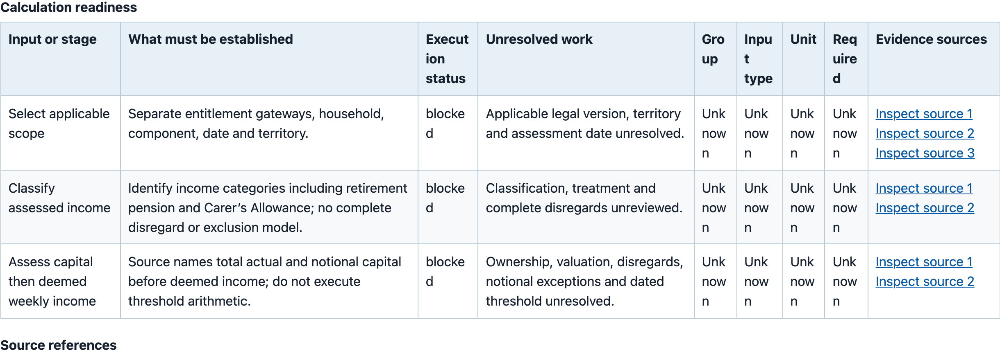
03 / HELP ME INSPECT AND CHALLENGE
A useful calculation model can still be blocked
STAFF-016 • AUTHORED, UNREVIEWED • NO AWARD CALCULATION
Unknown inputs are not zero. Missing rules are not permission to invent them.
S10 • enlarged native stages excerpt, rows 1–3 of 18 • all cited packages remain insufficient
Independent experimental demonstration • Public sources
03 / Help me inspect and challenge
19
Notes:
SLIDE 19: A useful calculation model can still be blocked
Presenter: Nick narrates; Chris supports the saved model inspection
Suggested time: 2 minutes
This screen exposes proposed stages and the evidence requirements that block execution. It is not a calculator. The first three of eighteen rows are shown; fields, applicability and effective dates remain unresolved. The proposal is authored and unreviewed. There are no approved executable rates or an individual award result. This is useful business analysis: the missing contract can be examined before anyone claims the system is ready to calculate. Keep unknown separate from zero, false or an assumed default.
CAPTURE EVIDENCE — genuine source pixels, not a new live test
S10-stages: Enlarged native table. Authored and unreviewed; insufficient; partial. Read with the complete limitations in S10.
Capture: 2026-09-28T22:26:01.910Z; classification: saved package; blocked unreviewed calculation model; outcome: captured.
Original: raw/S10.png; original SHA-256: 179ae352bfc23a1c7e7c8c5b856187605cae1ec86959b3a6bc7bedd98a436e59.
Crop: {"x":1323,"y":3625,"width":2440,"height":880}.
Source/launch URL: https://chris-page-gov.github.io/okf-explorer/evidence/?manifest=https%3A%2F%2Fraw.githubusercontent.com%2Fchris-page-gov%2Fokf-dwp%2Fd31f16fb7143d04b9de73e14cd493cfb832ae83e%2Fevaluation%2Fevidence-workbench%2Ftools-manifest.json&case=staff-016&record=https%3A%2F%2Fchris-page-gov.github.io%2Fokf-dwp%2Fid%2Fstaff-domain%2Fcalculation&tab=calculation
Receipt in supplied pack: receipts/S10.json
S10: Unknown scope, inputs and dates do not become zero or false. No award arithmetic.
Capture: 2026-09-28T22:26:01.910Z; classification: saved package; blocked unreviewed calculation model; outcome: captured.
Original: raw/S10.png; original SHA-256: 179ae352bfc23a1c7e7c8c5b856187605cae1ec86959b3a6bc7bedd98a436e59.
Crop: {"x":1290,"y":1772,"width":2509,"height":3129}.
Source/launch URL: https://chris-page-gov.github.io/okf-explorer/evidence/?manifest=https%3A%2F%2Fraw.githubusercontent.com%2Fchris-page-gov%2Fokf-dwp%2Fd31f16fb7143d04b9de73e14cd493cfb832ae83e%2Fevaluation%2Fevidence-workbench%2Ftools-manifest.json&case=staff-016&record=https%3A%2F%2Fchris-page-gov.github.io%2Fokf-dwp%2Fid%2Fstaff-domain%2Fcalculation&tab=calculation
Receipt in supplied pack: receipts/S10.json
SOURCES
MODEL: Frozen blocked calculation inspection model
https://github.com/chris-page-gov/okf-dwp/blob/77ef16047415ee48dcb93b80adf1ba057ea00d9b/docs/workbench-model-inspection.md
Editable text and shapes. Source screenshots are intentionally images; their content has not been rewritten. Research checks: 29 September 2026. Presentation date: 30 September 2026 (editable).

Slide 28
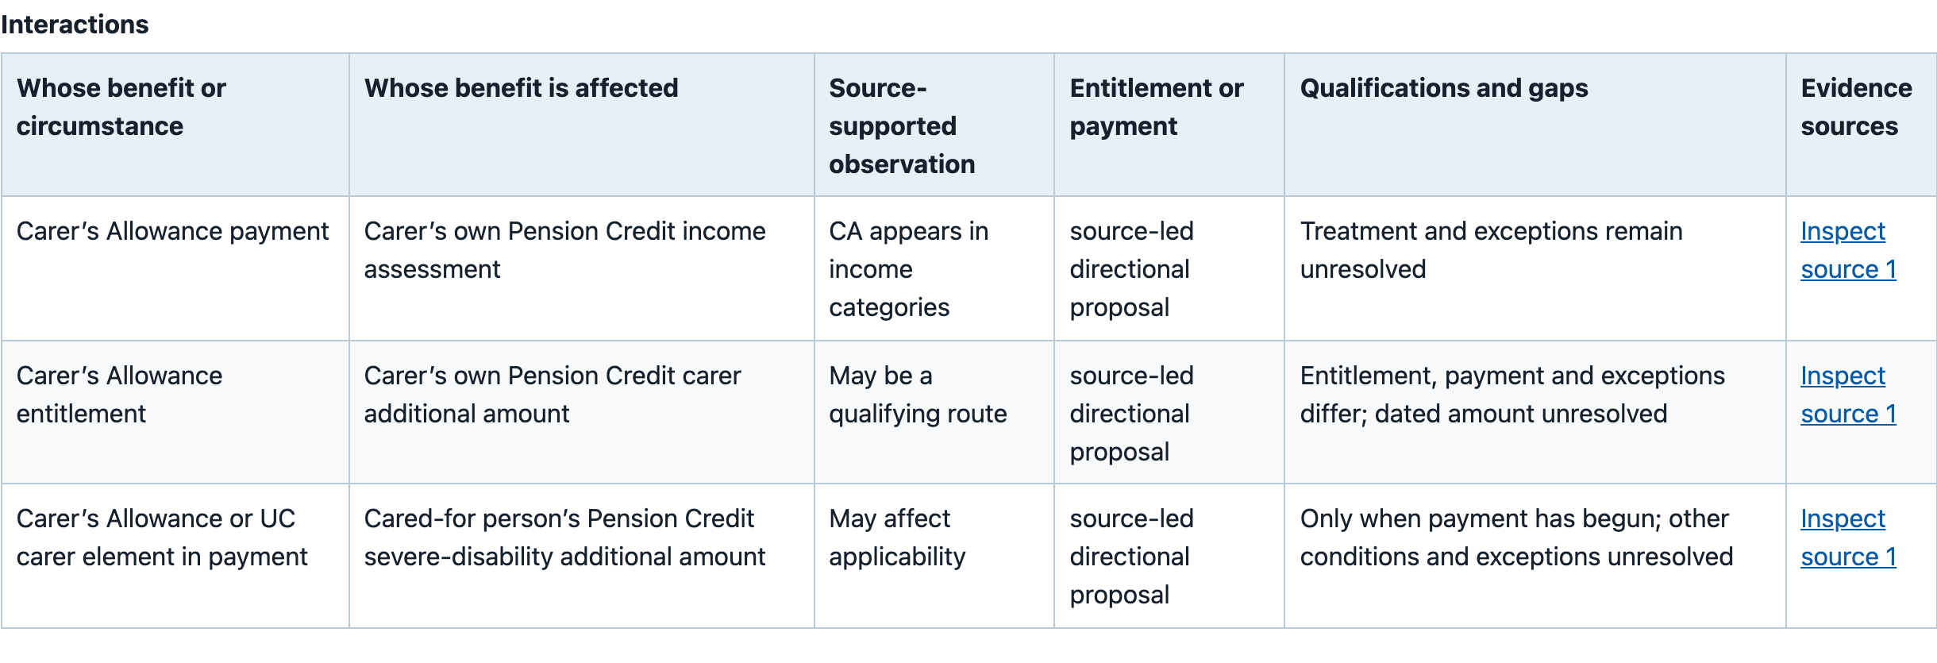
03 / DIRECTION MATTERS
Whose benefit affects whose?
STAFF-039 • SOURCE-LED PROPOSALS • ROWS 1–3 OF 4
Carer → the carer’s own assessment
Carer → the cared-for person’s assessment
S11 • directions and qualifications are visible; unresolved scope and dates remain • not an award decision
Independent experimental demonstration • Public sources
03 / Direction matters
20
Notes:
SLIDE 20: Whose benefit affects whose?
Presenter: Nick
Suggested time: 2 minutes
Ask “whose benefit affects whose?” before reading the details. The table distinguishes the carer’s own income assessment and additional amount from a possible effect on the cared-for person’s severe-disability amount. Entitlement and payment are not interchangeable. These are directional, qualified and unreviewed source-led proposals; they do not form a symmetric interaction rule. We show three of four rows, with unresolved conditions and dates. Do not reverse an arrow or infer an actual change to someone’s award.
CAPTURE EVIDENCE — genuine source pixels, not a new live test
S11-directions: Enlarged native table; partial and unreviewed. Each row retains its direction and unresolved conditions.
Capture: 2026-09-28T22:26:05.825Z; classification: saved package; source-led directional interaction proposals; outcome: captured.
Original: raw/S11.png; original SHA-256: bcddb784e40e57297fa412c9ffaef0bbdf4b919c0c35906b42ab1f85554b59c3.
Crop: {"x":1323,"y":3210,"width":2440,"height":835}.
Source/launch URL: https://chris-page-gov.github.io/okf-explorer/evidence/?manifest=https%3A%2F%2Fraw.githubusercontent.com%2Fchris-page-gov%2Fokf-dwp%2Fd31f16fb7143d04b9de73e14cd493cfb832ae83e%2Fevaluation%2Fevidence-workbench%2Ftools-manifest.json&case=staff-039&record=https%3A%2F%2Fchris-page-gov.github.io%2Fokf-dwp%2Fid%2Funit%2Fdmg%2Fdmg-vol3-ch15%2Fmanual-structure-v1%2Fsource-0000210821-000-cd55afa87a13&tab=interactions
Receipt in supplied pack: receipts/S11.json
S11: Carer and cared-for person are different. These are unreviewed directional proposals with gaps.
Capture: 2026-09-28T22:26:05.825Z; classification: saved package; source-led directional interaction proposals; outcome: captured.
Original: raw/S11.png; original SHA-256: bcddb784e40e57297fa412c9ffaef0bbdf4b919c0c35906b42ab1f85554b59c3.
Crop: {"x":1290,"y":1834,"width":2509,"height":2665}.
Source/launch URL: https://chris-page-gov.github.io/okf-explorer/evidence/?manifest=https%3A%2F%2Fraw.githubusercontent.com%2Fchris-page-gov%2Fokf-dwp%2Fd31f16fb7143d04b9de73e14cd493cfb832ae83e%2Fevaluation%2Fevidence-workbench%2Ftools-manifest.json&case=staff-039&record=https%3A%2F%2Fchris-page-gov.github.io%2Fokf-dwp%2Fid%2Funit%2Fdmg%2Fdmg-vol3-ch15%2Fmanual-structure-v1%2Fsource-0000210821-000-cd55afa87a13&tab=interactions
Receipt in supplied pack: receipts/S11.json
SOURCES
MODEL: Frozen blocked calculation inspection model
https://github.com/chris-page-gov/okf-dwp/blob/77ef16047415ee48dcb93b80adf1ba057ea00d9b/docs/workbench-model-inspection.md
Editable text and shapes. Source screenshots are intentionally images; their content has not been rewritten. Research checks: 29 September 2026. Presentation date: 30 September 2026 (editable).

Slide 29
EVIDENCE BEFORE CONFIDENCE
What is established — and what remains open
Observed or recorded
Not established
Source and occurrence navigation
Complete legal coverage or applicability
Inspectable selection and provenance
Improved decision or answer accuracy
Visible requirements and blocked stages
An operational calculator or universal host support
The fresh sidebar transition failed twice.
Manual inspection remains the main demonstration. The real failure is retained in the appendix.
Capture receipts and release records • all 40 retained workbench packages remain insufficient
Independent experimental demonstration • Public sources
Evidence before confidence
21
Notes:
SLIDE 21: What is established — and what remains open
Presenter: Nick
Suggested time: 2 minutes
Separate evidence coverage, delivery identity, retrieval quality, interpretation and operational safety. The 27 September release records sixteen public browser checks and forty byte-identical replay packages; the screenshot pack does not rerun those checks. All forty packages remain insufficient. Our newest sidebar follow-up failed twice at the developer connection and did not return staff-039 rows. Earlier reported page-tool use is not a retained raw invocation transcript. Voice is untested. These limitations do not erase the useful manual inspection, but they limit the claims.
SOURCES
RELEASE: Frozen DWP reading-help release record, 27 September 2026
https://github.com/chris-page-gov/okf-dwp/blob/77ef16047415ee48dcb93b80adf1ba057ea00d9b/docs/reading-help-release-2026-09-27.md
Source: supplied archive README, captions, receipts/S12.json and the release record. Detailed sidebar evidence is in appendix slide 28.
Editable text and shapes. Source screenshots are intentionally images; their content has not been rewritten. Research checks: 29 September 2026. Presentation date: 30 September 2026 (editable).

Slide 30
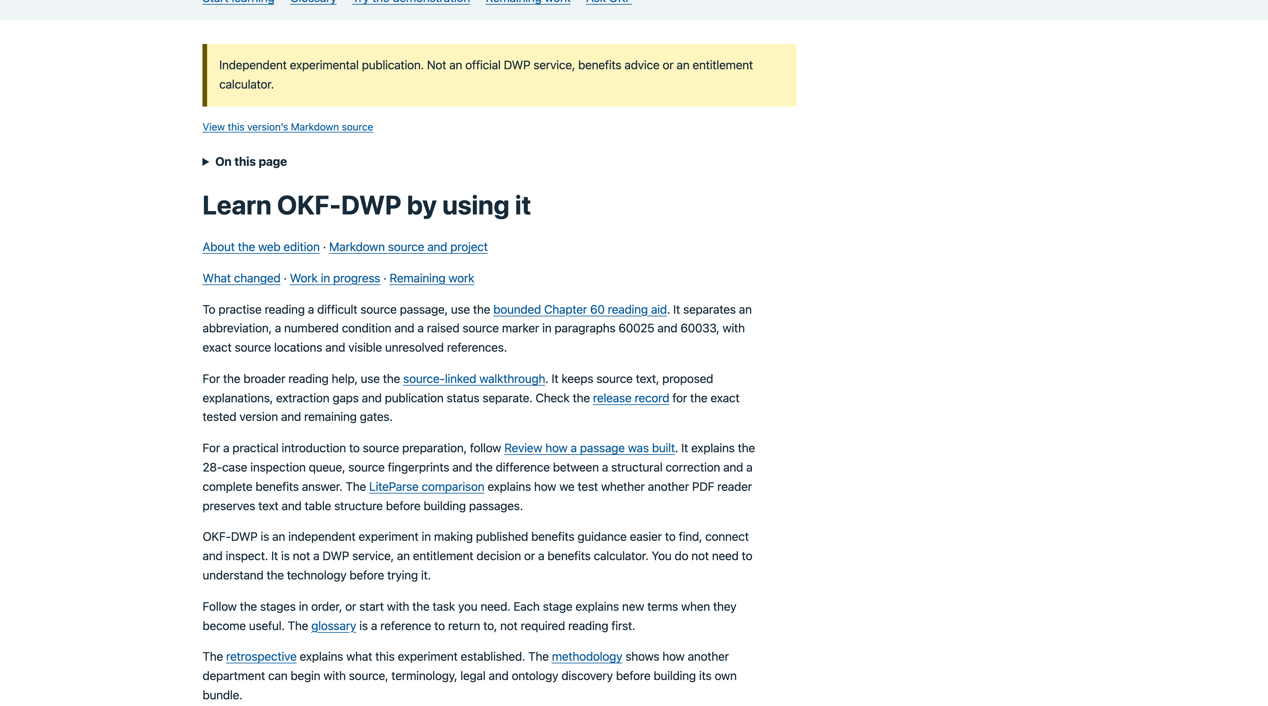
FROM DEMONSTRATION TO INSPECTION
Try the public learning route
Read → investigate → challenge
Open the learning guide
Independent experimental publication. Not benefits advice or an entitlement calculator.
S16 • public page captured in the supplied run • QR opens the same learning route
Independent experimental demonstration • Public sources
From demonstration to inspection
22
Notes:
SLIDE 22: Try the public learning route
Presenter: Nick
Suggested time: 2 minutes
Offer one clear next step: open the learning route and inspect a passage, the evidence selected for a question and an unresolved requirement. The page was successfully captured in the supplied run; the link is not a promise of real-time health. The QR code encodes this exact public URL and is also clickable. Close with the central claim: we can make evidence and system behaviour more inspectable while keeping professional judgement and accountability visible. Do not present this as an official DWP service.
CAPTURE EVIDENCE — genuine source pixels, not a new live test
S16: Independent experiment, not an official DWP service or entitlement calculator.
Capture: 2026-09-28T22:26:06.846Z; classification: fresh capture of public learning entry point; outcome: captured.
Original: raw/S16.png; original SHA-256: 822b544b4ca10a10cd350cb49a43e19c33f6e204aded925a4ce23cc6db3c7269.
Crop: {"x":16,"y":156,"width":3808,"height":2120}.
Source/launch URL: https://chris-page-gov.github.io/okf-dwp/docs/learning-path.html
Receipt in supplied pack: receipts/S16.json
SOURCES
DEMO: Public learning route
https://chris-page-gov.github.io/okf-dwp/docs/learning-path.html
Editable text and shapes. Source screenshots are intentionally images; their content has not been rewritten. Research checks: 29 September 2026. Presentation date: 30 September 2026 (editable).

Slide 31
DISCUSSION / 10 MINUTES
Questions ?
Chris Page
Supporting
Nick Briggs
DCMS (BDUK) + Warwickshire CC
Lead Technical Architect (Citizen Information)
AI Research Engineer
chris.page@bduk.gov.uk
Department for Work and Pensions (DWP)
uk.linkedin.com/in/covpages
Email
nick.briggs@engineering.digital.dwp.gov.uk
Independent experimental demonstration • Public sources
Discussion / 10 minutes
23
Notes:
SLIDE 23: Questions — what would you need to trust the next step?
Presenter: Nick leads questions; Chris supports technical detail
Suggested time: 10 minutes
Use this contact slide during discussion. Ask the audience what evidence they would need before a next-stage trial: coverage, exception handling, independent source review, reproducibility or a tested host interaction. Nick remains the lead presenter. Chris’s exact supplied affiliation and role are preserved, with the BDUK email. Phone numbers and office address are intentionally omitted. LinkedIn URLs and all contact lines are editable text and hyperlinks; the QR modules are native editable PowerPoint shapes.
SOURCES
CHRIS: Chris Page on LinkedIn
https://uk.linkedin.com/in/covpages
NICK: Nick Briggs on LinkedIn
https://www.linkedin.com/in/nickbriggsuk/
Nick’s title and email: explicitly supplied by the user. Chris’s display line and email: confirmed in the final brief. Chris’s LinkedIn URL was recovered from prior supplied context and checked via public search on 29 September 2026: https://uk.linkedin.com/in/covpages . No guessed contact information is used.
Editable text and shapes. Source screenshots are intentionally images; their content has not been rewritten. Research checks: 29 September 2026. Presentation date: 30 September 2026 (editable).

Slide 32
APPENDIX / BENCHMARK DETAIL
ARC: keep dataset, configuration and cost together
Date
Evaluation
Score
Qualification
Sep 2024
GPT-4o baseline
5%
ARC-AGI-1 semi-private;
public score was 9%.
Dec 2024
o3-preview / lower compute
75.7%
ARC-AGI-1 semi-private.
Dec 2024
o3-preview / higher compute
87.5%
About 172× the compute.
24 Mar 2025
ARC-AGI-2 launched
New benchmark
Known design weaknesses
were addressed; not an o3 reaction only.
25 Mar 2026
ARC-AGI-3 launched
New score design
Interactive tasks; completion
and action efficiency.
Cost qualification
The later repricing gives $4,560 per task / $456,000 for the 100-task high-compute run.
These are retrospective inference estimates, not a verified December 2024 invoice.
Primary sources checked 29 September 2026 • no cross-generation “intelligence percentage”
Independent experimental demonstration • Public sources
Appendix / Benchmark detail
24
Notes:
SLIDE 24: ARC: keep dataset, configuration and cost together
Presenter: Nick leads; Chris supports the demonstration
Suggested time: Appendix — on request
Use only for benchmark questions. ARC Prize’s o3 page was repriced on 10 December 2025; older official estimates therefore differ. The preview was not the subsequently released production o3. ARC-AGI-2 was discussed publicly on 6 December 2024, before the o3 announcement. The generations address different test designs, so avoid one continuous percentage chart. Source footnotes and the date/configuration labels are part of the claim.
SOURCES
O1: ARC Prize: OpenAI o1 results, 13 September 2024
https://arcprize.org/blog/openai-o1-results-arc-prize
O3: ARC Prize: o3-preview, 20 December 2024; costs repriced 10 December 2025
https://arcprize.org/blog/oai-o3-pub-breakthrough
ARC2: ARC Prize: ARC-AGI-2 launch, 24 March 2025
https://arcprize.org/blog/announcing-arc-agi-2-and-arc-prize-2025
ARC3: ARC Prize: ARC-AGI-3 launch, 25 March 2026
https://arcprize.org/blog/arc-agi-3-launch
PRE2: ARC Prize: 2024 winners and technical report, 6 December 2024
https://arcprize.org/blog/arc-prize-2024-winners-technical-report
Editable text and shapes. Source screenshots are intentionally images; their content has not been rewritten. Research checks: 29 September 2026. Presentation date: 30 September 2026 (editable).

Slide 33
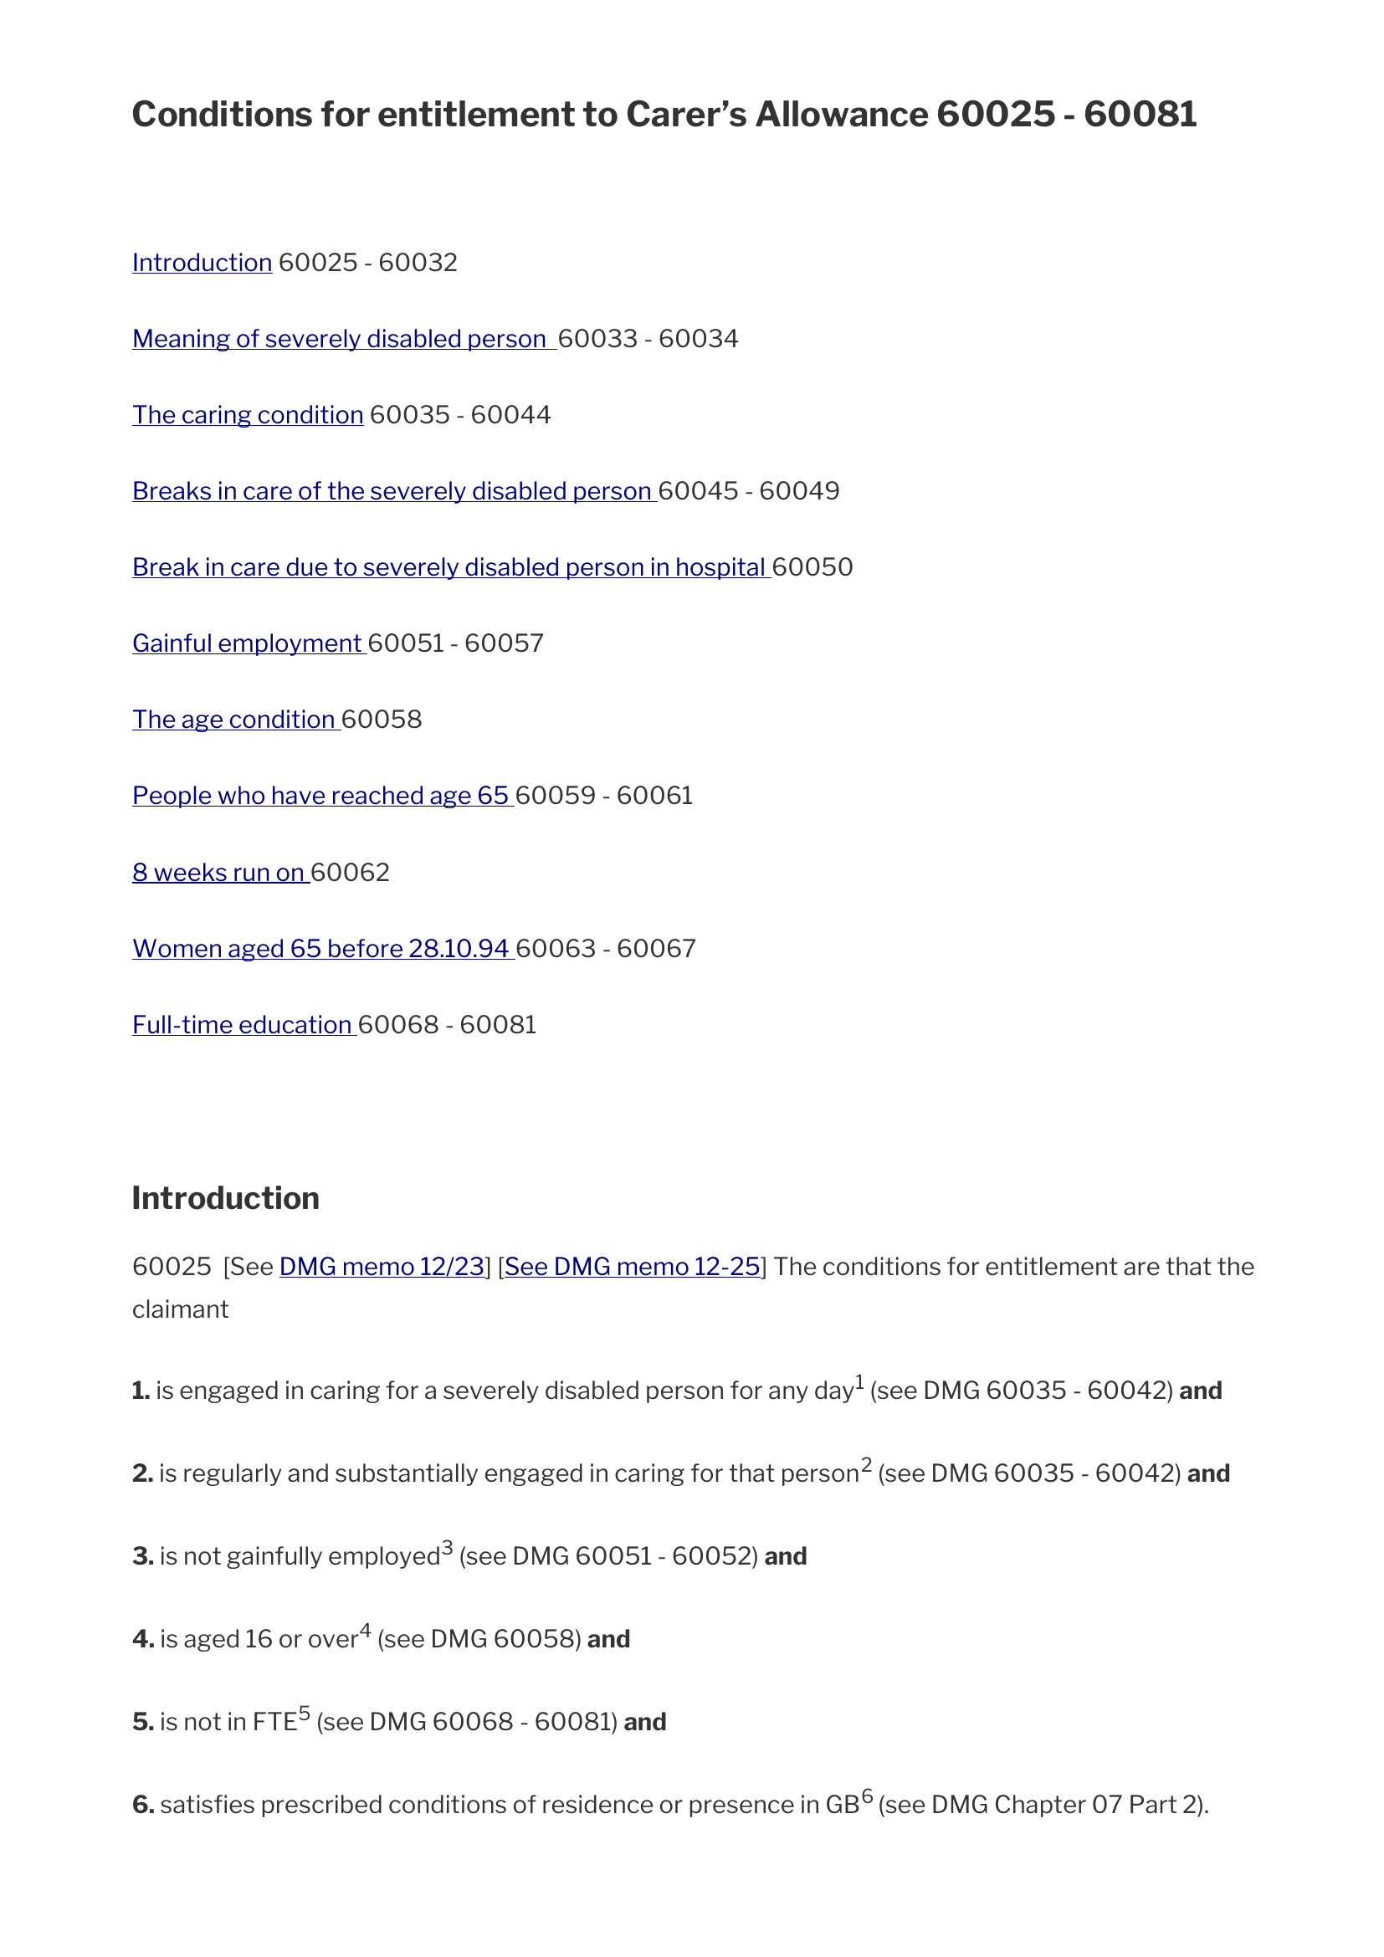
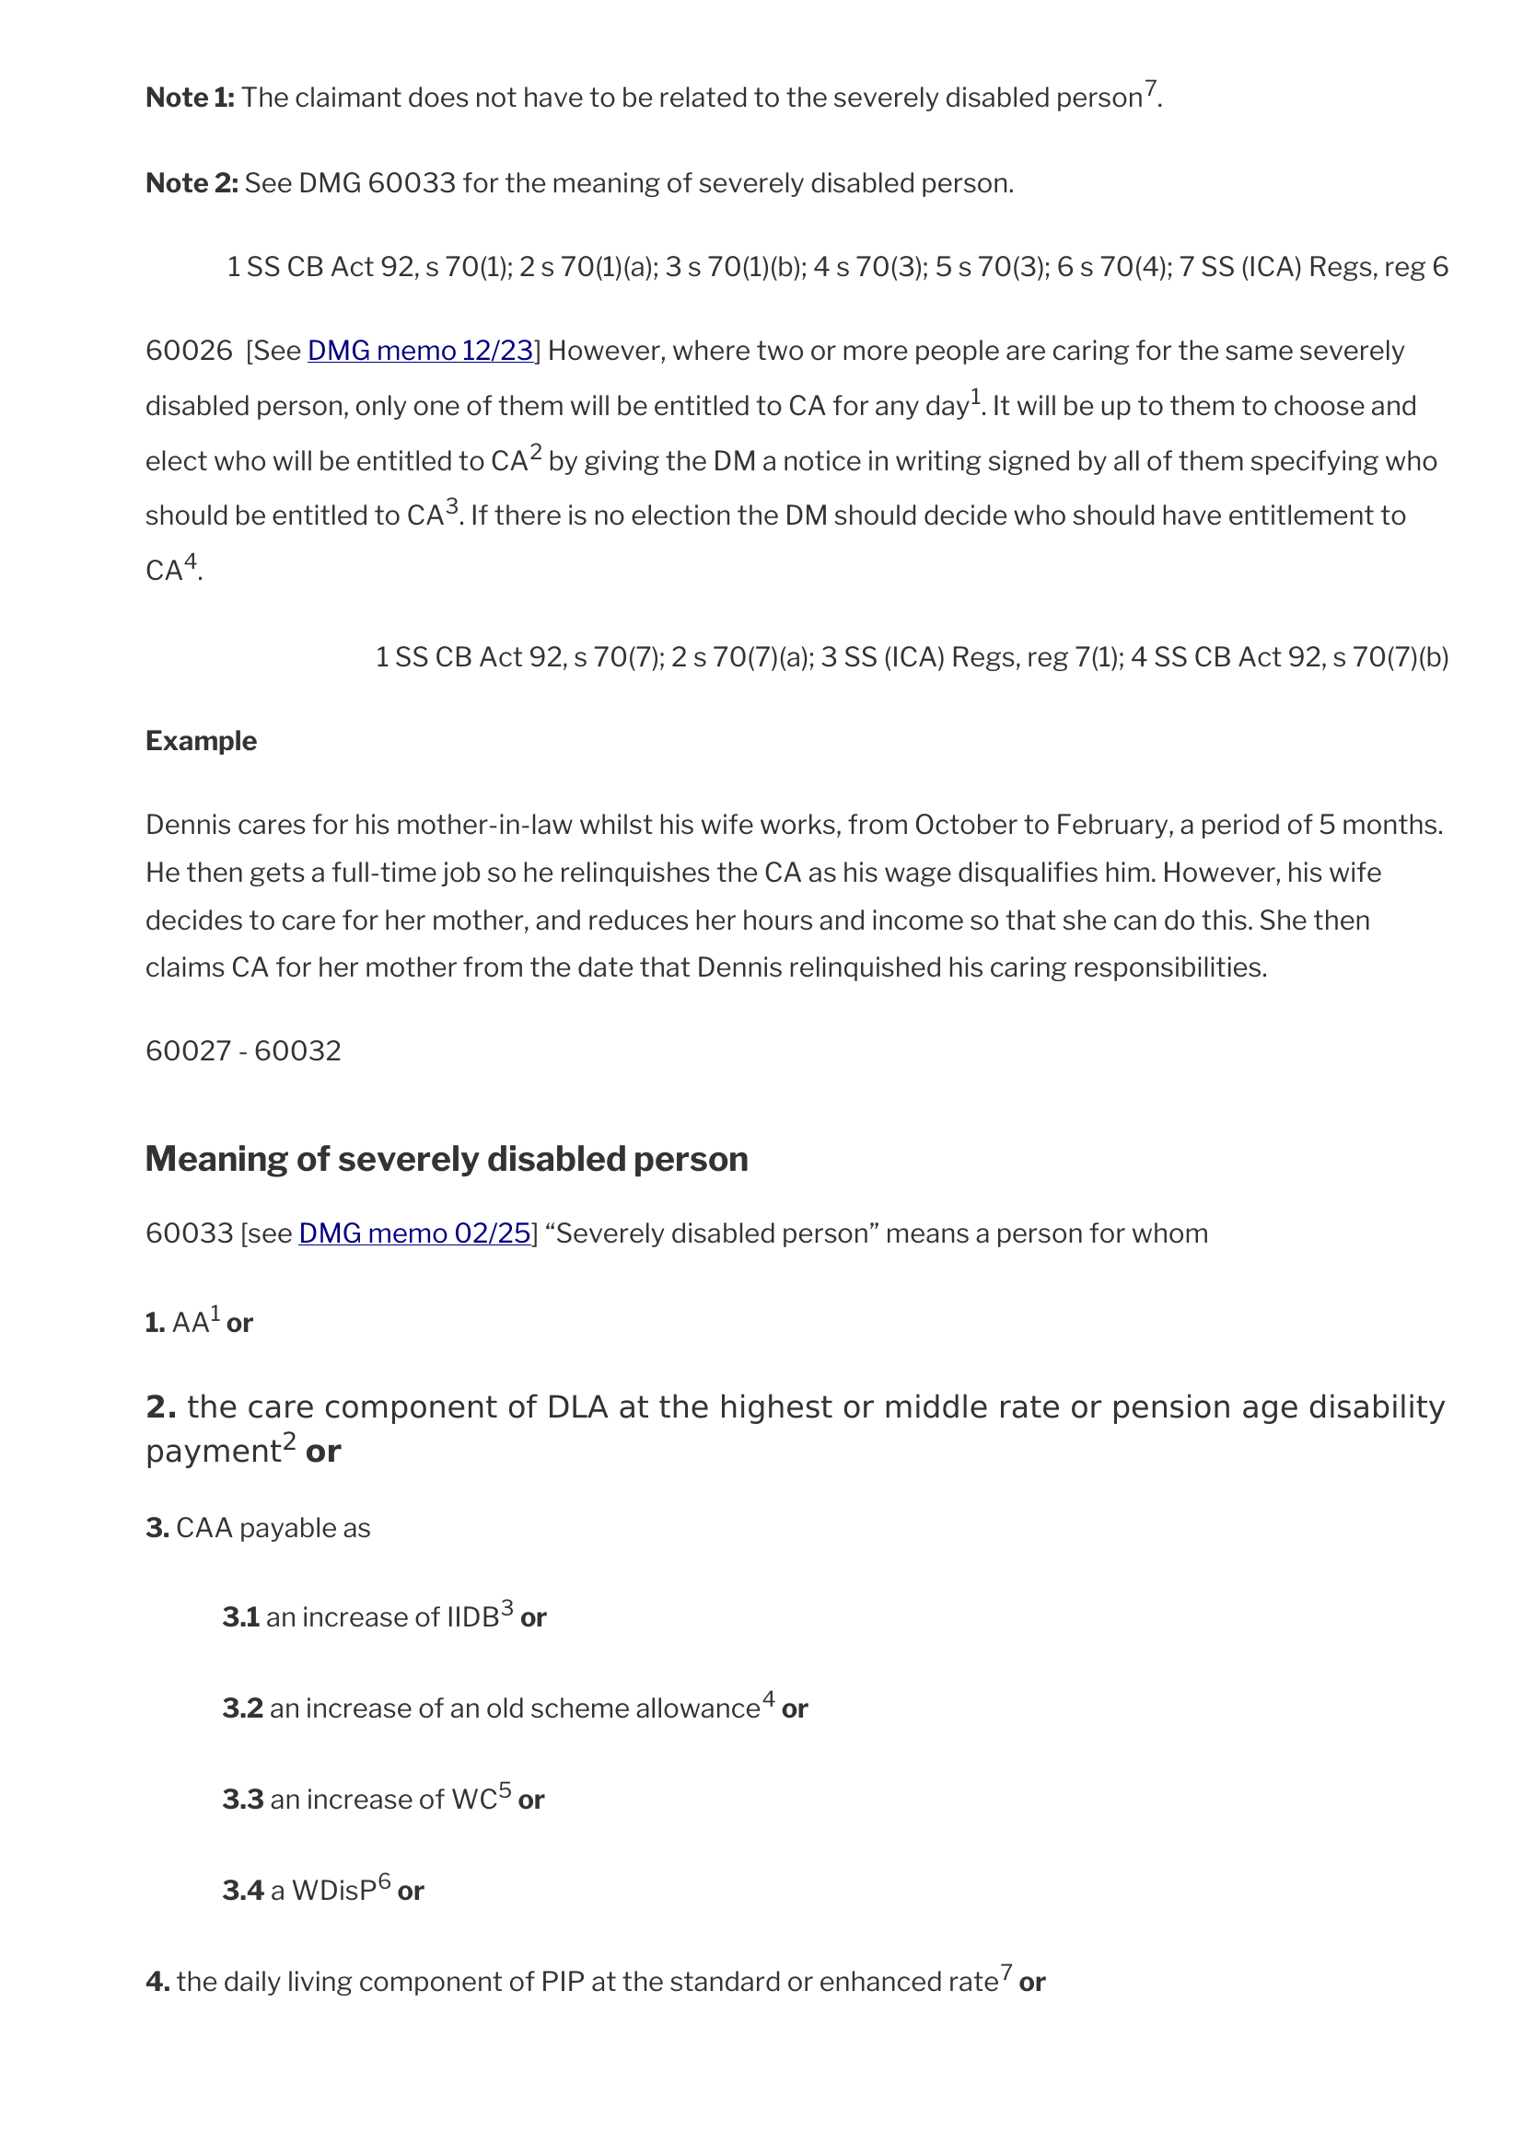
APPENDIX / ORIGINAL PDF PAGES
Retained source context: DMG 60025
S01 • PDF pages 3 and 4 • full-page context for the enlarged passages on slides 10–12
Independent experimental demonstration • Public sources
Appendix / Original PDF pages
25
Notes:
SLIDE 25: Retained source context: DMG 60025
Presenter: Nick leads; Chris supports the demonstration
Suggested time: Appendix — on request
These full-page images are for source context, not for reading every line from the room. Return to slides 10–12 for enlarged details. The original PDF bytes and hash were preserved in the capture process. The links can be used to inspect the corresponding published source, but a current web response is a separate observation.
CAPTURE EVIDENCE — genuine source pixels, not a new live test
S01-p3: Original source typography, conditions and notes — before reading assistance.
Capture: 2026-09-28T22:24:54.956Z; classification: human inspection of retained original PDF; outcome: captured.
Original: raw/S01-p3.png; original SHA-256: fc6fa8017e8fda02db464002d03418f1d93e1a377e8a847f4cca955c3a3c90af.
Crop: {"x":0,"y":0,"width":1654,"height":2339}.
Source/launch URL: https://assets.publishing.service.gov.uk/media/69e0fdcbb5e95ca5017ed9da/dmg-Chap-60.pdf#page=3
Receipt in supplied pack: receipts/S01.json
S01-p4: Original source typography, conditions and notes — before reading assistance.
Capture: 2026-09-28T22:24:55.280Z; classification: human inspection of retained original PDF; outcome: captured.
Original: raw/S01-p4.png; original SHA-256: a33f7d83d5f013d26f18e3597ce99b7eecb9d807c69be5ce6b7fc50d370eeb05.
Crop: {"x":0,"y":0,"width":1654,"height":2339}.
Source/launch URL: https://assets.publishing.service.gov.uk/media/69e0fdcbb5e95ca5017ed9da/dmg-Chap-60.pdf#page=4
Receipt in supplied pack: receipts/S01.json
Editable text and shapes. Source screenshots are intentionally images; their content has not been rewritten. Research checks: 29 September 2026. Presentation date: 30 September 2026 (editable).

Slide 34
APPENDIX / EVIDENCE IDENTITIES
Fresh assembly and saved inspection are different packages
Fresh S07 capital assembly
Saved S08–S09 staff-006
44 records / 68 relationships
30 records / 47 relationships
522,995 bytes used
516,227 bytes used
U07 and DMG 84861 selected
DMG 84001 fallback inspected
Insufficient and truncated
Insufficient and truncated
S07 requested: 64 records • 128 relationships • depth 6 • 524,288 bytes.
A 32,768-byte delivery part is not the whole-package budget.
Supplied capture pack README, fresh JSON and saved manifest-bound package
Independent experimental demonstration • Public sources
Appendix / Evidence identities
26
Notes:
SLIDE 26: Fresh assembly and saved inspection are different packages
Presenter: Nick leads; Chris supports the demonstration
Suggested time: Appendix — on request
This comparison is about package identity, not which result is more correct. Fresh S07 was assembled during the capture run and is not byte-identical to the saved staff-006 package. The workbench fallback was explicitly selected because the saved manifest lacked the desired U07/84861 route. The 32 KiB transport part is separate from the 512 KiB assembly budget. Technical delivery cannot recover source text that retrieval never selected.
CAPTURE EVIDENCE — genuine source pixels, not a new live test
S07c-r1: 32,768-byte delivery parts are separate from the 524,288-byte assembly budget.
Capture: 2026-09-28T22:30:02.036Z; classification: fresh deterministic evidence assembly; no AI answer; outcome: captured.
Original: raw/S07c-r1.png; original SHA-256: 1d4e01f6c7a324a3d813aef9e164d2d4a9682d1e6415e66e0d026d80bdacdf9d.
Crop: {"x":1082,"y":635,"width":2227,"height":1400}.
Source/launch URL: https://chris-page-gov.github.io/okf-explorer/explore/?bundle=https%3A%2F%2Fraw.githubusercontent.com%2Fchris-page-gov%2Fokf-dwp%2F7eeded763042ddd0070f4fed834c6074149e8e2f%2Fstructured-context%2Fevidence-connect-explorer.json#overview
Receipt in supplied pack: receipts/S07.json
S08a: Saved capital-related package; U07/84861 absent here. This is not the fresh S07 result.
Capture: 2026-09-28T22:25:23.899Z; classification: inspection of saved package, not S07 fresh assembly; outcome: fallback.
Original: raw/S08a.png; original SHA-256: 6144bd9ddcb88b1eafd085f169a6a4eaa84179eeceddf86fbb663335bf400747.
Crop: {"x":1290,"y":1772,"width":2509,"height":1556}.
Source/launch URL: https://chris-page-gov.github.io/okf-explorer/evidence/?manifest=https%3A%2F%2Fraw.githubusercontent.com%2Fchris-page-gov%2Fokf-dwp%2Fd31f16fb7143d04b9de73e14cd493cfb832ae83e%2Fevaluation%2Fevidence-workbench%2Ftools-manifest.json&case=staff-006&record=https%3A%2F%2Fchris-page-gov.github.io%2Fokf-dwp%2Fid%2Funit%2Fdmg%2Fdmg-vol14-ch84%2Fmanual-structure-v1%2Fsource-0000001157-000-d863e5f8aafb&tab=passage
Receipt in supplied pack: receipts/S08.json
Editable text and shapes. Source screenshots are intentionally images; their content has not been rewritten. Research checks: 29 September 2026. Presentation date: 30 September 2026 (editable).

Slide 35
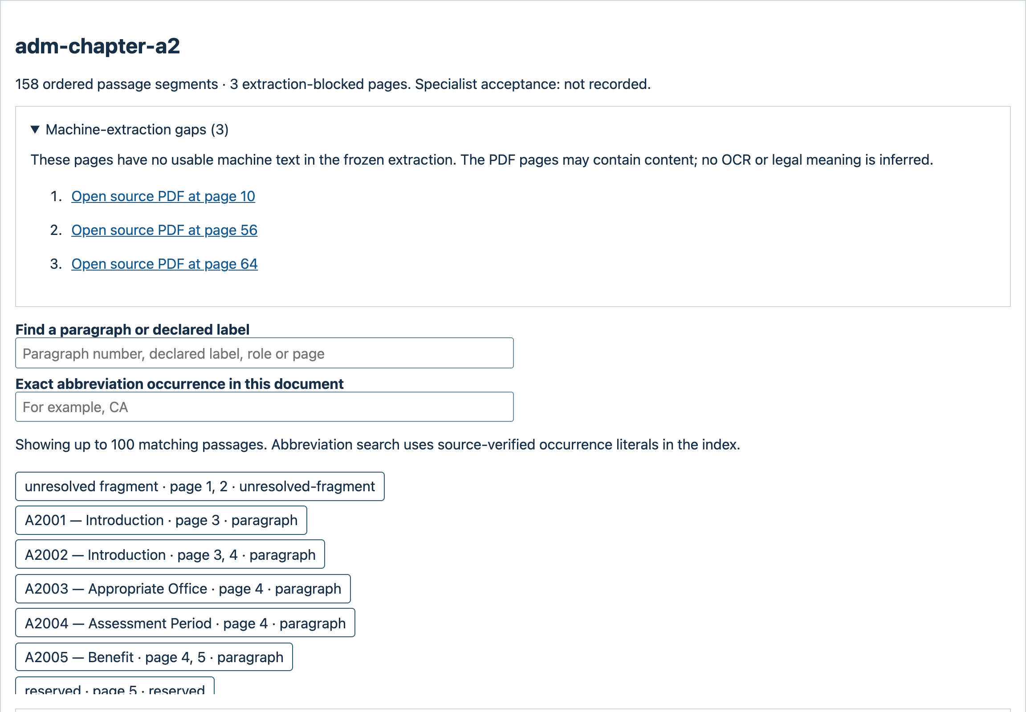
APPENDIX / COVERAGE LIMITS
An extraction gap must remain a visible gap
ADM A2, page 10
No usable extracted text is not proof that the PDF page is blank.
Processing coverage
is not complete
explanation or review.
S04 • actual recorded extraction gap • 893 such pages in the adopted corpus ledger
Independent experimental demonstration • Public sources
Appendix / Coverage limits
27
Notes:
SLIDE 27: An extraction gap must remain a visible gap
Presenter: Nick leads; Chris supports the demonstration
Suggested time: Appendix — on request
Use this reserve when discussing completeness. The page has a recorded lack of usable extraction, not a blank-page finding. Do not infer what was on the page from a missing text record. Source fidelity and extraction quality require their own checks; neither the number of documents processed nor the presence of a hash makes the text complete.
CAPTURE EVIDENCE — genuine source pixels, not a new live test
S04: No usable extracted text is not proof that the original page is blank.
Capture: 2026-09-28T22:26:08.409Z; classification: actual machine-extraction gap; outcome: captured.
Original: raw/S04.png; original SHA-256: 1eb23d92d5fdaaedfea8ce5c241846d962a93982ee80528c598e92889718bd32.
Crop: {"x":768,"y":1424,"width":2304,"height":1600}.
Source/launch URL: https://chris-page-gov.github.io/okf-explorer/reading-help/corpus/?catalogue=https%3A%2F%2Fraw.githubusercontent.com%2Fchris-page-gov%2Fokf-dwp%2Fcbada7bf544106bdceb2445fc379c8b3e5b73ee4%2Freading-help-corpus%2Fmanifest.json&catalogue_sha256=6c53b659b519aa4cbf7529e7e10eb4ad3bfe8efcac18055ec2a5ade724998b46&catalogue_bytes=260797&family=adm&document=adm-chapter-a2
Receipt in supplied pack: receipts/S04.json
SOURCES
RELEASE: Frozen DWP reading-help release record, 27 September 2026
https://github.com/chris-page-gov/okf-dwp/blob/77ef16047415ee48dcb93b80adf1ba057ea00d9b/docs/reading-help-release-2026-09-27.md
Editable text and shapes. Source screenshots are intentionally images; their content has not been rewritten. Research checks: 29 September 2026. Presentation date: 30 September 2026 (editable).

Slide 36
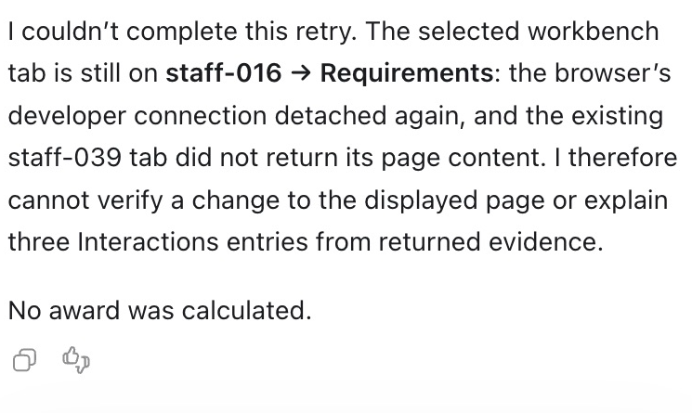
APPENDIX / GENUINE NEGATIVE EVIDENCE
The sidebar boundary: preserve the failed transition
REQUESTED STAFF-016 → STAFF-039 TRANSITION NOT ESTABLISHED
What was observed
Two follow-ups failed to attach. No returned staff-039 rows; Requirements stayed displayed.
Earlier tool use was reported,
not retained as a raw transcript.
Manual inspection is separate.
Voice was not tested.
S12 • real native-window capture, privacy-redacted • no successful interaction was fabricated
Independent experimental demonstration • Public sources
Appendix / Genuine negative evidence
28
Notes:
SLIDE 28: The sidebar boundary: preserve the failed transition
Presenter: Nick leads; Chris supports the demonstration
Suggested time: Appendix — on request
The newer observation is a failed follow-up, not a success. The owner-approved public-origin access cleared the screenshot controller’s gate, but the sidebar’s developer connection failed twice. Requirements remained displayed and no staff-039 rows returned. An earlier response reports CDP page-tool use; its raw invocation transcript is not retained here. Native registration, CDP access, dedicated WebMCP discovery and actual host invocation are different observations. Do not assert that a single browser setting resolves every failure. All visible privacy redactions were already in the supplied master; no private browser bytes are included.
CAPTURE EVIDENCE — genuine source pixels, not a new live test
S12-failure-2: Real sidebar excerpt: requested transition unverified, no returned Interactions entries, no award calculated.
Capture: 2026-09-28T23:59:14.556Z; classification: real sidebar before/failure evidence; requested tool-led transition blocked; outcome: blocked.
Original: raw/S12-follow-up-2-failure-privacy-redacted.png; original SHA-256: add15d1112f18153826d8e771ef0868129e9e834fb4e44b5250c671f38cc0401.
Crop: {"x":2260,"y":1190,"width":745,"height":445}.
Source/launch URL: https://chris-page-gov.github.io/okf-explorer/evidence/?manifest=https%3A%2F%2Fraw.githubusercontent.com%2Fchris-page-gov%2Fokf-dwp%2Fd31f16fb7143d04b9de73e14cd493cfb832ae83e%2Fevaluation%2Fevidence-workbench%2Ftools-manifest.json&case=staff-016&record=https%3A%2F%2Fchris-page-gov.github.io%2Fokf-dwp%2Fid%2Fstaff-domain%2Fcalculation&tab=requirements
Receipt in supplied pack: receipts/S12.json
S12-before-qualifications: Actual Requirements and real sidebar: rows 1–3 of 6, dates unknown, retained projection, insufficient. Not legal assurance.
Capture: 2026-09-28T23:50:26.395Z; classification: real sidebar before/failure evidence; requested tool-led transition blocked; outcome: blocked.
Original: raw/S12-before-qualifications-privacy-redacted.png; original SHA-256: f1c13dcdf95f108e45d2b07ab859737cf4a013ef04d4fb57113e2e7c3084ce12.
Crop: {"x":1428,"y":321,"width":1596,"height":1355}.
Source/launch URL: https://chris-page-gov.github.io/okf-explorer/evidence/?manifest=https%3A%2F%2Fraw.githubusercontent.com%2Fchris-page-gov%2Fokf-dwp%2Fd31f16fb7143d04b9de73e14cd493cfb832ae83e%2Fevaluation%2Fevidence-workbench%2Ftools-manifest.json&case=staff-016&record=https%3A%2F%2Fchris-page-gov.github.io%2Fokf-dwp%2Fid%2Fstaff-domain%2Fcalculation&tab=requirements
Receipt in supplied pack: receipts/S12.json
Editable text and shapes. Source screenshots are intentionally images; their content has not been rewritten. Research checks: 29 September 2026. Presentation date: 30 September 2026 (editable).

Slide 37
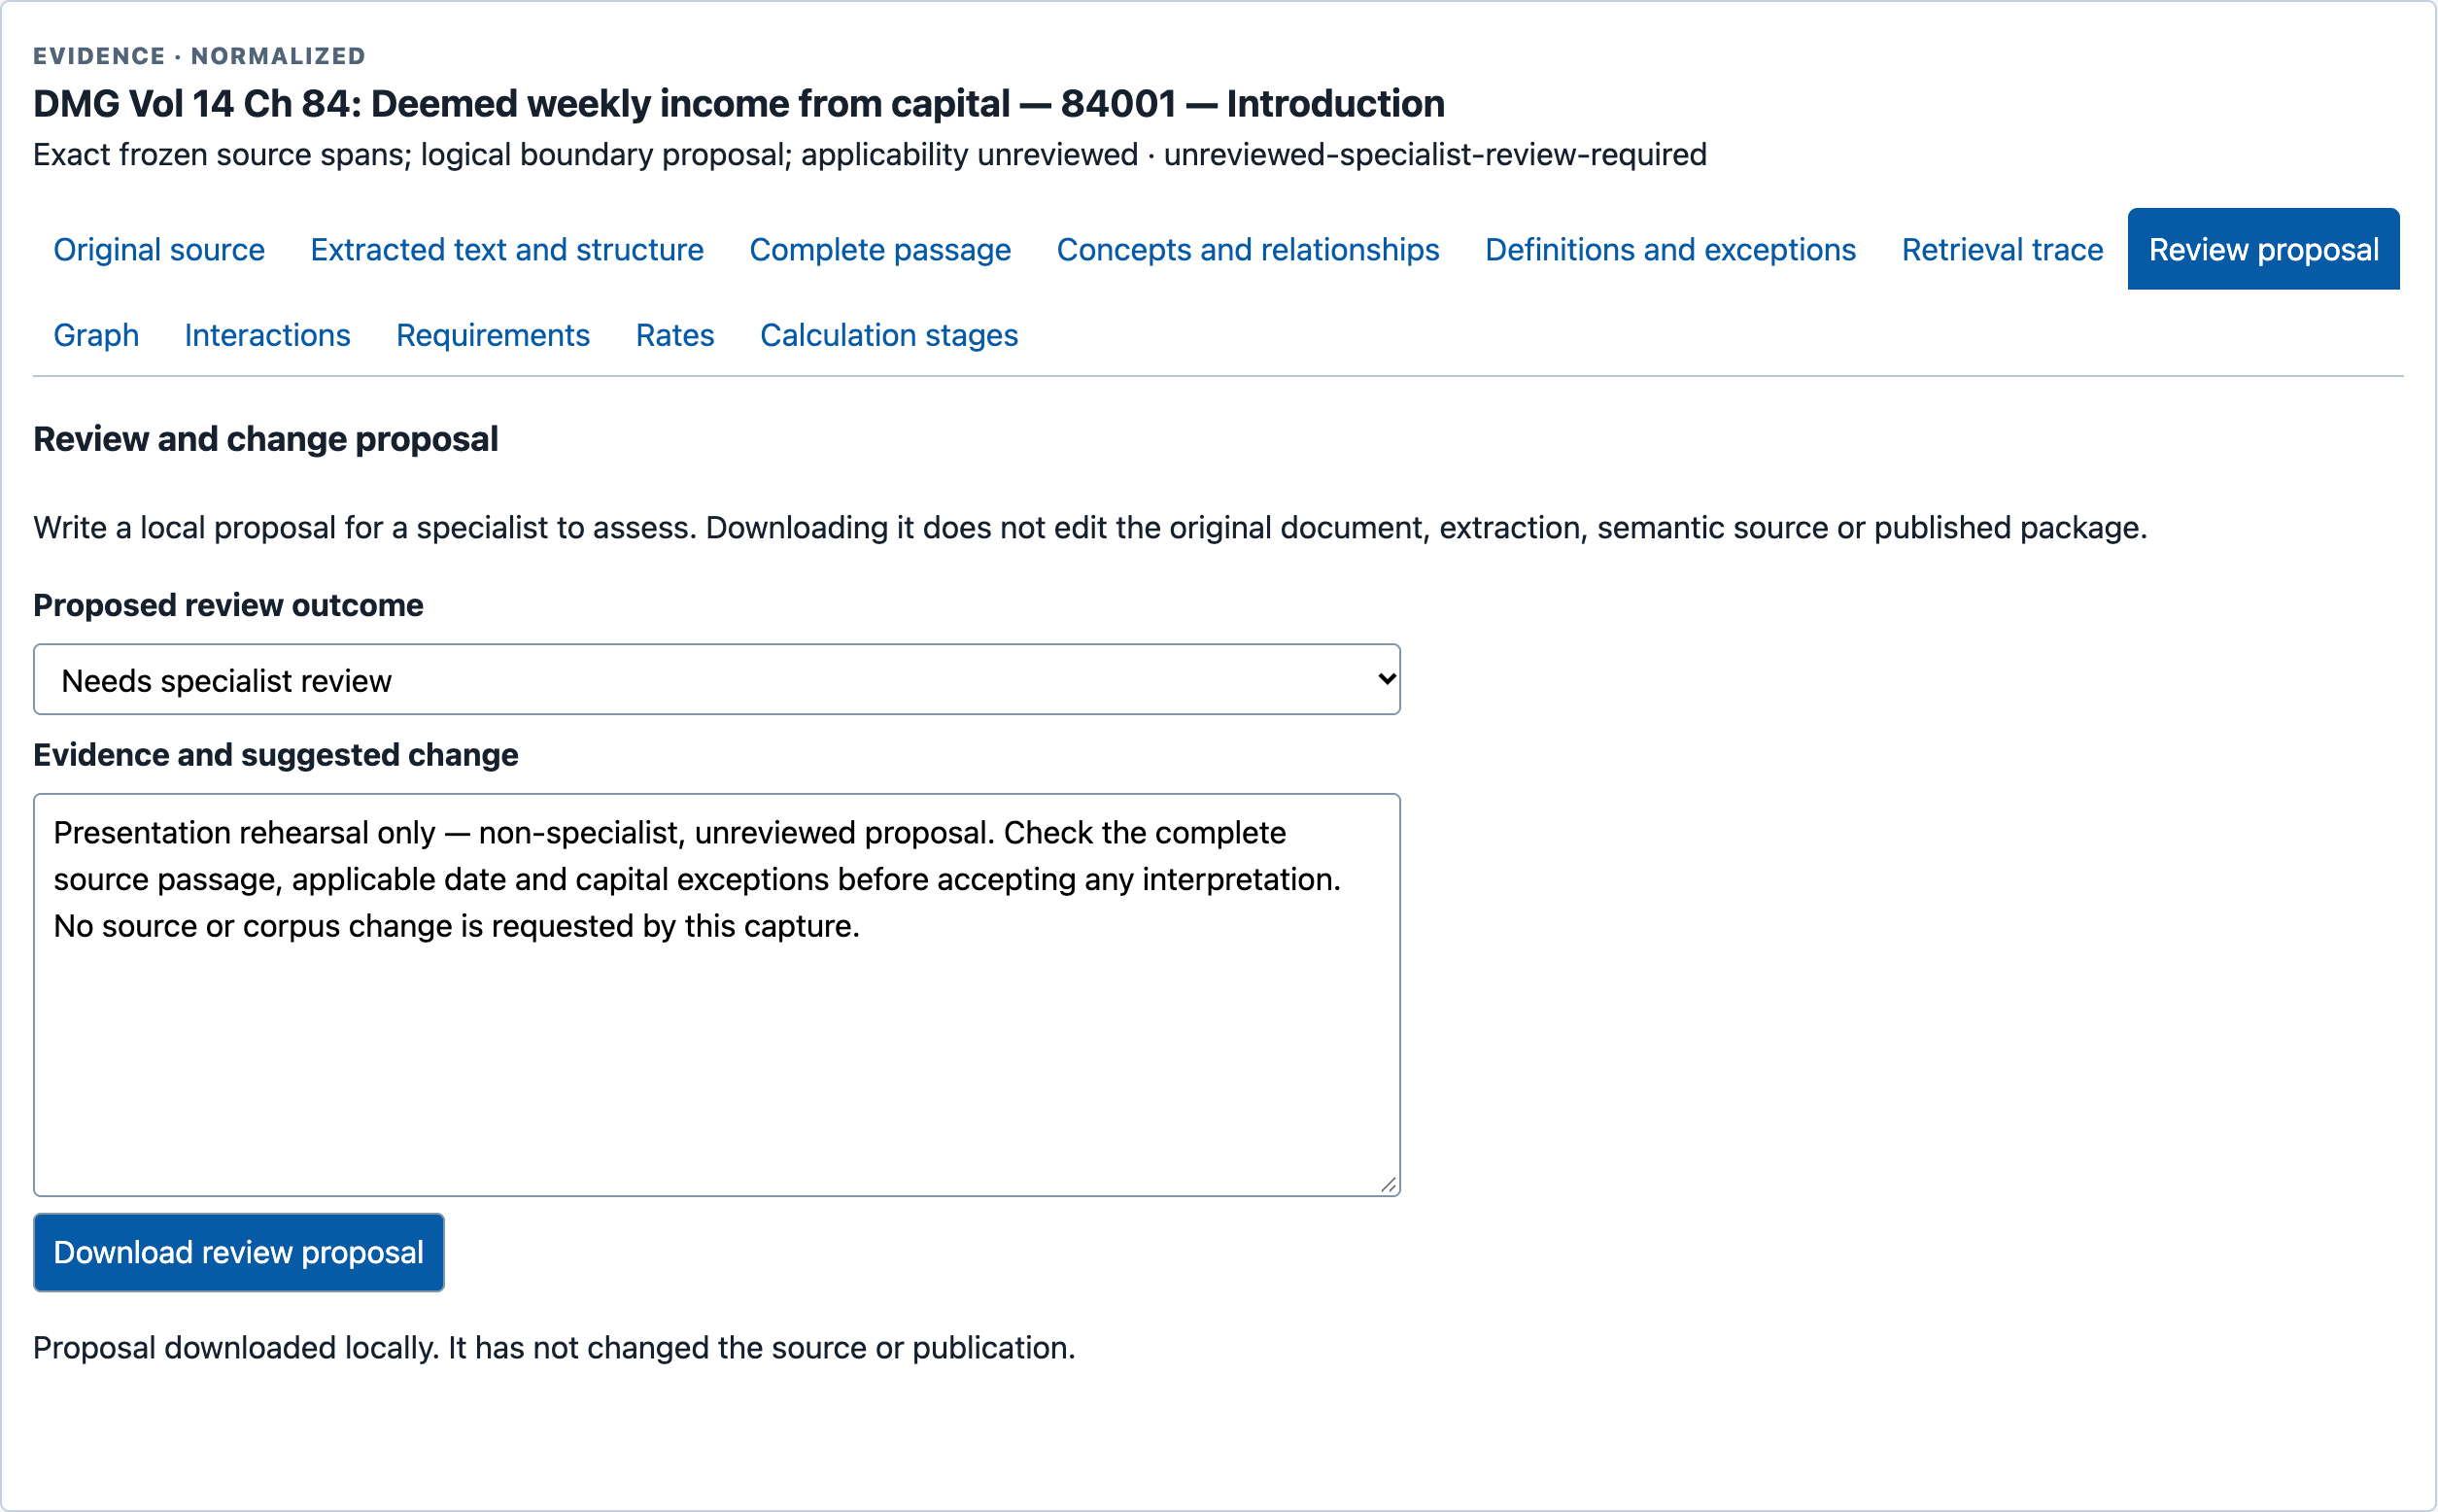
APPENDIX / REVIEW AND FEEDBACK
A local review proposal is not specialist acceptance
Actually exported
A local, non-specialist rehearsal proposal was downloaded.
Unreviewed.
Not adopted.
Not published.
S13 • review-exports/ contains the actual JSON • no repository publication or entitlement decision
Independent experimental demonstration • Public sources
Appendix / Review and feedback
29
Notes:
SLIDE 29: A local review proposal is not specialist acceptance
Presenter: Nick leads; Chris supports the demonstration
Suggested time: Appendix — on request
A review workflow needs somewhere to put suggested changes without silently changing the authoritative source or promoting a proposal to approval. This local export was actually created in the capture run and is marked a non-specialist rehearsal. Nothing was adopted or published. The JSON is in the source screenshot pack; the deck is not a new review decision.
CAPTURE EVIDENCE — genuine source pixels, not a new live test
S13-r1: A rehearsal proposal was exported locally. Nothing was adopted or published.
Capture: 2026-09-28T22:30:03.475Z; classification: inspection of saved package, not S07 fresh assembly; outcome: captured.
Original: raw/S13-r1.png; original SHA-256: 48eb00225865b7c8726dfdec26b29dce2dc0b193b136c3ec97c17f0361729cd8.
Crop: {"x":1290,"y":1772,"width":2509,"height":1556}.
Source/launch URL: https://chris-page-gov.github.io/okf-explorer/evidence/?manifest=https%3A%2F%2Fraw.githubusercontent.com%2Fchris-page-gov%2Fokf-dwp%2Fd31f16fb7143d04b9de73e14cd493cfb832ae83e%2Fevaluation%2Fevidence-workbench%2Ftools-manifest.json&case=staff-006&record=https%3A%2F%2Fchris-page-gov.github.io%2Fokf-dwp%2Fid%2Funit%2Fdmg%2Fdmg-vol14-ch84%2Fmanual-structure-v1%2Fsource-0000001157-000-d863e5f8aafb&tab=review
Receipt in supplied pack: receipts/S13.json
Editable text and shapes. Source screenshots are intentionally images; their content has not been rewritten. Research checks: 29 September 2026. Presentation date: 30 September 2026 (editable).

Slide 38
APPENDIX / EVALUATION SCOPE
The reported checks measure technical properties
16
40 / 40
40
recorded public
browser checks
unchanged retained
package replays
packages still
insufficient
Delivery identity, navigation and non-regression
Not a new measurement of legal correctness, answer accuracy or improved decisions.
The capture shows the historical 27 September report; those checks were not rerun for the slide.
S15 / frozen release record • separate technical and specialist-review gates
Independent experimental demonstration • Public sources
Appendix / Evaluation scope
30
Notes:
SLIDE 30: The reported checks measure technical properties
Presenter: Nick leads; Chris supports the demonstration
Suggested time: Appendix — on request
The figures are the results reported by the release record. They are not fresh browser tests performed during deck assembly. The equal-budget replays preserved all forty packages, which remained insufficient. The claims are technical non-regression and delivery/navigation checks, not answer-quality gains. Earlier failures and unresolved source-review cases remain part of the underlying release evidence. A freshly captured screenshot of a report does not turn the report’s tests into new tests.
CAPTURE EVIDENCE — genuine source pixels, not a new live test
S15a-r1: Dated delivery/navigation/non-regression evidence; not measured improvement in answer accuracy.
Capture: 2026-09-28T22:30:04.949Z; classification: fresh capture of historical release report; outcome: captured.
Original: raw/S15a-r1.png; original SHA-256: 9363036db252e7910e8b02cb86cfb309b0370694ff6ead8a5525393ec765beb8.
Crop: {"x":1229,"y":772,"width":2024,"height":2000}.
Source/launch URL: https://github.com/chris-page-gov/okf-dwp/blob/77ef16047415ee48dcb93b80adf1ba057ea00d9b/docs/reading-help-release-2026-09-27.md
Receipt in supplied pack: receipts/S15.json
S15b-r1: 40/40 identical retained packages; all insufficient. Zero new answer-model calls for that increment.
Capture: 2026-09-28T22:30:05.504Z; classification: fresh capture of historical release report; outcome: captured.
Original: raw/S15b-r1.png; original SHA-256: 84861b636aa0d556cd198a321d4b9a2b298bd187b2bbe8cda0c14daf0134f821.
Crop: {"x":1229,"y":1950,"width":2024,"height":2300}.
Source/launch URL: https://github.com/chris-page-gov/okf-dwp/blob/77ef16047415ee48dcb93b80adf1ba057ea00d9b/docs/reading-help-release-2026-09-27.md
Receipt in supplied pack: receipts/S15.json
SOURCES
RELEASE: Frozen DWP reading-help release record, 27 September 2026
https://github.com/chris-page-gov/okf-dwp/blob/77ef16047415ee48dcb93b80adf1ba057ea00d9b/docs/reading-help-release-2026-09-27.md
Editable text and shapes. Source screenshots are intentionally images; their content has not been rewritten. Research checks: 29 September 2026. Presentation date: 30 September 2026 (editable).

Slide 39
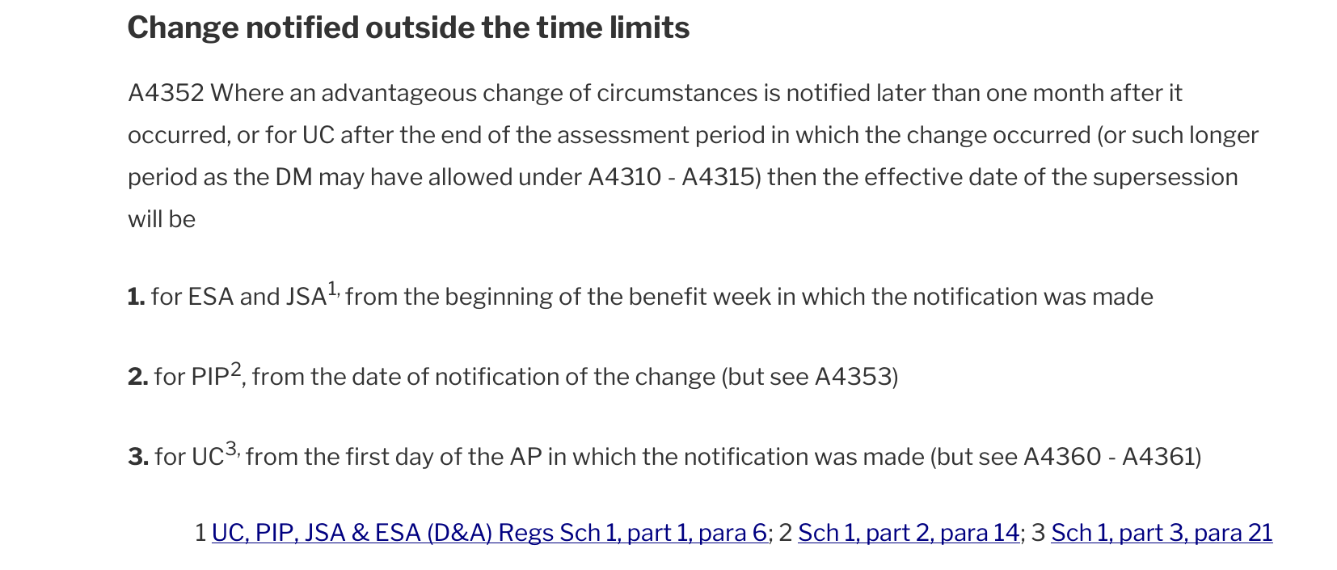
APPENDIX / RETAINED ADM A4
A4352: the ordinary rule contains an exception pointer
S06 • retained ADM A4, PDF page 34 • read with A4361 on slide 15; not an applicability decision
Independent experimental demonstration • Public sources
Appendix / Retained ADM A4
31
Notes:
SLIDE 31: A4352: the ordinary rule contains an exception pointer
Presenter: Nick leads; Chris supports the demonstration
Suggested time: Appendix — on request
Full source context for the exception pointer highlighted in the main presentation. The UC line points to A4360–A4361. Keep the conditions and printed citations together. This is separate source inspection, not proof that the historical UC retrieval selected this passage. Return to slide 15; no assessment-period dates or award calculation have been supplied.
CAPTURE EVIDENCE — genuine source pixels, not a new live test
S06-A4352: Retained ADM A4 page 34, including “but see A4360 - A4361”. No assessment-period dates are invented.
Capture: 2026-09-28T22:25:02.485Z; classification: human inspection of retained original PDF; outcome: captured.
Original: raw/S06-p34.png; original SHA-256: 074ef150e90484bb28ecb721f967945e5e826a2f06e1cfa64389adab7bb5cb0b.
Crop: {"x":0,"y":1250,"width":1654,"height":705}.
Source/launch URL: https://assets.publishing.service.gov.uk/media/6a2172db56e988a798b38645/adm-ch-a4.pdf#page=34
Receipt in supplied pack: receipts/S06.json
S06-p34: Separate source inspection: this was not selected by the historical UC retrieval. No award decision.
Capture: 2026-09-28T22:25:02.485Z; classification: human inspection of retained original PDF; outcome: captured.
Original: raw/S06-p34.png; original SHA-256: 074ef150e90484bb28ecb721f967945e5e826a2f06e1cfa64389adab7bb5cb0b.
Crop: {"x":0,"y":0,"width":1654,"height":2339}.
Source/launch URL: https://assets.publishing.service.gov.uk/media/6a2172db56e988a798b38645/adm-ch-a4.pdf#page=34
Receipt in supplied pack: receipts/S06.json
Editable text and shapes. Source screenshots are intentionally images; their content has not been rewritten. Research checks: 29 September 2026. Presentation date: 30 September 2026 (editable).

Slide 40
APPENDIX / CLICKABLE REFERENCES
Source map and routes for further inspection
Benchmarks and workflow
Architecture and DWP evidence
François Chollet, On the Measure of Intelligence (2019)
Open Knowledge Format: official project README and v0.2 specification
ARC Prize: o3-preview, 20 December 2024; costs repriced 10 December 2025
MCP architecture overview, version 2026-07-28
ARC Prize: ARC-AGI-2 launch, 24 March 2025
WebMCP: Draft Community Group Report, 28 September 2026
ARC Prize: ARC-AGI-3 launch, 25 March 2026
Frozen DWP reading-help release record, 27 September 2026
ARC Prize: GPT-6 Astra on ARC-AGI-3, 3 September 2026
Frozen UC out-of-sample follow-up and retained diagnostic
François Chollet: post text supplied by Chris; X retrieval unavailable
Frozen workbench handover, 24 September 2026
Deck sources: supplied screenshots and receipts; supplied architecture notes; targeted primary-source checks.
Presenter details: explicitly supplied. Benchmark and specification checks: 29 September 2026.
The full source/capture references, limitations and narration are also in PowerPoint speaker notes.
Independent experimental demonstration • Public sources
Appendix / Clickable references
32
Notes:
SLIDE 32: Source map and routes for further inspection
Presenter: Nick leads; Chris supports the demonstration
Suggested time: Appendix — on request
This is a navigation index, not an assertion that every link is live forever or that all evidence is legally complete. DWP links are pinned where available. A pinned data URL does not pin a live Pages application. The original X post was not independently retrievable; its quotation is attributed to Chris’s supplied text. For each screenshot, use the exact capture receipt and raw-image hash in its slide notes. The older synthesis graphic has been substantively redrawn to match the supplied access-enforcement distinction.
SOURCES
ARC1: François Chollet, On the Measure of Intelligence (2019)
https://arxiv.org/abs/1911.01547
O1: ARC Prize: OpenAI o1 results, 13 September 2024
https://arcprize.org/blog/openai-o1-results-arc-prize
O3: ARC Prize: o3-preview, 20 December 2024; costs repriced 10 December 2025
https://arcprize.org/blog/oai-o3-pub-breakthrough
ARC2: ARC Prize: ARC-AGI-2 launch, 24 March 2025
https://arcprize.org/blog/announcing-arc-agi-2-and-arc-prize-2025
PRE2: ARC Prize: 2024 winners and technical report, 6 December 2024
https://arcprize.org/blog/arc-prize-2024-winners-technical-report
ARC3: ARC Prize: ARC-AGI-3 launch, 25 March 2026
https://arcprize.org/blog/arc-agi-3-launch
ASTRA: ARC Prize: GPT-6 Astra on ARC-AGI-3, 3 September 2026
https://arcprize.org/blog/astra
CHOLLET: François Chollet: post text supplied by Chris; X retrieval unavailable
https://x.com/fchollet/status/2104598248501699067
OKF: Open Knowledge Format: official project README and v0.2 specification
https://github.com/GoogleCloudPlatform/open-knowledge-format
MCP: MCP architecture overview, version 2026-07-28
https://modelcontextprotocol.io/docs/2026-07-28/learn/architecture
WEBMCP: WebMCP: Draft Community Group Report, 28 September 2026
https://webmachinelearning.github.io/webmcp/
RELEASE: Frozen DWP reading-help release record, 27 September 2026
https://github.com/chris-page-gov/okf-dwp/blob/77ef16047415ee48dcb93b80adf1ba057ea00d9b/docs/reading-help-release-2026-09-27.md
UC: Frozen UC out-of-sample follow-up and retained diagnostic
https://github.com/chris-page-gov/okf-dwp/blob/77ef16047415ee48dcb93b80adf1ba057ea00d9b/docs/uc-disabled-child-supersession-follow-up.md
WORKBENCH: Frozen workbench handover, 24 September 2026
https://github.com/chris-page-gov/okf-dwp/blob/77ef16047415ee48dcb93b80adf1ba057ea00d9b/docs/evidence-workbench-handover.md
MODEL: Frozen blocked calculation inspection model
https://github.com/chris-page-gov/okf-dwp/blob/77ef16047415ee48dcb93b80adf1ba057ea00d9b/docs/workbench-model-inspection.md
Editable text and shapes. Source screenshots are intentionally images; their content has not been rewritten. Research checks: 29 September 2026. Presentation date: 30 September 2026 (editable).

