Slide 1
IBM University Engagement Project Submission
“Exploring the Power of Agentic AI with IBM Granite and LangFlow”

Slide 2

Project Tile – [Problem Statement No. 41- Power System Fault Detection and Classification ]
Domain of Project – [Electrical Engineering]
Student Name | Recent Passport Photo | Email ID | Mobile number [WhatsApp]
Anuska Bhattacharyya |  | anuskabhattacharyya1@gmail.com | 6290032176
Recommended font style and size: Font Style: Arial Font Size (Heading): 28
Font Size (Content): 20

Slide 3
Problem Statement -
Problem Statement : Power System Fault Detection and Classification
The Challenge
Design a machine learning model to detect and classify different types of faults in a power distribution system. Using electrical measurement data (e.g., voltage and current phasors), the model should be able to distinguish between normal operating conditions and various fault conditions (such as line-to-ground, line-to-line, or three-phase faults). The objective is to enable rapid and accurate fault identification, which is crucial for maintaining power grid stability and reliability
The Objective
Build an AI-powered Fault Detection and Classification System that uses machine learning to identify and classify different fault conditions in a power distribution network using electrical measurement data. The solution should:
Fault Detection – Detect whether the power distribution system is operating under normal conditions or experiencing a fault.
Fault Classification – Accurately classify faults into categories such as Line-to-Ground (LG), Line-to-Line (LL), Double Line-to-Ground (LLG), and Three-Phase (LLL) faults.
Electrical Data Analysis – Process and analyse voltage and current phasor measurements to identify abnormal system behaviour.
Real-Time Fault Identification – Provide rapid detection and classification to minimize outage time and improve grid reliability.
Machine Learning-Based Decision Making –
Data Processing Agent (preprocesses and normalizes electrical measurement data)
Fault Detection Agent (distinguishes normal and faulty operating conditions)
Fault Classification Agent (identifies the specific type of fault)
Performance Evaluation Agent (measures model accuracy, precision, recall, and F1-score)
Visualization Dashboard – Display fault status, predicted fault type, confidence score, and model performance metrics for operators to support quick and informed decision-making.

Slide 4
Proposed Solution -
Proposed Solution: AI-Powered Fault Detection and Classification System
The proposed solution is a multi-agent AI-powered Fault Detection and Classification System built using LangFlow, IBM watsonx.ai, and IBM Granite Models to provide intelligent, real-time fault detection and classification in power distribution systems. The system addresses challenges in rapid fault identification, grid monitoring, and power system reliability through an intelligent, modular architecture.
At its core, the solution uses a Machine Learning pipeline to process electrical measurement data such as voltage and current phasors. The data is preprocessed, normalized, and analysed by trained machine learning models to distinguish between normal operating conditions and various fault types. IBM Granite models assist in reasoning, analysis, and generating explainable insights for fault diagnosis.
The system consists of four key agents:
Data Processing Agent preprocesses, cleans, and normalizes voltage and current measurement data before feeding it to the machine learning model.
Fault Detection Agent continuously monitors incoming electrical data and identifies whether the power distribution system is operating normally or experiencing a fault.
Fault Classification Agent classifies detected faults into categories such as Line-to-Ground (LG), Line-to-Line (LL), Double Line-to-Ground (LLG), and Three-Phase (LLL) faults using machine learning models.
Performance Evaluation Agent evaluates prediction accuracy, precision, recall, F1-score, and confidence scores while generating performance reports for system validation.
The solution includes a user-friendly dashboard (built with Streamlit or React) that visualizes real-time electrical parameters, detected fault types, confidence scores, historical fault records, and model performance metrics, enabling operators to make quick and informed decisions.
LangFlow is used to orchestrate communication between the AI agents, while IBM watsonx.ai provides scalable AI model deployment, governance, and lifecycle management. IBM Granite models enhance reasoning, explainability, and intelligent decision-making throughout the fault diagnosis process.

Slide 5
Technology Used
LangFlow Platform – For designing and orchestrating multi-agent AI workflows visually.
IBM Granite Model– For intelligent reasoning, fault explanation, and generating human-readable insights from detected power system faults.
IBM watsonx.ai – For AI model deployment, prompt engineering, model governance, and integrating AI services into the fault detection system.
IBM Cloud – Provides a secure, scalable, and reliable cloud infrastructure for deploying and monitoring the AI-powered fault detection system.
Machine Learning (Scikit-learn/TensorFlow) – For training and deploying models that detect and classify power system faults using voltage and current phasor data.
Python – For data preprocessing, feature engineering, model training, and system integration.
Pandas & NumPy – For processing and analysing electrical measurement datasets.
Streamlit – For developing an interactive dashboard that displays fault predictions, confidence scores, and system status.

Slide 6
Langflow component Used -
1) File Input – Uploads the power system dataset containing voltage, current phasors, and fault labels for preprocessing and machine learning analysis.
2) IBM watsonx AI Agent – Processes electrical measurement data and collaborates with multiple agents to provide intelligent fault diagnosis, explain predictions, and generate recommendations using IBM Granite models.
3) IBM Granite Model → Performs reasoning, explains detected faults, summarizes system conditions, and assists operators in understanding fault classification results.
4) Machine Learning Agent – Uses the trained machine learning model to detect abnormal operating conditions and classify faults such as Line-to-Ground (LG), Line-to-Line (LL), Double Line-to-Ground (LLG), and Three-Phase (LLL) faults.
5) Chat Output – Displays the detected fault type, confidence score, fault explanation, and recommended corrective actions in natural language.
6) File Component – Stores and retrieves electrical measurement datasets, trained machine learning models, prediction results, and historical fault records.
7) Prompt Template – Formats user queries and electrical measurement data into structured prompts for the IBM Granite model, ensuring consistent and accurate responses.

Slide 7
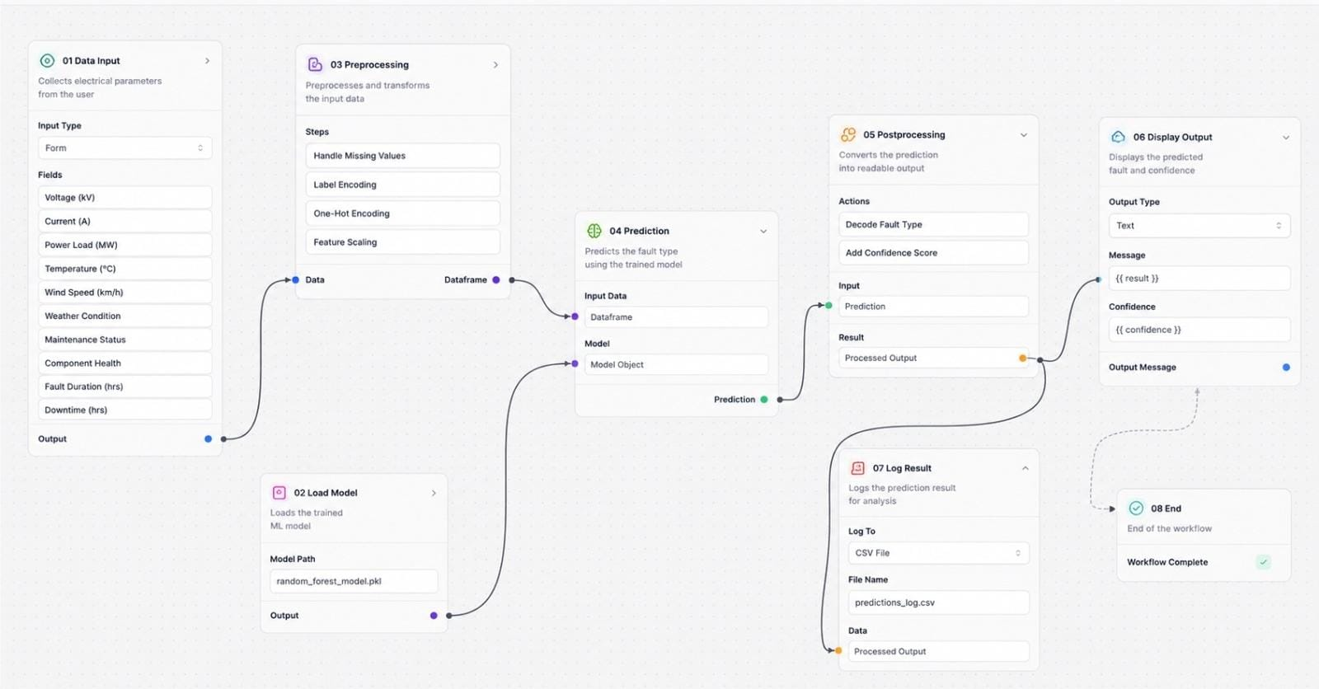
Langflow workflow -

Slide 8
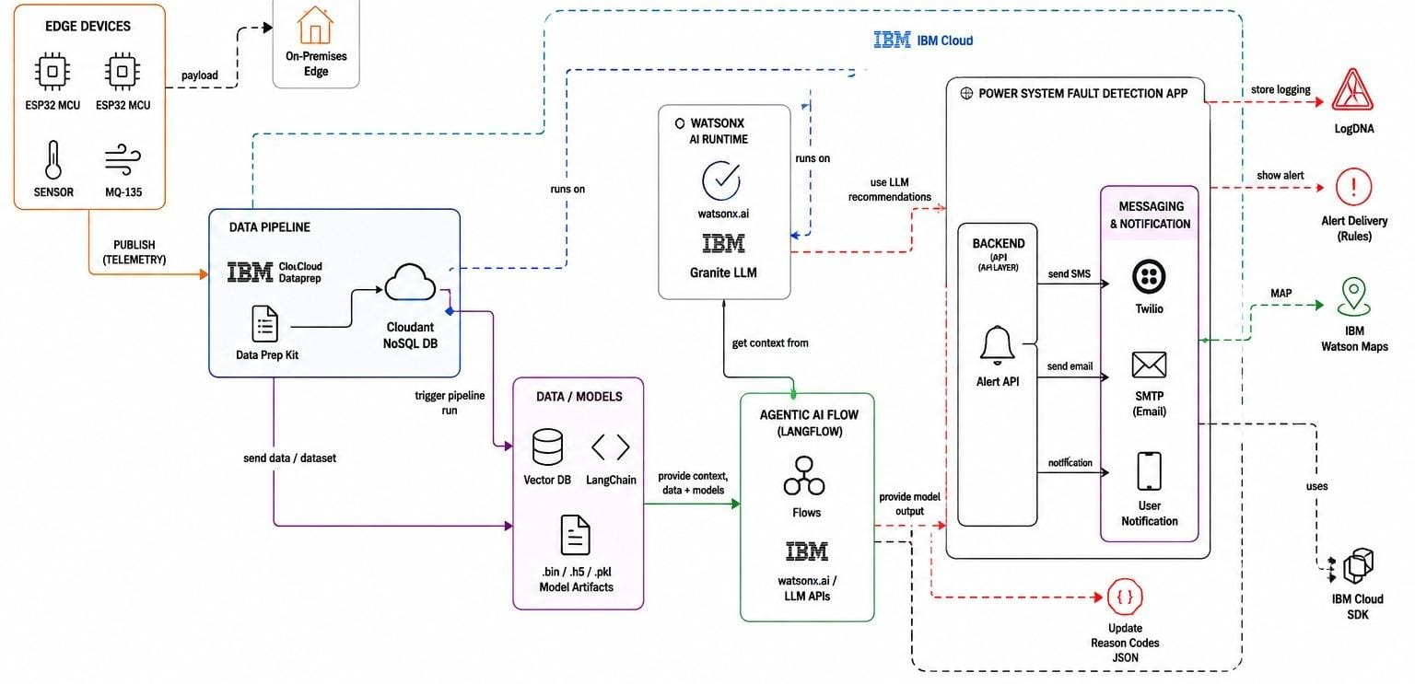
Architecture blueprint

Slide 9

Role of Agentic AI in the solution
Role of Agentic AI in Fault Detection and Classification System
Agentic AI enables the Fault Detection and Classification System to function as an intelligent, autonomous platform rather than a conventional fault monitoring application. Using IBM watsonx.ai and IBM Granite models, it coordinates multiple specialized agents to analyse electrical measurement data and identify faults in real time.
Each agent performs a dedicated task—such as preprocessing voltage and current phasor data, detecting abnormal operating conditions, classifying the type of fault, and evaluating model performance—while collaborating with other agents. This multi-agent architecture ensures faster analysis, higher accuracy, and efficient fault diagnosis.
Agentic AI also provides context awareness by understanding power system operating conditions and historical measurement patterns to improve fault detection and reduce false alarms. It supports real-time adaptation, continuously processing incoming electrical data and updating predictions as new measurements become available.
Additionally, the agents communicate with one another, allowing the system to validate results, improve decision-making, and provide reliable fault classification for grid operators.
Overall, Agentic AI makes the system proactive, intelligent, and data-driven, acting as a smart power grid assistant that enables rapid fault detection, accurate fault classification, and improved stability and reliability of the power distribution network.

Slide 10
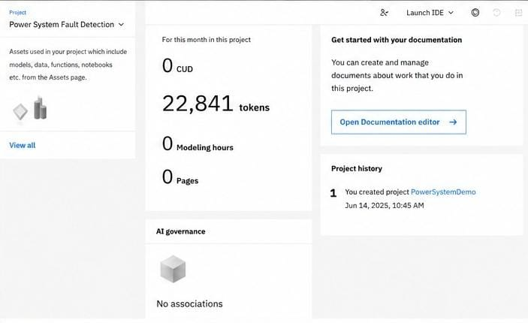
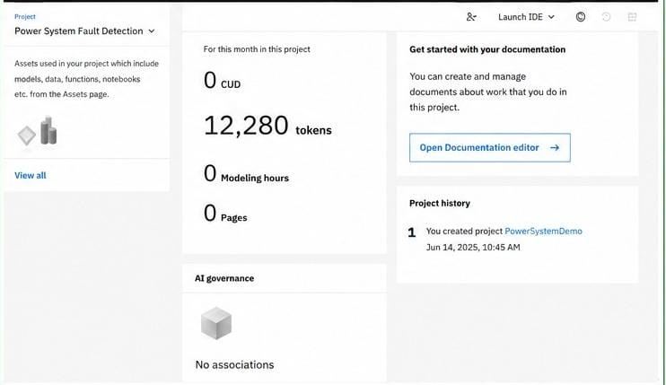
Token Usage
10,561 token are used
Before Prompt
After the Prompt
·
·

Slide 11
Novelty and Uniqueness
The proposed Fault Detection and Classification System stands out by combining Agentic AI, Machine Learning, and real-time electrical data analysis into a single intelligent solution.
Multi-Agent Intelligence – Instead of relying on a single prediction model, multiple specialized agents collaborate to preprocess data, detect faults, classify fault types, and evaluate model performance.
AI-Driven Fault Diagnosis – Utilizes machine learning to automatically detect and classify faults, reducing dependence on traditional rule-based or manual fault analysis methods.
Real-Time Fault Detection – Continuously analyses voltage and current phasor measurements, enabling rapid identification of abnormal operating conditions and minimizing response time.
High Classification Accuracy – Distinguishes between multiple fault types such as Line-to-Ground (LG), Line-to-Line (LL), Double Line-to-Ground (LLG), and Three-Phase (LLL) faults with improved precision.
Adaptive Learning – Learns from historical and newly available electrical measurement data, allowing the system to improve prediction accuracy over time.
Visualization Dashboard – Provides operators with real-time fault status, predicted fault type, confidence scores, and performance metrics for faster and more informed decision-making.
Scalable & Enterprise-Ready – Built on IBM watsonx.ai with IBM Granite models, ensuring scalability, reliability, governance, and seamless deployment for modern smart grid environments.
This makes the solution a smart, adaptive, and proactive power grid monitoring system, not just a conventional fault detection tool.

Slide 12
Git Hub Link
https://github.com/bitsnbytes12/Power-System-Fault-Detection
·
·
·

Slide 13
Future Scope
1. Integration with IoT Sensors & Smart Grid Infrastructure – The system can be integrated with IoT-enabled sensors, Phasor Measurement Units (PMUs), Smart Meters, and SCADA systems to collect real-time voltage and current measurements across the power distribution network. This will enable continuous monitoring, faster fault detection, and improved situational awareness for utility operators.
2. AI-Powered Predictive Maintenance & Self-Healing Grid – The solution can be extended with predictive maintenance capabilities to identify potential equipment failures before faults occur. By combining Agentic AI with advanced machine learning and smart grid technologies, the system can recommend preventive maintenance actions and support self-healing power networks that automatically isolate faults and restore power, improving grid reliability and reducing downtime.
·
·
·

Slide 14
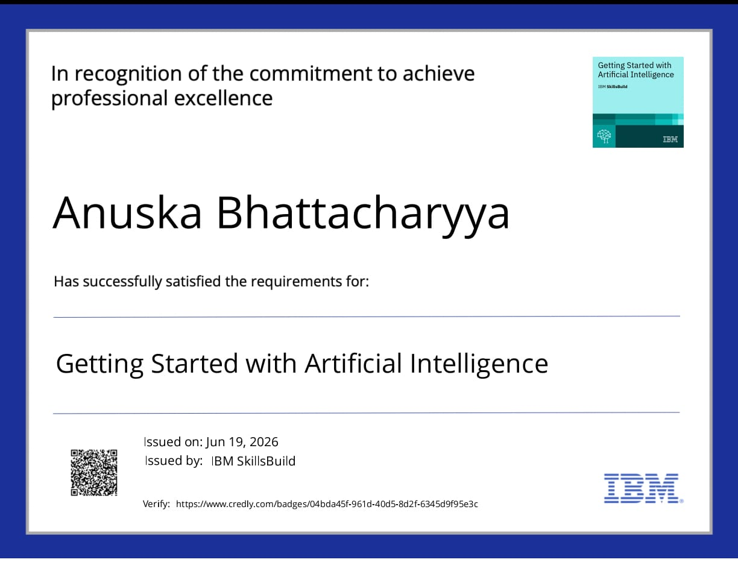
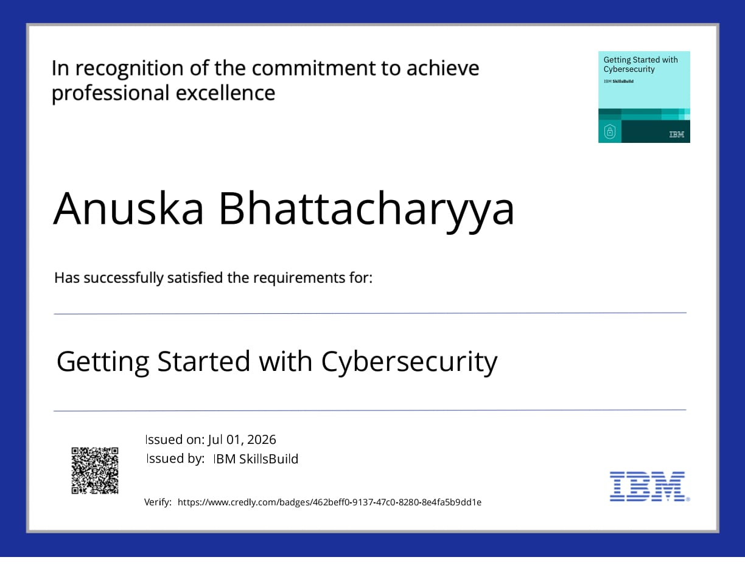
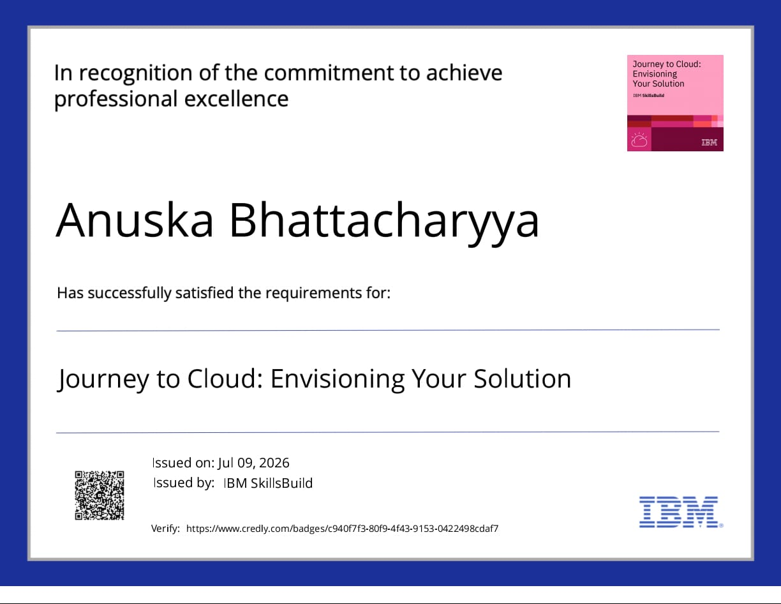
Certificates Earned:

Slide 15
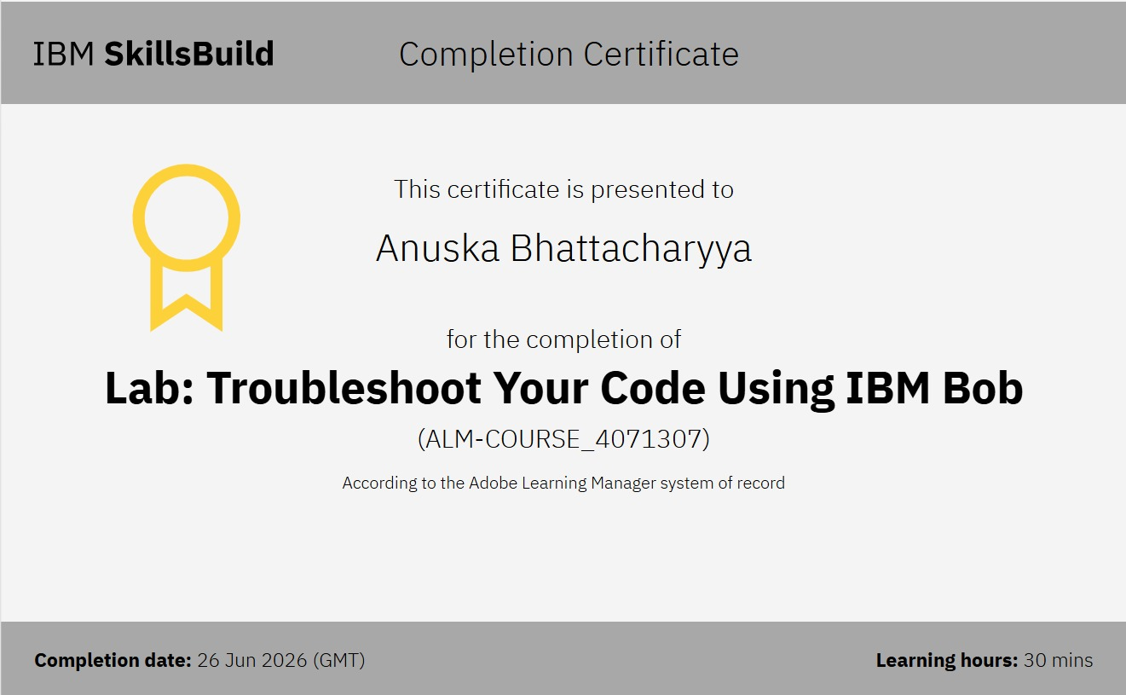
Certificates Earned:​

Slide 16


