Slide 1
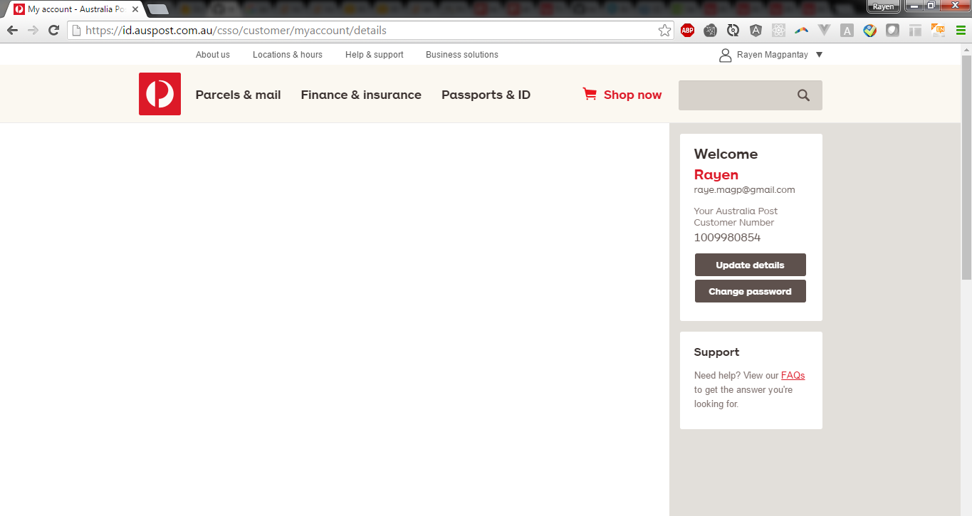
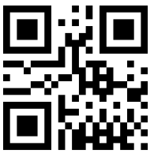

Short-term link code
Use the QR code or PIN number below to link your MyPost account to compatible applications. The link code expires for security purposes. You would have to generate a new link code after 4 minutes.
PIN 1234
Helpful guides
Linking with Australia Post applications
Linking with messaging applications
Linking with social media
Linking with Digital Assistants
Other linking methods
Generate again

Slide 2
Short-term link code
Use the QR code or PIN number below to link your MyPost account to compatible applications. The link code expires for security purposes. You would have to generate a new link code after 4 minutes.
PIN 8910
Helpful guides
Linking with Australia Post applications
Linking with messaging applications
Linking with social media
Linking with Digital Assistants
Other linking methods
Generate again

