Slide 1



BUILDING AT HACK MERIDIAN
STELLAR
SMART
ACCOUNTS
Why a C-address, and how to build an app on one
Notes:
SLIDE 1: Stellar smart accounts
TIME: 0:00–0:35 (35 seconds)
SCRIPT
Imagine someone trying your hackathon app for the first time. They get the idea right away, and then you ask them to learn a wallet: a seed phrase, a browser extension, a signature for every click.
In the next fifteen minutes: why an account with rules is a better start, how Perch and Nido give you one, an app a coding agent built on testnet, and what six teams ran into when they built their own in two hours.
SOURCES (not spoken)
https://developers.stellar.org/docs/build/guides/contract-accounts
https://github.com/nidohq/nido/blob/4fee10dc55b877e828c5f9fe60cc6807ea10ea6e/README.md
https://github.com/stellar-registry/perch/blob/2d1df9b3eefbaa70c74bbf83ffb8f96cc9581f63/README.md
Visual template and reused photography/brand assets: https://docs.google.com/presentation/d/1-HRAkfaI2YZQZzSWonXNrDxBCA1HZ4r_OjJ-YvP6lNM/edit

Slide 2



T H E B I G I D E A
YOUR ACCOUNT SHOULD
HAVE RULES,
NOT JUST A KEY
G-addresses hold keys. C-addresses run code.
Notes:
SLIDE 2: Rules, not just a key
TIME: 0:35–1:15 (40 seconds)
SCRIPT
Here is the idea in one line. Today, most Stellar users have an account that is a key. Whoever holds the key, or enough of the keys, can do anything the account can do.
A smart account is an account with rules. It is a contract, so its address starts with C, and the network asks that contract whether each request is allowed. The rules can say who may sign, for which contract, for which function, for how long, and for how much.
SOURCES (not spoken)
https://developers.stellar.org/docs/build/guides/contract-accounts
https://developers.stellar.org/docs/build/guides/auth/contract-authorization
Visual template and reused photography/brand assets: https://docs.google.com/presentation/d/1-HRAkfaI2YZQZzSWonXNrDxBCA1HZ4r_OjJ-YvP6lNM/edit

Slide 3

C L A S S I C A C C O U N T S
G-ADDRESS: A KEY
Ed25519 signers, weights, thresholds:
fixed rules the protocol defines.
An app asks every time, or holds your key.
Multisig exists. Scoped permission does not.
Notes:
SLIDE 3: The G-address
TIME: 1:15–2:00 (45 seconds)
SCRIPT
Let's be fair to the classic account first. A G-address is an ed25519 key, and it can have several signers with weights and thresholds. That's real multisig, and every wallet and exchange supports it.
What it can't do is scope. There's no way to say "this key may only call this one contract", "only until Friday", or "no more than two XLM a day".
So an app that wants to act for you has two choices: ask you to sign every single action, or hold a key that can do everything.
SOURCES (not spoken)
https://developers.stellar.org/docs/learn/fundamentals/transactions/signatures-multisig
Visual template and reused photography/brand assets: https://docs.google.com/presentation/d/1-HRAkfaI2YZQZzSWonXNrDxBCA1HZ4r_OjJ-YvP6lNM/edit

Slide 4
C O N T R A C T A C C O U N T S
C-ADDRESS:
AN ACCOUNT
THAT RUNS CODE
from.require_auth()
→ the account’s __check_auth
→ its rules decide
Same Address type for your contract
Notes:
SLIDE 4: The C-address
TIME: 2:00–2:50 (50 seconds)
SCRIPT
A contract account turns that around. When your contract calls require_auth on an address, Soroban checks a classic account's signatures the classic way. If the address is a contract, the host calls that contract's check-auth function and passes it everything: the signature, and the exact calls being authorized.
The account then evaluates its own rules. The important part for you as an app developer: your contract doesn't change. It asks an Address to authorize, the same as always. The difference lives in the account.
One caution. If your contract trusts an address it never calls require_auth on, a smart wallet won't save it.
SOURCES (not spoken)
https://developers.stellar.org/docs/build/guides/auth/contract-authorization
https://developers.stellar.org/docs/build/guides/contract-accounts
Visual template and reused photography/brand assets: https://docs.google.com/presentation/d/1-HRAkfaI2YZQZzSWonXNrDxBCA1HZ4r_OjJ-YvP6lNM/edit

Slide 5



W H A T R U L E S B U Y Y O U
WHAT RULES BUY YOU
PASSKEYS
Face ID instead of a seed phrase
SCOPED KEYS
One contract, listed functions, an expiry
SPENDING CAPS
A rolling limit the account enforces
Notes:
SLIDE 5: What rules buy you
TIME: 2:50–3:45 (55 seconds)
SCRIPT
Three things you can build with rules.
Passkeys. A passkey signs with P-256, which a classic account can't verify. A contract account can, through a WebAuthn verifier contract. The biometric check happens on the device; the chain only sees a signature.
Scoped keys. You can give a key permission for one contract, a list of functions, and an expiry. That's how an app acts for you without holding your account.
Spending caps. A rule can carry a limit, say two XLM per day, and the account enforces it on every transfer. You'll see one refuse a payment.
The same rules also cover recovery, sponsored onboarding, and adding or removing devices; that's in the appendix.
SOURCES (not spoken)
https://github.com/stellar-registry/perch/blob/2d1df9b3eefbaa70c74bbf83ffb8f96cc9581f63/crates/perch-webauthn-verifier/src/lib.rs
https://github.com/stellar-registry/perch/blob/2d1df9b3eefbaa70c74bbf83ffb8f96cc9581f63/crates/perch-ir/src/doc.rs
https://github.com/stellar-registry/perch/blob/2d1df9b3eefbaa70c74bbf83ffb8f96cc9581f63/crates/perch-spending-limit/src/lib.rs
Visual template and reused photography/brand assets: https://docs.google.com/presentation/d/1-HRAkfaI2YZQZzSWonXNrDxBCA1HZ4r_OjJ-YvP6lNM/edit

Slide 6
W H A T I T C O S T S
THE HONEST TRADE-OFFS
COMPATIBILITY
WHAT NIDO’S
RELAYER PAYS
No classic operations; Horizon shows no account
COST
Account: about 1.4 XLM
First grant: about 4.5 XLM
Capped grant: about 2.7 XLM
Sponsored, up to a shared daily budget
MATURITY
Testnet, pre-audit, forked dependencies
From one 100 XLM/day pot, on 22 Oct 2026
Notes:
SLIDE 6: Honest trade-offs
TIME: 3:45–5:00 (75 seconds)
SCRIPT
Now the costs, because you should know them before you choose.
Compatibility. A C-address can't be the source of a classic operation, and Horizon has no account record for it, so your app reads balances from the token contract over RPC. Many tools, exchanges included, still assume a G-address.
Cost. A contract account is storage, so it pays rent, and so does every rule. On testnet, Nido's relayer pays for you, but from one shared budget: a hundred XLM a day for all of testnet. On the twenty-second it counted about 1.4 XLM to create an account, 4.5 for an app's first grant, and 2.7 for a capped one. That's around twenty grants a day for everyone, so a busy room can run it dry. I'll show you what that looks like.
Maturity. Perch and Nido are testnet-only and not yet audited, and Nido's revoke button doesn't work yet. Build on it tonight; don't put real money behind it.
SOURCES (not spoken)
Feedback report from a six-team simulated hackathon run, Oct 2026 §3
Team hk-ai-claude feedback, simulated hackathon run, Oct 2026
https://github.com/nidohq/nido/blob/4fee10dc55b877e828c5f9fe60cc6807ea10ea6e/docs/ADD-NIDO-TO-DAPP.md
https://github.com/stellar-registry/perch/blob/2d1df9b3eefbaa70c74bbf83ffb8f96cc9581f63/docs/audit-scope.md
https://github.com/nidohq/nido/blob/4fee10dc55b877e828c5f9fe60cc6807ea10ea6e/docs/MAINNET_READINESS.md
Visual template and reused photography/brand assets: https://docs.google.com/presentation/d/1-HRAkfaI2YZQZzSWonXNrDxBCA1HZ4r_OjJ-YvP6lNM/edit

Slide 7
P E R C H · T H E P O L I C Y L A Y E R
PERCH: A RULE YOU CAN READ
{ "name": "kudos-xlm",
"scope": { "type": "contract", "address": "CDLZ…CYSC" },
"principals": { "type": "all", "signers": ["session"] },
"functions": ["transfer"],
"cap": { "limit": "20000000", "period-ledgers": 17280 },
"not-after-ledger": 5342393 }
One document per account, hashed and compiled on chain, enforced in __check_auth.
Notes:
SLIDE 7: Perch: a rule you can read
TIME: 5:00–6:05 (65 seconds)
SCRIPT
The rules live in Perch, a policy layer for Soroban smart accounts built on OpenZeppelin's account framework. An account's whole authorization is one JSON document: signers, rules, and optional recovery. It's canonical, so the account stores its hash and anyone can check it.
This is a real rule from the demo you'll see. Scope: one contract, the XLM token. Principal: the app's session key. One function, transfer. A cap of two XLM per seventeen thousand two hundred and eighty ledgers, about a day. And an expiry ledger.
Perch compiles the document on chain, and the account enforces it in check-auth on every call, denying by default. Verifiers, the registry and factories are in the appendix if you want the deep dive.
SOURCES (not spoken)
https://github.com/stellar-registry/perch/blob/2d1df9b3eefbaa70c74bbf83ffb8f96cc9581f63/README.md
https://github.com/stellar-registry/perch/blob/2d1df9b3eefbaa70c74bbf83ffb8f96cc9581f63/CANONICAL.md
https://github.com/stellar-registry/perch/blob/2d1df9b3eefbaa70c74bbf83ffb8f96cc9581f63/docs/schema.md
https://github.com/stellar-registry/perch/blob/2d1df9b3eefbaa70c74bbf83ffb8f96cc9581f63/crates/perch-doc-compiler/src/lib.rs
Kudos Jar, an agent-built demo app run live on testnet, Oct 2026
Visual template and reused photography/brand assets: https://docs.google.com/presentation/d/1-HRAkfaI2YZQZzSWonXNrDxBCA1HZ4r_OjJ-YvP6lNM/edit

Slide 8
T H E W A L L E T
NIDO
Passkey-native Perch accounts.
Connect, sign, or grant a session.
Creation and fees sponsored.
test.nido.fyi · TESTNET
Notes:
SLIDE 8: Nido
TIME: 6:05–6:50 (45 seconds)
SCRIPT
Nido is the wallet people see, and every Nido account is a Perch account. You open test.nido.fyi, approve with your face or fingerprint, and you have a C-address on its own subdomain, created and funded with five test XLM by Nido's relayer.
From your app, Nido sits in Stellar Wallets Kit next to the usual wallets. You can ask it for three things: connect, which gives you the address; sign one transaction in a popup; or grant your app a scoped session. The third one turns out to matter most.
SOURCES (not spoken)
https://github.com/nidohq/nido/blob/4fee10dc55b877e828c5f9fe60cc6807ea10ea6e/README.md
https://github.com/nidohq/nido/blob/4fee10dc55b877e828c5f9fe60cc6807ea10ea6e/docs/ADD-NIDO-TO-DAPP.md
https://github.com/nidohq/nido/blob/4fee10dc55b877e828c5f9fe60cc6807ea10ea6e/infra/relayer/README.md
Visual template and reused photography/brand assets: https://docs.google.com/presentation/d/1-HRAkfaI2YZQZzSWonXNrDxBCA1HZ4r_OjJ-YvP6lNM/edit

Slide 9
V E R I F I E D O N T E S T N E T
THE POPUP CAN’T SIGN
FOR YOUR CONTRACT
guess(3, CAXS…) → __check_auth
context_rule_ids: [0] // "admin", scoped to the account
contexts: guess, transfer // two calls, one rule
→ Error(Contract, #3014) ContextRuleIdsLengthMismatch
One contract: #3002. Several: #3014. Fix: ask once for a session.
Notes:
SLIDE 9: Finding: the popup and your contract
TIME: 6:50–7:50 (60 seconds)
STAGE CUE: Slow down on the first sentence; this is the turning point of the talk.
SCRIPT
Here's the most important sentence in this talk: today, your app can't ask the passkey to sign a call to your own contract.
Nido's popup signs under the admin rule, and admin covers only the account itself. When our sample game asked the account to authorize a guess, which also moves one XLM, the account got two calls and one rule that covers neither, and refused. A call into a single contract fails the same way, with 3002.
So you ask once for a session. Your app holds its own key, and the owner approves one Perch rule for each contract the call touches. After that, your app's key signs, and the account checks every call.
SOURCES (not spoken)
../template/NIDO.md
https://github.com/nidohq/nido/blob/4fee10dc55b877e828c5f9fe60cc6807ea10ea6e/packages/frontend/src/lib/walletSign.ts
https://github.com/theahaco/stellar-contracts-OZ/tree/33726766a1fd5e7e3d2977d79f64ee29e1ea3ca9/packages/accounts
Team hk-hu-noscaffold feedback, simulated hackathon run, Oct 2026
Visual template and reused photography/brand assets: https://docs.google.com/presentation/d/1-HRAkfaI2YZQZzSWonXNrDxBCA1HZ4r_OjJ-YvP6lNM/edit

Slide 10

A N A G E N T B U I L D S A N A P P
ONE PROMPT: KUDOS JAR
01
Copy the template with new-app
02
Write and test the contract
03
Deploy it to testnet
04
Run it with a real Nido account
Notes:
SLIDE 10: An agent builds Kudos Jar
TIME: 7:50–8:40 (50 seconds)
SCRIPT
To prove it end to end, we gave a coding agent the template and one prompt: build a small app that shows off a smart account, with passkey sign-in and a policy-limited action, live on testnet.
It built Kudos Jar: tip a hackathon team in XLM, with a public tally. It copied the template with new-app, wrote and unit-tested a Soroban contract, deployed it with one Scaffold command, and built a React board on the generated client. Then it ran the real flow with a Nido account on testnet, created with a throwaway virtual passkey, because an agent has no fingerprint.
SOURCES (not spoken)
Kudos Jar, an agent-built demo app run live on testnet, Oct 2026
Log of the agent-built Kudos Jar run, Oct 2026
Visual template and reused photography/brand assets: https://docs.google.com/presentation/d/1-HRAkfaI2YZQZzSWonXNrDxBCA1HZ4r_OjJ-YvP6lNM/edit

Slide 11
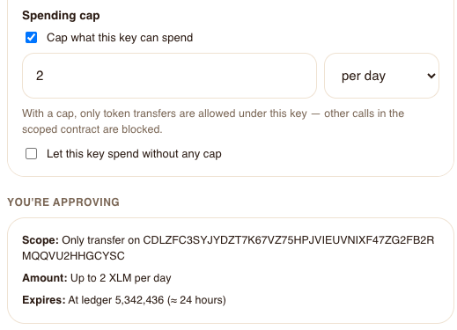
A P P R O V E O N C E
APPROVE THE RULE IN NIDO
SCOPE
Only transfer, only on XLM
CAP
Up to 2 XLM per day
EXPIRY
About 24 hours, then gone
Nido’s grant page, before the passkey
Notes:
SLIDE 11: Approve the rule
TIME: 8:40–9:25 (45 seconds)
SCRIPT
After connecting, the app asks once, in plain words: may it call tip on the jar and move up to two XLM a day, for twenty-four hours? A tip touches two contracts, the jar and the XLM token, so that's two rules and two passkey confirmations.
Each one happens on Nido's page, not the app's. Nido shows the contract, the functions, the cap and the expiry. The owner confirms with the passkey, Nido applies the new policy document, and the browser comes back to the app. The app never touches the passkey.
SOURCES (not spoken)
Kudos Jar, an agent-built demo app run live on testnet, Oct 2026
https://github.com/nidohq/nido/blob/4fee10dc55b877e828c5f9fe60cc6807ea10ea6e/packages/frontend/src/pages/security/delegate-doc/index.astro
Visual template and reused photography/brand assets: https://docs.google.com/presentation/d/1-HRAkfaI2YZQZzSWonXNrDxBCA1HZ4r_OjJ-YvP6lNM/edit

Slide 12
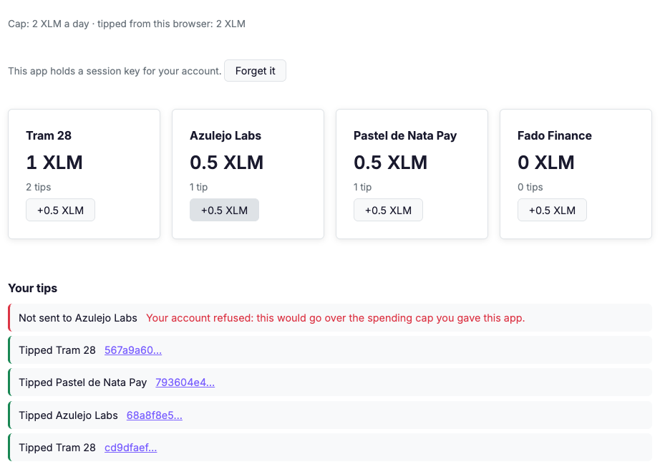
T I P U N T I L T H E C A P
TAP, TAP, TAP… REFUSED
NO PROMPTS
Four tips, each confirmed
THE CAP
The fifth would pass 2 XLM
ON CHAIN
The account said no: #3221
Live testnet, 22 Oct 2026
Notes:
SLIDE 12: Tap until the cap
TIME: 9:25–10:20 (55 seconds)
STAGE CUE: Pause on the red line before reading it.
SCRIPT
And now the fun part. Tap a team, and the tip goes through: no popup, no prompt. The app's key signs inside the account's own authorization entry, the account checks its rules, and the transaction confirms. Four taps, two XLM, four transaction hashes you can look up.
The fifth tap would take the day's total past two XLM. The app didn't stop it. The account did: its spending-limit policy refused, with error 3221, and the app shows that as a plain sentence.
That's the whole point of a C-address. The limit isn't a promise the app makes. It's a rule the account enforces.
SOURCES (not spoken)
Kudos Jar, an agent-built demo app run live on testnet, Oct 2026
https://stellar.expert/explorer/testnet/tx/cd9dfaefb145bd56d6239b1bd3ce8fa12eb5ca10bdee317d6b53e0012e043c1f
https://stellar.expert/explorer/testnet/tx/567a9a60e2e8d91c33e8dd3cac0f4349ce173b5c8c7a2dd401628b0ad94790ec
Visual template and reused photography/brand assets: https://docs.google.com/presentation/d/1-HRAkfaI2YZQZzSWonXNrDxBCA1HZ4r_OjJ-YvP6lNM/edit

Slide 13
W H E N I T G O E S W R O N G
WHEN THE WALLET SAYS “UNKNOWN”
429 · BUDGET USED UP
CHECK THE CHAIN
BEFORE YOU RETRY
Nothing was sent. Wait, or pay your own fee
503 · RELAYER BUSY
Go back to the app, press Check again:
it reads the account’s rules on chain.
Nothing there? Ask Nido again.
Nothing was sent. Retry in a moment
504 · TIMED OUT
It may have landed. Check, then retry
A failed response can follow a success
Notes:
SLIDE 13: When the wallet says unknown
TIME: 10:20–11:35 (75 seconds)
SCRIPT
Now the part most talks skip. In our dry run, Nido's relayer ran out of budget partway through, and every team hit it. Nido's page showed one message for three different failures: "we couldn't confirm what happened; retrying could pay twice."
A 429, FEE_LIMIT_EXCEEDED: the shared budget is used up, and nothing was sent. A 503, POOL_CAPACITY: the relayer is busy, nothing was sent, retry in a moment. A 504 is the tricky one: one team's grant timed out and had landed anyway.
So check the chain before you retry. Go back to the app and press Check again: the template reads the account's rules on chain. If nothing landed, Ask Nido again; that can't pay twice.
And when the budget is gone, the passkey's signature doesn't care who pays the fee. The template can already submit the signed grant with its own key, for about a quarter of an XLM; Nido's page doesn't offer that yet.
SOURCES (not spoken)
Feedback report from a six-team simulated hackathon run, Oct 2026 §3, §5.2 N-A2, N-H1
../template/NIDO.md (When Nido’s relayer says no)
../template/CHANGELOG.md
Team hk-hu-codex feedback, simulated hackathon run, Oct 2026
Team hk-hu-template’s self-relay script, simulated hackathon run, Oct 2026
../template/app-lib/session.ts
Visual template and reused photography/brand assets: https://docs.google.com/presentation/d/1-HRAkfaI2YZQZzSWonXNrDxBCA1HZ4r_OjJ-YvP6lNM/edit

Slide 14
W H A T S I X T E A M S B U I L T
PATTERNS THAT WORKED
01
Per-user cap: a rule on the token
02
Shared pot: a contract, 2 of 3 approve
03
No money moves: one grant, no cap
04
Allowance or time lock: a vault holds it
Notes:
SLIDE 14: Patterns that worked
TIME: 11:35–13:00 (85 seconds)
SCRIPT
We ran a dry run of this kit: six teams, all driven by AI, three as coding agents and three simulating a person working from these slides, each with two hours on testnet. All six prototypes work, and four patterns came out of them.
One: a per-user cap, like Kudos Jar. Put the cap on the token rule, and the account enforces it.
Two: a shared pot. Group Pot's contract holds the money and pays an expense when two of three members approve. Each member signs in with their own Nido account and approves their own session.
Three: nothing moves. Event tickets, a one-question poll, a guestbook: one grant on your contract, with no cap. Nido asks the owner to accept "no cap" explicitly, and the app's key pays the fees. The template's blank starter is exactly this.
Four: limits the user mustn't undo. A cap limits a key, not the account's admin, so Pocket Money keeps a teen's allowance in a parent-owned vault. And expiry stops a key; it doesn't delay a withdrawal, so Goalpost puts its unlock date in the vault contract.
SOURCES (not spoken)
Feedback report from a six-team simulated hackathon run, Oct 2026 §2, §5.1 D-H2
../template/NIDO.md (patterns that work)
Team hk-ai-claude feedback, simulated hackathon run, Oct 2026
Team hk-ai-sonnet feedback, simulated hackathon run, Oct 2026
Team hk-ai-codex feedback, simulated hackathon run, Oct 2026
Team hk-hu-codex feedback, simulated hackathon run, Oct 2026
Team hk-hu-template feedback, simulated hackathon run, Oct 2026
Team hk-hu-noscaffold feedback, simulated hackathon run, Oct 2026
Visual template and reused photography/brand assets: https://docs.google.com/presentation/d/1-HRAkfaI2YZQZzSWonXNrDxBCA1HZ4r_OjJ-YvP6lNM/edit

Slide 15
B U I L D Y O U R O W N
YOUR OWN APP, START TO FINISH
npm run new-app -- ../my-app --blank && cd ../my-app
npm run tools:scaffold && npm ci && npm run doctor
# grow contracts/check-in, or add a crate and list it in scaffold.yml
npm run deploy:testnet # deploys, pins its testnet ID, writes the client
<SessionGate grants={grants}> // one Grant per contract in env.auths()
const { result, hash } = await submitCall(address, (publicKey) =>
myContract.my_fn({ user: address }, { publicKey }))
Helpers from the template’s app-lib. NIDO.md has the whole path; AGENTS.md is for your agent.
Notes:
SLIDE 15: Build your own
TIME: 13:00–14:20 (80 seconds)
SCRIPT
Here's your own app, start to finish. new-app with blank copies the template with a one-function starter, and gives it its own name, port and deployer key. tools-colon-scaffold installs the right Scaffold into the project in seconds, and doctor checks your tools, keys and testnet, with a fix for each problem.
Grow the starter contract, or add your own crate to scaffold.yml. deploy-colon-testnet deploys it, pins its ID, and writes its client.
To find your grants, assert env.auths in a unit test: one Grant per contract in that list, usually your contract, plus the token if it moves the user's money. Keep require_auth at the top of your function. Then submitCall is the whole call site: it builds the call, signs with whatever the user connected, and returns the result and the hash.
You're done when you have a passkey account, a confirmed transaction hash, and one refusal from the account itself. The template's NIDO.md has the details for you, and AGENTS.md for your coding agent.
SOURCES (not spoken)
../template/NIDO.md (Quick start; Your own contract in five steps; Calling a contract from React)
../template/AGENTS.md
../template/CHANGELOG.md
../template/app-lib/wallet.ts
../template/app/src/components/SessionGate.tsx
Feedback report from a six-team simulated hackathon run, Oct 2026 §5.1 D-H1, D-A2, D-A4
Visual template and reused photography/brand assets: https://docs.google.com/presentation/d/1-HRAkfaI2YZQZzSWonXNrDxBCA1HZ4r_OjJ-YvP6lNM/edit

Slide 16
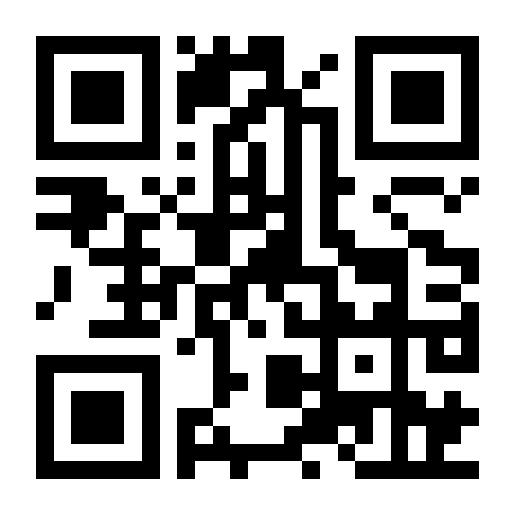

K E E P B U I L D I N G
YOUR FIRST SMART ACCOUNT APP
Give the app a rule, not your key.
Let the account say no.
test.nido.fyi · testnet
github.com/nidohq/nido
github.com/stellar-registry/perch
Notes:
SLIDE 16: Your first smart account app
TIME: 14:20–15:00 (40 seconds)
STAGE CUE: Leave this slide up for questions; the appendix follows.
SCRIPT
For your hackathon project: pick the one action your app takes for a user, write down the rule that should bound it, and let the account enforce it. Ask for that rule once, in plain words, and then get out of the user's way.
Nido gives you the passkey wallet. Perch gives the account a policy you can read. The template gives you a working start. The QR code opens Nido's testnet wallet. Thank you.
SOURCES (not spoken)
https://test.nido.fyi
https://github.com/nidohq/nido/blob/4fee10dc55b877e828c5f9fe60cc6807ea10ea6e/README.md
https://github.com/stellar-registry/perch/blob/2d1df9b3eefbaa70c74bbf83ffb8f96cc9581f63/README.md
Visual template and reused photography/brand assets: https://docs.google.com/presentation/d/1-HRAkfaI2YZQZzSWonXNrDxBCA1HZ4r_OjJ-YvP6lNM/edit

Slide 17
A P P E N D I X
BACKUP
SLIDES
Perch in depth, the full walkthrough, and what broke
Notes:
SLIDE 17: Appendix
TIME: appendix, not part of the 15:00 talk (about 20 seconds if used for questions)
SCRIPT
Backup slides for questions: more of what rules buy you, Perch in depth, what an app can ask Nido for, the rest of the Kudos Jar walkthrough, what the agent tripped on, findings for the Nido team, and how to run Kudos Jar yourself.
Visual template and reused photography/brand assets: https://docs.google.com/presentation/d/1-HRAkfaI2YZQZzSWonXNrDxBCA1HZ4r_OjJ-YvP6lNM/edit

Slide 18
A N D T H R E E M O R E
ONE ADDRESS, MANY KEYS
RECOVERY
Guardians or a recovery kit
SPONSORED START
A relayer pays the fees
ADD AND REMOVE
Devices and app keys come and go
Notes:
SLIDE 18: What rules buy you (2/2)
TIME: appendix, not part of the 15:00 talk (about 60 seconds if used for questions)
SCRIPT
Three more.
Recovery. The same rules can say how you get back in: a quorum of guardians, a zero-knowledge recovery kit, or both. It's opt-in, and you set it up before you need it.
Sponsored onboarding. Because the account is a contract, someone else can pay to create it and to submit its transactions. On testnet, Nido's relayer does exactly that, and new accounts arrive with five test XLM.
And one address, many keys. You can add a second device or an app's key, and remove it later, by updating the account's rules. The address never changes, so your balances and history stay put. Grants also expire on their own, which matters, because today expiry is the bound you can rely on most.
SOURCES (not spoken)
https://github.com/stellar-registry/perch/blob/2d1df9b3eefbaa70c74bbf83ffb8f96cc9581f63/docs/recovery/README.md
https://github.com/nidohq/nido/blob/4fee10dc55b877e828c5f9fe60cc6807ea10ea6e/infra/relayer/README.md
https://github.com/nidohq/nido/blob/4fee10dc55b877e828c5f9fe60cc6807ea10ea6e/packages/frontend/src/components/PolicyBuilder.ts
Visual template and reused photography/brand assets: https://docs.google.com/presentation/d/1-HRAkfaI2YZQZzSWonXNrDxBCA1HZ4r_OjJ-YvP6lNM/edit

Slide 19
P O L I C Y D O C U M E N T S
ONE DOCUMENT,
ONE HASH
Signers, rules, optional recovery.
Canonical JSON, hashed on chain.
apply_doc is the only way to change it.
Every rule names who, where, what, until when, how much
Notes:
SLIDE 19: One document, one hash
TIME: appendix, not part of the 15:00 talk (about 55 seconds if used for questions)
SCRIPT
A Perch policy is one JSON document: a list of signers, a list of rules, and optionally recovery. It's written in a canonical form, so the same document always produces the same bytes, and the account stores its hash.
That gives you a property I really like: anyone can fetch the applied document, hash it, and check it against the chain. Nido's policy page does exactly that.
And there's one way to change an account's authorization: apply a new document. Adding a device, granting an app, removing a key: each is a document update, signed by the account's admin rule.
Each rule says who may sign, which contract it covers, which functions, until which ledger, and optionally how much may move.
SOURCES (not spoken)
https://github.com/stellar-registry/perch/blob/2d1df9b3eefbaa70c74bbf83ffb8f96cc9581f63/CANONICAL.md
https://github.com/stellar-registry/perch/blob/2d1df9b3eefbaa70c74bbf83ffb8f96cc9581f63/crates/perch-smart-account/src/lib.rs
https://github.com/stellar-registry/perch/blob/2d1df9b3eefbaa70c74bbf83ffb8f96cc9581f63/crates/perch-account/src/lib.rs
Visual template and reused photography/brand assets: https://docs.google.com/presentation/d/1-HRAkfaI2YZQZzSWonXNrDxBCA1HZ4r_OjJ-YvP6lNM/edit

Slide 20
H O W I T R U N S
DOCUMENT TO ENFORCEMENT
01
Write the document
02
Compile it on chain
03
Install as account rules
04
Enforce in __check_auth
Notes:
SLIDE 20: From document to enforcement
TIME: appendix, not part of the 15:00 talk (about 55 seconds if used for questions)
SCRIPT
How does a document become enforcement?
You write the document, or a wallet writes it for you. The account sends it to Perch's doc compiler, which is itself a contract, so compilation happens on chain. The compiler lowers each rule onto an OpenZeppelin context rule. Simple rules need nothing more than OpenZeppelin's own signer check. Rules with constraints get a small program for Perch's interpreter, and a cap attaches OpenZeppelin's spending-limit policy next to it.
Then, on every authorization, the account picks the rule the signature names, checks scope and expiry, verifies the signers, and runs every attached policy. All of them must pass. The interpreter denies by default: if anything can't be decoded, the answer is no.
SOURCES (not spoken)
https://github.com/stellar-registry/perch/blob/2d1df9b3eefbaa70c74bbf83ffb8f96cc9581f63/crates/perch-doc-compiler/src/lib.rs
https://github.com/stellar-registry/perch/blob/2d1df9b3eefbaa70c74bbf83ffb8f96cc9581f63/crates/perch-interpreter/src/lib.rs
https://github.com/stellar-registry/perch/blob/2d1df9b3eefbaa70c74bbf83ffb8f96cc9581f63/crates/perch-spending-limit/src/lib.rs
Visual template and reused photography/brand assets: https://docs.google.com/presentation/d/1-HRAkfaI2YZQZzSWonXNrDxBCA1HZ4r_OjJ-YvP6lNM/edit

Slide 21
W H O M A Y S I G N
VERIFIERS
Coming: ML-DSA (post-quantum) as one more verifier contract. On Perch’s roadmap; not built yet.
ED25519
Classic keys, as a verifier contract
WEBAUTHN
Passkeys on P-256
DELEGATED
Another account signs (CAP-71)
Notes:
SLIDE 21: Verifiers
TIME: appendix, not part of the 15:00 talk (about 55 seconds if used for questions)
SCRIPT
Who can sign for a Perch account? Three kinds of signer today.
Ed25519, the classic key type, checked by a verifier contract. WebAuthn, for passkeys on the P-256 curve, also a verifier contract; this is what Nido uses for its admin key. And delegated signers: any G or C address, authenticated by the host inside the account's own authorization entry, using a protocol 27 feature, CAP-71. That's what the demo app's session key is.
Because verifiers are contracts, new signature schemes can be added without changing accounts. ML-DSA, a post-quantum scheme, is on Perch's roadmap as exactly that kind of verifier. It is not built yet, so treat it as direction, not a feature.
SOURCES (not spoken)
https://github.com/stellar-registry/perch/blob/2d1df9b3eefbaa70c74bbf83ffb8f96cc9581f63/crates/perch-ed25519-verifier/src/lib.rs
https://github.com/stellar-registry/perch/blob/2d1df9b3eefbaa70c74bbf83ffb8f96cc9581f63/crates/perch-webauthn-verifier/src/lib.rs
https://github.com/stellar-registry/perch/blob/2d1df9b3eefbaa70c74bbf83ffb8f96cc9581f63/docs/recovery/cap-0071.md
https://github.com/stellar-registry/perch/blob/2d1df9b3eefbaa70c74bbf83ffb8f96cc9581f63/docs/slides/index.html
Visual template and reused photography/brand assets: https://docs.google.com/presentation/d/1-HRAkfaI2YZQZzSWonXNrDxBCA1HZ4r_OjJ-YvP6lNM/edit

Slide 22
C O N T E N T - A D D R E S S E D P U B L I S H I N G
CONSTRUCTORLESS
Shared contracts deploy with no arguments.
Address = registry + hash of the wasm.
Accounts pin them by hash; no one repoints.
Upgrades wait ~7 days
Notes:
SLIDE 22: Constructorless publishing
TIME: appendix, not part of the 15:00 talk (about 55 seconds if used for questions)
SCRIPT
Perch's shared contracts, the compiler, the interpreter, the verifiers, the spending limit, are published through a Stellar Registry instance that only deploys them one way: no constructor arguments, and the deploy salt is the hash of the wasm. So the address of each contract is a pure function of the registry and the code.
That has a nice consequence. An account build pins its compiler, interpreter and spending limit by hash, at build time. There's no admin setting that can point your account at different code later.
If the account itself needs new code, it goes through a scheduled upgrade with a delay of about seven days, which the owner can cancel.
SOURCES (not spoken)
https://github.com/stellar-registry/perch/blob/2d1df9b3eefbaa70c74bbf83ffb8f96cc9581f63/crates/perch-constructorless-registry/src/lib.rs
https://github.com/stellar-registry/perch/blob/2d1df9b3eefbaa70c74bbf83ffb8f96cc9581f63/AGENTS.md
https://github.com/stellar-registry/perch/blob/2d1df9b3eefbaa70c74bbf83ffb8f96cc9581f63/docs/deploy/README.md
Visual template and reused photography/brand assets: https://docs.google.com/presentation/d/1-HRAkfaI2YZQZzSWonXNrDxBCA1HZ4r_OjJ-YvP6lNM/edit

Slide 23
A C C O U N T S
ACCOUNTS AND
FACTORIES
Rule 0, admin: full owner authority.
Perch factory: the address commits to its signers.
Nido factory: the address exists before the passkey.
Everything else arrives as a document
Notes:
SLIDE 23: Accounts and factories
TIME: appendix, not part of the 15:00 talk (about 55 seconds if used for questions)
SCRIPT
Every Perch account starts with one rule, admin, created by its constructor. Admin is scoped to the account itself, which sounds narrow, but it covers apply-doc and execute, so it is full owner authority. Every other rule arrives later as a document.
Accounts come from factories. Perch's own factory derives the address from the admin signers, so an address commits to who controls it.
Nido runs its own factory, for a practical reason: a passkey is bound to a web origin, and Nido gives every account its own subdomain. So the address has to exist before the passkey. Nido reserves it with a one-time setup key, then binds the passkey, and its relayer pays for the deployment.
SOURCES (not spoken)
https://github.com/stellar-registry/perch/blob/2d1df9b3eefbaa70c74bbf83ffb8f96cc9581f63/crates/perch-account/src/lib.rs
https://github.com/stellar-registry/perch/blob/2d1df9b3eefbaa70c74bbf83ffb8f96cc9581f63/crates/perch-account-factory/src/lib.rs
https://github.com/nidohq/nido/blob/4fee10dc55b877e828c5f9fe60cc6807ea10ea6e/DEPLOYED.md
https://github.com/nidohq/nido/blob/4fee10dc55b877e828c5f9fe60cc6807ea10ea6e/contracts/factory/src/contract.rs
Visual template and reused photography/brand assets: https://docs.google.com/presentation/d/1-HRAkfaI2YZQZzSWonXNrDxBCA1HZ4r_OjJ-YvP6lNM/edit

Slide 24
T H E D A P P I N T E R F A C E
WHAT AN APP CAN ASK
01
Connect: the C-address
02
Sign one transaction
03
Grant a scoped session
04
Recovery stays in Nido
Notes:
SLIDE 24: What a dApp can ask Nido for
TIME: appendix, not part of the 15:00 talk (about 45 seconds if used for questions)
SCRIPT
From an app's point of view, Nido shows up in Stellar Wallets Kit next to the usual wallets. Four things you can ask it for.
Connect, which gives you the account's address and nothing else. Sign a transaction, in a popup, with the passkey; Nido's relayer submits it and hands you back the hash. Grant a scoped session: the app holds a key, and the owner approves a rule for it, once. And everything about the account itself, recovery, devices, policies, stays in Nido's own pages.
The popup can only sign calls on the account itself, which is why apps use the session for their own contracts.
SOURCES (not spoken)
https://github.com/nidohq/nido/blob/4fee10dc55b877e828c5f9fe60cc6807ea10ea6e/docs/ADD-NIDO-TO-DAPP.md
https://github.com/nidohq/nido/blob/4fee10dc55b877e828c5f9fe60cc6807ea10ea6e/packages/stellar-wallets-kit-module/src/module.ts
https://github.com/nidohq/nido/blob/4fee10dc55b877e828c5f9fe60cc6807ea10ea6e/packages/frontend/src/lib/policy/docRequest.ts
Visual template and reused photography/brand assets: https://docs.google.com/presentation/d/1-HRAkfaI2YZQZzSWonXNrDxBCA1HZ4r_OjJ-YvP6lNM/edit

Slide 25
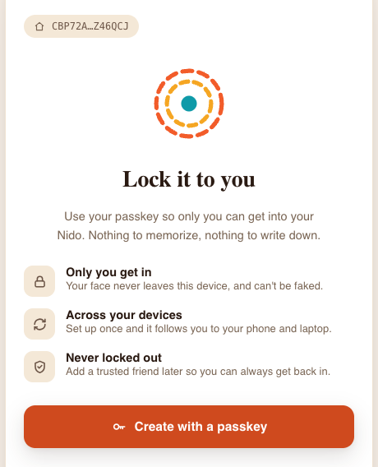
W A L K T H R O U G H · S I G N I N
A PASSKEY ACCOUNT
RESERVE
The C-address exists first
LOCK
One passkey ceremony
FUNDED
5 test XLM, fees sponsored
test.nido.fyi on testnet
Notes:
SLIDE 25: Walkthrough: a passkey account
TIME: appendix, not part of the 15:00 talk (about 35 seconds if used for questions)
SCRIPT
The walkthrough starts on Nido. Nido reserves the account's address first, here CBP7-something, and then asks for a passkey, which gets bound to that address's own subdomain.
One ceremony, and the relayer deploys the account and funds it with five test XLM. The person never needed XLM, a seed phrase, or a browser extension. It took a minute or two, most of it waiting for the network.
SOURCES (not spoken)
Kudos Jar, an agent-built demo app run live on testnet, Oct 2026
https://github.com/nidohq/nido/blob/4fee10dc55b877e828c5f9fe60cc6807ea10ea6e/packages/frontend/src/pages/new-account/index.astro
Visual template and reused photography/brand assets: https://docs.google.com/presentation/d/1-HRAkfaI2YZQZzSWonXNrDxBCA1HZ4r_OjJ-YvP6lNM/edit

Slide 26
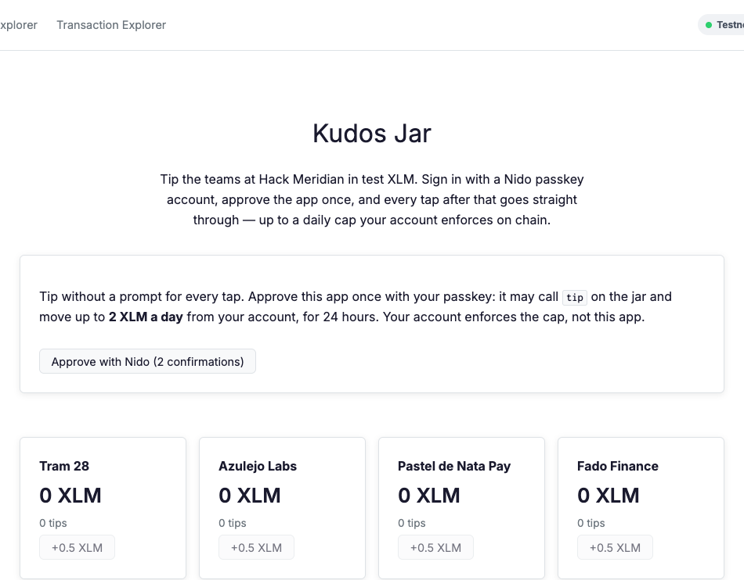
W A L K T H R O U G H · C O N N E C T
CONNECT, THEN ASK ONCE
PICK NIDO
From the usual wallet list
THE ACCOUNT
C-address and its XLM balance
ONE REQUEST
Two rules, two confirmations
Kudos Jar, running locally
Notes:
SLIDE 26: Walkthrough: connect and ask once
TIME: appendix, not part of the 15:00 talk (about 40 seconds if used for questions)
SCRIPT
Next, in the app. Connect, choose Nido from the regular wallet list, pick the account. The app now knows the C-address and reads its balance from the XLM token contract.
Then it asks one thing, up front, in plain words: may this app call tip on the jar, and move up to two XLM a day from your account, for twenty-four hours? That's two rules, because a tip touches two contracts, the jar and the XLM token, so it's two passkey confirmations.
SOURCES (not spoken)
Kudos Jar, an agent-built demo app run live on testnet, Oct 2026
Kudos Jar’s KudosBoard component, same run
Visual template and reused photography/brand assets: https://docs.google.com/presentation/d/1-HRAkfaI2YZQZzSWonXNrDxBCA1HZ4r_OjJ-YvP6lNM/edit

Slide 27
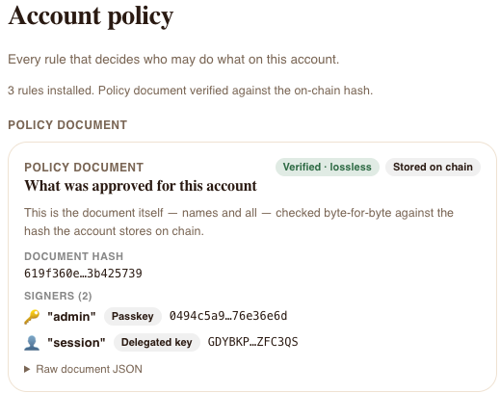
A F T E R W A R D S
THE ACCOUNT’S POLICY
DOCUMENT
Hash verified against the chain
RULES
admin, kudos-tip, kudos-xlm
KEYS
A passkey and the app’s key
Nido’s policy page
Notes:
SLIDE 27: Walkthrough: the policy afterwards
TIME: appendix, not part of the 15:00 talk (about 30 seconds if used for questions)
SCRIPT
Afterwards, the account's policy page in Nido shows the document: its hash, checked byte for byte against the one stored on chain, the two signers, the passkey and the app's key, and the three rules.
When the rules expire, the app's key stops working, with nothing for anyone to remember to clean up.
SOURCES (not spoken)
Kudos Jar, an agent-built demo app run live on testnet, Oct 2026
https://github.com/nidohq/nido/blob/4fee10dc55b877e828c5f9fe60cc6807ea10ea6e/packages/frontend/src/lib/policyChainFetch.ts
Visual template and reused photography/brand assets: https://docs.google.com/presentation/d/1-HRAkfaI2YZQZzSWonXNrDxBCA1HZ4r_OjJ-YvP6lNM/edit

Slide 28
T H E R E A C T C A L L S I T E
THE CODE THAT MATTERS
const tx = await kudosJar.tip(
{ from: address, team: team.id, amount: 5_000_000n },
{ publicKey: transactionSource(address) },
)
const { result } = await submitContract(tx, address)
transactionSource and submitContract are template helpers from @stellar-scaffold/app-lib.
Notes:
SLIDE 28: Walkthrough: the call site
TIME: appendix, not part of the 15:00 talk (about 45 seconds if used for questions)
SCRIPT
For developers, the code is short. The generated client builds the tip call. transactionSource keeps the C-address out of the transaction source, because a contract can't be one.
submitContract does the rest. For a classic wallet it signs and sends as usual. For a Nido account with an approved session, the app's key signs a CAP-71 entry that names the right rule for each contract, submits, and returns the confirmed result.
Both helpers come from the template's app-lib, not the Stellar SDK. Kudos Jar predates submitCall, which now wraps these steps in one call.
SOURCES (not spoken)
Kudos Jar’s KudosBoard component, same run
../template/app-lib/session.ts
Visual template and reused photography/brand assets: https://docs.google.com/presentation/d/1-HRAkfaI2YZQZzSWonXNrDxBCA1HZ4r_OjJ-YvP6lNM/edit

Slide 29
F I X E D I N T H E T E M P L A T E
WHAT THE AGENT TRIPPED ON
SILENT TOOLS
Old Scaffold wrote no clients
BLOCKED POPUP
Simulation outlived the click
WRONG PATH
Popup signing, then non-root auth
Notes:
SLIDE 29: What the agent tripped on
TIME: appendix, not part of the 15:00 talk (about 65 seconds if used for questions)
SCRIPT
What got in the way, and what we changed.
Silent tools. The globally installed Scaffold was too old for the template's config, and it failed silently: it compiled contracts and wrote no clients. The template now installs its own tested Scaffold with tools-colon-scaffold, and refuses an older one. A fresh client also brought its own copy of the Stellar SDK, which broke types, so there's a script that folds it back in.
A blocked popup. The app built and simulated the call before opening Nido's popup, and by then the browser had forgotten the click. The template now reserves the popup during the click.
And the wrong path twice: first the popup signing we just saw, then a contract that skipped require-auth to save a rule, which simulation refuses. The agent's own instructions file now says both.
SOURCES (not spoken)
Log of the agent-built Kudos Jar run, Oct 2026
../template/NIDO.md
Visual template and reused photography/brand assets: https://docs.google.com/presentation/d/1-HRAkfaI2YZQZzSWonXNrDxBCA1HZ4r_OjJ-YvP6lNM/edit

Slide 30
F O R T H E N I D O T E A M
FOUND ALONG THE WAY
NIDO SIGNER
Admin rule only: no app calls
NIDO RELAYER
Can’t relay CAP-71 entries yet
DOCS
Still describe signed XDR
Notes:
SLIDE 30: Upstream findings
TIME: appendix, not part of the 15:00 talk (about 55 seconds if used for questions)
SCRIPT
A few findings belong upstream, and we've written them up.
Nido's signer, as we saw, signs only under the admin rule. Nido's relayer can't yet decode the CAP-71 entries that its own session grants produce, so the demo's session key pays its own fees. And Nido's integration guide still says the wallet returns signed XDR for the app to submit; the code now submits and returns a hash, and the template handles that.
The dry run added more for Nido: tell the app why the relayer refused, and let it pay its own fee when the budget is gone. The template's half of both is ready; the feedback report has the full list.
SOURCES (not spoken)
Log of the agent-built Kudos Jar run, Oct 2026
Feedback report from a six-team simulated hackathon run, Oct 2026 §5.2, §6
https://github.com/nidohq/nido/blob/4fee10dc55b877e828c5f9fe60cc6807ea10ea6e/docs/ADD-NIDO-TO-DAPP.md
https://github.com/nidohq/nido/blob/4fee10dc55b877e828c5f9fe60cc6807ea10ea6e/packages/stellar-wallets-kit-module/README.md
Visual template and reused photography/brand assets: https://docs.google.com/presentation/d/1-HRAkfaI2YZQZzSWonXNrDxBCA1HZ4r_OjJ-YvP6lNM/edit

Slide 31
T R Y I T T O N I G H T
RUN KUDOS JAR
01
npm ci
02
npm run clients:testnet
03
npm run dev
04
Create a Nido, approve, tip
Notes:
SLIDE 31: Run Kudos Jar yourself
TIME: appendix, not part of the 15:00 talk (about 35 seconds if used for questions)
STAGE CUE: Have the app open in a tab as a fallback if the network is slow.
SCRIPT
To try the demo app tonight: clone the repository, go into examples slash kudos-jar, run npm ci, generate the client for the demo jar with clients-colon-testnet, and npm run dev.
Create a Nido account at test.nido.fyi, connect, approve the session, and tip. To start your own app instead, follow the build-your-own slide: the template's NIDO.md has the rules for you, and AGENTS.md has them for your coding agent.
SOURCES (not spoken)
Kudos Jar, an agent-built demo app run live on testnet, Oct 2026
../template/NIDO.md
Visual template and reused photography/brand assets: https://docs.google.com/presentation/d/1-HRAkfaI2YZQZzSWonXNrDxBCA1HZ4r_OjJ-YvP6lNM/edit

