Slide 1
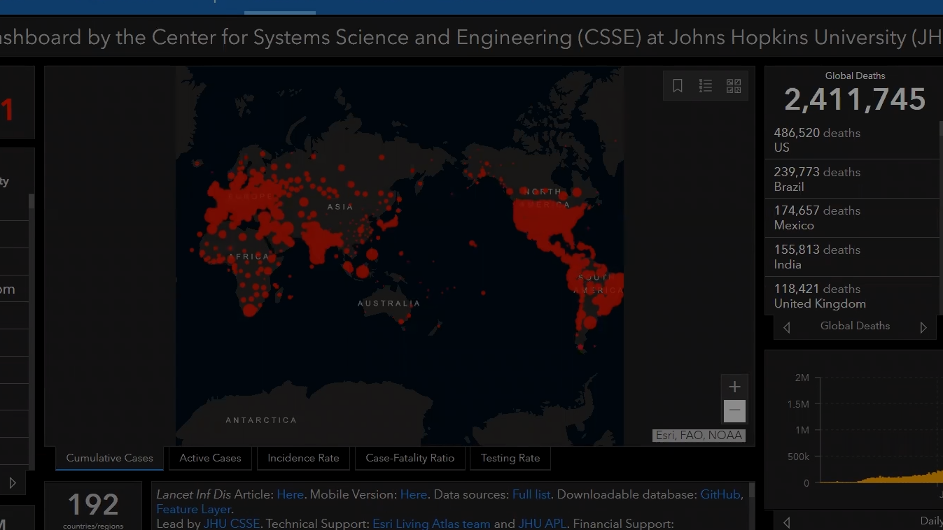

COVID-19 Global Case Study
Storyline built from the OWID dataset
Data through 2024-08-14
243 countries
67 variables
Prepared as a presentation-ready summary of global burden, geography, income segmentation, and statistical patterns.
Notes:
[Sources] - User-uploaded owid-covid-data.csv - User-uploaded covid19-case-study.ipynb - User-provided dashboard reference image

Slide 2
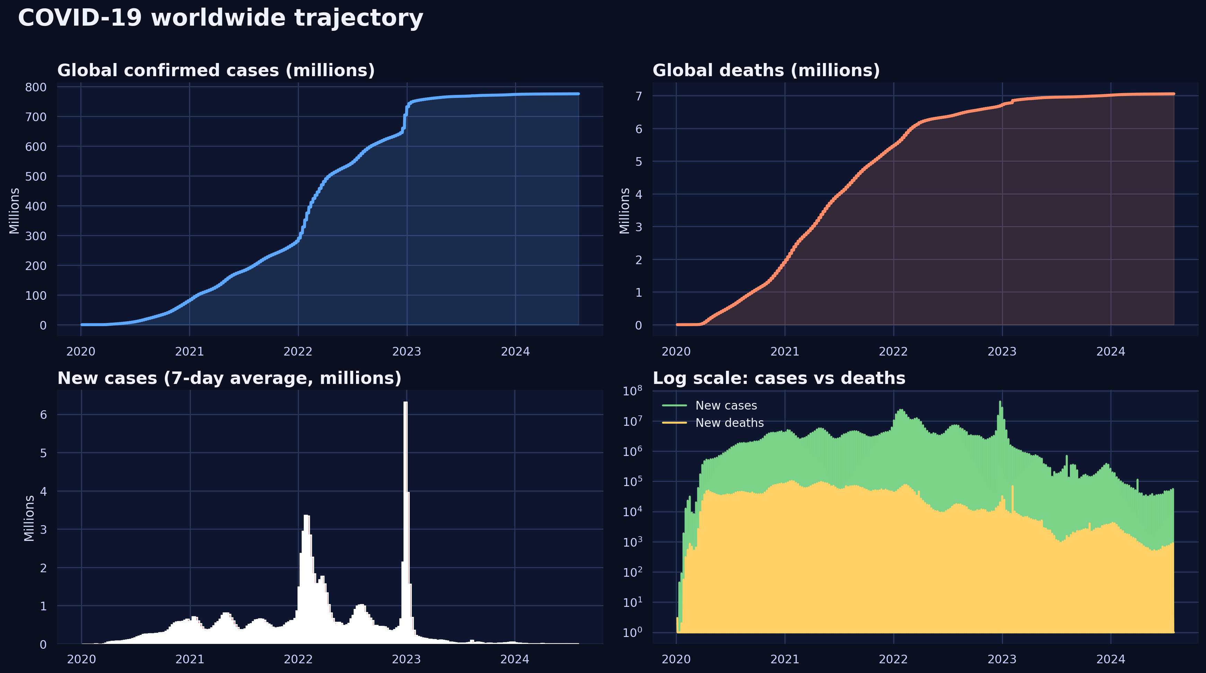
Executive summary
The uploaded analysis points to a large, uneven, and structurally different global burden.
Global confirmed cases
Global deaths
Cases / world population
Peak reported daily new cases
775.9M
7.1M
9.7%
44.2M
What matters most
• Confirmed cases peaked at 44.2M on 2022-12-25.
• Asia carried the largest cumulative case burden at 301.5M.
• Africa showed the highest mortality rate (1.97%), while Oceania stayed lowest (0.22%).
• High-income groups accumulated 429.0M cases, far above low-income groups at 1.9M.
Notes:
[Sources] - User-uploaded owid-covid-data.csv - User-uploaded covid19-case-study.ipynb

Slide 3
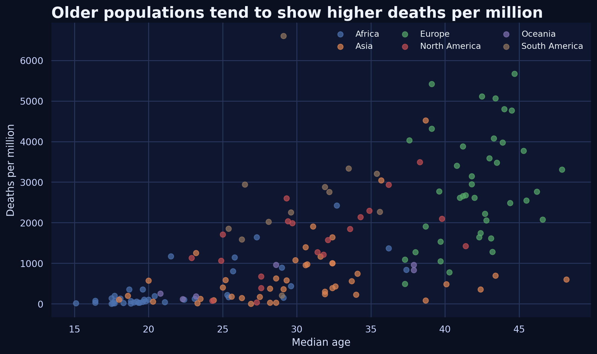
Data scope and analysis logic
The presentation follows the structure of your Kaggle notebook: understand → aggregate → visualize → test.
Dataset footprint
Method choices
Structural view
• Filtered to country rows when comparing locations.
A demographic cross-check shows that countries with older populations tend to exhibit higher deaths per million in the uploaded extract.
Rows
Columns
429K
67
• Used latest available record per country for rankings.
Context layer before deeper comparisons
• Used log transform + Shapiro checks before correlation.
Entities
Countries
255
243
Latest data point
2024-08-14
Scope caveat:
this is reported confirmed case data, so interpretation should focus on burden and patterns rather than true infections.
Notes:
[Sources] - User-uploaded owid-covid-data.csv - User-uploaded covid19-case-study.ipynb

Slide 4
Global trajectory over time
Cumulative counts climb continuously, while new cases and deaths move in distinct waves.
Key read-outs
9.7%
of the world population appears in the dataset as confirmed cases.
44.2M
highest reported daily increase
(2022-12-25)
7.1M
global deaths accumulated more slowly than cases but remained substantial.
Wave patterns matter
Use date filters in dashboard
Notes:
[Sources] - User-uploaded owid-covid-data.csv - User-uploaded covid19-case-study.ipynb

Slide 5
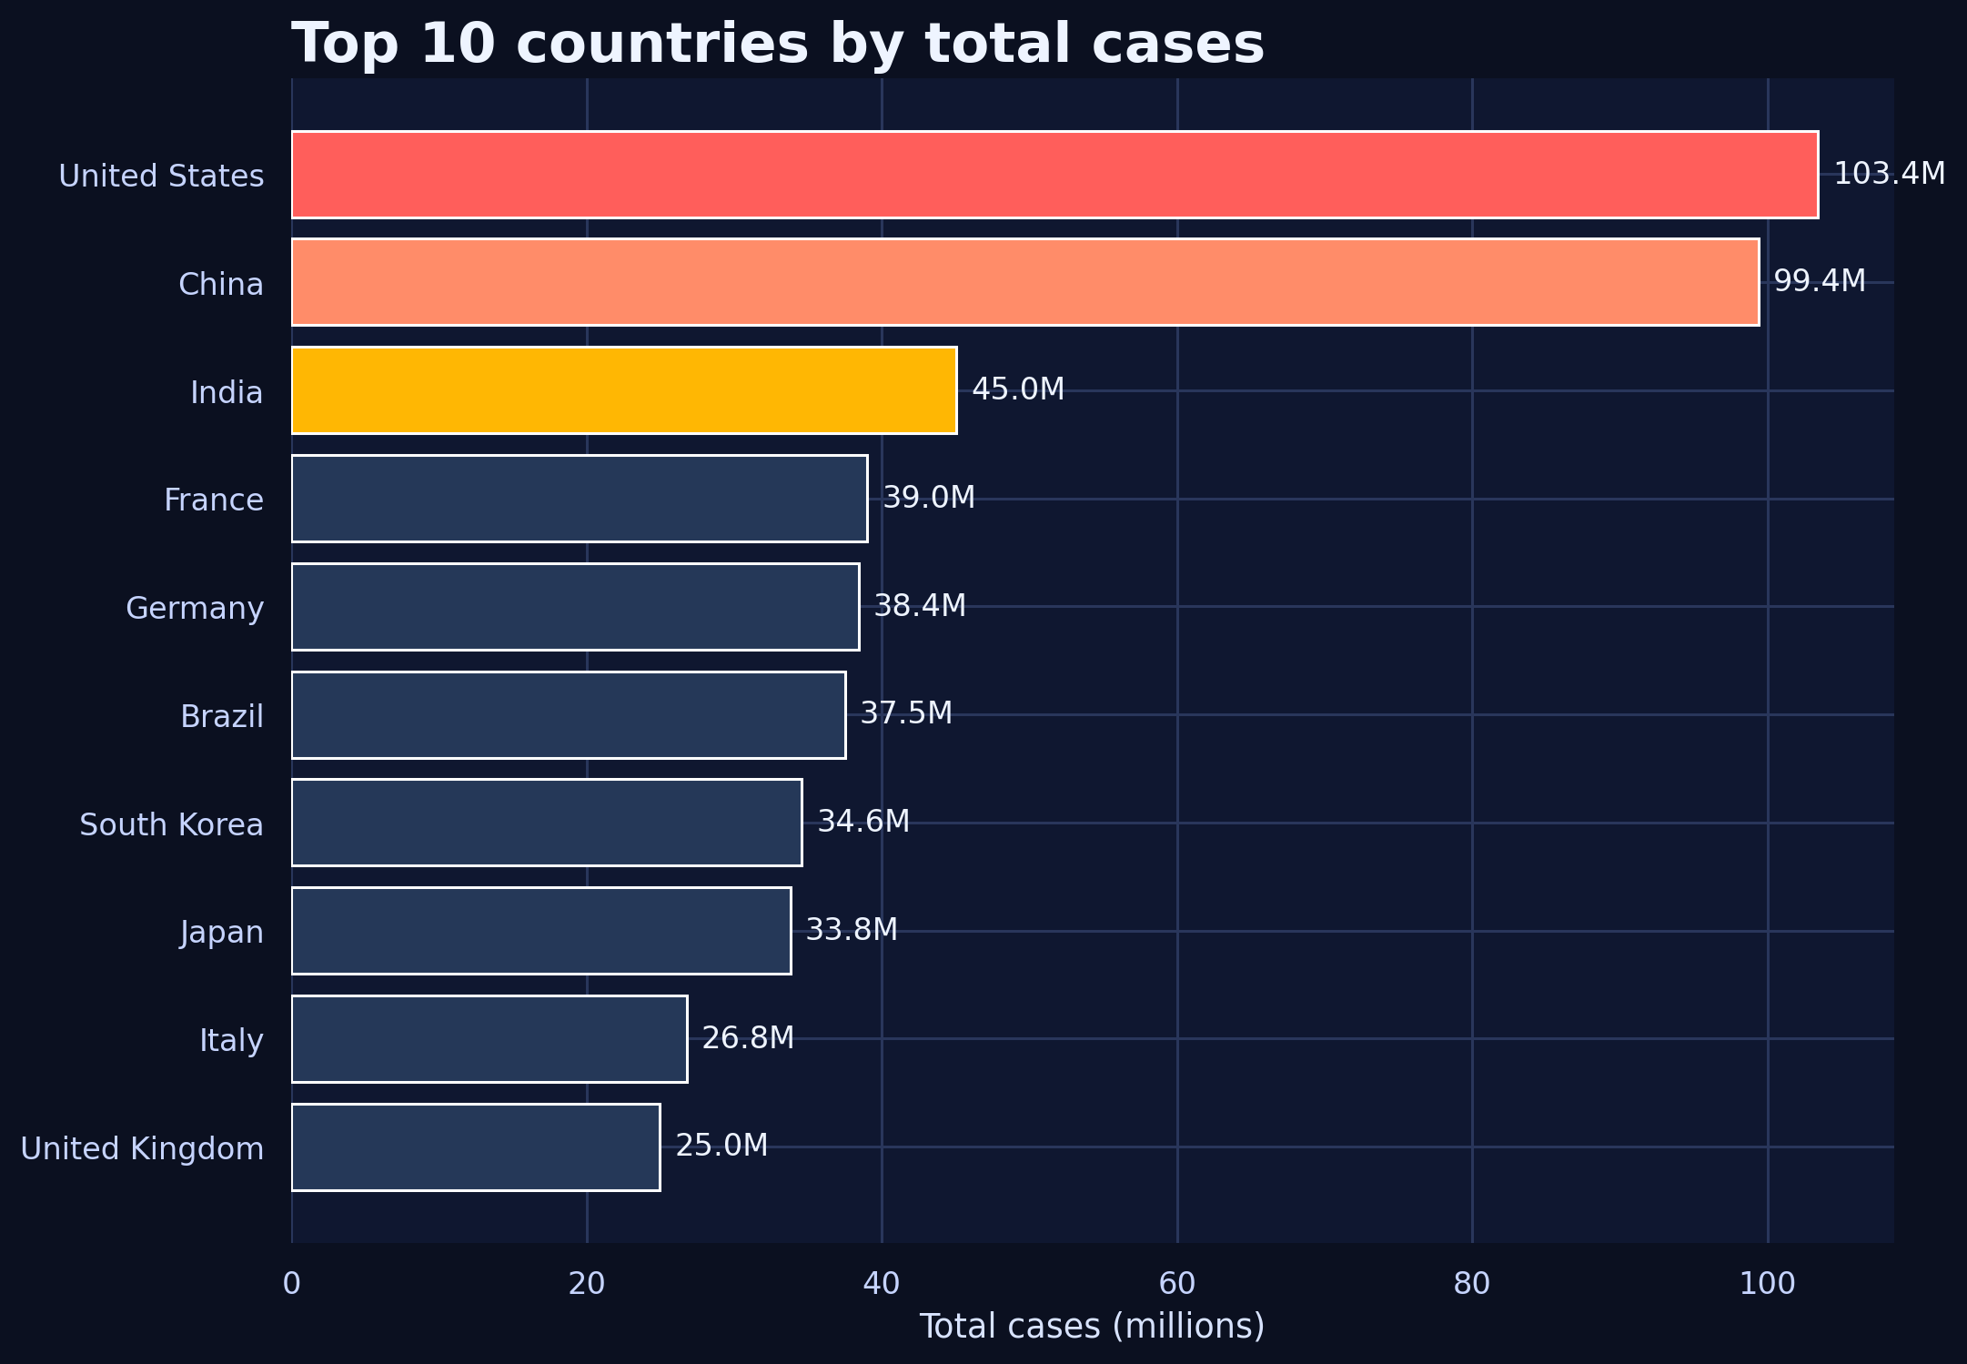
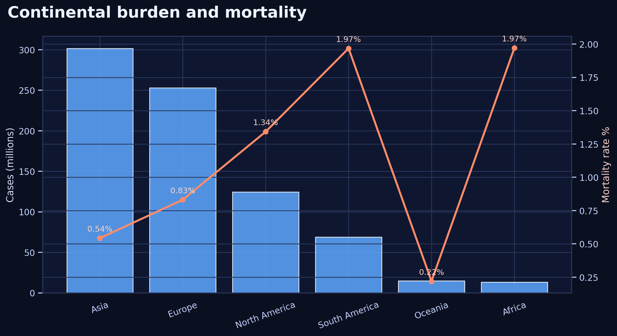
Geographic concentration of burden
Country rankings and continent summaries show concentration, but mortality differs by region.
The United States ranks first in cumulative cases (103.4M), while Asia contributes the largest continental total. Mortality is highest in Africa (~1.97%) and lowest in Oceania (~0.22%).
Notes:
[Sources] - User-uploaded owid-covid-data.csv - User-uploaded covid19-case-study.ipynb

Slide 6
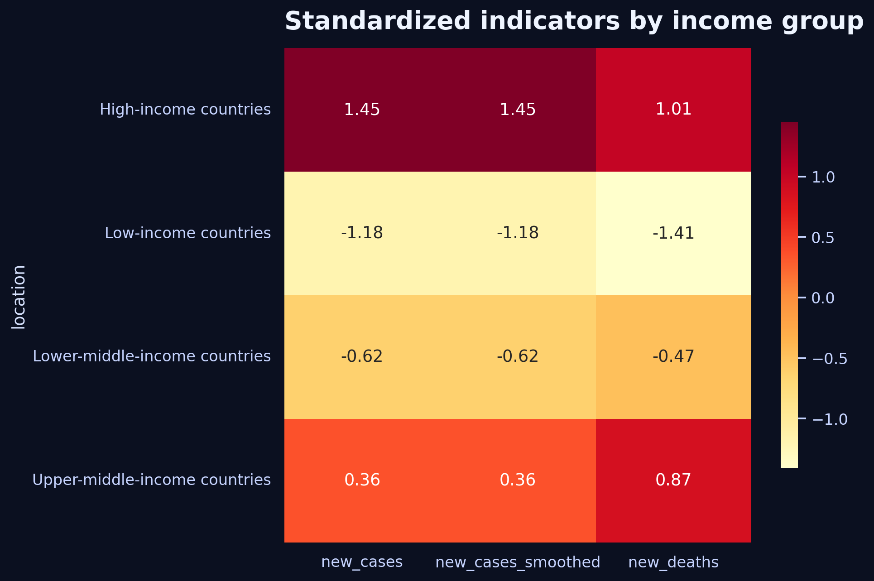
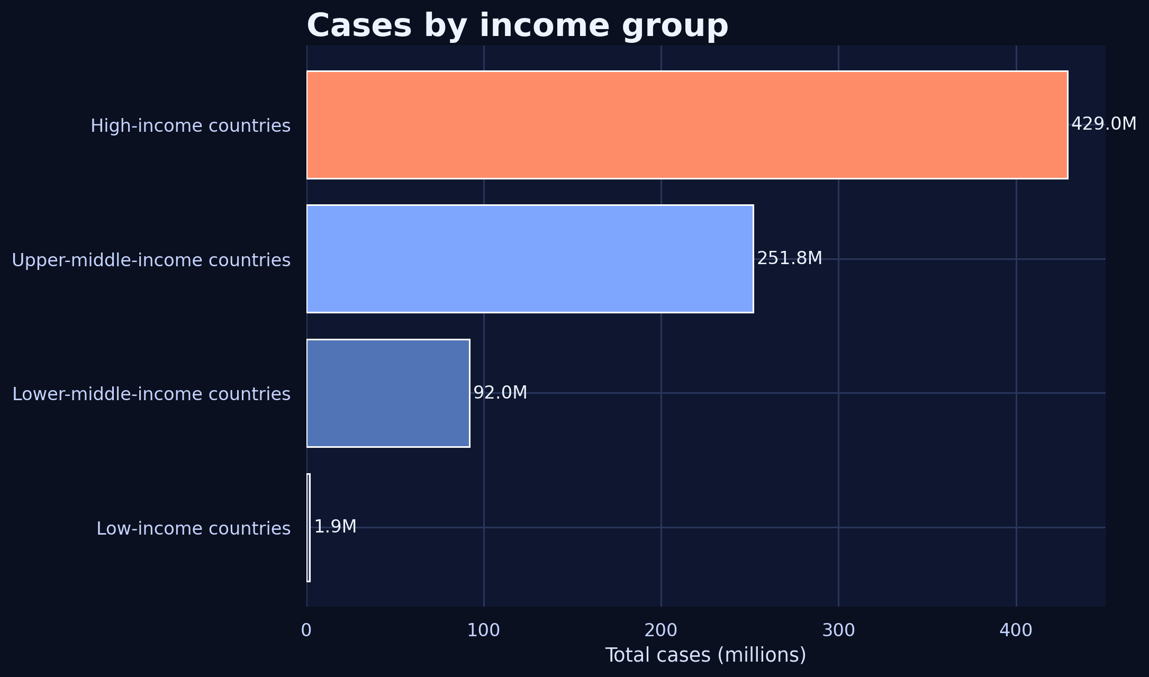
Income segmentation and structural differences
Economic grouping changes the scale of cases and the pattern of standardized indicators.
High-income countries dominate the cumulative case count (429.0M), while upper-middle-income countries form the second largest block (251.8M). The heatmap suggests meaningful differences in GDP, new cases, and new deaths across income tiers.
Notes:
[Sources] - User-uploaded owid-covid-data.csv - User-uploaded covid19-case-study.ipynb

Slide 7
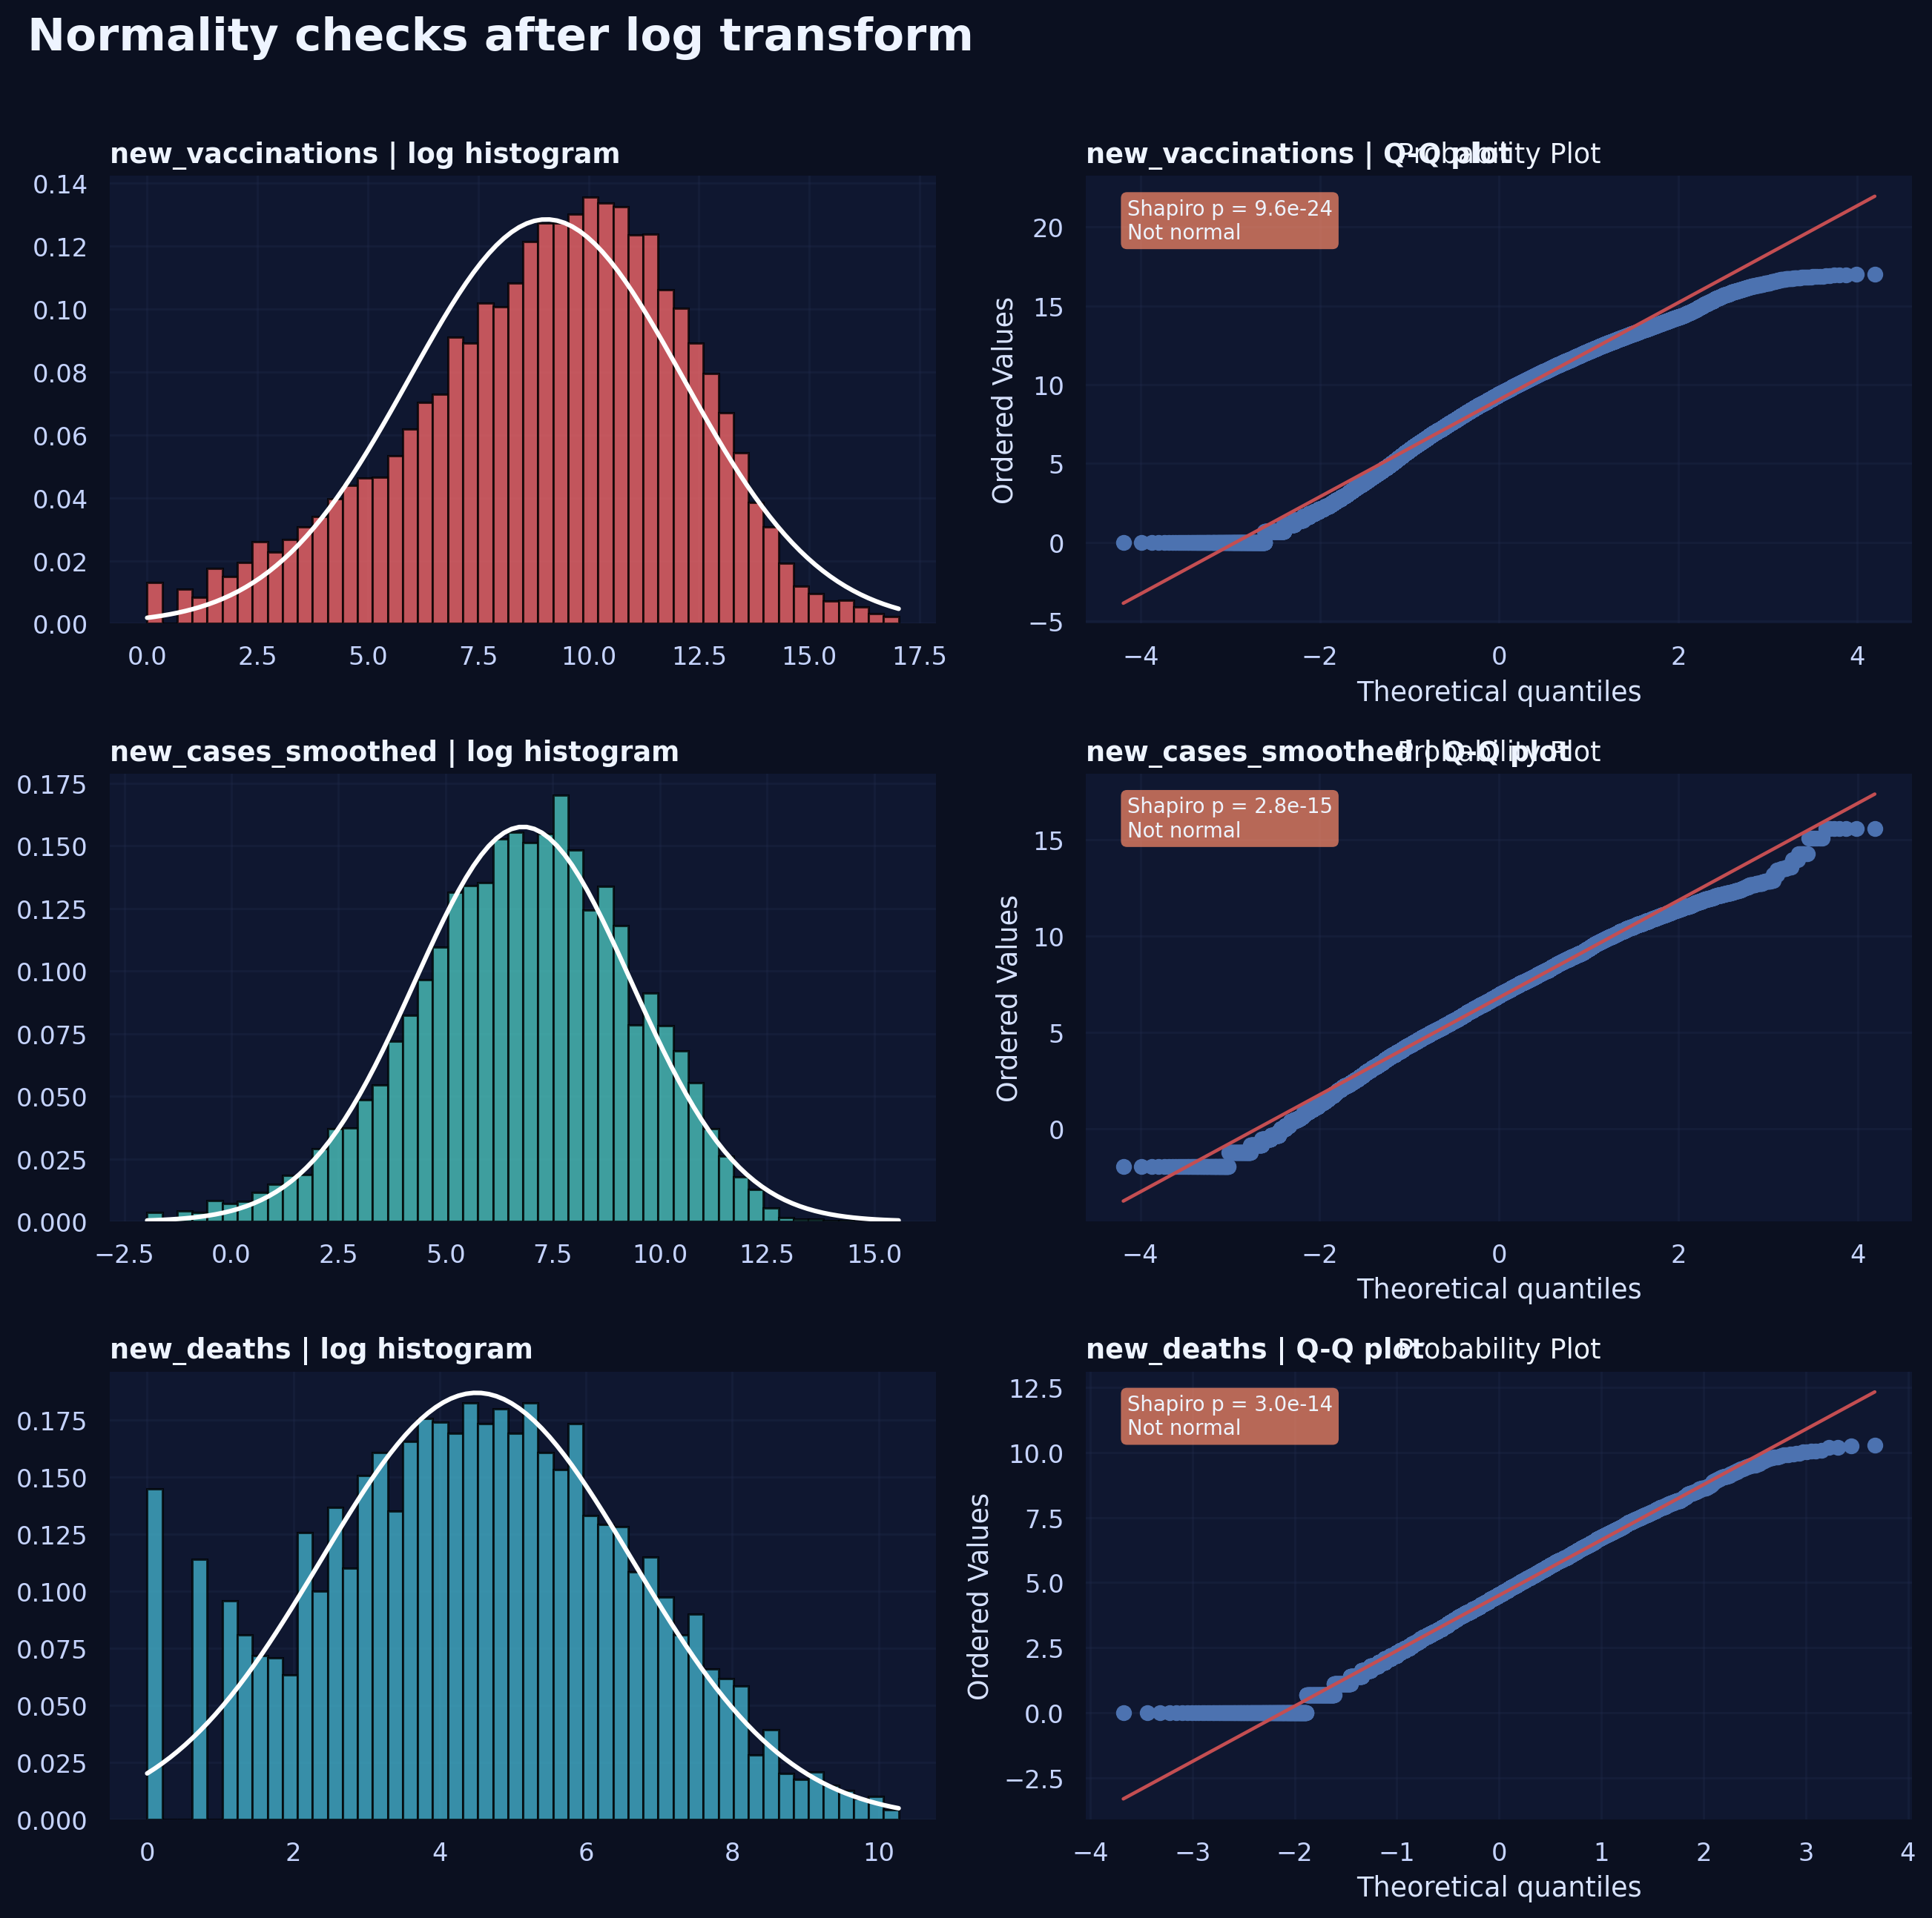
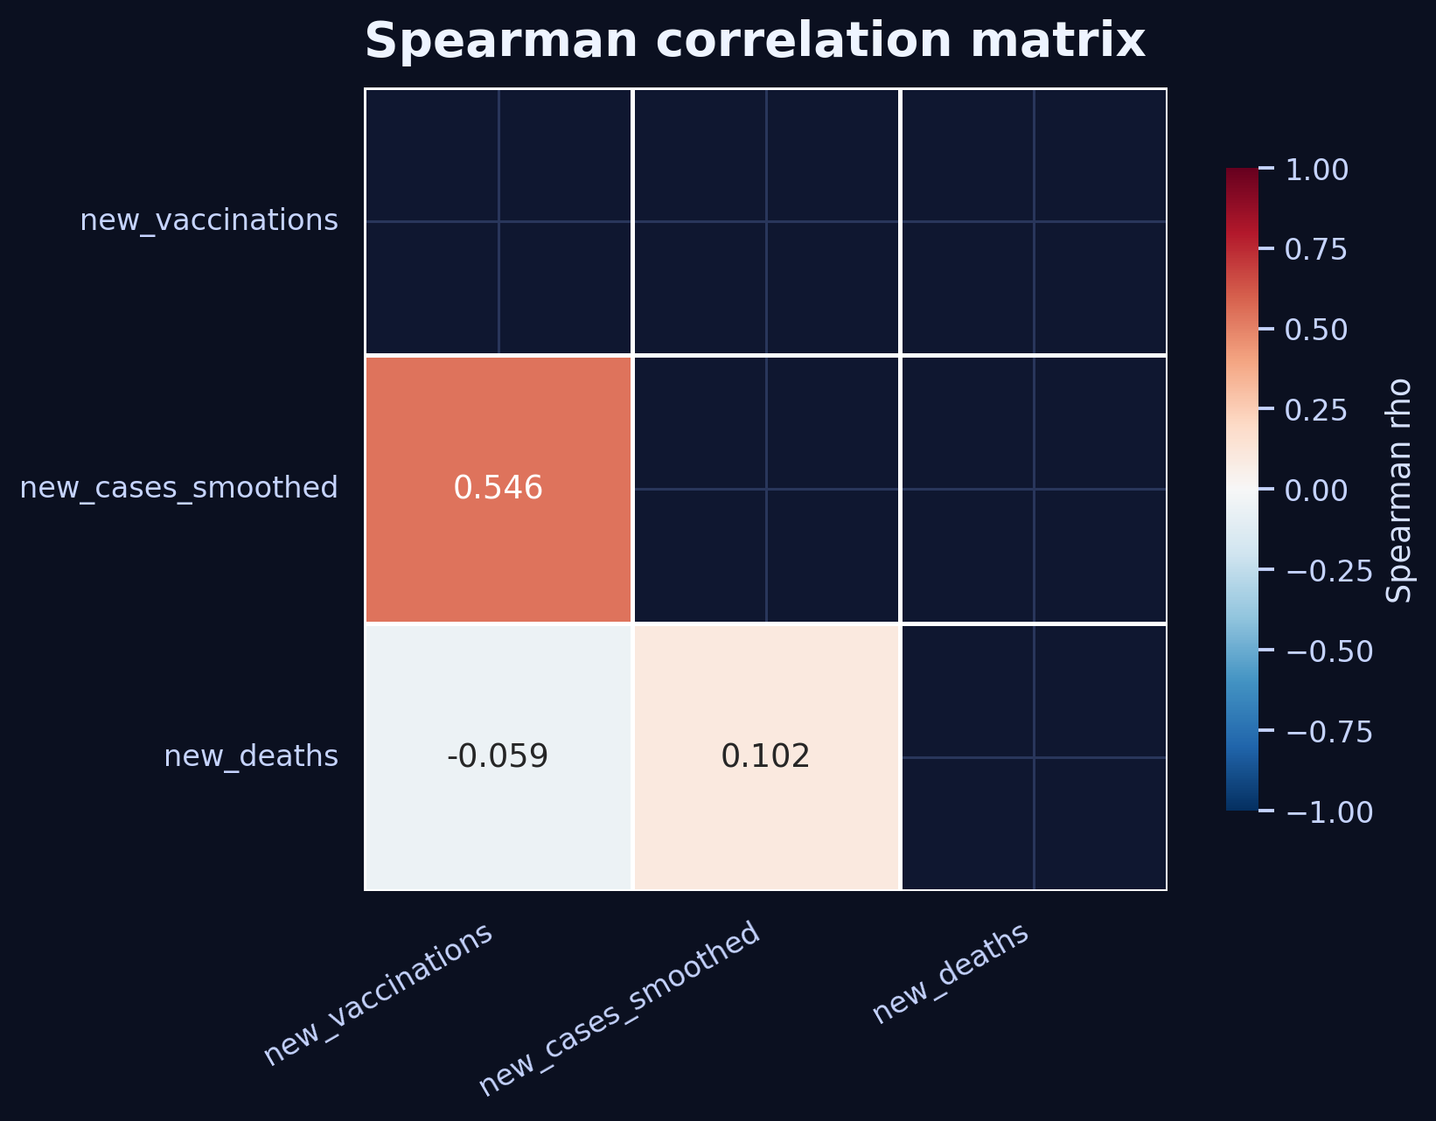
Statistical validation and correlation findings
Normality was rejected after log transformation, so the notebook correctly moved to Spearman correlation.
Interpretation
• Vaccinations vs new cases: ρ = 0.546 (moderate positive).
• Vaccinations vs deaths: ρ = -0.059 (very weak negative).
• New cases vs deaths: ρ = 0.102 (weak positive).
This pattern supports the notebook’s conclusion: timing, policy response, healthcare capacity, and lag effects all shape the relationships seen in aggregated COVID data.
Notes:
[Sources] - User-uploaded owid-covid-data.csv - User-uploaded covid19-case-study.ipynb

Slide 8
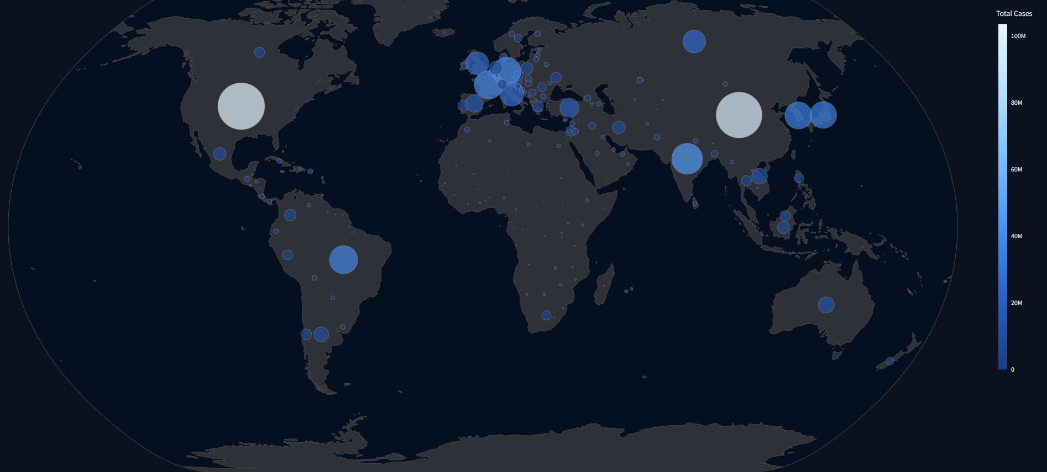
From analysis to dashboard
The same dataset can power an interactive Streamlit experience with filters, time windows, and country comparisons.
Suggested dashboard story
Map
Filters
Rankings
Daily curve
• Global KPI cards for cases, deaths, vaccinations, and daily change.
• Date-range picker to isolate any wave or policy period.
• Country and continent filters to compare burden across regions.
• Trend views, ranking tables, and correlation charts on one canvas.
Use this presentation as the narrative layer, and the Streamlit app as the exploration layer.
Notes:
[Sources] - User-uploaded owid-covid-data.csv - User-uploaded covid19-case-study.ipynb - User-provided dashboard reference image

