Slide 1
The Scientific Method
Intro to Scientific Inquiry

Slide 2
Nature of Scientific Inquiry
Natural phenomena governed by physical processes
Physical processes similar today as in the past
Scientists discover these processes and make predictions.
Called the scientific method

Slide 3
The Nature of Scientific Inquiry
Science is a process of producing knowledge
Based on making observations and developing explanations
Assumes the natural world behaves consistently and predictably
The goal of science is to discover patterns in nature and use that knowledge to make predictions.
Data are essential to science and the development of scientific theories.
Scientific Inquiry is a Logical, problem-solving technique

Slide 4
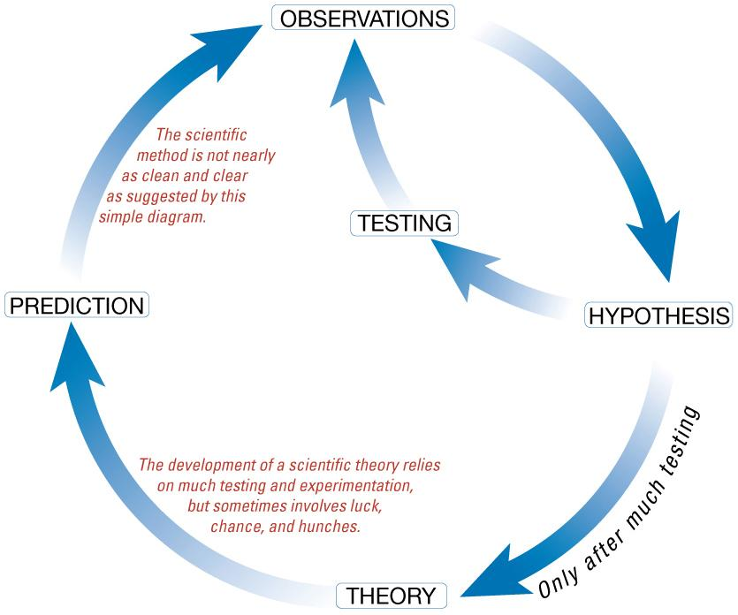
The Scientific Method

Slide 5
The Nature of Scientific Inquiry, Continued
How or why things happen are explained using:
Hypothesis - a tentative (or untested) explanation
A hypothesis must fit observations and be testable
Theory - a well-tested and widely accepted view that the scientific community agrees best explains certain observable facts
How it begins:
Identify a Problem--observe the world around you
Using observations, identify a problem you would like to solve
(Example: Why do termites follow an ink line?)
--This is a question we don’t know the answer to
--Good questions often begin with “Why” or “What would happen if…”

Slide 6
Scientific Inquiry, Continued
OBSERVATION: Uses our senses to gather information
--Qualitative--uses our 5 senses to gather data
--Quantitative--uses numbers
Inference: A logical interpretation of events based on prior knowledge or opinion--an EDUCATED GUESS
Step 2: Use references to do background research

Slide 7
The Nature of Scientific Inquiry, Continued
Step 3: Formulate a Hypothesis
--a possible answer to a question that can be tested
--based on observations AND knowledge
--an “If” “Then” “Because” statement
I hypothesize that if _________then _______________because _________________________
Step 4: Set up an experiment

Slide 8
The Nature of Scientific Inquiry, Continued
Variables:
Independent Variable: the variable that is changed or manipulated
Dependent Variable: Is what is being measured in the experiment--changes because of the independent variable
--depends on the independent variable
(Independent variable) causes a change in (Dependent Variable) and it isn't possible that (Dependent Variable) could cause a change in (Independent Variable).
(Time Spent Studying) causes a change in (Test Score) and it isn't possible that (Test Score) could cause a change in (Time Spent Studying).
Constant variables: All variables that are kept the same
--keeps the experiment fair
--everything but the independent variable
Control: The normal conditions you compare the other conditions to
--recreate the conditions first observed

Slide 9
The Nature of Scientific Inquiry, Continued
Mythbusters
Step 5: Record and Analyze data
--write down all observations and measurements
--Use a table to organize your data: list independent variable on left side and record dependent variables on right side
for each dependent variable, create a new column
Step 6: Analyze Data
--Compare and look for trends using graphs and stats
Step 7: Make Conclusions
--Experiment must be repeatable
--You should run experiments at least three times to confirm results
--Each separate experiment is called a repetition

Slide 10
Law: a verbal or mathematical description of a phenomenon that allows for general predictions. A law simply says what happens; it does not address the question of why.
law of definite proportions, which was discovered by the French scientist Joseph Proust (1754–1826), states that a chemical substance always contains the same proportions of elements by mass. Thus sodium chloride (table salt) always contains the same proportion by mass of sodium to chlorine, in this case 39.34% sodium and 60.66% chlorine by mass, and sucrose (table sugar) is always 42.11% carbon, 6.48% hydrogen, and 51.41% oxygen by mass.
Theory: attempts to explain why nature behaves as it does.
Laws are unlikely to change greatly over time unless a major experimental error is discovered. In contrast, a theory, by definition, is incomplete and imperfect, evolving with time to explain new facts as they are discovered.
The theory developed to explain the extinction of the dinosaurs, for example, is that Earth occasionally encounters small- to medium-sized asteroids, and these encounters may have unfortunate implications for the continued existence of most species. This theory is by no means proven, but it is consistent with the bulk of evidence amassed to date.

Slide 11
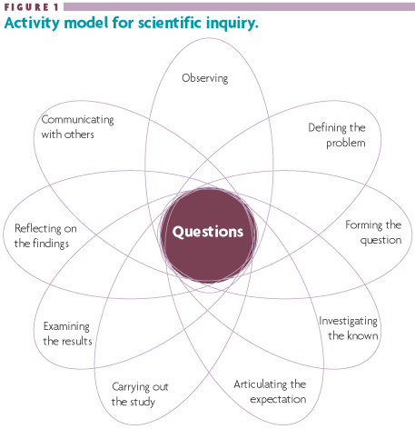
Scientific Inquiry

Slide 12
Theories and Truth
Science never reaches absolute truth.
Truth is probable and based on available observations.
New observations yield scientific progress.
In reality, scientists have no formal method.
Theory - well-substantiated explanation of some aspect of the natural world.

Slide 13
HOMEWORK
Observe something where you live
Ask a comparative question (should not be a yes/no question)
Form a hypothesis
Make a list about how you could investigate
Set up a simple experiment (3 trials is usually good)
Gather data
Reflect
Could you improve your experiment?
More questions?
Communicate results

