Slide 1
Influences of Parameters on Defects of Asymmetrical Roll Forming
PR-Vortrag
Carrie Yan
02.08 2016
02. Aug 2016 | Institut für Produktionstechnik und Umformmaschinen | 1

Slide 2
Outline
Units & Abbreviations
Numerical Model & Measurements of Defects
Explanation of Defects
Investigation on Twist
Investigation on Curving
Conclusion and Outlook
02. Aug 2016 | Institut für Produktionstechnik und Umformmaschinen | 2

Slide 3
Introduction
Roll Forming: continuously transversal bending a long metal strip into constant, desirable cross-sectional profile
Efficient and Effective in mass production for metals
When deforming, only deformations in transversal direction are necessary
Reluctant strains result in unexpected deformations
Unexpected deformations over the elastic range cause permanent defects, such as curving, twist, spring-back
Especially for asymmetrical profile, the sheet undergoes non-uniform bending forces
Previous research has been done on
—pertinent methods to reduce the defects for asymmetrical profile (Ona & Jimma 1983)
—influences factors for symmetrical profiles (Safdarian et al, 2015)
Lack of research on the reason of defects and the influence factors for asymmetrical profiles
02. Aug 2016 | Institut für Produktionstechnik und Umformmaschinen | 3

Slide 4
Units and Abbreviations
MPA Units: mm in length, s in time, MPa in pressure
Abbreviations
S: short flange length (mm)
W: web length of the desired cross section (mm)
T: thickness of the sheet (mm)
F: fillet radius of the top rolls (mm)
HC: Horizontal Curving VC: Vertical Curving
02. Aug 2016 | Institut für Produktionstechnik und Umformmaschinen | 4

Slide 5
Influence Factors
Short Flange and Long Flange Ratio
Length of Web: 40mm or 80mm
Thickness of the flat sheet: 1mm or 2mm
Radius of the fillet of the top rolls: 3mm or 6mm
short flange (mm) | 15 | 25 | 35
Long Flange(mm) | 77 | 67 | 57
02. Aug 2016 | Institut für Produktionstechnik und Umformmaschinen | 5

Slide 6
Numerical Model
① flat sheet:
leftmost bottom node on web section fixed at (0,0) in x-y plane, marked as
thickness × width × length(1002mm)
initial position -100mm in z-direction
② 6 roll stations:
distance between stands 400mm
radius & center of roll
first stand location in z-direction
③ supporting rolls:
located at negative 400mm in z-direction
no deforming forces, only supportive in y-direction
△
Fig· Front View of Sheet for S35T40T2 at t=0s
△
Fig· Numerical Model
02. Aug 2016 | Institut für Produktionstechnik und Umformmaschinen | 6

Slide 7
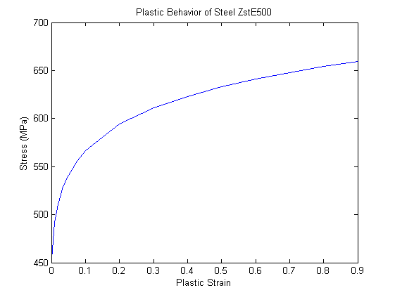
Setting for simulations
Material Properties ZstE500
Young ´s Modulus 210000 MPa =2.1×10⁵MPa
Poisson ratio 0.29
Plastic Behavior
Contact Body & Table
flat sheet deformable
rolls rigid: translate 100mm/s in negative z
all touching
Boundary Conditions
I· center of sheet front-end fixed x-direction in the first 5s
II· center of sheet back-end fixed all directions in the simulation
Job Setting
stepping multicriteria
save data every 0.5s
Fig· Plastic Behavior for ZstE500
02. Aug 2016 | Institut für Produktionstechnik und Umformmaschinen | 7

Slide 8
Measurements of Defects
Curving:
defined by translation of the centroid of the cross-section along the channel horizontally or vertically
measured by coordinate differences of central nodes locating on the web section of two cross sections at the same time
horizontal curving positive, when sheet convex in z-x plane; vertical curving positive, when sheet convex in z-y plane
Twist:
defined by rotation about centroid of cross section along the length of sheet
measured by the magnitude of twist angle per meter
positive, when the long flange approaches the short flange
02. Aug 2016 | Institut für Produktionstechnik und Umformmaschinen | 8

Slide 9
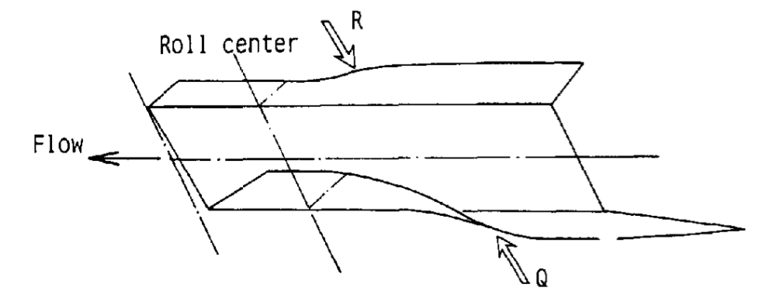
Explanation of Defects
Forces on the side rolls
Horizontal Curving & Twist:
—force on long flange occurs before force on short flange
—torsional & horizontal bending moment
Vertical Curving: edges of flanges stretched more than web
Fig· Force on side rolls
02. Aug 2016 | Institut für Produktionstechnik und Umformmaschinen | 9
Reference: H. Ona & T. Jimma, 1983, “Experiments into the cold roll-forming of straight asymmetrical channels”

Slide 10
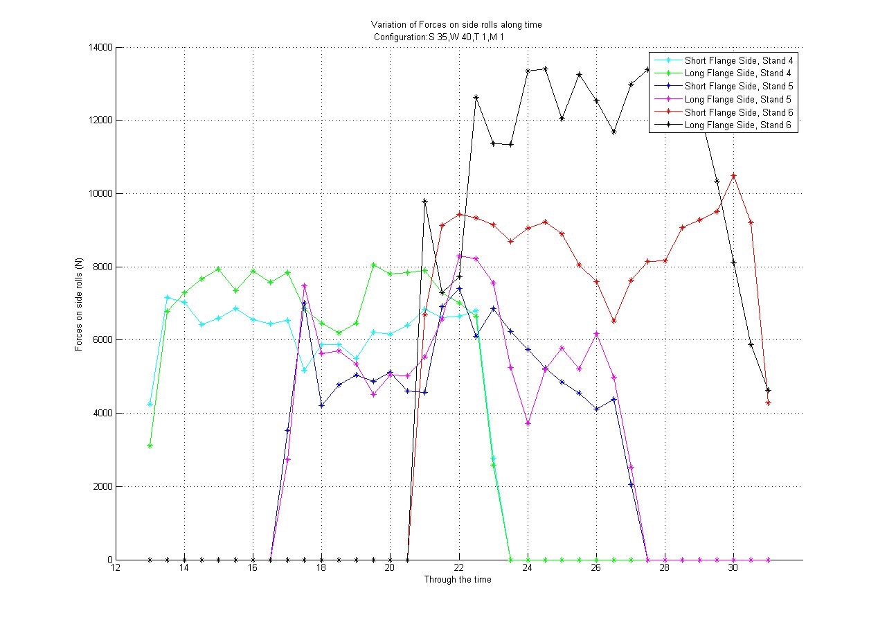
Fig· Force on side rolls for S35W40T1 profile

Slide 11
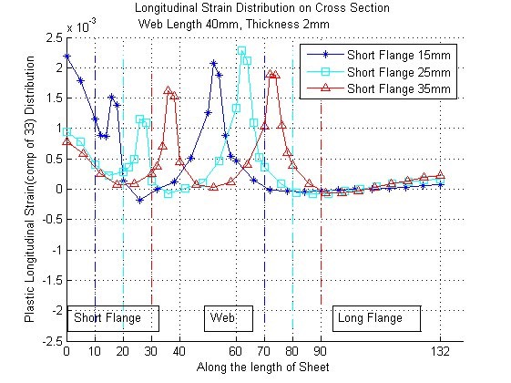
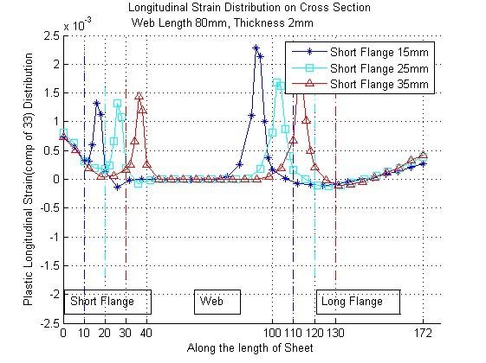
Explanation of Defects
Non-uniform Distribution of Longitudinal Strain on Cross Section
1
Fig· Longitudinal Strain Distribution on Cross Section
W40T1
Fig· Longitudinal Strain Distribution on Cross Section
W80T2
02. Aug 2016 | Institut für Produktionstechnik und Umformmaschinen | 10

Slide 12
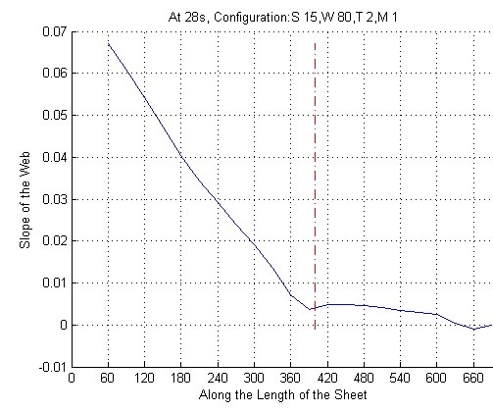
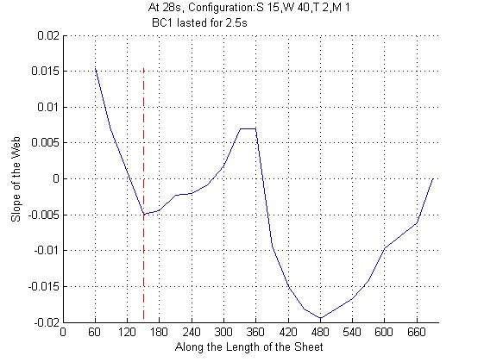
Progressive Twist Zone
Slope of the Web
Progressively Twist Zone: approximately Linearly change of twist region
Discontinuity of the slope (at 400mm)
Boundary Condition 1 (center of sheet front-end fixed x-direction in the first 5s)
After first 5s, a sudden change in x-direction
Set BC1 lasted 2.5s, the location of discontinuity changes to 150mm
Fig· Slope of web S15W80T2
Fig· Slope of web S15W40T2
02. Aug 2016 | Institut für Produktionstechnik und Umformmaschinen | 11

Slide 13
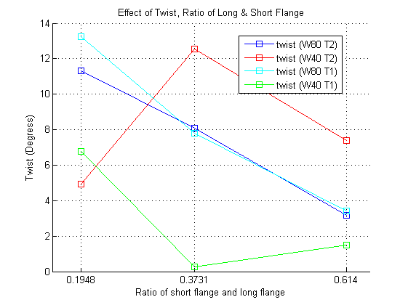
Progressive Zones and Magnitude of Twist
Progressive Twist Zone
Magnitude of Twist (degree per 1000mm)
Tolerance of Twist: 1 degree per 1000mm
Unexpected Results:
Web length=40mm
Short flange=15mm
Choice of Measuring Zone (from/to a specific position on the sheet along length(mm))
S15 W80 T2 | S25 W80 T2 | S35 W80 T2 | S15 W40 T2 | S25 W40 T2 | S35 W40 T2
90/330 | 90/330 | 90/330 | 60/210 | 60/210 | 90/330
S15 W80 T1 | S25 W80 T1 | S35 W80 T1 | S15 W40 T1 | S25 W40 T1 | S35 W40 T1
90/330 | 60/210 | 90/330 | 60/180 | Weird behave | 90/210
Tendency
Table· Progressive Twist Zones
profile | twist | profile | twist | profile | twist | profile | twist
S15W80T2 | 11.3006 | S15W40T2 | 4.9517 | S15W80T1 | 13.2461 | S15W40T1 | 6.7630
S25W80T2 | 8.0791 | S25W40T2 | 12.5284 | S25W80T1 | 7.8057 | S25W40T1 | 0.2671
S35W80T2 | 3.1807 | S35W40T2 | 7.3903 | S35W80T1 | 3.4236 | S35W40T1 | 1.4859
Table· Magnitude of Twist
Fig· Tendency of Twist with respect to ratio of flanges
02. Aug 2016 | Institut für Produktionstechnik und Umformmaschinen | 12

Slide 14
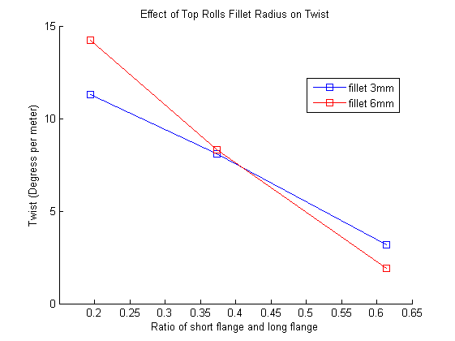

Effect of Input Parameters on Twist
Fig· Tendency of Twist with respect to ratio of flanges
Fig· Tendency of Twist with respect to radius of top rolls fillet
-twist values are decreasing with increase of ratio of flanges,
except W40T2 grows up first and then drops, and W40T1 decrease first and increase then
-fillet radius has very less influence on the magnitude of twist
02. Aug 2016 | Institut für Produktionstechnik und Umformmaschinen | 13

Slide 15
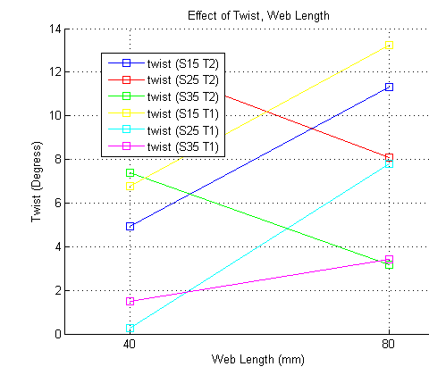
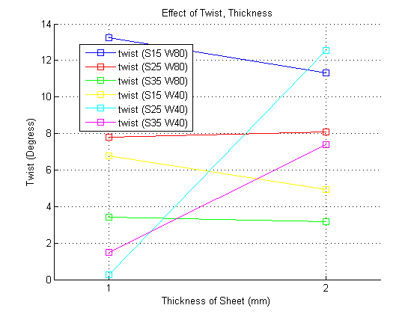
Effect of Input Parameters on Twist
Fig· Tendency of Twist with respect to web length
Fig· Tendency of Twist with respect to thickness of sheet
-twist values are increasing with increase of web length, except S25T2 and S35T2
-twist values are decreasing with increase of thickness, except S25W80, S25W40 and S35W40
02. Aug 2016 | Institut für Produktionstechnik und Umformmaschinen | 14

Slide 16
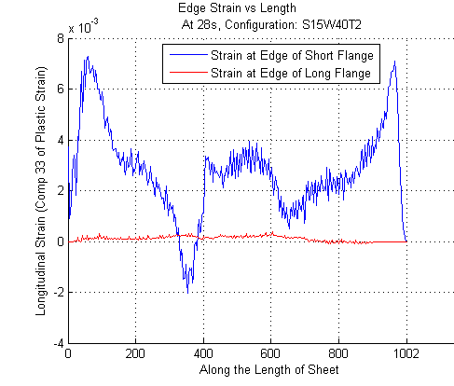
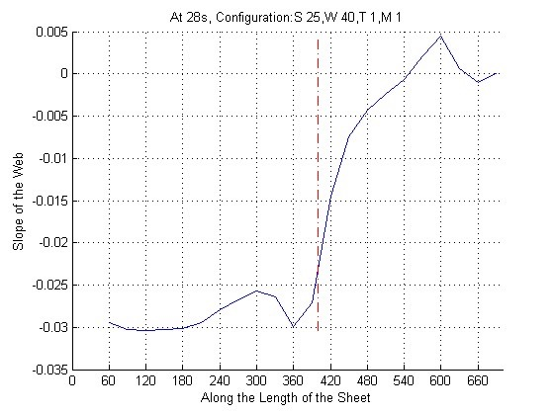
Explanation of Unexpected Results
non-constant longitudinal strain on flange edge (S15)
counterclockwise twist (S25W40T1)
Fig· Slope of the Web S25W40T1
Fig· Flange Edge Longitudinal Strain S15W40T2
02. Aug 2016 | Institut für Produktionstechnik und Umformmaschinen | 15

Slide 17
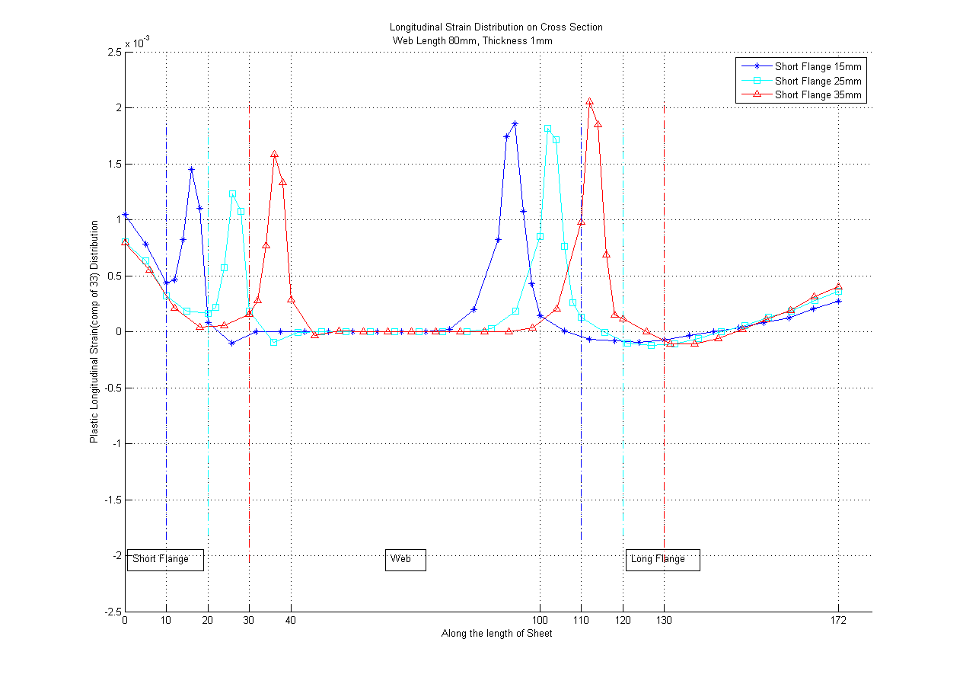
Explanation of Unexpected Results
constant longitudinal strain on web for web length 80mm
Fig· Cross Section Longitudinal Strain W80T2
Fig· Cross Section Longitudinal Strain W80T1
02. Aug 2016 | Institut für Produktionstechnik und Umformmaschinen | 16

Slide 18
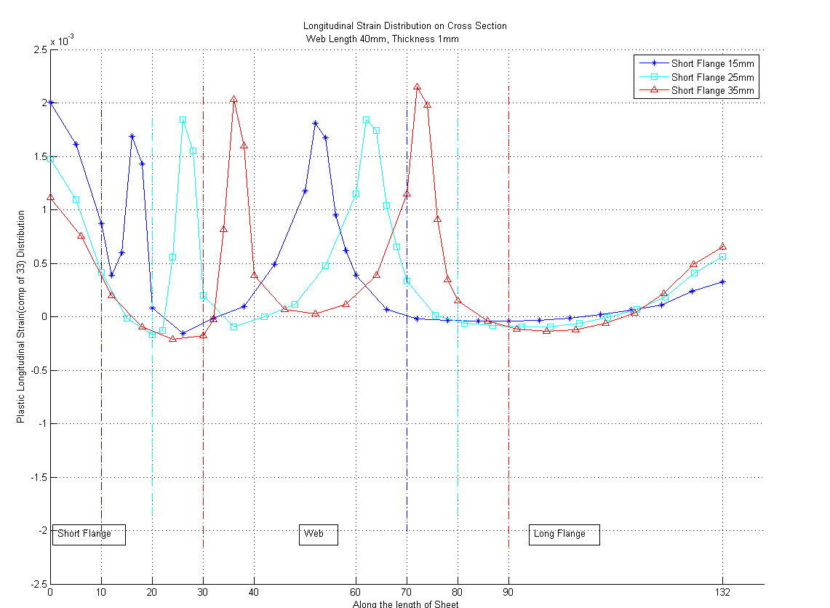
Explanation of Unexpected Results
unstable behaviour for web length 40mm
1
Fig· Cross Section Longitudinal Strain W40T2
Fig· Cross Section Longitudinal Strain W40T1
02. Aug 2016 | Institut für Produktionstechnik und Umformmaschinen | 17

Slide 19

Explanation of Unexpected Results
Deformation Length
bending angle increments ∆θ are 13°, 16°, 18°, 18°, 15°, 10°
distance between stands = 400mm
 | (mm) | minimum deformation length | maximum deformation length | (mm) | minimum deformation length | maximum deformation length
short flange | 15 | 28.0178514522438 | 37.589892258425 | 15 | 39.6232255123179 | 53.160135440008
long flange | 77 | 325.862231739234 | 437.19006088123 | 77 | 460.838787590789 | 618.280113432954
thickness | 2 |  |  | 1
short flange | 25 | 60.284817817252 | 80.8805703903395 | 25 | 85.2556069623489 | 114.38239957849
long flange | 67 | 264.490540333536 | 354.851296554862 | 67 | 374.046109259075 | 501.835516213563
thickness | 2 |  |  | 1
short flange | 35 | 99.8619417366166 | 133.978854052919 | 35 | 141.226112368835 | 189.474712472843
long flange | 57 | 207.544019427205 | 278.44952145766 | 57 | 293.511567063378 | 393.787089681721
thickness | 2 |  |  | 1
Table· Deformation Length
02. Aug 2016 | Institut für Produktionstechnik und Umformmaschinen | 18
Reference: Bhattacharyya et al. 1984, “Prediction of strain development while roll forming fundamental sections, Advanced technology of plasticity“

Slide 20
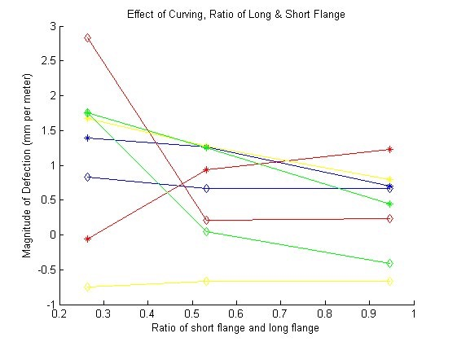
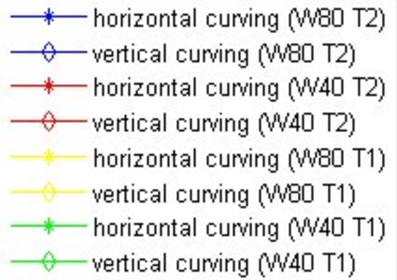
Effect of Input Parameters on Curving
The magnitude of curving is always around 1mm per 1000mm
not problematic
Fig· Tendency of Curving with respect to flange ratios
02. Aug 2016 | Institut für Produktionstechnik und Umformmaschinen | 19

Slide 21
Conclusion & Outlook
Conclusion
1. In summary, magnitude of twist decrease when the profile cross-sectional area grows to more symmetry.
—ratio of short flange length to the long flange length increases,
—web length decreases,
—thickness increases.
2. The twist is partially progressive because of the boundary condition I.
3. For S15T2, S15T1 and S25T1 profile, the deformation length is sometimes larger than distance between two neighbour stands, which is problematic.
Outlook
1. In order to neutralize the effect of boundary condition I, we can implement supportive rolls in both x and y directions
2. Investigation on different type of materials
3. Investigation on simulations with asymmetric fillet radius of top rolls
02. Aug 2016 | Institut für Produktionstechnik und Umformmaschinen | 20

Slide 22
Thank you for your attention!
19. Juli 2016 | Institut für Produktionstechnik und Umformmaschinen | 21

Slide 23
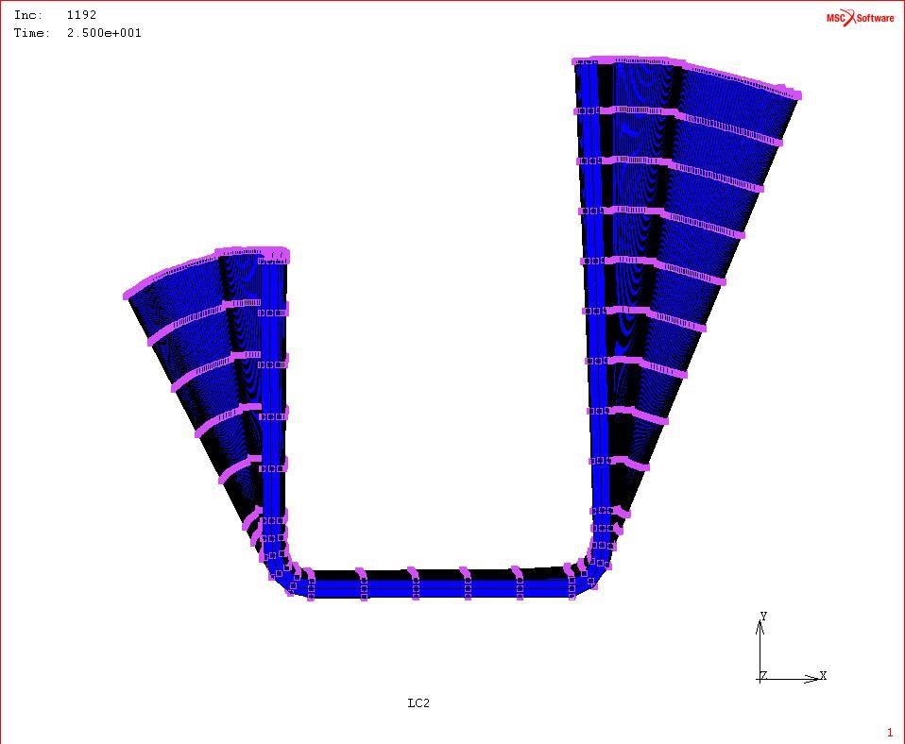
Front View of the Sheet after deformation at time t=25s
△
Fig· Front View of Sheet for S35T40T2 at t=25s

Slide 24
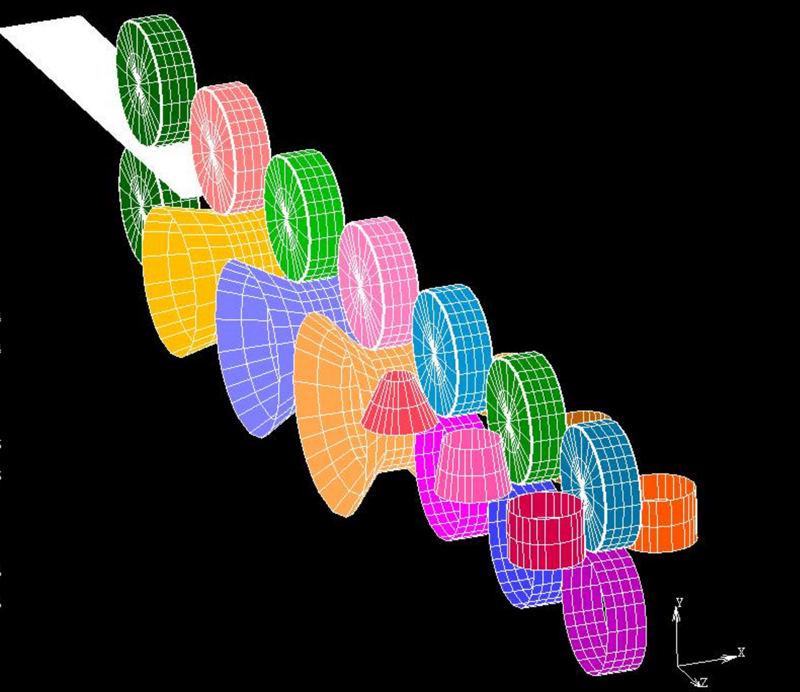
Initial Position of Sheet

