Slide 1
Getting Physical Extreme abuse of Intel based Paging Systems
Nicolas A. Economou
Enrique E. Nissim

Slide 2
About us
Enrique Elias Nissim
Information System Engineer
Previously worked at Core Security as an Information Security Consultant
Now joining Intel Corp at Mexico to work in Graphics Security
Infosec Enthusiast (Exploit Writing, Reversing, Pentest, Programming)
Discovered some 0Days in Kernel components
@kiqueNissim
Nicolas Alejandro Economou
Exploit Writer specialized in Windows kernel exploitation at Core Security Technologies for +10 years.
Infosec Enthusiast (Exploit Writing, Reversing, Patch Diffing and Programming)
Several defensive/offensive research, presentations and security tools as turbodiff, Sentinel and Agafi
@NicoEconomou

Slide 3
Agenda
Arbitrary Write: Explanation
Reviewing Modern Kernel Protections
Current ways of abusing kernel arbitrary writes
Intel Paging Mechanism
Windows
- Implementation
- Attacks
- Live Demo
Linux
- Implementation
- Attacks
- Live Demo
Conclusions

Slide 4
What is an arbitrary write?
Arbitrary Write:
This is the result of exploiting a binary bug.
You can write a crafted value (or not) where you want (write-what-where) -> MOV [EAX], EBX
As a result: If you write in the correct place, you can get primitives to read/write memory or you can control EIP/RIP
Examples:
Heap overflows – overwrite pointers that point to specific structs
Memory Corruptions – idem above
Use after free – nt/win32k – Decrementing one unit (“DEC [EAX]”)

Slide 5
Reviewing Modern Protections
DEP/NX: is a security feature included in modern operating systems. It marks areas of memory as either "executable" or "nonexecutable".
KASLR: Address-space layout randomization (ASLR) is a well-known technique to make exploits harder by placing various objects at random, rather than fixed, memory addresses.
Integrity Levels: call restrictions for applications running in low integrity level – since Windows 8.1

Slide 6
Reviewing Modern Protections
SMEP: Supervisor Mode Execution Prevention allows pages to be protected from supervisor-mode instruction fetches. If SMEP = 1, software operating in supervisor mode cannot fetch instructions from linear addresses that are accessible in user mode.
SMAP: allows pages to be protected from supervisor-mode data accesses. If SMAP = 1, software operating in supervisor mode cannot access data at linear addresses that are accessible in user mode.

Slide 7
Current techniques

Slide 8
Current techniques
Low Integrity Level in “Windows 8.1” suppressed all the kernel addresses returned by “NtQuerySystemInformation”
The most affected exploits are “Local Privilege Escalation” launched from sandboxes like IE, Chrome, etc.

Slide 9
Call Restrictions
Running in Medium Integrity Level
You know where the kernel base is, process tokens, some kernel structs, etc
Exploitation tends to be “trivial”
Running in Low Integrity Level
You DON’T know where the kernel base is, process tokens, some kernel structs, etc
You need a memory leak (second vulnerability) to get some predictable kernel address
Without memory leaks exploitation tends to be much harder.

Slide 10
What can be done?
If you are running in Low/Medium Integrity Level and you have:
- Full arbitrary write (DWORD/QWORD):
You can overwrite GDI objects
Kernel GDI objects addresses are in USER SPACE – “Keen Team” technique.
This technique consists of linking one GDI object to another one
- Partial arbitrary write (WORD):
You can overwrite GDI objects
It depends on the low part of the object address what you want to overwrite, sometimes it is not possible.

Slide 11
What about…
Partial writes?
Single BIT controlled?
Decrement a controlled position?
You don’t have control over the value?
Let’s see…

Slide 12
Intel Paging Mechanism

Slide 13
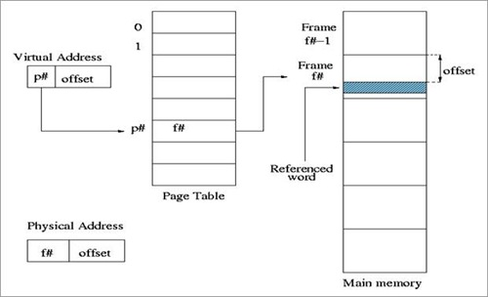
Paging 101
Paging is a functionality provided by the MMU and used by the processor to implement virtual memory.
A virtual address is the one used in processor instructions; this must be translated into a physical address to actually refer a memory location.

Slide 14
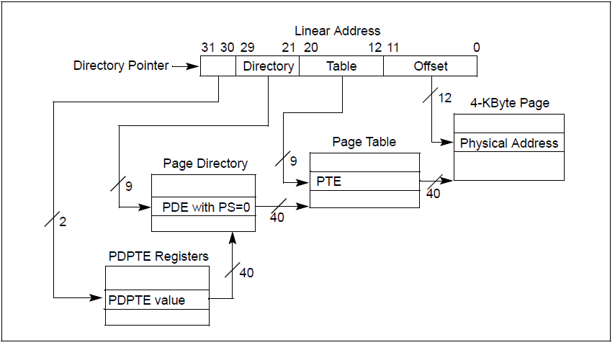
PAE Paging

Slide 15
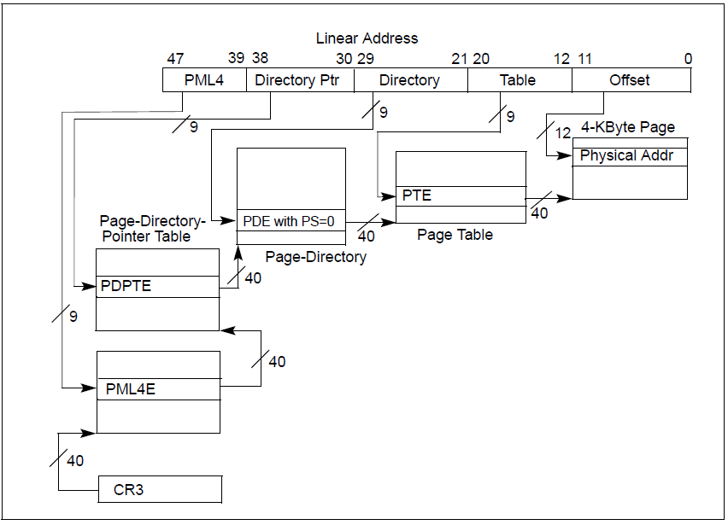
x64 Paging

Slide 16
PxE Structure (entry)
Interesting fields to know for our purposes:
R/W: readonly/readwrite
U/S: if set, the range mapped by the entry is accessible at CPL3. Otherwise it is only accessible at CPL0.
PS: if set, the entry describes a LARGE_PAGE.
XD: if set, instruction fetching is not allowed for the region mapped by the entry.
63 | 62:52 | 51:12 | 11 | 10 | 9 | 8 | 7 | 6 | 5 | 4 | 3 | 2 | 1 | 0
XD | I | PFN (physical address >> 12) | I | I | I | G | PS | D | A | PCD | PWT | U/S | R/W | P

Slide 17
Paging Implications
All memory accesses and instruction fetching done by the processor will use virtual addresses.
Given that the OS needs to manipulate the table entries not only for memory allocation but also for page level protection, all the paging structures of the current process are mapped to virtual memory.
In order to comply with performance and memory savings requirements, a common approach taken by operating systems is to make use a of self-reference table entry or a fixed location where all the paging structures will reside.

Slide 18
Windows Paging Implementation

Slide 19
Windows Implementation
Each process has its own set of paging tables
All paging structures virtual addresses can be calculated
512GB of virtual range is assigned for Paging Structures (x64)

Slide 20
Windows Implementation
Only one PML4 entry is used for Paging management (0x1ED)
Entry 0x1ED is self-referential (physical address points to PML4 physical address)
Virtual range described:
0xFFFFF680’00000000 – 0xFFFFF6FF’FFFFFFFF

Slide 21
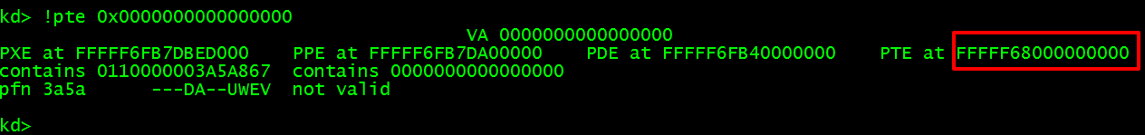
Quick Formula
_int64 get_pxe_address(_int64 address)
{
_int64 result = address>>9;
result = result | 0xFFFFF68000000000;
result = result & 0xFFFFF6FFFFFFFFF8;
return result;
}

Slide 22
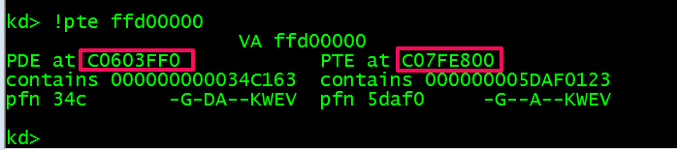
Quick Formula
int get_pxe_32(int address)
{
int result = address>>9;
result = result | 0xC0000000;
result = result & 0xC07FFFF8;
return result;
}

Slide 23
Strengths and Weaknesses
Strengths:
Paging structures reside in random physical addresses
Weaknesses:
Paging tables are in fixed virtual addresses
Paging tables are writables

Slide 24
Windows Paging Attacks some clarifications

Slide 25
Techniques Overview
We are going to show 2 different ways of abusing write-what-where conditions. (3 ways in the full-slide version)
They do not require memory leaks.
The 3 ways work from Low Integrity Level included.
All Windows versions are affected. Specially Win 8, 8.1 and Win 10.

Slide 26
Windows Paging Attacks “HAL’s heap”

Slide 27
HAL’s Heap
Same virtual address for all Windows versions: 0xffffffff’ffd00000
Same physical address by OS version
Some juicy kernel function pointers located there

Slide 28
HAL’s Heap
HAL’s heap x64 – physical address list
OS Version | Virtual Address | Physical Address
Windows 7/2008 R2 | 0xffffffff’ffd00000 | 0x100000 (1mb)
Windows 8/2012 | 0xffffffff’ffd00000 | 0x100000 (1mb)
Windows 8.1/2012 R2 | 0xffffffff’ffd00000 | 0x1000 (4kb)
Windows 10/10 TH2 | 0xffffffff’ffd00000 | 0x1000 (4kb)

Slide 29
HAL’s Heap
HAL’s heap x64 – ‘HalpInterruptController’ pointer list:
+20: hal!HalpApicInitializeLocalUnit
+28: hal!HalpApicInitializeIoUnit
+30: hal!HalpApicSetPriority
+38: hal!HalpApicGetLocalUnitError
+40: hal!HalpApicClearLocalUnitError
+48: NULL
+50: hal!HalpApicSetLogicalId
+58: NULL
+60: hal!HalpApicWriteEndOfInterrupt
+68: hal!HalpApic1EndOfInterrupt
+70: hal!HalpApicSetLineState
+78: hal!HalpApicRequestInterrupt

Slide 30
HAL’s Heap
We know the physical address of the HAL’s heap
We know where our Page Table Entries are
And we are able to allocate memory in USER SPACE (VirtualAlloc)
It means that
We can use an arbitrary write to modify a PTE of our allocated virtual memory
We can point this PTE to the HAL’s heap physical address

Slide 31
HAL’s Heap
PTE mapping VA 0xFFFFFFFF’FFD00000
Physical address 0x1000
kernel space
read-write
HAL’sheap
PTE mapping VA 0x401000
Physical address 0xNNNNNNNN
User
allocation
user space
read-write !

Slide 32
HAL’s Heap
As a result:
- We get read/write access from USER SPACE to the HAL’s heap
- We get access to some HAL’s heap function pointers
- We use this information to get the “HAL.DLL” base address
- We overwrite “hal!HalpApicRequestInterrupt” pointer
- We disable SMEP by ROPing (Ekoparty 2015: “Windows SMEP bypass: U=S”)
- And finally, we get system privileges …

Slide 33
Some days before Cansec…

Slide 34
Improving the Technique
We can improve the approach considerably by using a LARGE_PAGE.
If we write a single byte into an EMPTY PDE, we map 2MB starting from PFN 0 (this will include the physical address of the HAL’s Heap) with R/W access from user mode.
E.g:
00 00 00 00 00 00 00 00 -> E7 00 00 00 00 00 00 00

Slide 35
Improving -= 1
Let’s say we have a simple DEC [RAX] (Win32k UAF)
We can use it to decrement an empty PDE in a shifted way.
00 00 00 00 00 00 00 00 – 00 00 00 00 00 00 00 00
00 FF FF FF FF FF FF FF – FF 00 00 00 00 00 00 00
We effectively mapped a User R/W LARGE_PAGE starting at PFN 0 by enabling all the bits!

Slide 36
Windows Paging Attacks “Heap Spraying Page Directories”

Slide 37
Heap spraying Page Directories
PDPTs are in fixed virtual addresses (we can calculate this)
PDPT entries point to Page Directories
A Page Directory maps up to 1GB (if all entries used)

Slide 38
Heap spraying Page Directories
Page Directories points to Page Tables or LARGE PAGES
A Large Page maps 2MB of physical memory (bit PS=1)
PDPT entries can be overwritten (via a partial arb.write – value controlled or not)

Slide 39
Heap spraying Page Directories
We can heap spray our PROCESS MEMORY with fake Page Directories with all entries used (by using “VirtualAlloc” + “memcpy”)
The idea is to produce a physical memory exhaustion
If we choose a valid random physical address, we will probably find our data in high physical addresses!

Slide 40
Heap spraying Page Directories
So, if we overwrite a PDPTE that maps memory in our process (E.g PDPTE that maps VA 1GB ~ 2GB)
And we point this entry to an “arbitrary physical address“ used by our heap spray
It means that we had just mapped 1GB of memory as read-write

Slide 41
Heap spraying Page Directories
PDPTE mapping VA 1GB-2GB
addr. chosen by Windows
Kernel
allocation
(Real PD)
user space
read-write
addr. chosen by us
User
Allocation
(Fake PD)

Slide 42
Heap spraying Page Directories
Depending on the chosen physical address, we can:
- Map the HAL’s heap
- Find a valid Page Table and dump the rest of the target memory
- Find and modify the kernel code, structures, etc, without any restriction.

Slide 43
Heap spraying Page Directories
As a result
We can insert ring-0 shellcode by replacing kernel code
We don’t need to bypass SMEP
And finally, we get system privileges…

Slide 44
Windows Paging Attacks ”Self-ref of death”

Slide 45
Self-ref of Death
We know that PML4 entry 0x1ED is used for Memory Paging management
We know that this entry is referencing itself
And we know that it’s at 0xfffff6fb`7dbedf68
Sign Extension | PML4 | PDPT | PD | PT | Offset
0xFFFFF | 0x1ED | 0x1ED | 0x1ED | 0x1ED | 0xF68

Slide 46
Self-ref of Death
PML4
PDPT
PD
PT
U
U
U
U
U
U
U
U
If we replace
SUPERVISOR by USER ?
0x1ED
S
S
S
S
S
S
S
S
S
PDPT
PD
PT

Slide 47
Self-ref of Death
PML4
PDPT
PD
PT
U
U
U
U
U
U
U
U
We get access
from USER SPACE
to all USER tables !!!
0x1ED
U
S
S
S
S
S
S
S
S
PDPT
PD
PT

Slide 48
Self-ref of Death
So, if we have a “bit/byte/word/dword” arbitrary write, we can get access from USER MODE to all User Tables including the PML4!
There is a weakness in the self-referential technique, only one entry is set a SUPERVISOR, the rest is USER
To be clear, after our arbitrary write, if we read from user space at 0xfffff6fb`7dbed000, we see our PML4 !

Slide 49
Self-ref of Death
It means that we can add/modify/delete entries in the four paging levels
So, we can do the same as seen before
- Point one PTE to the HAL’s heap
- or dump the complete physical memory
- or modify kernel parts

Slide 50
Windows Live Demo

Slide 51
Windows Demo
Target:
“Windows 10” 64 bits
Scenario:
Running in Low Integrity Level
Objective:
Dump physical memory and get SYSTEM privileges by using “Self-ref of Death”

Slide 52
Linux Paging Implementation

Slide 53
Linux Implementation
Only one PML4 entry is used for Paging management (0x110)
Entry 0x110 is NOT self-referential like Windows
Virtual range described:
0xFFFF8800’00000000 – 0xFFFF887F’FFFFFFFF

Slide 54
Linux Implementation
Each process has its own PML4 table in a unique virtual address (opposite to Windows)
Physical addresses can be read as virtual addresses by adding a base.
This base is called __PAGE_OFFSET:
- For 32 bits: 0xc0000000
- For 64 bits: 0xffff8800’00000000

Slide 55
Linux Implementation
Most of page table entries reside in random virtual and physical addresses.
But… there are some PDPTs, PDs and PTs in fixed physical addresses.

Slide 56
Linux Implementation
PDPT physical address list (pointed by entry 0x110)
OS version | Virtual Address | Physical Address
Debian 8.3 3.16.0-4-amd64 | 0xFFFF8800’01AF4000 | 0x01AF4000 (~26mb)
Xubuntu 14.04 3.19.0-25-gen | 0xFFFF8800’01FD4000 | 0x01FD4000 (~31mb)
Ubuntu 15.10 4.2.0-16-gen | 0xFFFF8800’01FF0000 | 0x01FF0000 (~32mb)
Ubuntu 14.04.3 LTS 3.19.0-25-generic | 0xC1B51000 | 0x01B51000 (~27mb)

Slide 57
Strengths and Weaknesses
Strengths:
None
Weaknesses:
Some PDPTs, PDs and PTs are in fixed virtual addresses
Paging structures are writable

Slide 58
Linux Paging Attacks “Setting the vDSO as rwx”

Slide 59
What is the vDSO?
vDSO (virtual dynamic shared object)
Small shared library mapped into all user processes
It was created to reduce the context-switch overhead

Slide 60
vDSO Page Entry
It’s set as “r-x” in user space
The vDSO virtual address changes per process
The PDE that describes this user space area is RANDOM

Slide 61
Setting the vDSO as “rwx”
But … the physical address is fixed
E.g: “Debian 8.3” 64 bits: 0x1805000
So, we can calculate the kernel virtual address
E.g: “Debian 8.3” 64 bits: 0xffff880001805000
For “Debian 8.3”, the PDE (large page) which maps the vDSO physical address is fixed and writable!

Slide 62
Setting the vDSO as “rwx”
Even worse, the PML4 and the PDPT entries are set with the USER bit!!!
So, What if we set the PDE as USER by using an arb.write?

Slide 63
Setting the vDSO as “rwx”
PML4
PDPT
PD
VA 0xffff880001805000
0
U
If we set
U ?
S
0x0C
S
vDSO
(2mb)
0x110
U

Slide 64
Setting the vDSO as “rwx”
PML4
PDPT
PD
VA 0xffff880001805000
0
U
S
0x0C
U
vDSO
(2mb)
Now it can be read from USER !
0x110
U

Slide 65
Setting the vDSO as “rwx”
As a result:
- We get read-write access to the vDSO from USER SPACE
- We can modify/hook functions located there like “gettimeofday”
- When a UID 0 process invokes this function, our shellcode will be called and will spawn a new root shell

Slide 66
Linux Paging Attacks “Creating self-ref entries”

Slide 67
Creating self-ref entries
There are several entries that always use the same fixed physical addresses:
PML4E 0x110
PML4E 0x192
PLM4E 0x1FE
PLM4E 0x1FF
… To be continued…
There are fixed entries for ALL levels of the paging hierarchy (PML4, PDPTs, PDs, PTs)

Slide 68
Creating self-ref entries
PML4 entry 0x110 points to a fixed PDPT
This PML entry is set as USER (0x67)
We know the virtual and physical address pointed by this entry

Slide 69
Creating self-ref entries
we’ll add a
self-ref entry
PML4
PDPT
0x110
U

Slide 70
Creating self-ref entries
PML4
PDPT
0x6
U
0x110
U

Slide 71
Creating self-ref entries
PDPT
PD
PT
DATA
0x6
U
0x6
U
0x6
U
→
PDPT

Slide 72
Creating self-ref entries
Real example - “Debian 8.3 x64”
- We add a PDPT entry at 0xFFFF8800’01AF4010 (entry 0x2)
- The written value is “67 04 AF 01 00 00 00 00”
- This entry is self-referential
- Calculating the mapped virtual address by this entry:
→ va = 0xFFFF8800’00000000
→ va += 512gb * 0x110 PML entries
→ va += ( 1gb + 2mb + 4kb ) * 0x2 PDPT entries
→ va = 0xFFFF8880’80402000

Slide 73
Creating self-ref entries
So, we are able to add/modify/delete PDPT entries
We then add another entry in this PDPT and it’s used as PTE.
This SPURIOUS PTE allows us to read and write the complete target’s physical memory!

Slide 74
Linux Live Demo

Slide 75
Linux Demo
Target:
Debian 8.3 64 bits - 3.16.0-4-amd64
Scenario:
Running as normal-unprivileged user
Objective:
Getting root privileges by modifying the vDSO

Slide 76
Linux Paging Attacks(bonus track): ”PaX/Grsec notes”

Slide 77
Pax/Grsec notes
PaX is a patch for the Linux kernel that implements least privilege protections for memory pages.
Grsecurity is a set of patches for the Linux kernel which emphasizes security enhancements.
Grsec + PaX change the rules of what we saw previously

Slide 78
Pax/Grsec notes
PaX/Grsec implements SMEP/SMAP by software
It uses two differents PML tables, one for USER MODE and one for KERNEL MODE
When a syscall is invoked, the kernel changes CR3 by pointing to the KERNEL MODE PML table

Slide 79
Pax/Grsec notes
The same physical address is used to map the PML for all current processes
In our Debian 8.3 compiled/focused to server mode
- CR3 for kernel mode points to 0x15f0000
- CR3 for user mode points to 0x15f1000
Each process has a PGD (Page Global Directory)

Slide 80
Pax/Grsec notes
These PGDs are “mirrored “ in CR3 by Pax/Grsec
For KERNEL SPACE entries: The first three level page tables are in fixed “virtual/physical” addresses
For USER SPACE entries: PDPTs, PDs and PTs are RANDOM

Slide 81
Pax/Grsec notes
A small detail, all not RANDOM page tables are set as READ-ONLY …
So, it’s not possible to overwrite a fixed page directory/table entry ☹
Requires more research!

Slide 82
Conclusions

Slide 83
Windows conclusions
Paging tables shouldn’t be in fixed VA addresses
It can be abused by LOCAL and REMOTE kernel exploits
The PML entry (0x1ed) should be RANDOMIZED
256 entries are available for the OS kernel
Only ~20 entries are used by Windows
All fixed paging structures should be read-only

Slide 84
Linux conclusions
Paging tables shouldn’t be in fixed addresses
It can be abused by LOCAL and REMOTE kernel exploits
All fixed paging structures should be read-only
Some advice, compile the kernel with Grsec ;-)

Slide 85
Questions? Thanks
Enrique Nissim
@kiqueNissim
n3k1990@gmail.com
Nicolas Economou
@NicoEconomou
neconomou@coresecurity.com

