Slide 1
How do we best represent clusters of spectra?
Wout Bittremieux, UCSD, USA
Michael Turewicz, Ruhr-University Bochum, Germany
Ralf Gabriels, VIB-UGent Center for Medical Biotechnology, Belgium
Timo Sachsenberg, Univ. of Tübingen, Germany
Eric Deutsch, ISB, USA
Julia Bubis, INEPCP RAS, Russia
Mark Ivanov, INEPCP RAS, Russia
Lev Levitsky, INEPCP RAS, Russia
Sander Willems, Laboratory of Pharmaceutical Biotechnology, Ghent University, Belgium
Henry Webel, Novo Nordisk Center for Protein Research, Copenhagen University, Denmark
Yasset Perez-Riverol, EBI, UK
Lukas Käll, KTH, Sweden
https://github.com/statisticalbiotechnology/specpride

Slide 2
Merged spectra, Representative spectrum
+
=
?

Slide 3
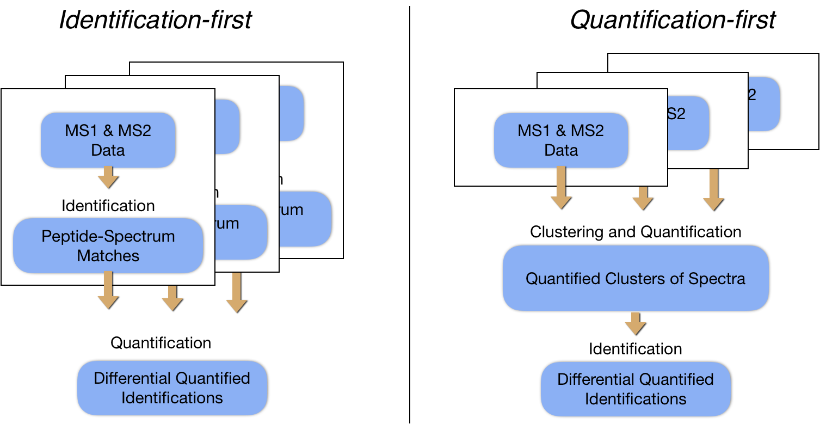


Label-free quantification
Repositories (PRIDE)
In label-free quantification, virtually the same set of MS² spectra are recorded for each sample. Rather than searching all spectra, we would like to search one representative spectrum for each peptide-species.
The overwhelming majority of all MS² spectra in PRIDE stem from peptides that are recorded in multiple experiments. Rather than searching all spectra from each run, we would like to search one representative spectrum for each peptide-species across multiple experiments.
Reanalysis
Cluster 1
Cluster 2

Slide 4
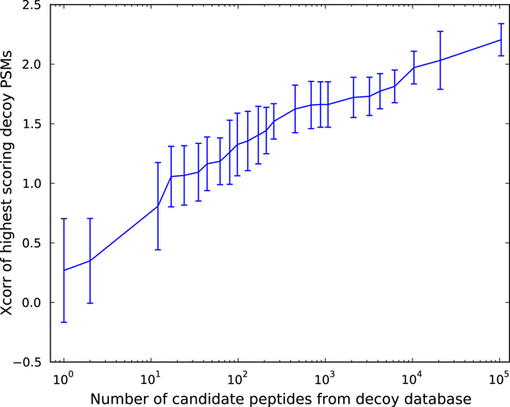
Benefits of searching consensus spectra instead of individual spectra
It’s often faster to cluster than to search data.
Its generally better to model and integrate on the level of the data rather than integration after inferences.
The statistical properties are nicer. A lower number of inferences naturally lowers the burden of multiple testing corrections.
[Granholm&Käll, Proteomics, 2011]

Slide 5
Best spectrum
A virtual spectrum constructed by selecting the highest scoring that maximizes a certain score.
Peptide annotations required.
Consensus spectrum
A virtual spectrum constructed by averaging all spectra in the cluster.
Not peptide annotations required.
Xcorr=3.1
+
+
Xcorr=2.7
=
=
“Most similar” spectrum
A virtual spectrum constructed by selecting the most “central” spectrum, i.e. the spectrum with the shortest average distance to the other spectra.
Not peptide annotations required.

Slide 6
Benchmarking
We aim at investigating each merging method’s performance by:
Comparing consensus spectrum with each group member, and calculate average spectral distance (e.g. cosine distance) using leave-one out.
Research consensus spectra, and see how frequent the library annotation and search engine result disagree
Research the consensus spectra and investigate the fraction of the ion-intensity that is explained by b- and y-ions.

Slide 7
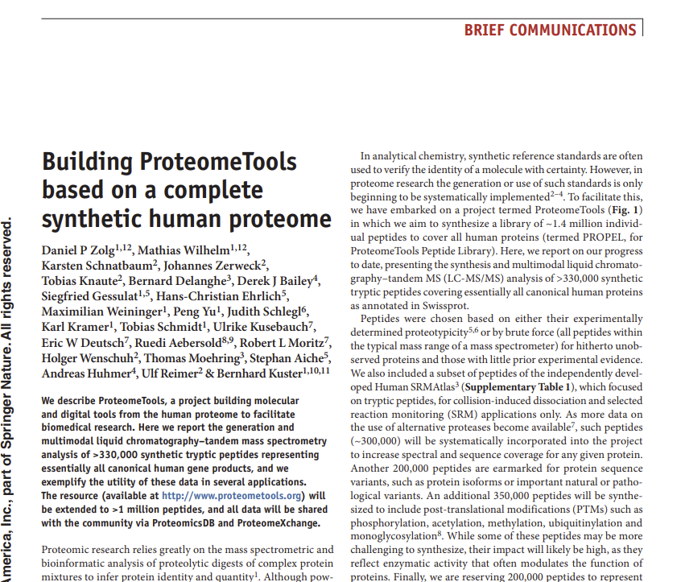
Test data
We will use a subset of Proteome tools, consisting of spectra from synthesised peptides, available from https://drive.google.com/drive/u/1/folders/1VO9VXTsfacZB7yna_3yw77a7AegRu34G

Slide 8
Enriched MGF
Best-spectrum
method
Binning-spectrum
method
cluster-conversion-tool
Enriched MGF
MostSimilar-spectrum
method
Clustering-spectrum
method
MaRaCluster Clustering
Spectra-Cluster
Representative Spectrum MGF
Representative Spectrum MGF
Identification pipeline (crux)
Identification pipeline (MSgf+)
ProteomeTools synthetic peptides
Benchmark
Identification
Pipeline (OpenMS & OpenSearch)
Metrics
(b & y ions) & cosine similarity
Representative Spectrum benchmark platform
Benchmark metrics matrix and plots

Slide 9
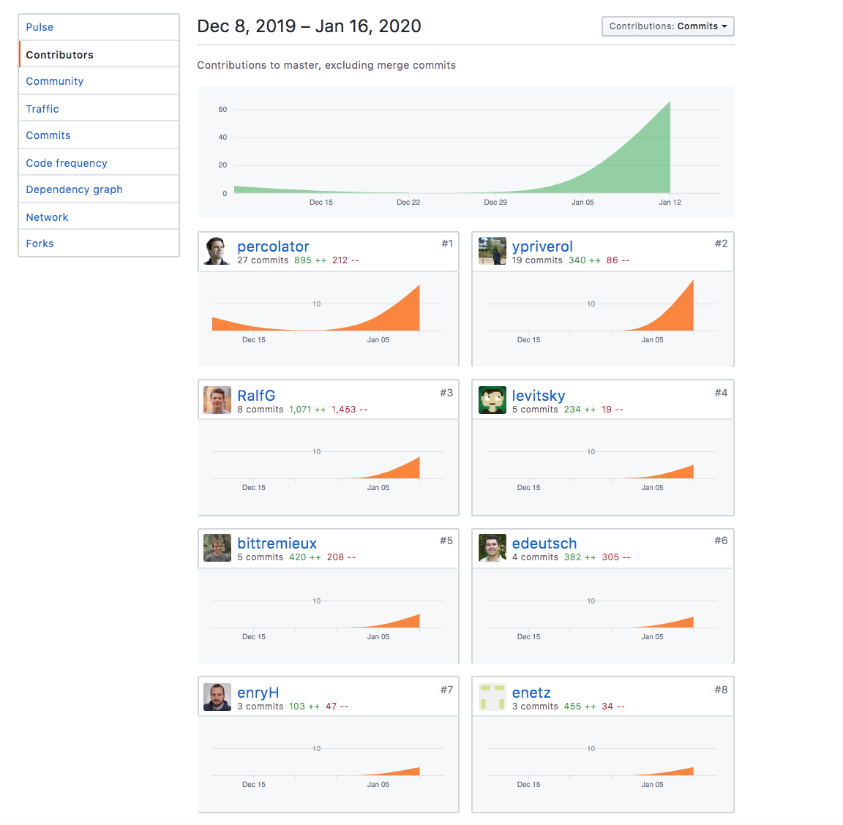
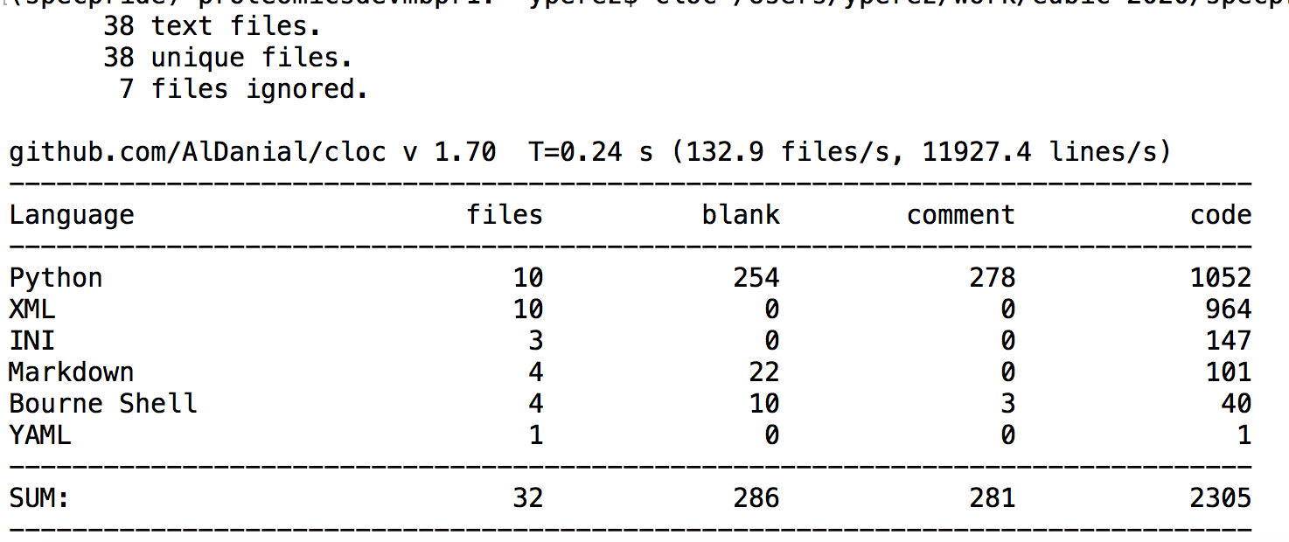
Contributions

Slide 10
Representative (WithQuorum_NoEdgeMerging)

Slide 12

Where we are going
Test the b and y ion metrics
Test with a more real dataset
Test with a phospho-proteomics dataset
Optimize the re-identification pipeline with OpenMS
Test spectral library search using the different methods

