Slide 1

Amazon Product Review Data Warehouse

Slide 2


Overview
data sources
CLOUD storage
data processing
analysis and visualization
DWH
Multiple
Product Catalogue
User Reviews
Variety
JSON
Types
Batch
Real Time
Data Warehouse
AI/ML
Reporting
ML/Report

Slide 3




Dimensional Modelling
Star Schema: Consists of one or more fact tables referencing any number of dimension tables.
Product
Product Category
Price Bucket
Dimensions
Product
Fact
Product Reviews
Product Category
Price Bucket
Product Reviews
STG Reviews

Slide 4
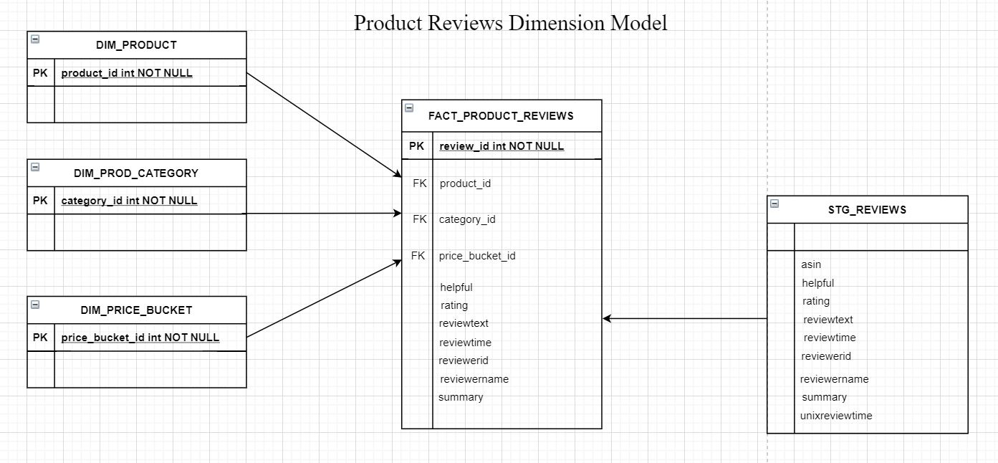
Data Model

Slide 5
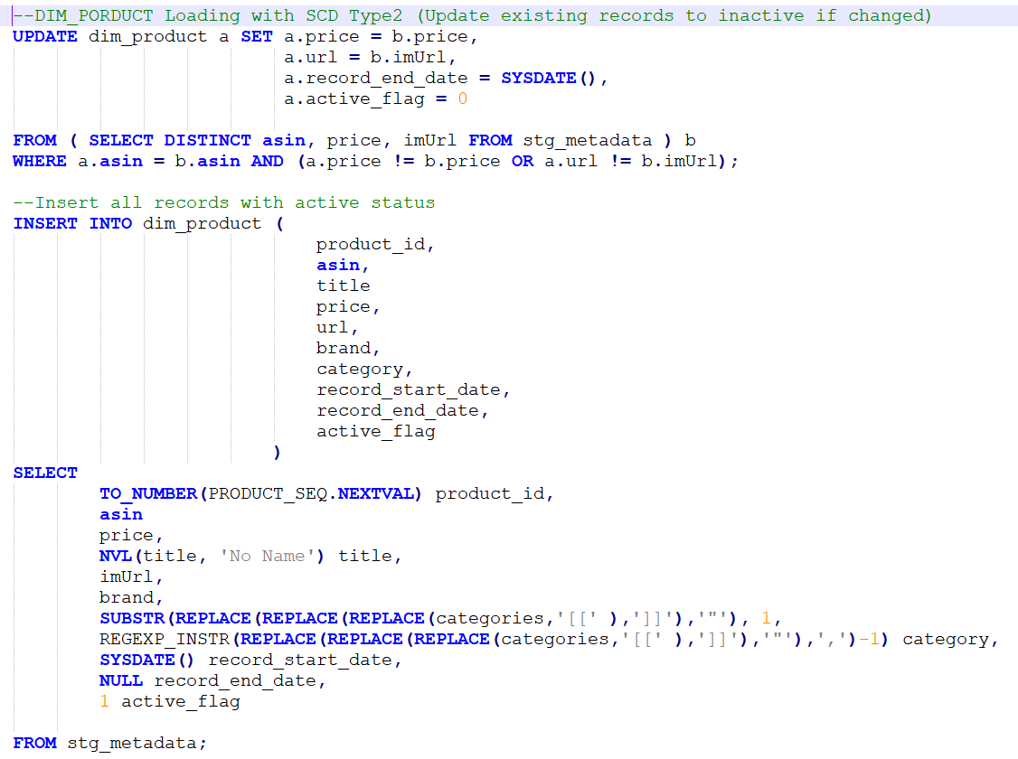
Slowly Changing Dimension
SCD Type2:
Creating multiple records in the dimensional tables with separate keys with new version numbers.
Product Dimension
Price
URL

Slide 6
Data Quality Checks
NULL: Replaced with “NA” or “0”, Discarded while transforming
Duplicates: Distinct values are taken
DQ Layer: Separate DQ check layer can be added

Slide 7






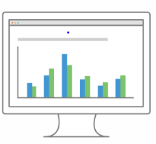


ETL Batch Processing Data Pipeline
Source
Data
Transform
Ingest
Extract
Load
Landing Bucket
External Stage
Staging Table
Takeaway DWH
Loading
Transform
Visualisation/ML
Click Here
Notes:
https://databricks-prod-cloudfront.cloud.databricks.com/public/4027ec902e239c93eaaa8714f173bcfc/2269326428961072/3244486160382768/7487126396143688/latest.html

Slide 8
Workflow Flow
AWS S3
Data from source system is captured
Databricks Notebook
Scheduled Job to execute ETL scripts in Snowflake
Databricks Notebook
Load dim and fact tables into Spark
Databricks Notebook
Databricks Notebook
Error Logging ( <timestamp>_<script>_<status>.log )
Snowflake
Perform Analysis
Load final result set into Snowflake
Dataset for downstream applications

Slide 9
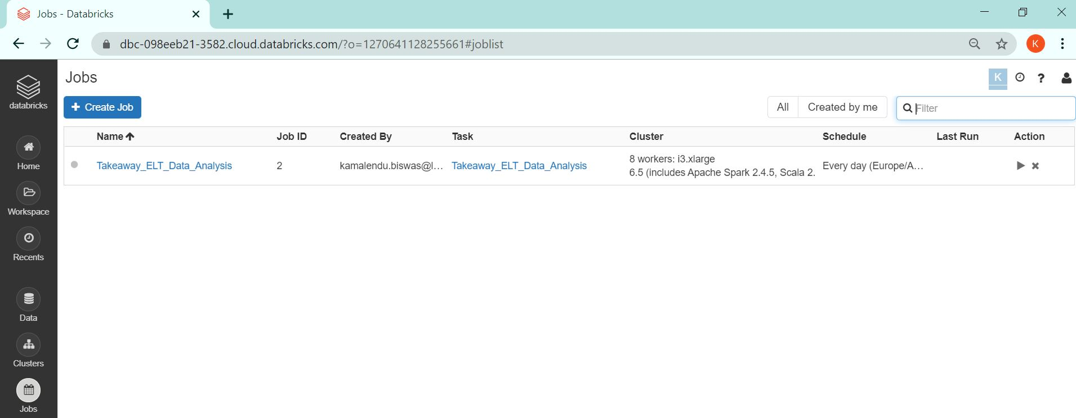
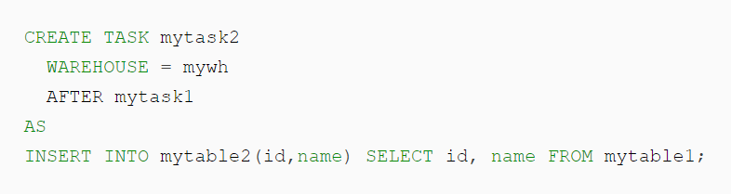

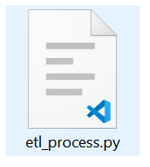

Job Scheduling
Scheduled notebook to run entire ETL and Analysis process.
Sequential execution.
Schedule SQL statement as Task with dependent task.
Cron based schedule, no visual status or monitoring.
ETL scripts can be scheduled in sequence.
Cron or Airflow based schedule.

Slide 10
Challenges
Huge Compressed
Source File
Slow Compute
Engine/Cluster
Lack of JSON Parsing
Capabilities
Connection and Authentication
** trial versions

Slide 11


Alternative ETL Approach
Load
Takeaway DWH
Ingest
Reports
Extract
Analysis / ML
Transform
Downstream

Slide 12
Benefits
Less Network/IO Traffic
Real Time
Big Data Processing
Capabilities
Controlled Optimization

Slide 13
Q&A ?
Thank you !
-Kamalendu Biswas

