Slide 1
Building Self-Correcting AI Agents in Python
Human-in-the-Loop Assistants to Autonomous Code Repair By Konagala Anudeep

Slide 2
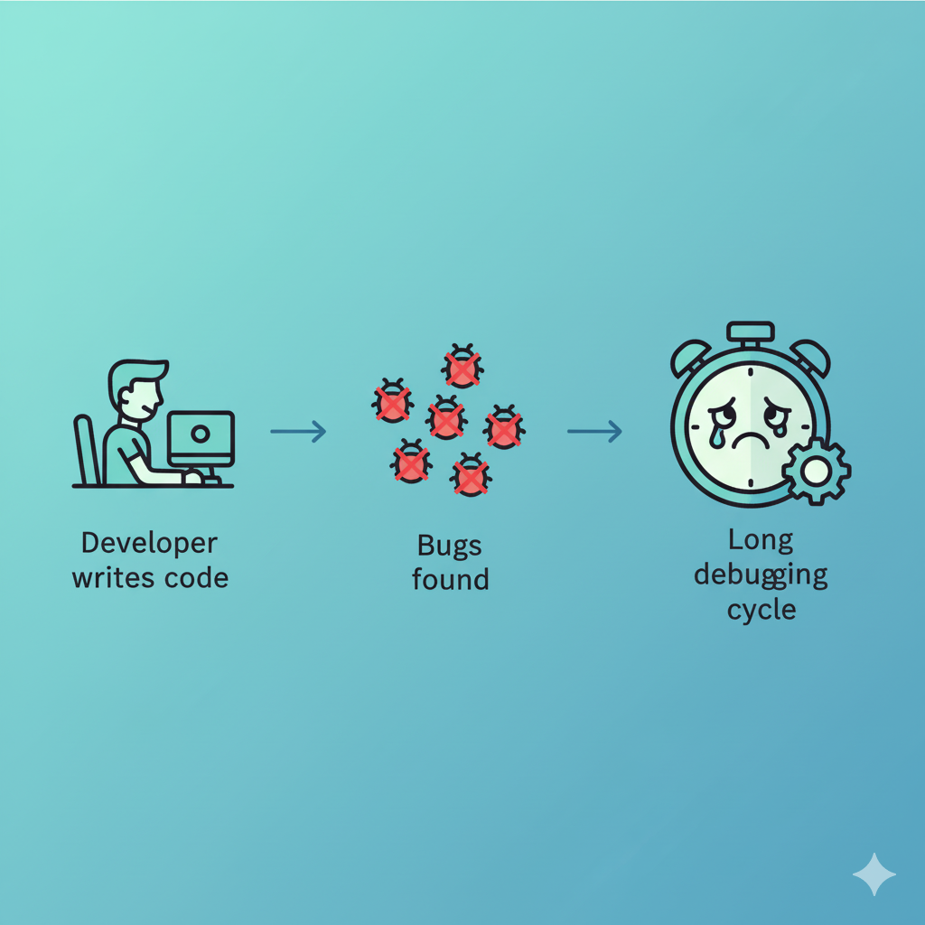
The Problem: The Cost of Bugs
Bugs are the most time-consuming part of development.
Traditional tools (linters, static analysis) catch syntax, not logic.
What if our code could fix itself?

Slide 3
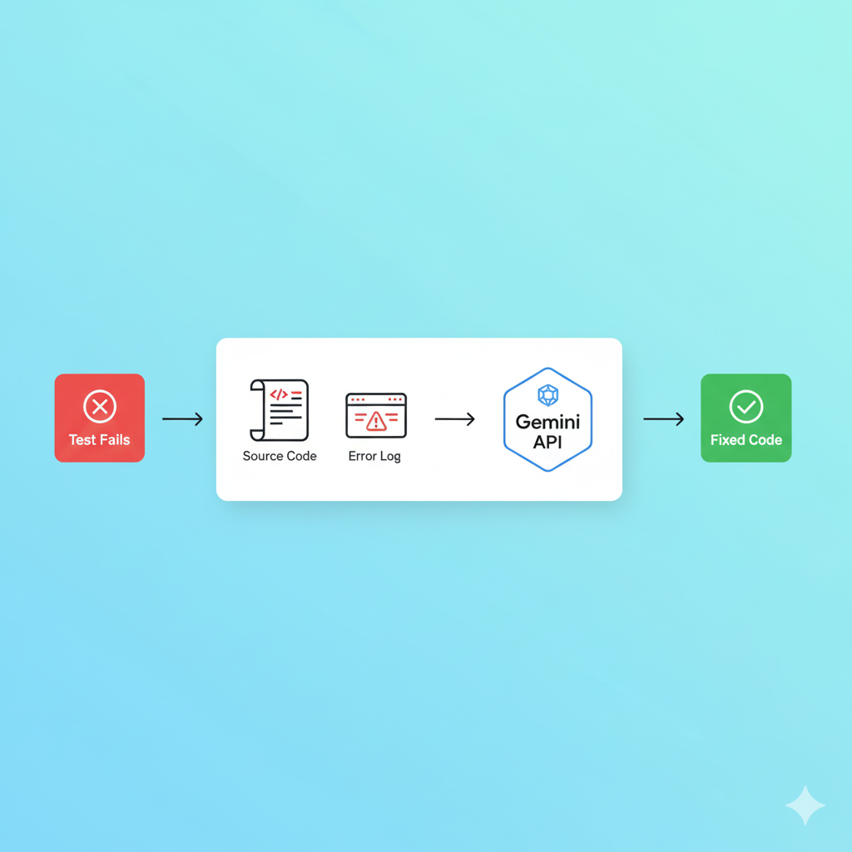
The Solution: Generative AI as a Teammate
We can use Generative AI (like Google's Gemini) to understand code logic.
By feeding an AI our failing tests and our source code, it can:
Analyze the error
Understand the intent of the code.
Generate a logical fix.

Slide 4
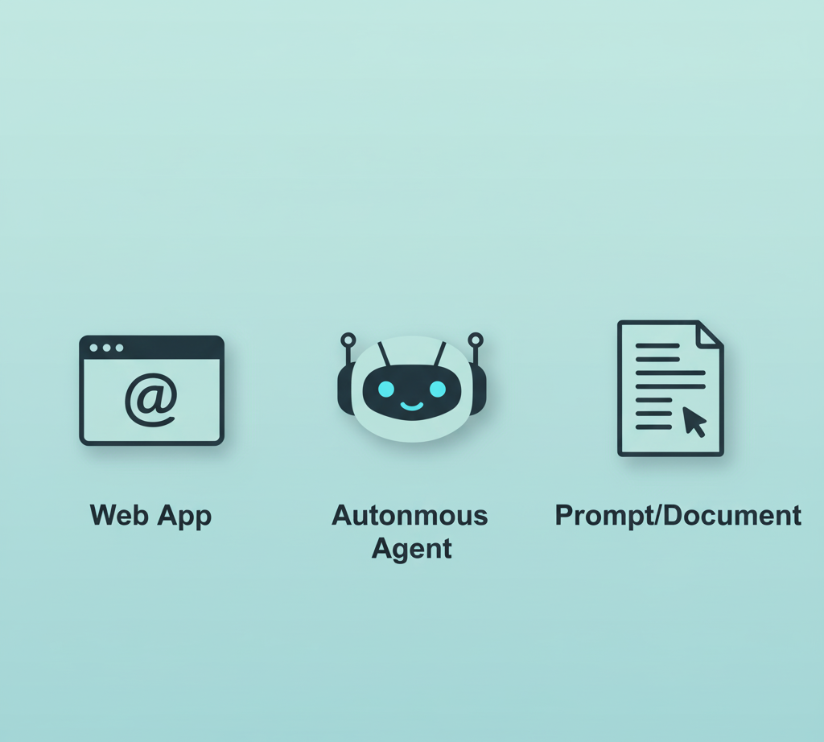
Our Project: What We've Built
This project contains two distinct AI-powered tools:
The AI Assistant: A web app for "human-in-the-loop" fixes.
The Autonomous Agent: A script that finds and fixes bugs on its own.
And a "meta-tool" to build our agent: 3. Prompt-Driven Development:
Using a prompt to write our agent.

Slide 5
Part 1: The AI Code Assistant (Web App)
Concept: The "Human-in-the-Loop" App
A simple Flask web app that provides "Correction as a Service".
User Flow:
A developer pastes their broken code into a web UI.
They click "Fix My Code."
The app calls the Gemini API and streams back a fix.

Slide 6
Web App: Architecture
A classic, simple client-server model.
(Visual): A diagram:
index.html (Frontend) -> fetch()
app.py (Flask Backend) -> @app.route("/api/correct")
genai.GenerativeModel() -> (Gemini API)
(Response) -> (Frontend)

Slide 7
Code Deep Dive: The Backend (app.py)
The key is using a system_instruction to "prime" the AI.
We tell the AI exactly how it should behave before we send the user's code.
(Visual / Code Snippet from (app.py):
@app.route("/api/correct", methods=["POST"])
def correct_code():
data = request.json
user_code = data.get("code")
system_prompt = data.get("prompt") # <-- From the frontend
# Create the model with the dynamic system prompt
model = genai.GenerativeModel(
"gemini-2.0-flash",
system_instruction=system_prompt # <-- THE FIX IS HERE
)
# Now, just pass the user's code
response = model.generate_content(user_code)
return jsonify({"corrected_code": response.text})

Slide 8
Code Deep Dive: The Frontend (index.html)
The frontend defines the AI's "persona" in the system prompt.
It then calls our own backend API, not Google's directly.
(Visual / Code Snippet from templates/index.html):
//1. Define the system prompt
const systemPrompt = `You are an expert Python developer...
Your response must contain ONLY the raw, corrected Python code.
Do not include explanations...`;
// 2. Call the backend API
async function callBackendWithBackoff(systemPrompt, userQuery) {
const payload = {
code: userQuery,
prompt: systemPrompt,
};
const response = await fetch("/api/correct", { // <-- Calls our Flask app
method: "POST",
headers: {"Content-Type": "application/json"},
body: JSON.stringify(payload),
});
// ...
}

Slide 9
The Autonomous "Self-Correcting" Agent
Concept: The Autonomous Agent
Now, we remove the human.
This agent is an autonomous script that iteratively fixes a project.
It's designed to run in a CI/CD pipeline or locally.
The Goal: Make a failing test suite pass, with zero human intervention.

Slide 10
The Core Loop: Test, Analyze, Fix, Repeat
The agent's logic is a simple, powerful loop.
(Visual): A diagram of the loop:
run_tests() -> Fails
generate_fix() -> (Uses stderr to ask Gemini for a fix)
apply_fix() -> (Overwrites the broken file)
run_tests() -> Fails again? (Repeat loop MAX_ATTEMPTS times)
run_tests() -> Passes! -> SUCCESS

Slide 11
Agent Architecture (agent.py)
The agent is composed of several key functions.
(Visual): A diagram showing the functions in agent.py:
main() (The Brain): Manages the core loop.
run_tests() (The Eyes): Runs pytest and "reads" the error.
generate_fix() (The Mind): Builds the prompt and calls Gemini.
apply_fix() (The Hands): Writes the fix to disk.
backup_project() / restore_project() (The Safety Net): Uses shutil to prevent disaster.

Slide 12
Code Deep Dive: run_tests()
Uses subprocess to run pytest as a shell command.
The most important part is capture_output=True.
This lets us "read" the stderr to find out what broke.
(Visual / Code Snippet from generated_agent/agent.py):
def run_tests():
"""Runs the pytest test suite."""
try:
# Use sys.executable to run pytest as a module
result = subprocess.run(
[sys.executable, "-m", "pytest", TEST_DIR],
capture_output=True,
text=True,
check=False,
)
logging.info("Test run completed with return code: %s", result.returncode)
return result
# ...

Slide 13
Code Deep Dive: generate_fix() - Part 1
This is the "brain" of the agent.
Step 1: Parse the error log (stderr) with Regex to find the exact file path that failed.
Step 2: Read the full source code of that file.
(Visual / Code Snippet from generated_agent/agent.py):
def generate_fix(stderr):
"""Generates a code fix based on the test error output."""
try:
# Step 1: Find the file path
match = re.search(r"(\.\/.*?\.py):", stderr)
# ... (fallback regex) ...
file_path_from_error = match.group(1).replace("\\", "/")
full_file_path = os.path.join(TARGET_DIR, file_path_from_error)
# Step 2: Read the file's content
with open(full_file_path, "r", encoding="utf-8") as f:
source_code = f.read()
# ...

Slide 14
Code Deep Dive: generate_fix() - Part 2
Step 3: Construct a highly specific prompt for the AI.
This prompt gives the AI all the context it needs: the role, the error, and the code.
(Visual / Code Snippet from generated_agent/agent.py):
# Step 3: Build the prompt
prompt_lines = []
prompt_lines.append(
"You are an expert developer. Fix the code based on the error message.\n"
)
prompt_lines.append(f"The error is:\n{stderr}\n")
prompt_lines.append(
f"The code for {full_file_path} is:\n```python\n{source_code}\n```"
)
prompt_lines.append(
("\nProvide only the complete, corrected Python code for the file, "
"without any explanations...")
)
prompt = "".join(prompt_lines)
response = model.generate_content(prompt) # Call the AI
fixed_code = response.text # ...
return full_file_path, fixed_code

Slide 15
Code Deep Dive: apply_fix()
This is the simplest, but most "dangerous" part.
It takes the AI-generated code and overwrites the original file on disk.
This is why backup_project() is so critical.
(Visual / Code Snippet from generated_agent/agent.py):
def apply_fix(file_path, fixed_code):
"""Applies the generated fix to the specified file."""
try:
with open(file_path, "w", encoding="utf-8") as f:
f.write(fixed_code) # <-- Overwrites the file!
logging.info("Applied fix to: %s", file_path)
except IOError as e:
logging.error("Error writing file: %s", e)
raise

Slide 16
Seeing it Think: The agent.log
The agent logs its entire "thought process" to agent.log.
We can watch it attempt to fix the code in real-time.
(Visual / Code Snippet from generated_agent/agent.log):
2025-10-24 22:50:55,915 - INFO - --- Attempt 1 of 3 ---
2025-10-24 22:51:00,752 - INFO - Test run completed with return code: 2
2025-10-24 22:51:00,752 - WARNING - Tests failed.
Generating fix...
2025-10-24 22:51:00,752 - ERROR - File not found at path: ...
2025-10-24 22:51:00,752 - ERROR - Failed to generate fix.
Restoring project.
2025-10-24 22:51:00,765 - INFO - Project restored successfully.
2025-10-24 22:51:00,765 - INFO - Agent run finished. (Speaker Note: This log shows a failure, which is a great learning example. It failed to parse the file path and safely restored the project.)

Slide 17
Part 3: "Prompt-Driven Development"
The "Meta" Idea
That agent.py file is complex. What if we didn't have to write it?
Prompt-Driven Development: Using a detailed, "blueprint" prompt to generate the entire agent script from scratch.
The agent.py file in this repo was written by the AI, not a human.

Slide 18
The Blueprint: main.prompt
We created a file, main.prompt, that acts as the "specification" for our agent.
It describes exactly what we want, in plain English.
(Visual / Code Snippet from main.prompt):
You are Smol Developer.
Your task is to generate a single Python file named `agent.py`.
Follow these exact specifications:
# Project Goal
Create a self-improving coding agent that:
1. Backs up a target project.
2. Runs pytest tests.
3. Detects errors and identifies which file caused them.
...
# Core Functions
1. backup_project()
- Copies the target project...
...
4. generate_fix(stderr): Parses the failing file path from stderr using regex....
No explanations, markdown, or extra commentary...

Slide 19
The "Builder": smol_dev.py
smol_dev.py is a simple script with one job:
Load the main.prompt file.
Send its contents to the Gemini API.
Save the AI's response as generated_agent/agent.py.
(Visual / Code Snippet from smol_dev.py
def main():
setup_logging()
logging.info("🚀 Starting Smol Developer...")
try:
setup_api()
prompt_text = load_prompt(PROMPT_PATH) # <-- Loads main.prompt
model = genai.GenerativeModel(MODEL_NAME)
code = generate_agent_code(prompt_text, model) # <-- Calls AI
save_agent_code(code, OUTPUT_DIR, OUTPUT_FILE) # <-- Saves agent.py
logging.info("🎉 Smol Developer finished successfully!")
# ...

Slide 20
The "Smol Developer" Workflow
This approach completely changes the development loop.
(Visual): A diagram:
Human: Edits main.prompt (The "Blueprint").
Runs: python smol_dev.py (The "Builder").
Result: A brand new agent.py is generated.
To change the agent's logic, you don't edit agent.py—you
main.prompt and re-run the builder.

Slide 21
Part 4: Setup & Execution
Step 1: Setup & Dependencies
Before running anything, we need to set up our environment.
1. Install Dependencies:
(Show requirements.txt.txt content)
pip install -r requirements.txt
2. Set API Key:
Create a .env file in the root.
(Show .env content)
GOOGLE_API_KEY="AIzaSy...KWo"

Slide 22
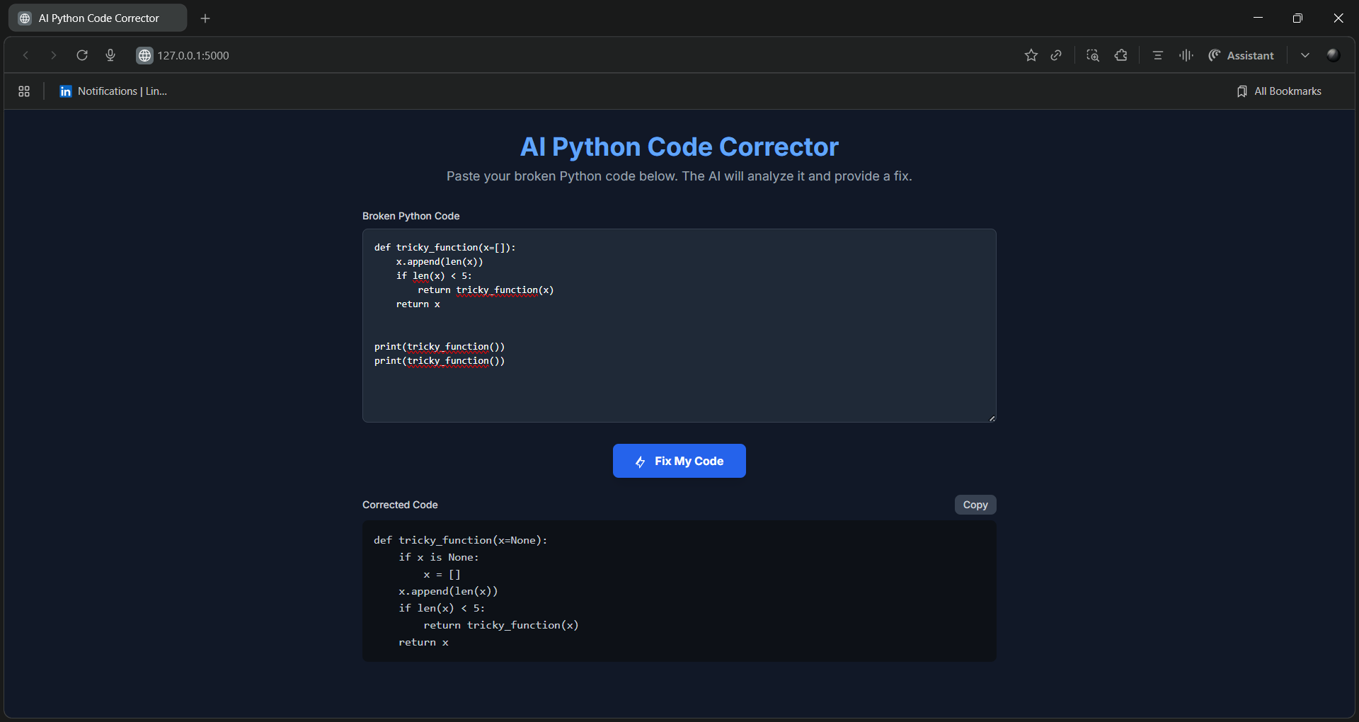
Step 2: Running the Web App
To run the "Human-in -the-Loop" assistant:
# 1. Ensure your .env file is in the root
# 2. Run the Flask app:
flask run
# 3. Access the application
Open your web browser and go to
http://127.0.0.1:5000

Slide 23
Step 3: Running the Autonomous Agent
To run the "Self-Correcting" agent: # 1. (Optional) Generate the agent
python smol_dev.py
# 2. Navigate to the agent's directory
cd generated_agent
# 3. Execute the agent
python agent.py

Slide 24
Key Takeaways
1. AI as an Assistant: System Prompts are key to creating powerful, helpful tools (like our Web App).
2. AI as an Agent: We can build autonomous systems that act on our behalf using a Test -> Analyze -> Fix loop.
3. AI as a "Meta-Developer": Prompt-Driven Development (smol_dev) is a new, powerful way to build and iterate on complex applications.

Slide 25
Q&A
Title: Thank You
Subtitle: Questions?

