Slide 1



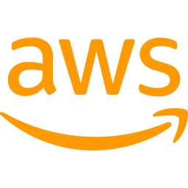

Quick.AI
AI SaaS Platform with DevOps Automation
Containerized Full Stack AI Application with CI/CD Pipeline & AWS Deployment
Docker
GitHub
Jenkins
AWS EC2
React
Built by Bitu Kumar

Slide 2
Project Overview
QuickAI — AI-Powered SaaS Platform
QuickAI is a full-stack AI SaaS platform providing multiple AI-powered tools, deployed using modern DevOps practices for automation, scalability, and reliable delivery.
✍️ Write Article
📝 Blog Titles
🖼️ Generate Images
AI-generated articles with custom length
Generate catchy blog title ideas
AI image creation with Clipdrop API
🎨 Remove Background
📄 Review Resume
👥 Community
Smart background removal tool
AI-powered resume analysis
Share and explore AI creations

Slide 3


Problem Statement
Common Challenges
QuickAI Solves With
Manual deployment is slow & error-prone
Docker containerization for consistency
→
Environment inconsistency between dev & prod
GitHub Actions for automated CI pipeline
Difficult scaling and maintenance
Jenkins for automated CD pipeline
Repetitive deployment tasks waste time
AWS EC2 for scalable cloud deployment

Slide 4



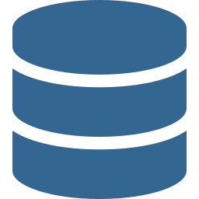
Technology Stack
Frontend
Backend
Database
DevOps
Cloud
React.js
Node.js
PostgreSQL
Docker
AWS EC2
Tailwind CSS
Express.js
Neon DB
Jenkins
GitHub Actions

Slide 5
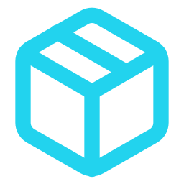



Docker Containerization
Consistent Environments
Container Architecture
Works the same in dev, staging & production
Docker Host (AWS EC2)
Faster Deployments
Pre-built images deploy in seconds
Frontend
Backend
React • Port 3000
Node • Port 5001
Portable & Scalable
Run anywhere Docker is installed
Jenkins
CD Pipeline • Port 8080
Isolated Services
Frontend, backend run in separate containers

Slide 6
CI/CD Pipeline
GitHub Actions (CI) + Jenkins (CD)
GitHub Actions — CI
Jenkins — CD
1
Developer pushes code to GitHub
1
Jenkins webhook receives GitHub push
2
GitHub Actions triggers automatically
⟶
2
Pulls latest images from Docker Hub
3
Docker images built for frontend & backend
Webhook
Trigger
3
Copies docker-compose.yml & .env
4
Images pushed to Docker Hub ✅
4
Runs docker-compose up -d 🚀
App deployed live at http://54.227.9.167:3000 — Fully Automated! Zero Manual Steps!

Slide 7

AWS Deployment Architecture
👤
⚛️
🟢
🗄️
→
→
→
User Browser
React Frontend
Port :3000
Node.js API
Port :5001
Neon PostgreSQL
Cloud DB
☁️ AWS EC2 • t3.small • Ubuntu 26.04 • us-east-1 • Elastic IP: 54.227.9.167
Auto Restart
Secure Secrets
Elastic IP
Zero Downtime
restart: always in compose
.env in Jenkins container
Permanent public IP
Rolling container updates

Slide 8
Complete DevOps Workflow
👨‍💻
📦
⚙️
🐳
🔧
☁️
🚀
Developer
(MacBook)
→
GitHub
Repository
→
GitHub Actions
(CI Build)
→
Docker Hub
(Registry)
→
Jenkins
(CD Deploy)
→
AWS EC2
(Live App)
→
Live App
:3000
git push
trigger
build & push
pull
webhook
deploy
GitHub Actions — CI
Jenkins — CD
✓ Checkout code
✓ Build Docker images
✓ Push to Docker Hub
✓ Webhook from GitHub
✓ Pull latest images
✓ docker-compose up -d

Slide 9

Key Benefits
Fully Automated Pipeline
Faster Software Delivery
Push code → app deploys automatically. Zero manual steps required.
GitHub Actions builds & pushes images in minutes, not hours.
Consistent Environments
Scalable Cloud Deployment
Docker ensures identical behavior across development and production.
AWS EC2 with Elastic IP for reliable, always-on availability.
Secure Secret Management
Real-World DevOps
API keys stored in GitHub Secrets & Jenkins credentials, never in code.
Industry-standard CI/CD practices with GitHub Actions + Jenkins.

Slide 10
Challenges & Learnings
⚠️ Challenges Faced
✅ Key Learnings
!
Docker socket permissions inside Jenkins container
✓
Practical CI/CD with GitHub Actions + Jenkins
!
EC2 SSH timeout — Security Group misconfiguration
✓
Docker containerization & image management
!
Elastic IP disassociating on EC2 restart
✓
AWS EC2 setup, security groups & Elastic IP
!
Environment variables not passed to containers
✓
Secret management in pipelines
!
.env file path mismatch in Jenkins workspace
✓
Debugging deployment issues systematically
!
VITE_BASE_URL baked at build time — needed rebuild
✓
Split CI and CD for better pipeline control

Slide 11
Future Improvements
☸️
🔒
📊
Kubernetes
HTTPS + SSL
Monitoring
Container orchestration for auto-scaling and self-healing deployments
NGINX reverse proxy with Let's Encrypt free SSL certificates
CloudWatch, Prometheus & Grafana for real-time metrics and alerts
🏗️
📈
🌐
Infrastructure as Code
Auto Scaling
Custom Domain
Terraform for automated, reproducible cloud infrastructure provisioning
AWS Auto Scaling Groups to handle traffic spikes automatically
Route 53 DNS with a custom domain for professional branding

Slide 12
Thank You!
Quick.AI — DevOps Automation Project
Docker
GitHub Actions
Jenkins
AWS EC2
Built with ❤️ using React • Node.js • Docker • GitHub Actions • Jenkins • AWS
Bitu Kumar

