Slide 1







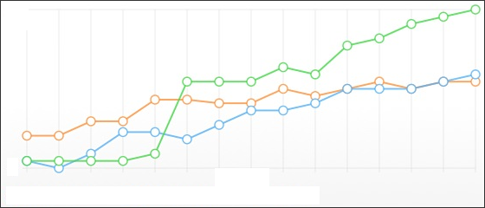

Data & Analysis flow
USB memory
Raw Data
Format unknown
PLC
Conversion & Store
Query &
Conversion
Excel
SQL database
(SQLite)
Query &
Plot on GUI app,
PowerPoint output
Qt (for GUI)
Trend Chart
PowerPoint

