Slide 1
IBM University Engagement Project Submission
“Exploring the Power of Agentic AI with IBM Granite and LangFlow”

Slide 2
Project Tile – AI Powered Interview Trainer Agent
Domain of Project – Education and Career Development
Student Name | Recent Passport Photo | Email ID | Mobile number [WhatsApp]
LAKSHYATA BITWAL |  | LAKSHYATABITWAL@GMAIL.COM | 7827903808

Slide 3
Problem Statement -
Problem Statement : AI Powered Interview Trainer Agent
The Challenge
Many students struggle to prepare for interviews due to lack of personalized guidance, practice opportunities, and constructive feedback. Traditional preparation methods do not adapt to individual skill levels and career goals.
The Objective
Build an AI-powered Interview Trainer Agent that:
Generates personalized interview questions.
Evaluates candidate responses.
Provides detailed feedback and improvement suggestions.
Identifies skill gaps.
Helps students improve confidence and interview performance.

Slide 4
Technology Used
Tech Stack (Mandatory)
Use any one of the following approaches:
LangFlow + IBM watsonx.ai + Granite Models
IBM Cloud Agentic Lab with IBM Granite Models
Replicate with LangChain + RAG + IBM Granite Models
I used LangFlow + IBM watsonx.ai + Granite Models

Slide 5
Proposed Solution -
The proposed solution is an AI-powered Interview Trainer Agent that helps students prepare for technical and HR interviews through personalized practice sessions. The system analyzes the user's resume, skills, and target job role to generate relevant interview questions.
Using IBM Granite models and LangFlow, the agent evaluates user responses, provides detailed feedback, identifies weak areas, and recommends improvement strategies. A RAG pipeline retrieves interview-related knowledge from trusted resources to improve response quality and relevance.
The solution consists of four intelligent agents:
Resume Analysis Agent – Extracts skills, projects, and experience from resumes.
Question Generation Agent – Creates role-specific interview questions.
Answer Evaluation Agent – Assesses answers and provides scores.
Feedback & Improvement Agent – Suggests improvements and learning resources.
The system includes a dashboard where users can track performance, strengths, weaknesses, and overall interview readiness.

Slide 6
Langflow component Used -
1) Chat Input – Interface where users enter their queries, preferences, or meal details (text/voice/image).
2) IBM watsonx AI Agent - Processes user input using Granite models to generate personalized nutrition insights and recommendations.
3) Name of IBM Granite model - Granite-4.0-8B-Instruct → Fast, efficient for real-time diet recommendations
4) Chat output -Displays AI-generated responses such as diet plans, nutritional analysis, and health suggestions.
5) File component - Stores and retrieves user data, meal logs, and nutritional datasets for analysis and tracking.
6) RAG Retriever
7) Vector database
8) Chat output

Slide 7
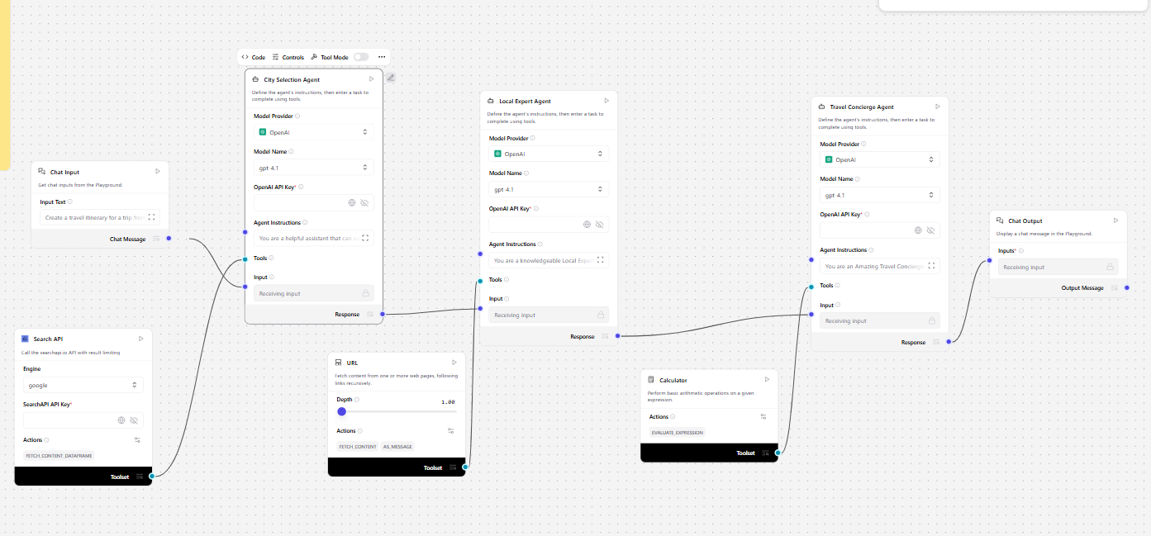
Langflow workflow -

Slide 8

Architecture blueprint

Slide 9

Role of Agentic AI in the solution
Agentic AI enables multiple specialized agents to collaborate autonomously and provide personalized interview preparation. Each agent performs a dedicated task such as resume analysis, question generation, answer evaluation, and feedback generation.
The agents share information and work together to create a dynamic and adaptive interview coaching experience. This allows the system to continuously improve recommendations and provide targeted guidance based on user performance..

Slide 10
Technology Used
Langflow platform -For designing and orchestrating multi-agent workflows visually
IBM Grainte model - for eg – ibm-granite-3-2-8b – For natural language understanding, reasoning, and personalization
IBM Cloud – It provides the infrastructure to build, deploy, and scale the Nutrition Agent efficiently. IBM Cloud enables a reliable, secure, and scalable environment for deploying the Nutrition Agent.
RAG– RAG to fetch real data first, then generate intelligent answers, making the Nutrition Agent more trustworthy and effective.
IBM Watsonx.ai - For model deployment, embeddings, and AI governance
Vector Database (FAISS/Chroma) – For RAG-based nutritional data retrieval

Slide 11
Novelty and Uniqueness
Multi-Agent Architecture
Personalized Interview Preparation
Resume-Based Question Generation
Real-Time Feedback and Scoring
Skill Gap Analysis
Adaptive Learning Approach
IBM Granite Powered Intelligence
Scalable and Enterprise-Ready

Slide 12
Git Hub Link
· Please create public github repository (Enable Add README button while creating repository) with format –
Please test and Paste the working Github URL –bitwallakshyata-ship-it/AI-Interview-Trainer-Agent
Make sure you have Uploaded following three files into your github repository 1) app.json file , 2) yourproblemstatement.pdf file 3) your projectpresntation.pptx file 4)any other files
·
·
·

Slide 13
Future Scope
1 Voice-Based Mock Interviews.
2.Video Interview Analysis using AI.
3.Emotion and Confidence Detection.
4.Multilingual Interview Support.
5.Integration with LinkedIn and Job Portals.
6.AI-Based Career Roadmap Suggestions..
·
·
·

Slide 14


