Slide 1
Phishing Detection using Decision Tree Classifier
Team_Name - bit_warriors
Team_Members - Aravind Umasankar, Yesvanthraja D

Slide 2
Problem
The problem statement is to find whether a given url is legitimate or not.
So here we can resolve this issue by implementing a machine learning model to classify whether it is legitimate or not.

Slide 3
Decision Tree Classifier for Phishing detection:
Decision tree is a one of the Machine Learning technique used to classify attributes based on requirements and predict the output.
The tree like structure enables us to interpret very easily.
In our model the tree traverses through the nodes and tests it with the data provided and classifies them under a certain class.
In our case the class can be considered as legitimate or not.

Slide 4
Working of model:
First we import the necessary libraries.
Next we read the csv data.
Do the preprocessing steps if any.
Split the data for training and testing.
Now import the decision tree classifier and using it fit the model.
Find the accuracy of the model using metrics.
Now plot the relationship between the accuracy and the max_depth to find the training and test loses.

Slide 5
How to run the model:
After downloading the notebook upload the csv data into the user environment(i.e) Jupyter,vscode or pycharm etc..
Now run each of the cells and the output will be displayed.

Slide 6
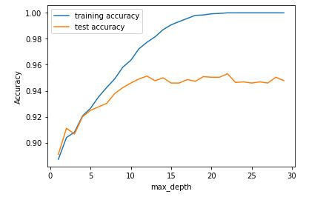
Output of the model:

