Slide 1


Introduction to Blogesation
This online blog is designed to provide a dynamic platform for users to share knowledge and information. With a focus on user engagement and content diversity, the blogesation offers a wide range of features to enhance the user experience.

Slide 2
Features of the Blog
1
Login Functionality
2
Sign up Functionality
Users can securely log in to their accounts, ensuring personalized access to features and content.
New users can easily register and create their personalized accounts to access all the features and start engaging with the community.
3
Adding Posts
4
Some more Features
Users can create and publish their own posts, sharing knowledge and experiences with the community.
The platform incorporates features similar to chat to other user and follow other users . Users can also see other users profile even without logging in.

Slide 3
Backend Architecture
Robust Framework
Efficient Data Processing
Scalability & Flexibility
The backend is built on a robust and scalable framework, ensuring seamless performance and future expansion.
Advanced algorithms and data management systems are implemented to handle high volumes of user-generated content efficiently.
The architecture is designed to be highly scalable and flexible, accommodating potential growth and technology advancements.

Slide 4
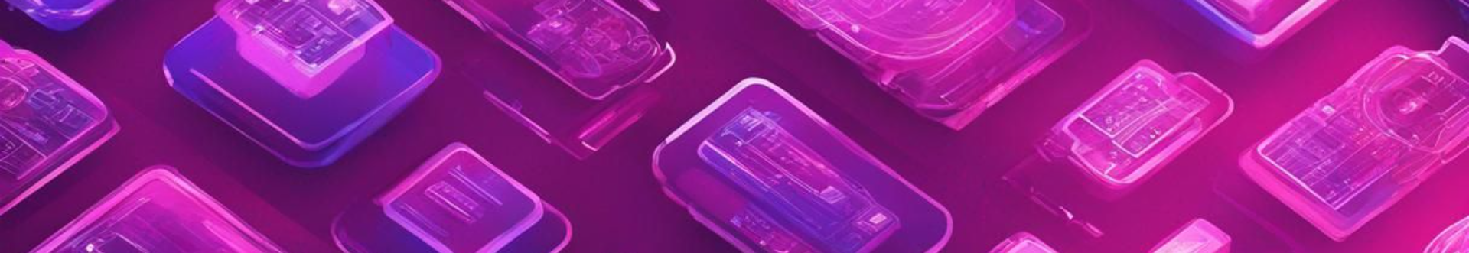



Security Measures
Encryption Protocols
Regular Audits
Multi-factor Authentication
Advanced encryption protocols are employed to secure user data and protect against unauthorized access.
Periodic security audits are conducted to identify and address vulnerabilities, ensuring continuous protection.
Enhanced security is implemented through multi-factor authentication, adding an extra layer of protection to user accounts.

Slide 5
Some more features to explore
Chat Messaging
User Profiles
🔥 Instantly connect and chat with other users
💻 Create and customize your own user profile
Follow Users
Upvoting and Downvoting
👥 Follow your favorite users and stay updated with their activities
👍👎 Express your opinion by upvoting or downvoting content

Slide 6
User friendly UI

Slide 7
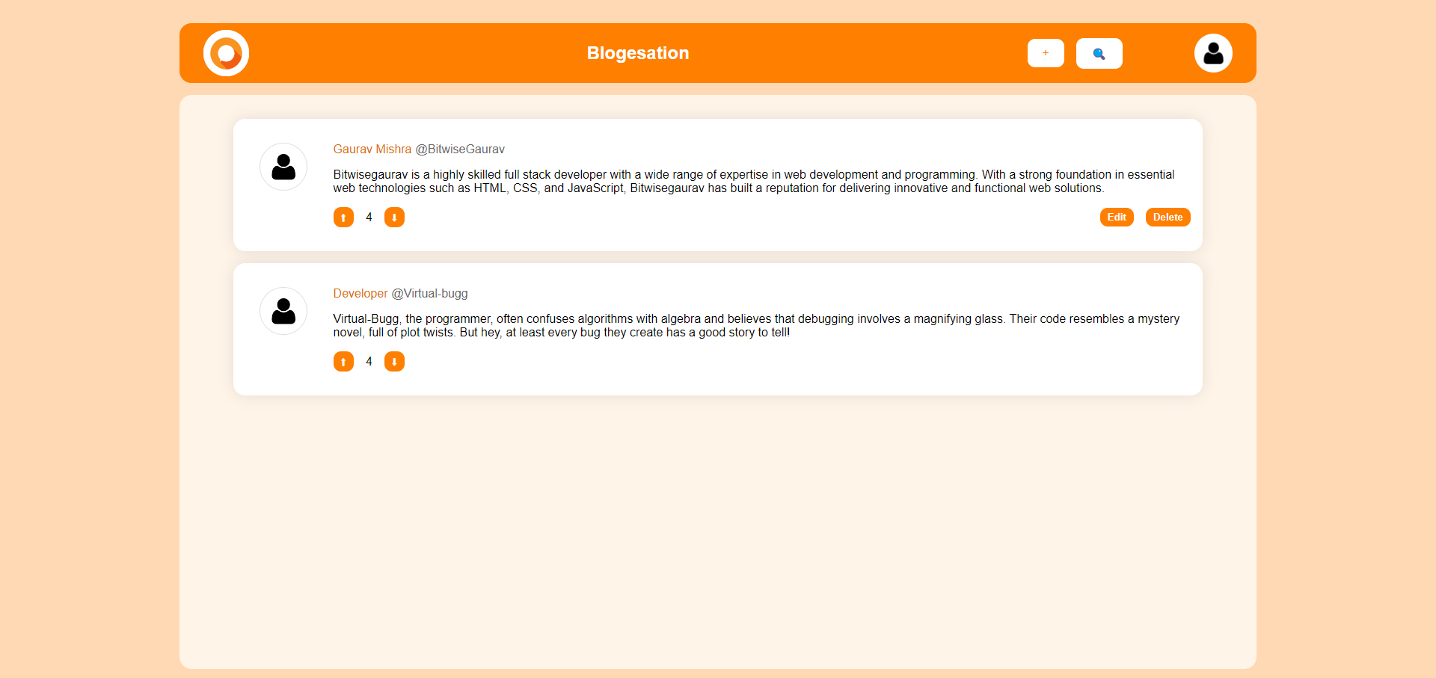
Explore Page

Slide 8
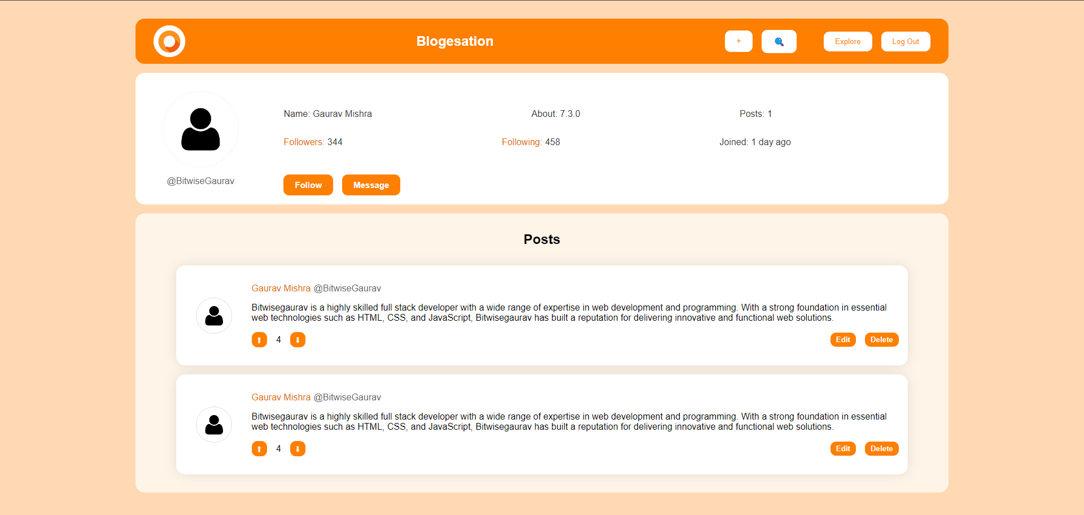
Profile Page

Slide 9
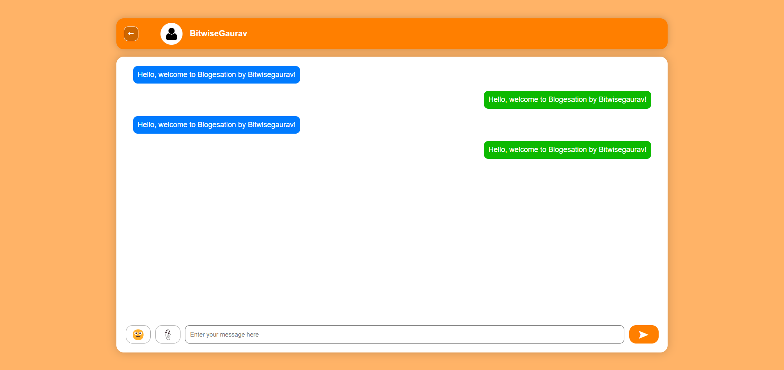
Chat Page

Slide 10
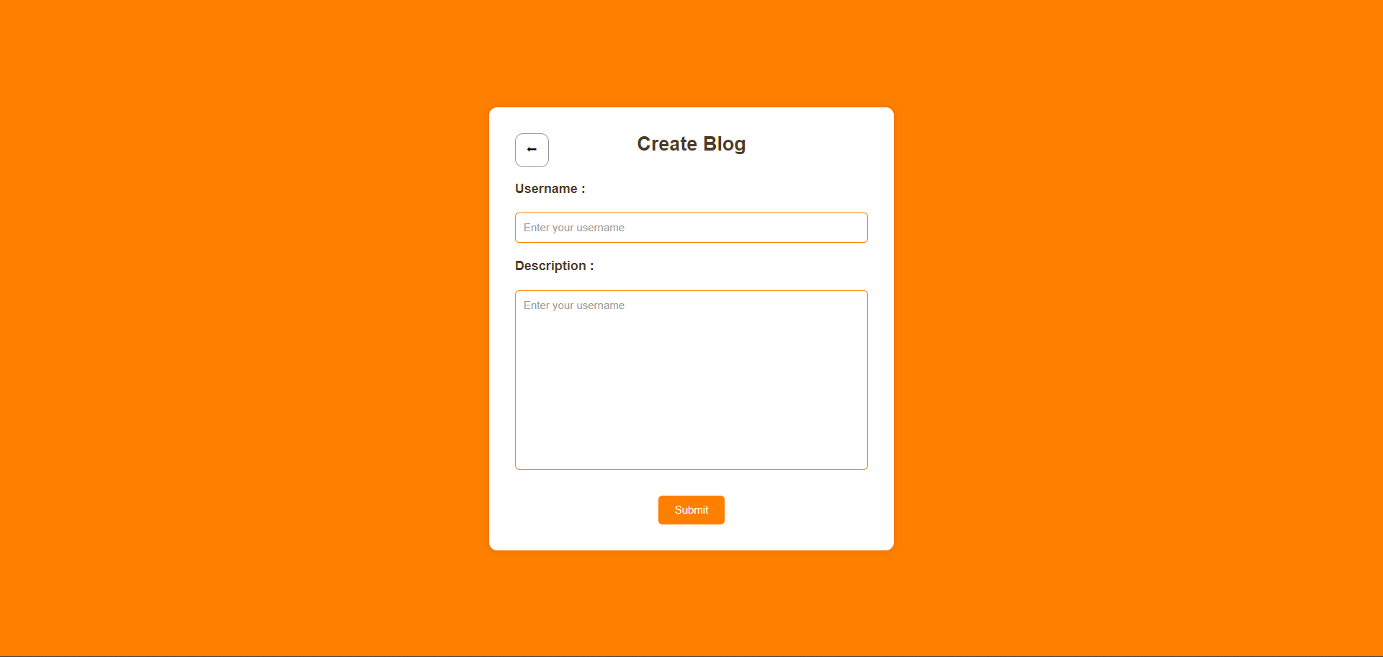
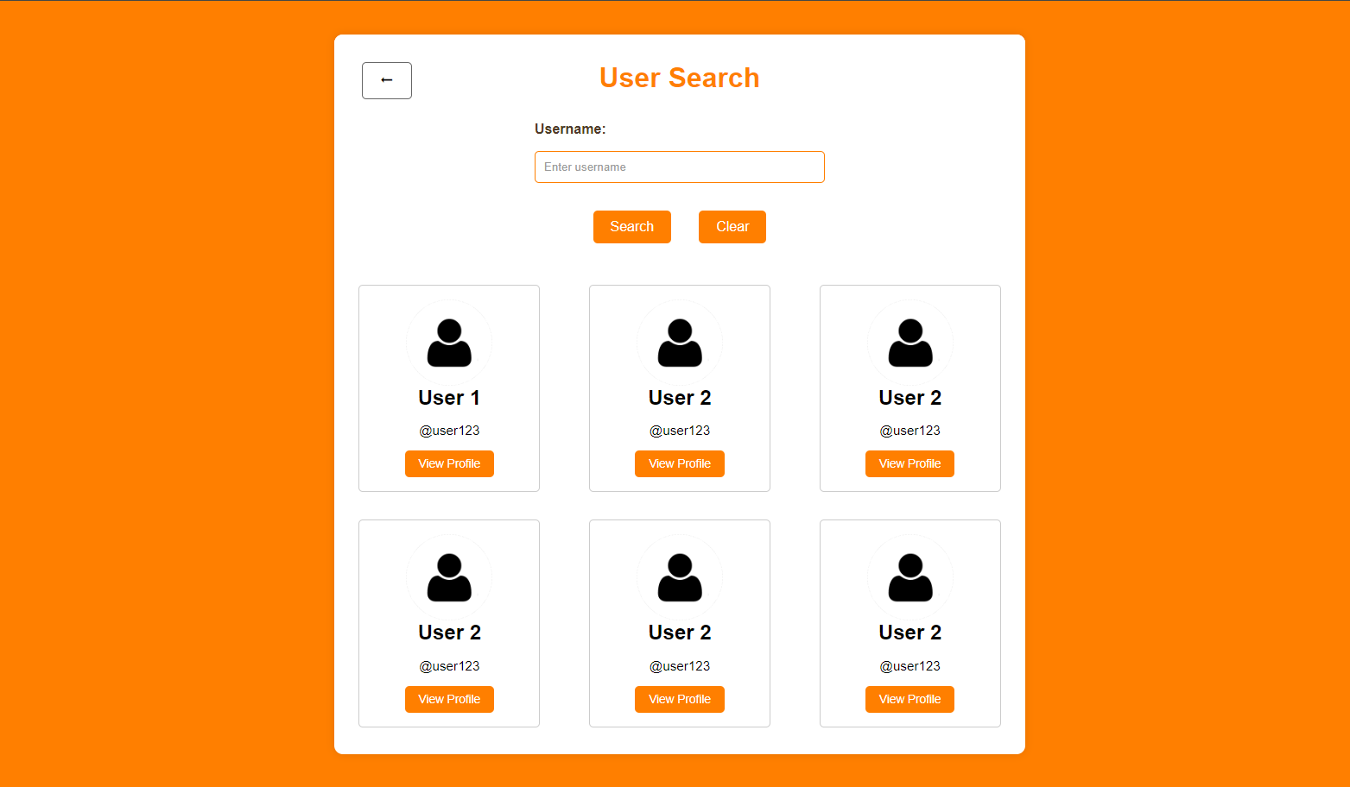
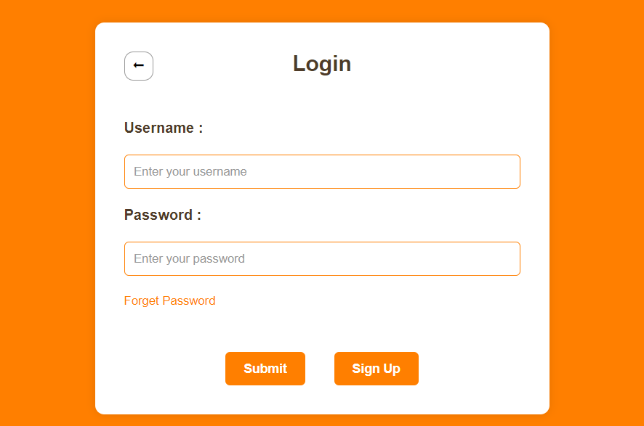
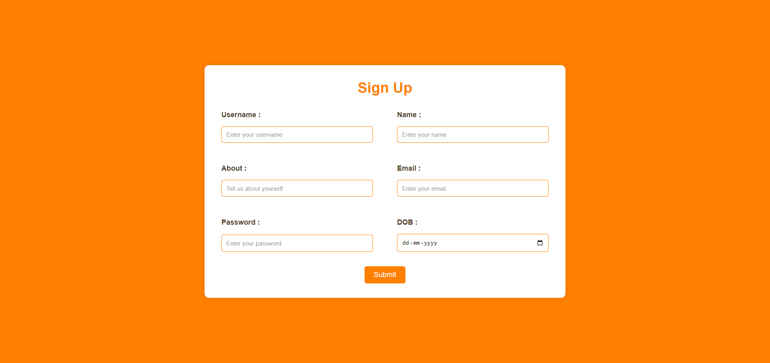
Some more Page

Slide 11

Thanks
We would like to express our sincere gratitude for your time and attention. Your support is greatly appreciated. Thank you!

