Slide 1

FINANCE
Financial Markets

Slide 2
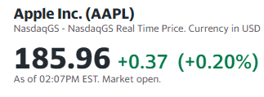
Stocks and Tickers
In simple terms a stock share is a piece of a company, Its price can go up or down
A ticker is a symbol that is represents a company’s stock
Each publicly traded company has a ticker
To find information about a company’s stock you use its ticker
Example, Apple: ”APPL”

Slide 3
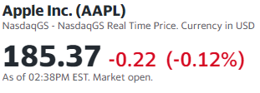
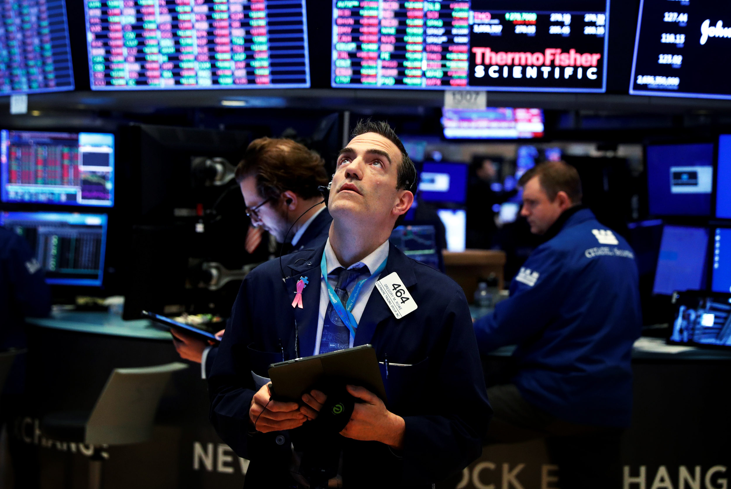
Stock Exchanges
Where and how the trading happens.
Probably seen some of them on the news of people looking worried
Stocks are traded on different exchanges
2 Stock exchanges to be aware of.
NYSE
NASDAQ

Slide 4




NYSE
Nasdaq
New York Stock Exchange
Old and most classic companies are traded here
Acronym for some nerdy stuff
Newer and associated with tech stocks
Ticker + Exchange
Other then being able to read the ticker, the exchange doesn’t really matter for our project

Slide 5
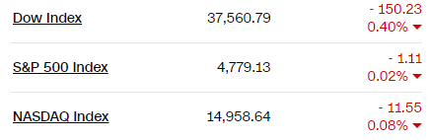
Stock Indexes
S&P 500
500 Large Cap Companies
DOW
30 Major US Companies
Dow Jones Industrial Average
NASDAQ
Just all the stocks on the NASDAQ Exchange
Measures of a specific section of the stock market.
Performance of stocks that share things in common

Slide 6
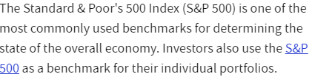
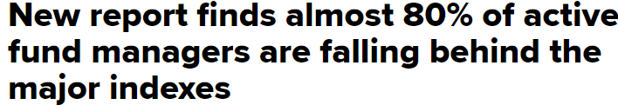
What are indexes used for?
S&P is commonly used as a metric to determine portfolio performance
Can also be used for a measure of the health of markets and overall economy

Slide 7
Funds
Mutual fund
ETF - exchange-traded funds
Mix of different assets
Were actively managed by fund managers, but are becoming more passive
Can only be purchased at the end of each trading day
Mix of different assets
Mostly passive
Can be bought and sold on exchanges

Slide 8
Portfolio Management
Investment portfolio management involves building and overseeing a selection of assets such as stocks, bonds, and cash that meet the long-term financial goals and risk tolerance of an investor.
Passive portfolio management seeks to match the returns of the market by mimicking the makeup of an index or indexes.
Active portfolio management requires strategically buying and selling stocks and other assets in an effort to beat the performance of the broader market

Slide 9
Other types of assets
Derivative
Financial Contract that derive their value from an underlying asset
Can be traded on exchanges
Forex
Trading of currencies for profit
Traded by using rate pairs, eg, EUR/USD
Commodity
Basic good
Gold, Oil, Gas
Usually invested through in funds
Options, Futures Calls, are all types of derivatives

