Slide 1
Obfuscating Web User Search Queries via Generative Adversarial Privacy
ang Zhang, Zhongxuan Ruan, Mengwei Yang
EE 599 Final Project
Jiang Zhang, Zhongxuan Ruan, Mengwei Yang
2020.4.xx

Slide 2
Content
Introduction
Related work
Approach
Evaluation
Conclusion

Slide 3
Introduction

Slide 4
Related work

Slide 5
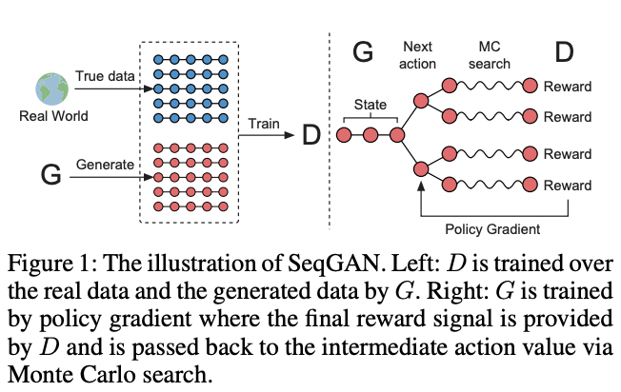
Approach: SeqGAN with multiple objectives
Real query
Generator
Obfuscated query
Distance
Discriminator
Adversary
Utility metric
Privacy metric
MLE Loss
Error rate1
Error rate2
Fig. 1. Original SeqGAN (single objective).
* Discriminator: predict where a query is real, to make the obfuscated query meaningful.
* Adversary: predict the category of a query, to enhance the privacy of user query.
Reward1
Reward2
Reward3
Policy gradient
Fig. 2. Our SeqGAN with multiple objectives.

Slide 6
Evaluation

Slide 7
Conclusion

