Slide 1
Obfuscating Web User Search Queries via Generative Adversarial Privacy
EE 599 Final Project
Jiang Zhang, Zhongxuan Ruan, Mengwei Yang
2020.4.xx

Slide 2
AOL Dataset
UserID
Query
QueryTime
Rank
Link
Preprocessing:
Filter the dataset by keywords from two topic: cancer, pregnancy.
Classify the dataset into three categories: cancer related, pregnancy related, and other.
Each category contains 1000 users, with queries related to each topic.
Goal:
Mutate word tokens in web search queries
Decrease its privacy risk: category inference accuracy
Maintain its stealthiness (utility metric1): the obfuscated query should be meaningful instead of random words
Reduce obfuscation cost (utility metric2): the crossentropy loss

Slide 3
Motivation
Baseline solution:
Delete words with high privacy risk (e.g. cancer, pregnancy)
Mutate words randomly
Mutate words with differential privacy
Limitations:
May not capture the correlation among words in the query
Context-free, no adversary

Slide 4
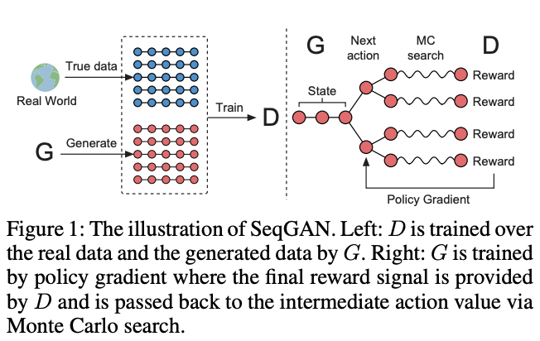
Our approach: SeqGAN with multiple objectives
Real query
Generator
Obfuscated query
Distance
Detector
Adversary
Utility metric
Privacy metric
CE Loss
Error rate1
Error rate2
Fig. 1. Original SeqGAN (single objective).
* Discriminator: predict where a query is real, to make the obfuscated query meaningful.
* Adversary: predict the category of a query, to enhance the privacy of user query.
Reward1
Reward2
Reward3
Policy gradient
Fig. 2. Our SeqGAN with multiple objectives.

Slide 5
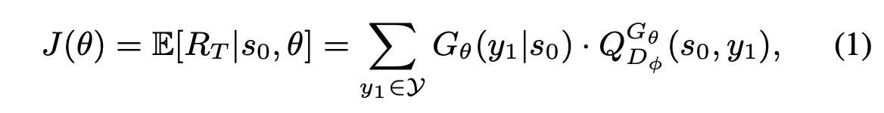
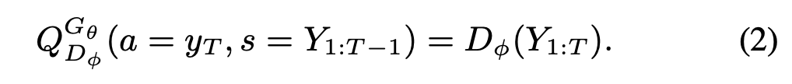
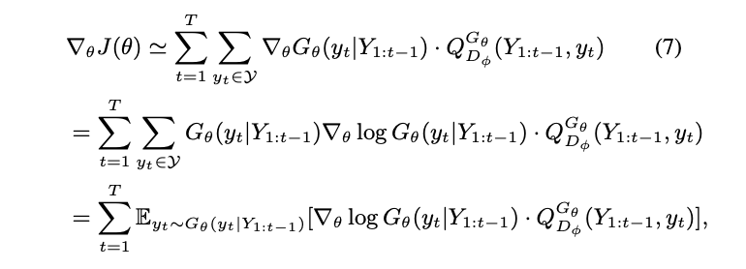

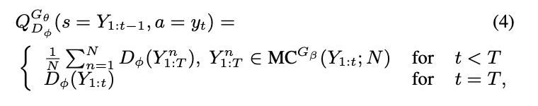


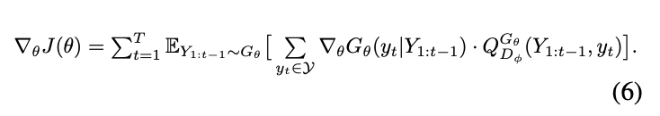
Policy gradient (theory part)

Slide 6
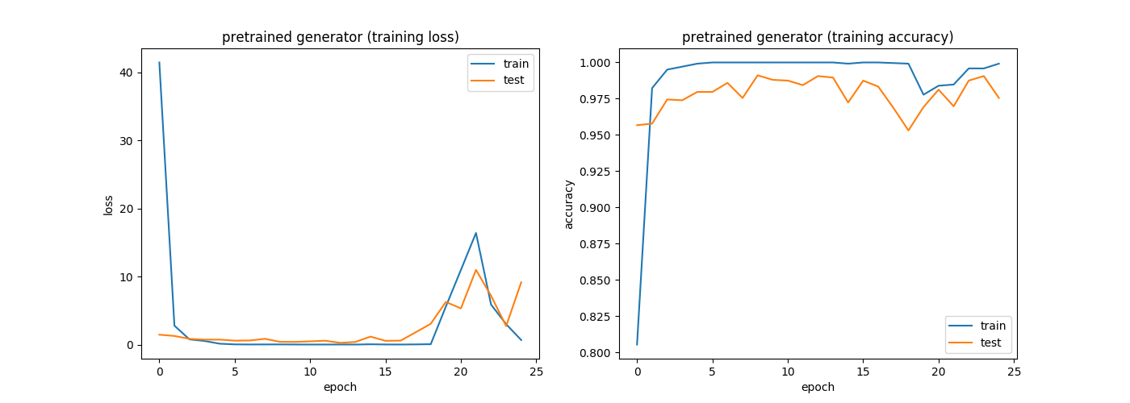
Pretrained Result (Adversary)
Pretrained adversary
Pretrained adversary

Slide 7
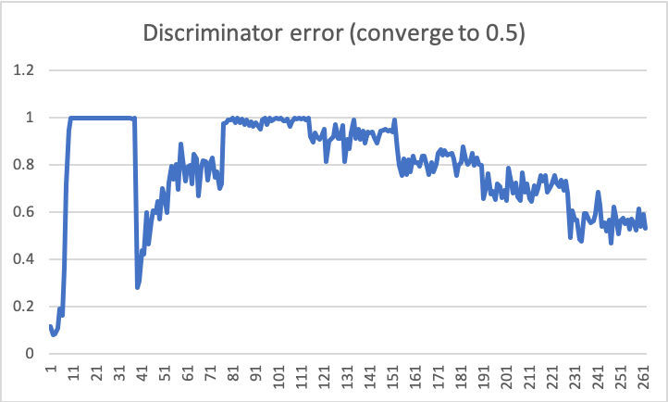
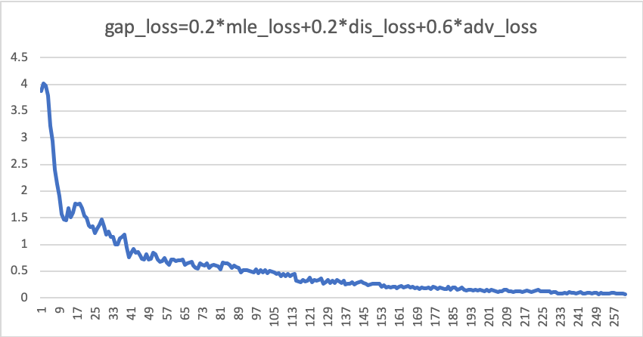
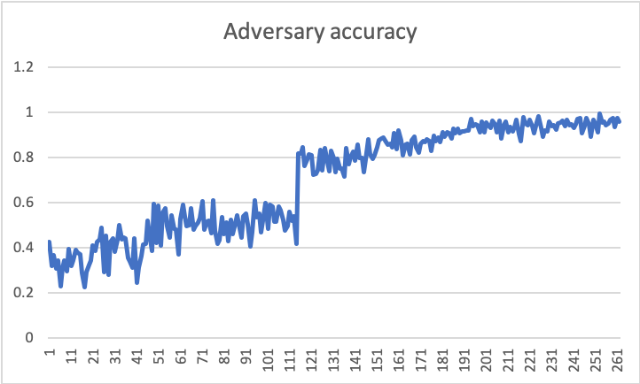
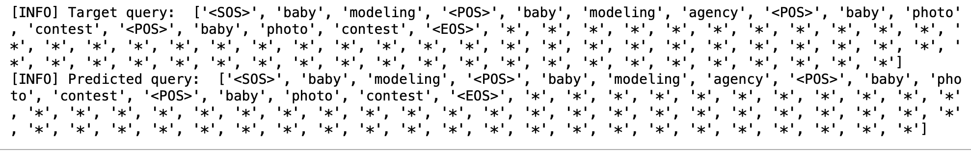
Pretrained Results (Generator)
Explanation: MLE loss -> 0 (Identity transformation)
Too slow! (Monte Carlo sampling part, O(T^2))

Slide 8
How to improve the sampling efficiency? Can we train GAP in a supervised approach instead of RL?

Slide 9
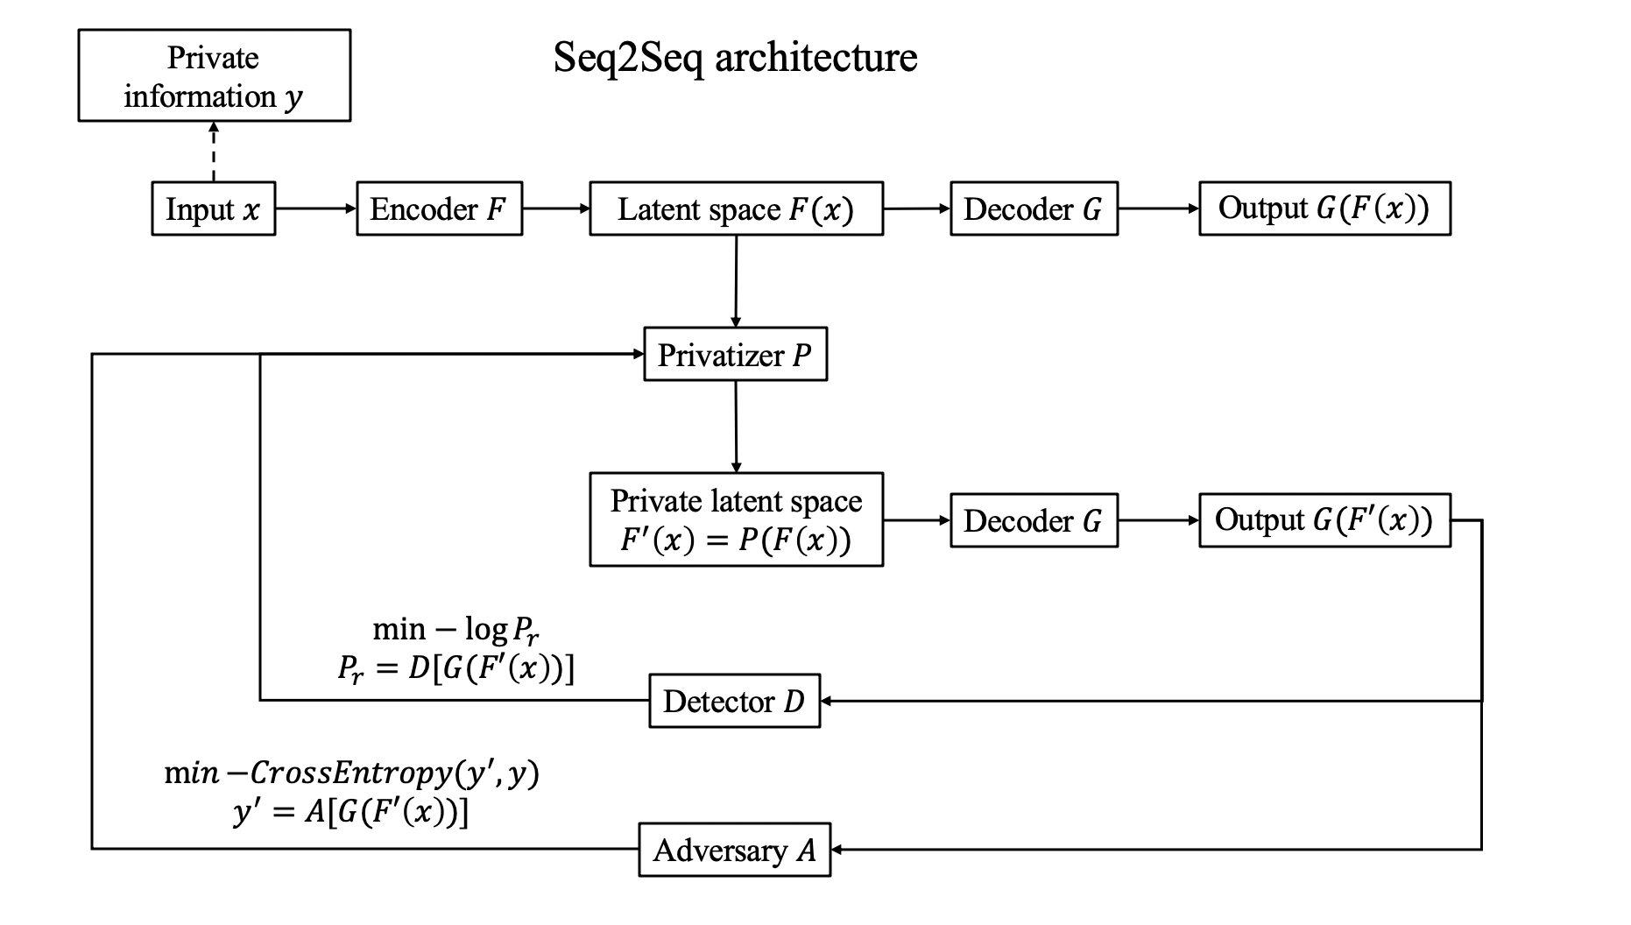

Slide 10
Not work for NLP task …

Slide 11
No gradient here!
Because the generated word sequences are actual index, not differentiable value.

Slide 12
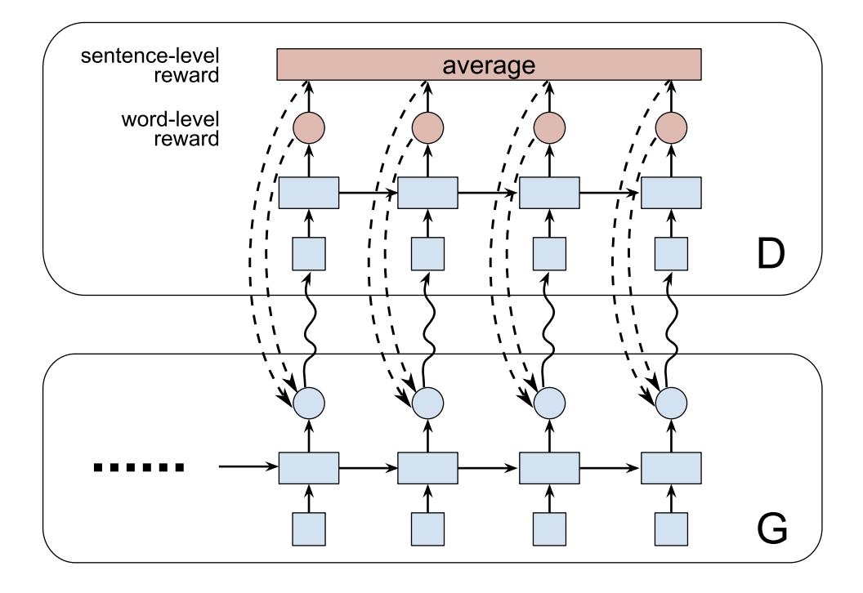
Back to SeqGAN, with O(T) sampling complexity
Xu, Jingjing, et al. "Dp-gan: Diversity-promoting generative adversarial network for generating informative and diversified text." arXiv preprint arXiv:1802.01345 (2018).

Slide 13
Still working on this ...

Slide 14
Content
Introduction
Related work
Approach
Evaluation
Conclusion

Slide 15
Conclusion

