Slide 1

The difference between East and West dragons

Slide 2

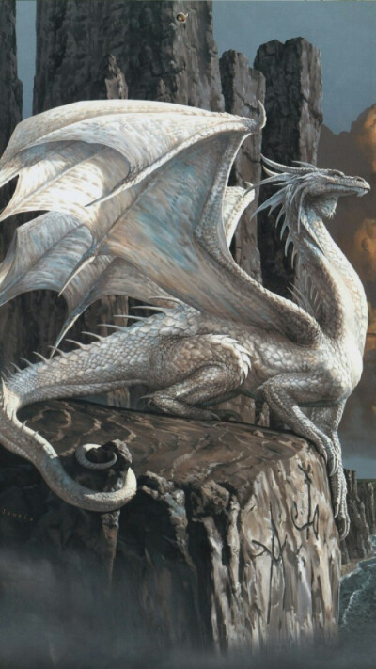
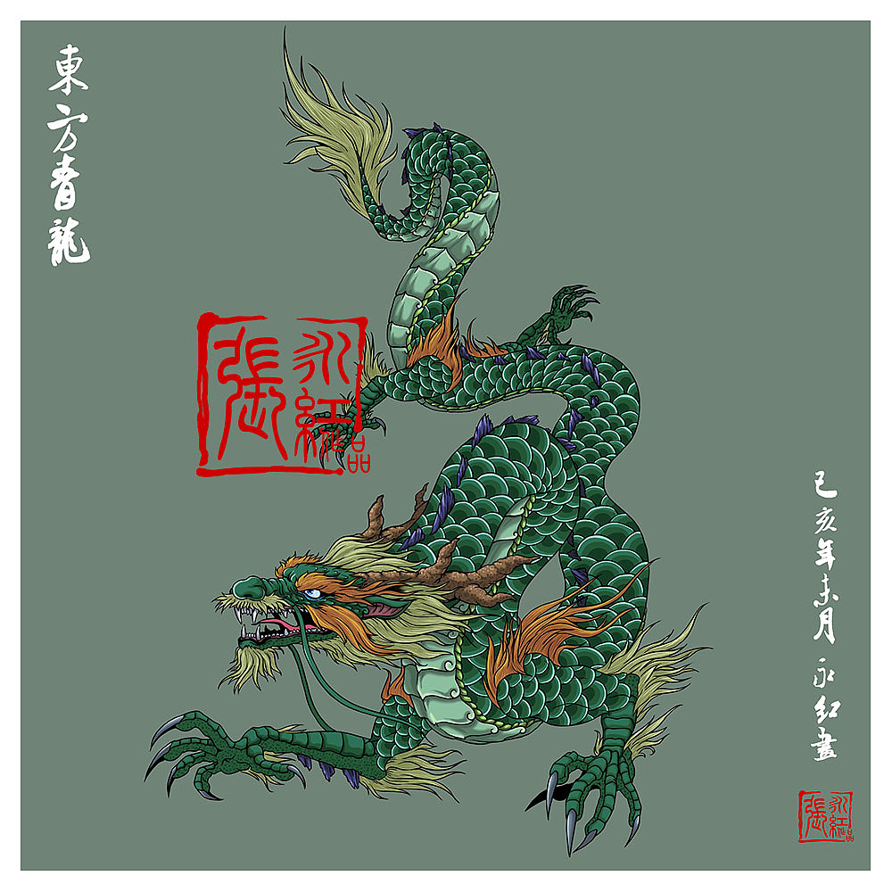
WING
Obviously, Chinese and West daragons have great differences in appearance, especially wings.

Slide 3
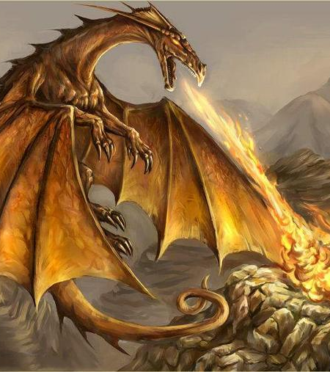

ABILITY
Western dragons can breathe fire, gas, water and have many special abilities.
The Chinese dragons has the power of the divine dragon, which can control the wind and rain,change the weather.

Slide 4


Implied Meaning
In the West, dragons generally symbolize evil, cruelty and some bad pronoun, and often act as villains in movies, with a darker image.
In the East, the dragon always represents auspiciousness, is a symbol of good fortune, but also extremely dignified, in the heart of the Chinese people has a very high status.

Slide 5
THANK YOU!
By----软工23-2 吴昊天

