Slide 1
实验三

Slide 2
1. 登录与注销
登录
注销
——session

Slide 3
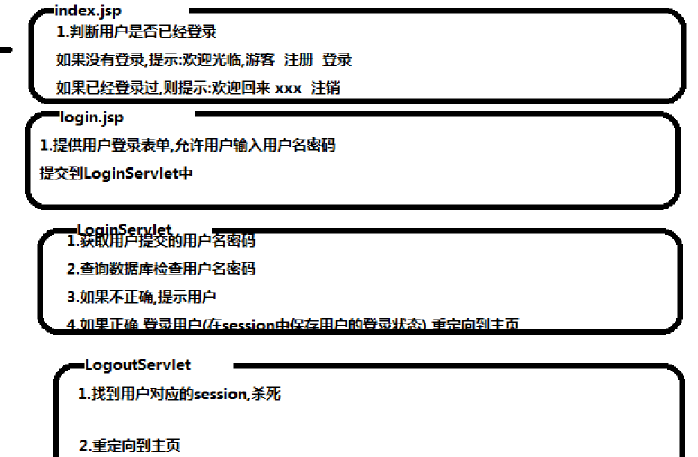

Slide 4
index.jsp
<h1>我的网站</h1>
<%String user=(String)session.getAttribute("user");
if( user==null || "".equals(user)){
%>欢迎光临！游客！
<a href="${pageContext.request.contextPath}/login.jsp">登录</a>
<a href="#">注册</a>
<%
}else{
%>欢迎回来！<%=user %>!
<a href="${pageContext.request.contextPath}/ogoutServlet">注销</a>
<%}
%>

Slide 5
Login.jsp
<h1>我的网站-登录</h1>
<form action="${pageContext.request.contextPath}/LoginServlet" method="post">
用户名：<input type="text" name="username" />
密码：<input type="password" name="password">
<input type="submit" value="登录" />
</form>

Slide 6
UserDao.java——仿数据库
package ustc.javaweb.session;
import java.util.LinkedHashMap;
import java.util.Map;
public class UserDao {
private UserDao() {}
private static Map <String,String> map=new LinkedHashMap<String,String>();
static {
map.put("张三", "123");
map.put("李四", "111111");
map.put("王五", "123456");
}
public static boolean valiNamePsw(String username,String password) {
return map.containsKey(username) && map.get(username).equals(password);
}
}

Slide 7
LoginServlet
request.setCharacterEncoding("utf-8");
response.setContentType("text/html;charset=utf-8");
String username=request.getParameter("username");
String password=request.getParameter("password");
if(UserDao.valiNamePsw(username, password)) {
request.getSession().setAttribute("user", username);
response.sendRedirect(request.getContextPath()+"/index.jsp");
}else {
response.getWriter().write("用户密码不正确！");
}

Slide 8
LogoutServlet
package ustc.javaweb.session;
import java.io.IOException;
import javax.servlet.ServletException;
import javax.servlet.annotation.WebServlet;
import javax.servlet.http.HttpServlet;
import javax.servlet.http.HttpServletRequest;
import javax.servlet.http.HttpServletResponse;
@WebServlet("/LogoutServlet")
public class LogoutServlet extends HttpServlet {
private static final long serialVersionUID = 1L;
protected void doGet(HttpServletRequest request, HttpServletResponse response) throws ServletException, IOException {
if(request.getSession(false) != null && request.getSession().getAttribute("user") != null) {
request.getSession().invalidate();
}
response.sendRedirect(request.getContextPath()+"/index.jsp");
}
protected void doPost(HttpServletRequest request, HttpServletResponse response) throws ServletException, IOException {
doGet(request, response);
}
}

Slide 9
如果页面没有显示成功登录，调试：
在index.jsp页面加入
System.out.print(user);
可以在eclipse中console view看到输出null
或者设置断点，在调试环境查看session
原因也可能：cookie被浏览器禁用了
查看工具-internet属性-隐私-高级

Slide 10
2. 数据库操作
下载Navicat_Premium_11.0.17.exe，并安装
登录到uf656p33u572e95l6zo.mysql.rds.aliyuncs.com

Slide 11
