Slide 1
BI Mini Project Restaurant Analysis
Presented By
Ayan Chakraborty
185900

Slide 2
Index
INTRODUCTION
DATA SOURCE
WORK FLOW
SCHEMA DESIGN
DEMO REPORTS

Slide 3
introduction
Take raw data and organize it in such a way that it can be used for analyzation.
To compare different Hotels in different City from the given data by performing ETL and generating reports.
Helps the customer with different choices of hotels in different city based on their ratings on various criteria.

Slide 4
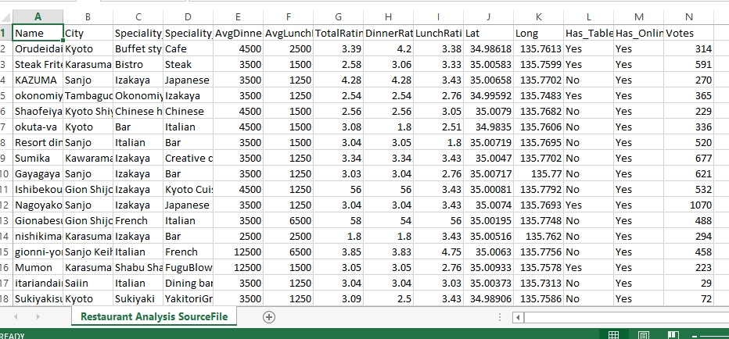
Data source

Slide 5
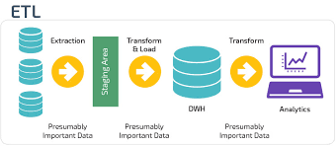
workflow

Slide 6
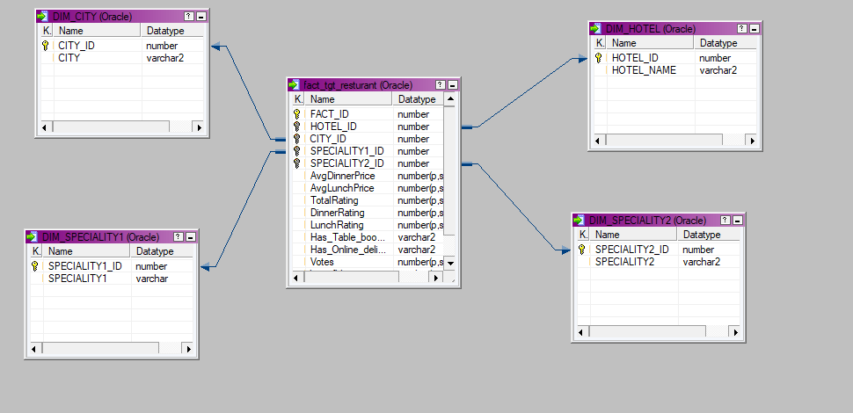
Schema design

Slide 7
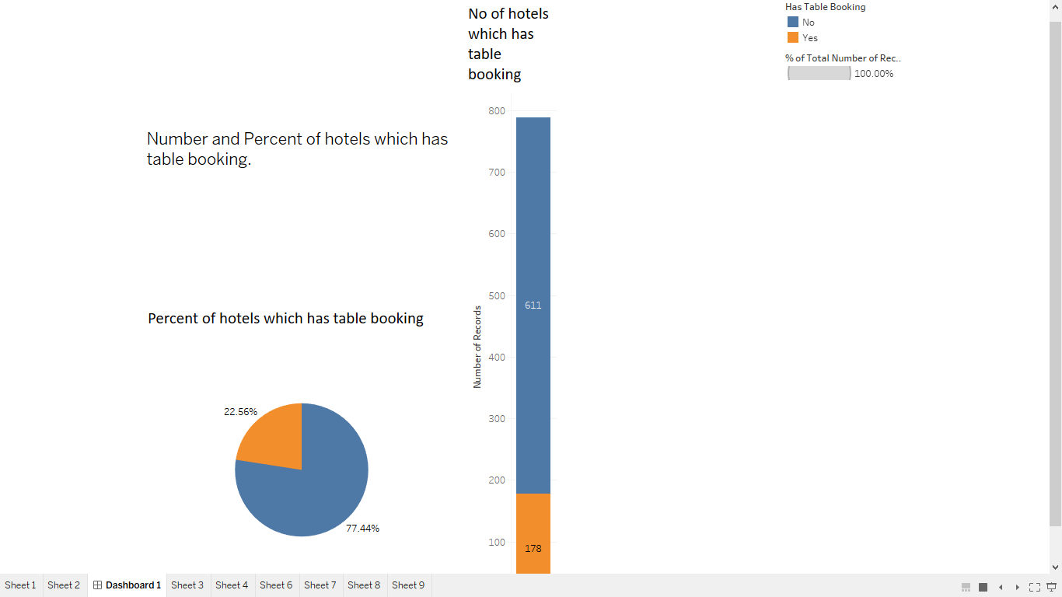
Demo reports

Slide 8
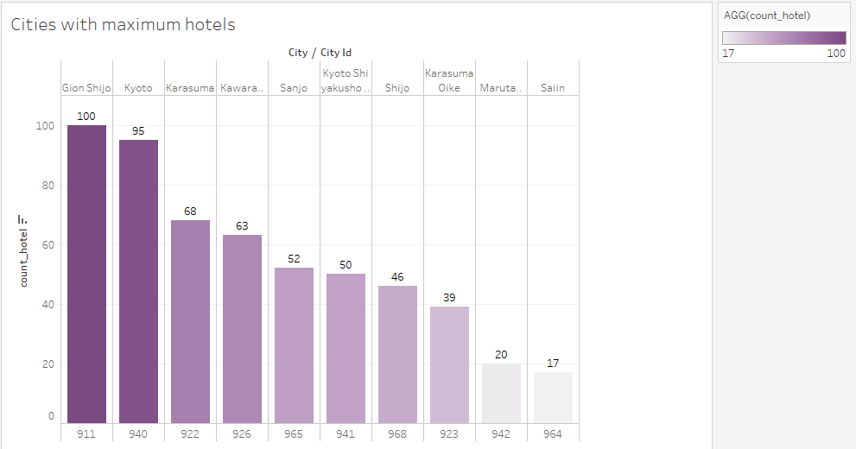
Contd..

Slide 9
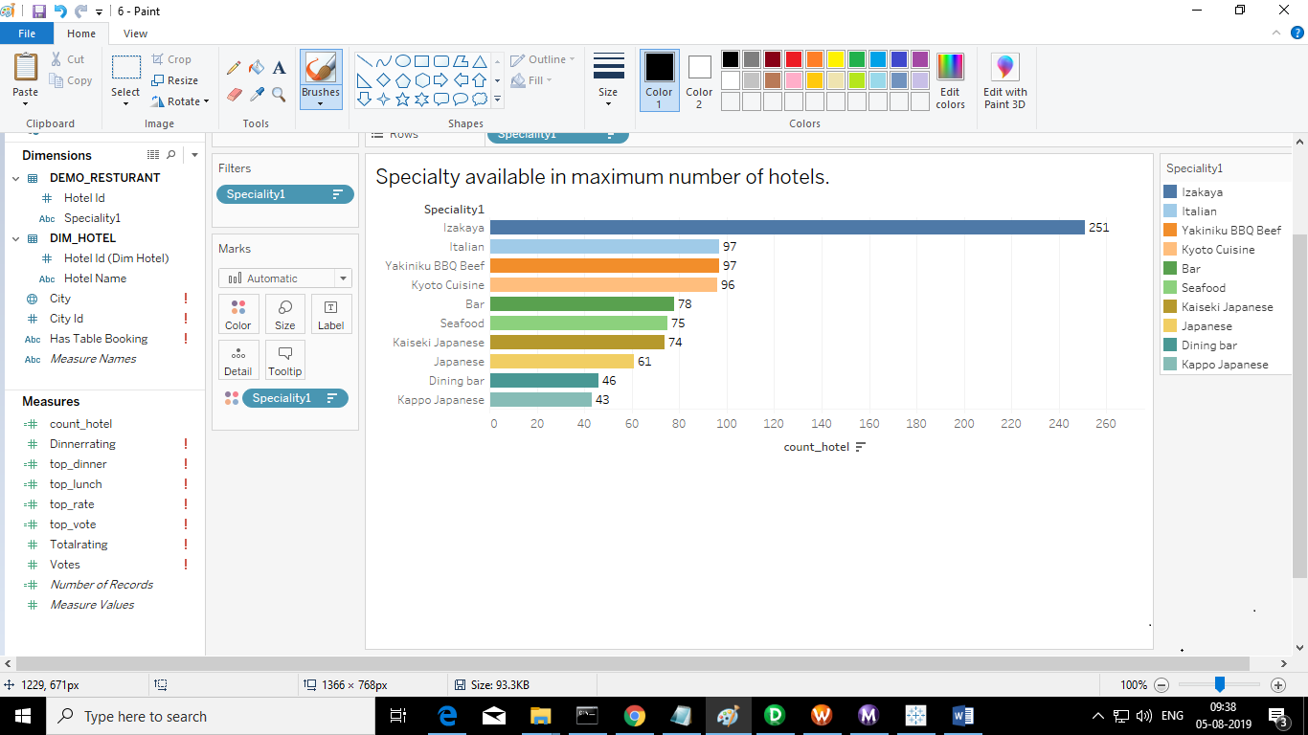
Contd..

Slide 10
THANK YOU

