Slide 1
BI Mini Project Bio Medical Data Analysis
Presented By:
Raghav Agarwal

Slide 2
INTRODUCTION
Objective: To Analyse Bio Medical Data.
Technology Used:
Oracle 11G / SQL server (Database)
Informatica Power Center (ETL Tool)
Tableau Desktop(Reporting Tool)

Slide 3
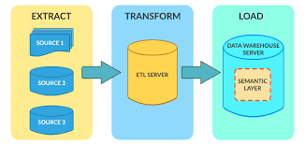
Project Flow

Slide 4
Data Sources
1. Clinical data space
DIM_patient
DIM_drug
DIM_test
DIM_disease
DIM_sample
2. Sample data space
DIM_sample
DIM _marker
DIM_assay
DIM_term

Slide 5
3. Microarray and proteomic data space
DIM_Probe
DIM_measureUnit
4. Gene data space
DIM_Gene
DIM_Go
DIM_Cluster
DIM_Domain
DIM_promoter

Slide 6
5. Experiment data space
DIM_Experiment
DIM_Project
DIM_Platform
DIM_Norm
DIM_Person
DIM_Protocol
DIM_publication

Slide 7
The Fact Tables are
Clinical_FACT
Sample_FACT
Microarray_FACT
Gene_FACT
Experiment_FACT

Slide 8
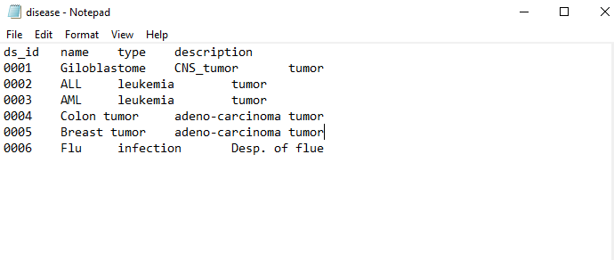
Screenshot of Few Data Sources
Dim_Disease Data Source

Slide 9
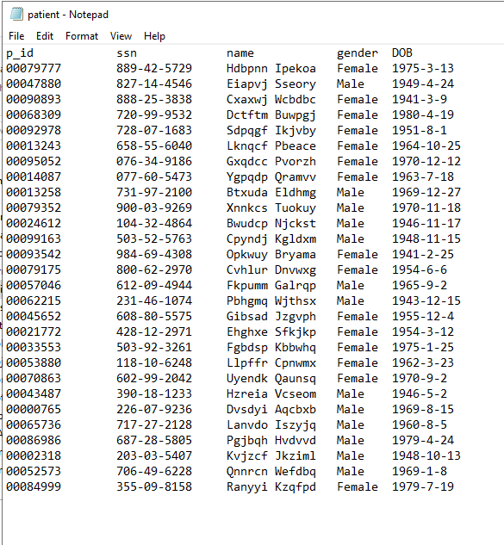
Dim_Patient Data Source

Slide 10
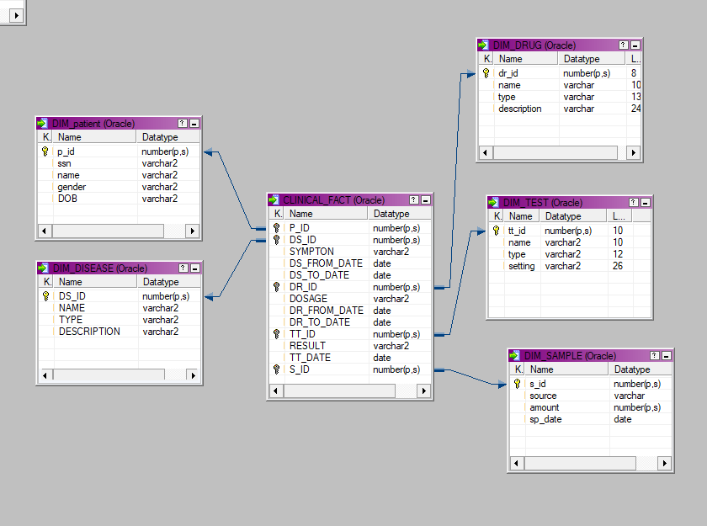
OLAP SCHEMA DESIGN

Slide 11
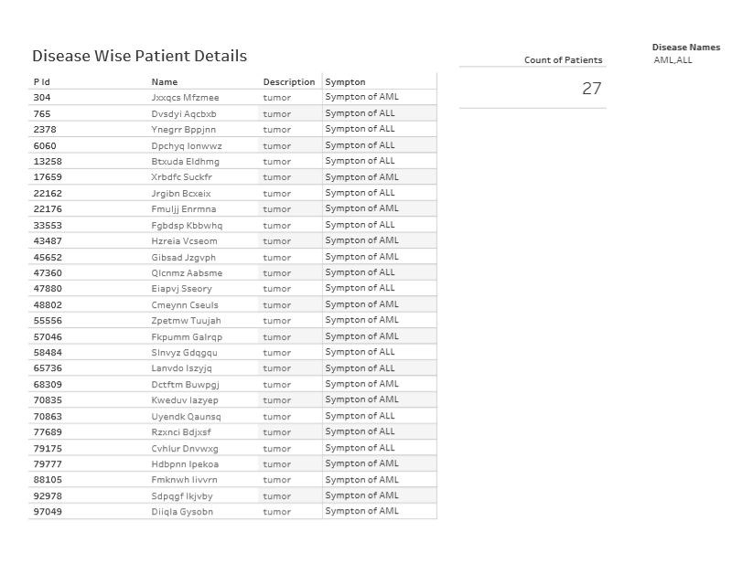
REPORTS

Slide 12
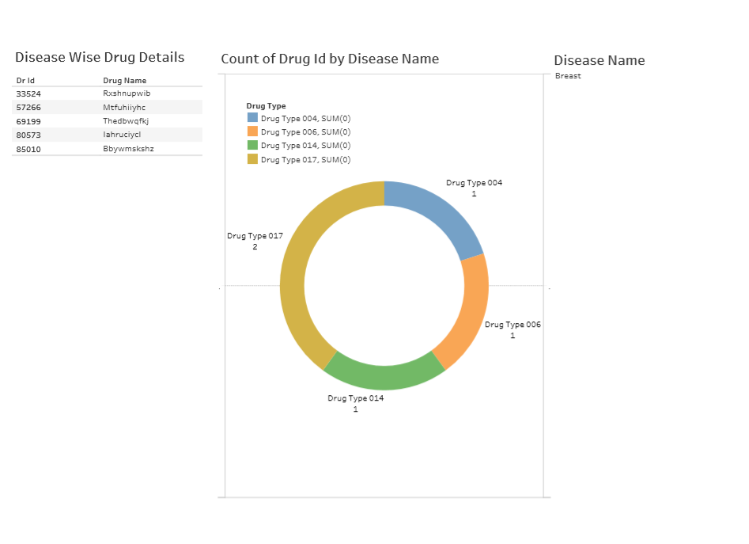

Slide 13
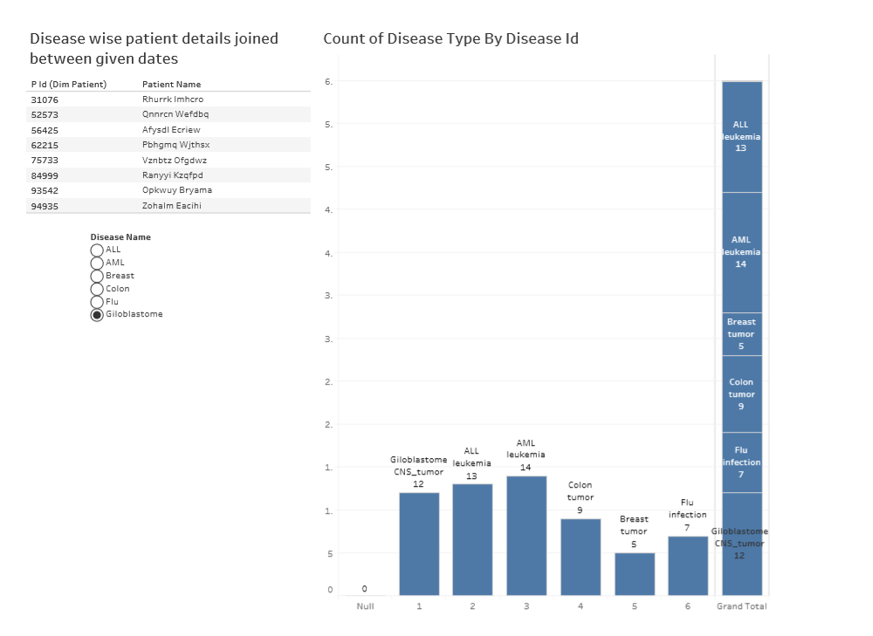

Slide 14
