Slide 1
Appharbor
A quick introduction

Slide 2
But 1st …………………….. Who Am I?
Brad Jennings
Developer @ hp (Hewlett Packard)
Twitter: @bivvo
Email : bivoauc@gmail.com
www.bivvo.com

Slide 3

What is Appharbor?
You do not add water. But its almost that easy.
Uses Git or Mecurial.
Builds and TEST your
app before deploying.
Easy to swap .config
settings
Build notifications for your CI server.

Slide 4
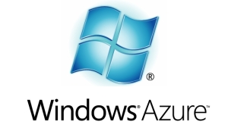


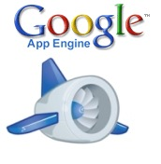

Other Options

Slide 5
Quick Comparison
Appharbor is a PaaS (Platform as a service)
Same as
Windows Azure
Heroku
Google App engine
Joyent
Amazon (with Elastic Beanstalk (beta))
No need to manage an Operating System.

Slide 6
But WHY I ASK!
Ease of use.
Deploy via Git/Mecurial
Roll back a deployment with a button click? (YES!)
Run test before deployment!
Ability to use some of the latest greatest open source products.
CouchDb
Redis
Mongo
Memcache
You can also use Ms Sql and Mysql
Free to try
Buzz word ahead ……. Work in the Cloud..

Slide 7
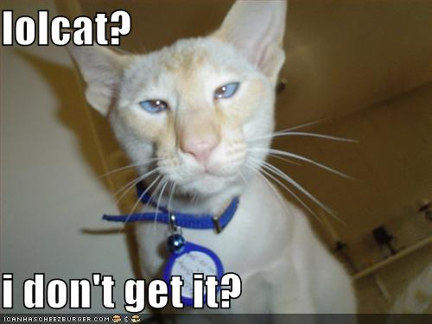
Git? I don’t git it?
Git is a DVCS (Distributed Version Control System)
Does not need a central repository to work.
Version your project on
your local machine.
Push when ready

Slide 8
A quick demo

Slide 9

Done.

