Slide 1
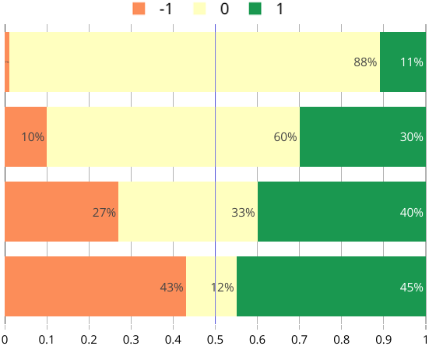



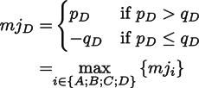
Choices
A
B
C
D
Each choice wins
under some rule:
Opponents of D: q_{D}
Proponents of D: p_{D}

