Slide 1
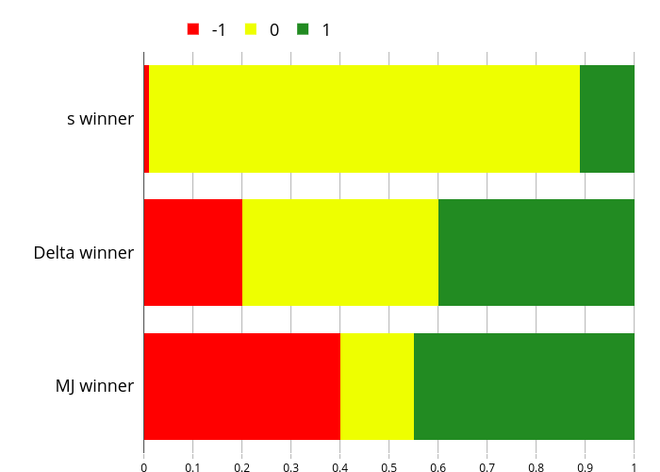


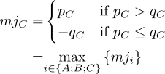
Choices
A
B
C
Each choice wins
under some rule:
Opponents of C: q_{C}
Proponents of C: p_{C}

