Slide 1
Public Acceptability of Climate Change Mitigation Policies
Selected Preliminary Results from the U.S. Survey
Partial sample: 1,789 respondents
Laurence Boone - OECD Chief Economist
30 April 2021

Slide 2
Project objectives
Motivation: Public acceptability needs to play an important role in the design of climate policies
Overall goal: contribute to construct country-specific advice on policies to deal with the transition to a low-carbon economy
Mechanism: understand people’s perceptions about climate change and preferences over available climate policies
Methodology: large-scale cross-country surveys with three different and randomized groups provided with information about the impacts of climate change and related policies
~2,000 respondents/country, representative of the population
Notes:
Motivation:
Policies to address climate change have been difficult to implement
The political economy and public acceptability needs to play an important role in the design of climate policies
Resistance to climate change mitigation action arises largely from:
Legitimate concerns about distributional and lifestyle impacts
Misconceptions about the impacts of climate change and the effects of climate policies on the economy and the environment
Addressing concerns and misconceptions may be difficult, as they are influenced by personal attributes, country specificities and political views
Limitations of existing research:
Scope is narrow: typically limited to a single (developed) country, focus on carbon pricing, and international surveys include only very general questions
For reviews of the surveys, see: Carattini et al. 2018, Drews and van den Bergh, 2016
Evidence is mainly descriptive: cross-country evidence remains largely descriptive.
The effectiveness of information provision and the willingness to update perceptions and beliefs following new information remains unclear
Comparability is limited: it is difficult to know if differences in people’s perceptions and preferences are driven by individual survey characteristics (e.g. format and phrasing) or by true cross-country differences
Studies on willingness to support climate policies usually do not offer an incentive relying on an actual payment and tangible actions
Main research questions:
Drivers of policy support: reveal how social attitudes, values, and perceptions drive support or opposition for climate policies
Cross-country comparisons: analyze how social preferences on climate change mitigation policies differ between countries
Effects of targeted information: understand how perceptions may change after receiving new information on the effects of policies/climate change (in a video format) and how it translates into beliefs and support

Slide 3

U.S. Survey
Sample: current preliminary results are based on a partial sample of 1,789 respondents. The full sample is expected to be 2,000
Representativeness: representative along the education, income, and wealth dimensions but not (yet) representative along the race/ethnicity, political views, and age dimensions
Key climate policies studied:
Other aspects studied:
Attitudes and knowledge about climate change and its impacts
Preferences for other policies
(e.g., insulation of buildings)
Willingness to pay for climate policies
Willingness to change behaviour
International burden-sharing
Effects of targeted information
Ban on combustion-engine cars
Green infrastructure program
Carbon tax with cash transfers

Slide 4
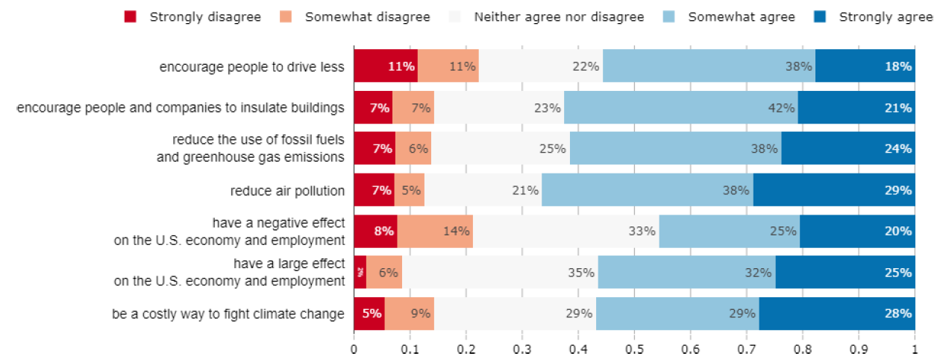
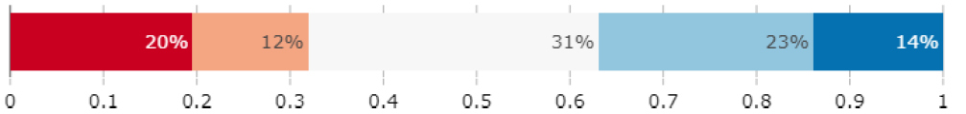
Carbon tax with cash transfers
Do you agree or disagree with the following statements? A carbon tax with cash transfers would. . .
Do you support or oppose a carbon tax with cash transfers?

Slide 5
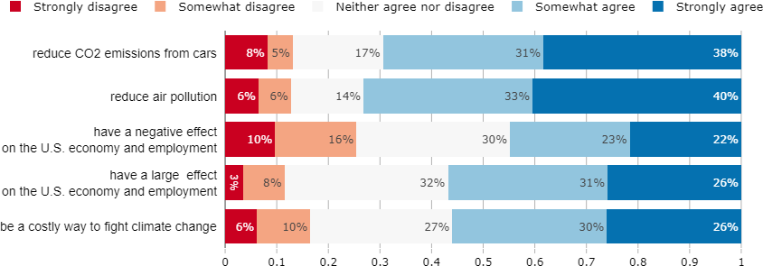
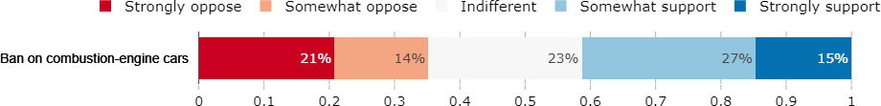
Ban on combustion-engine cars
Do you agree or disagree with the following statements? A ban on combustion-engine cars would. . .
Do you support or oppose a ban on combustion-engine cars?

Slide 6
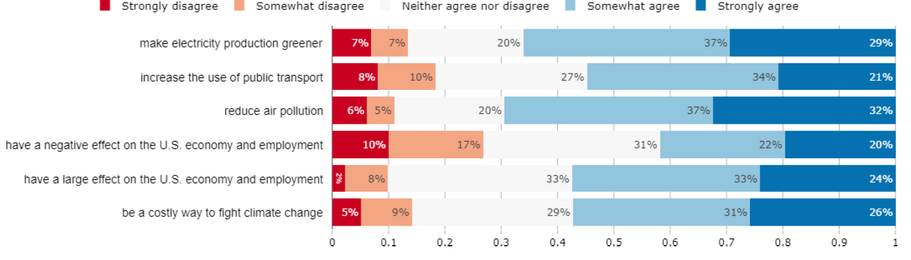

Green infrastructure program
Do we want this policy?
If so, Adrien, are these latest results?
Do you agree or disagree with the following statements? A green infrastructure program would. . .
Do you support or oppose a green infrastructure program?

Slide 7
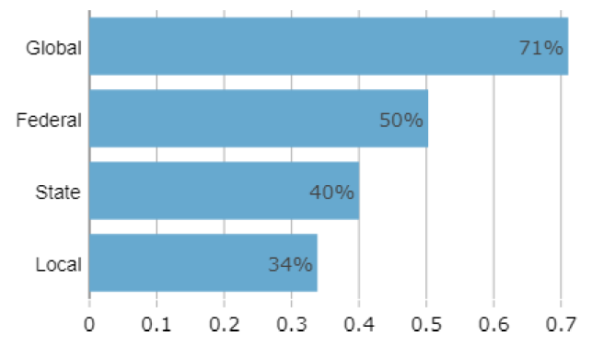
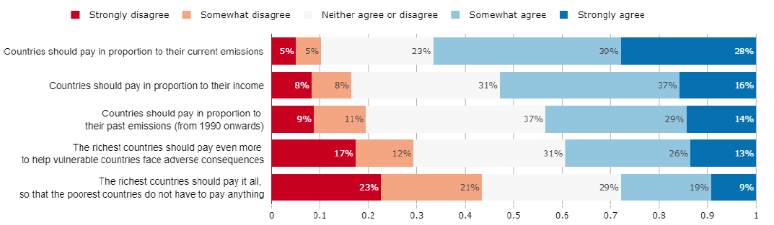
International burden-sharing
At which level(s) do you think public policies to tackle climate change need to be put in place? Multiple answers possible
To achieve a given reduction of greenhouse gas emissions globally, costly investments are needed.
Ideally, how should countries bear the costs of fighting climate change?

Slide 8
Selected findings
Support for climate policies: Overall there is more support than opposition, particularly for the green infrastructure program
Policies’ properties: Most people believe that climate policies will be effective at reducing emissions, air pollution, etc. However, they also think these policies are costly
International action:
The majority thinks that the U.S. should do more, regardless of whether other countries do more or less
The polluter-pays principle is the preferred burden-sharing approach
Attributing higher burden on high-income countries receives relative majority support

Slide 9

Thank you
For more information:
laurence.boone@oecd.org

Slide 10
Survey structure
Socio-demographics
Household composition and energy characteristics
Open-ended question about climate change considerations
Information video
Climate knowledge
Climate attitudes
Policy 1: Ban on sale of combustion-engine cars
Policy 2: Green infrastructure program
Policy 3: Carbon tax with cash transfers
Preferences for climate policies
Willingness to pay
International burden-sharing
Housing policies/Preferences for bans vs. incentives
Trust, perceptions of institutions, inequality, and the future
Feedback

