Slide 1
Background of respondent:
Socio-demographics, political views, energy use, consumption habits.

Slide 2
Background of respondent:
Socio-demographics, political views, energy use, consumption habits.
Open-ended question:
Main considerations about climate change; supported climate policies.

Slide 3

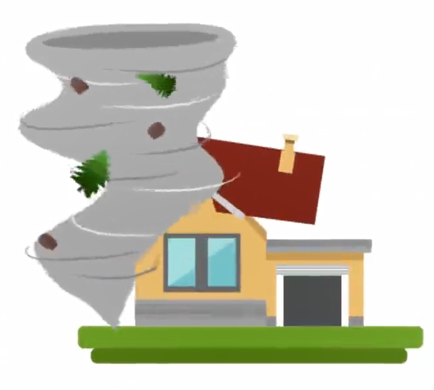
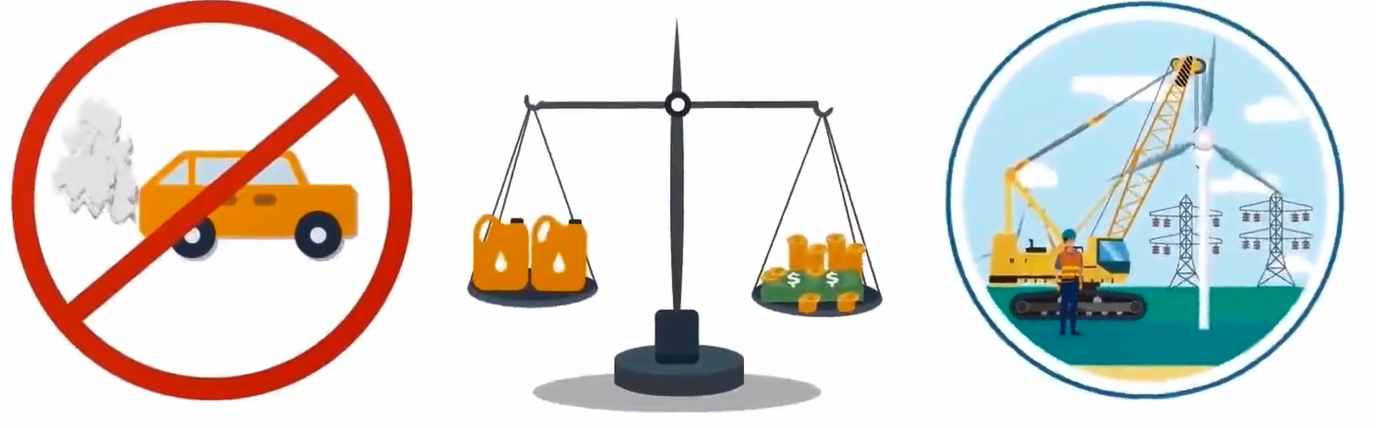
Background of respondent:
Socio-demographics, political views, energy use, consumption habits.
Open-ended question:
Main considerations about climate change; supported climate policies.
Video Treatment
~2,000 respondents
29%
24%
Random assignment
24%
24%
Control
group
Climate Impacts
Climate Policy
Climate + Policy
No video information provided
Local impacts of climate change
Ban on combustion-car engines
Carbon tax w/ cash transfers
Green infrastructure program
+

Slide 4
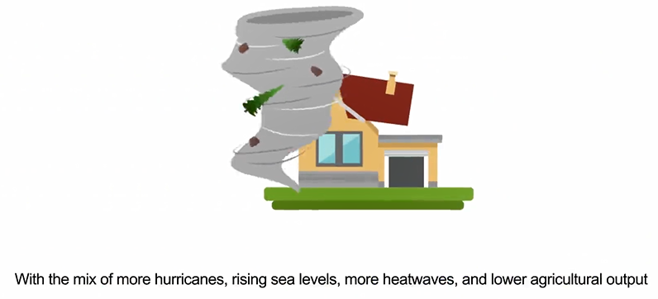
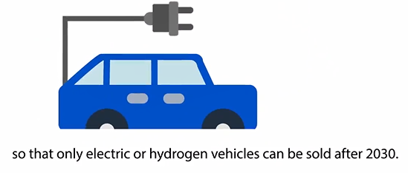
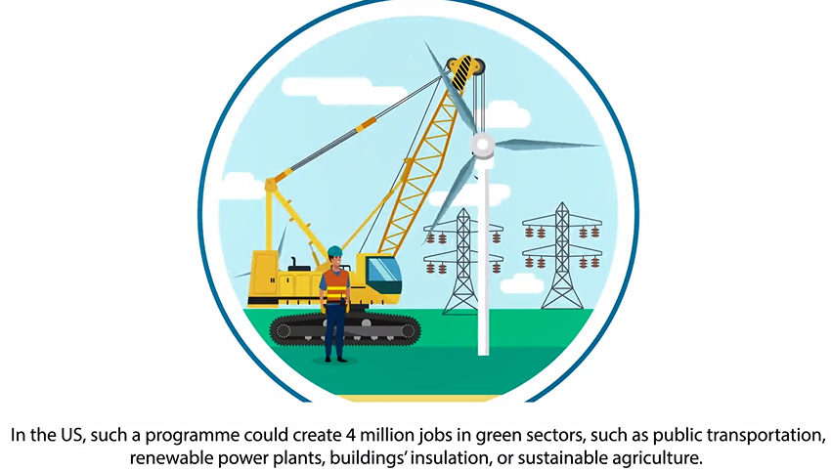
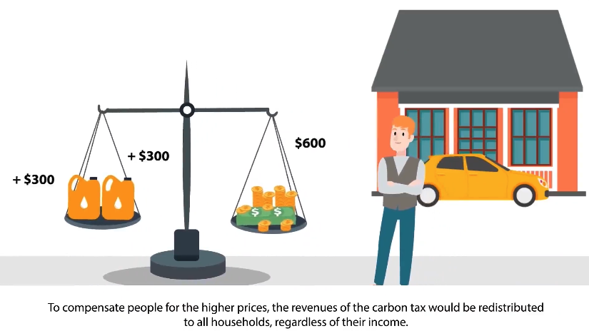
Local climate impact
Ban on combustion-engine cars
Green infrastructure program
Carbon tax with cash transfers

Slide 5
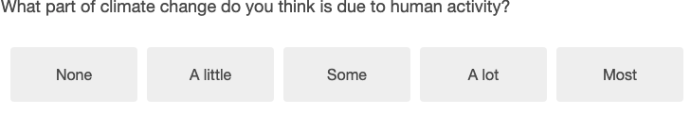
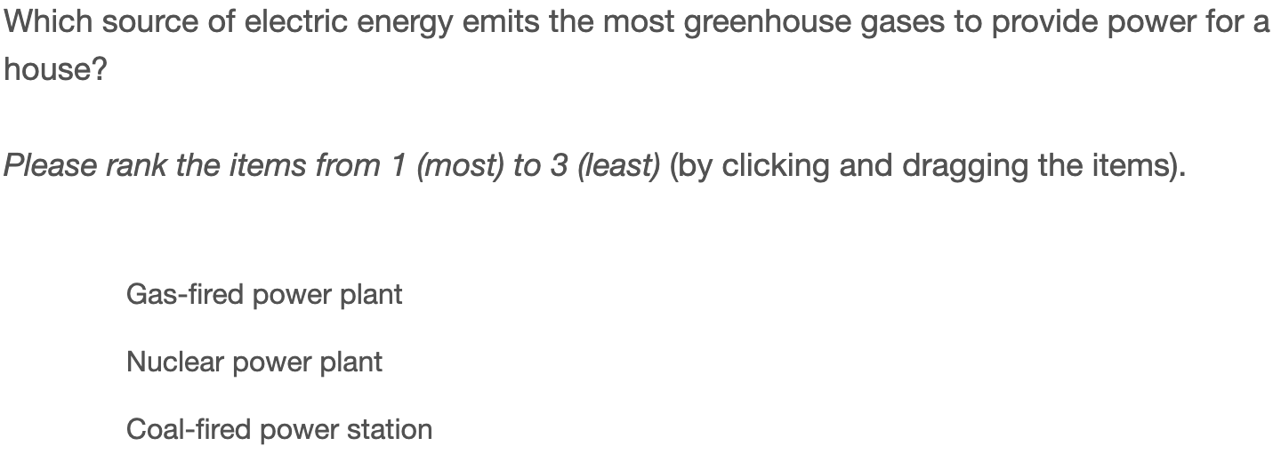
Background of respondent:
Socio-demographics, political views, energy use, consumption habits.
Open-ended question:
Main considerations about climate change; supported climate policies.
Video Treatment
No Video
Climate Impacts: local impacts
Climate Policy: info on 3 policies
Both: Climate Impacts + Climate Policy
Knowledge
Factual, quantitative questions on climate dynamics, factors and impacts of climate change, footprints.

Slide 6
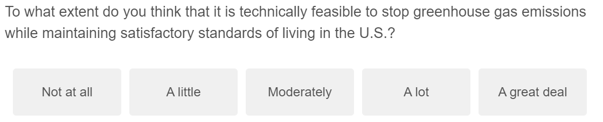
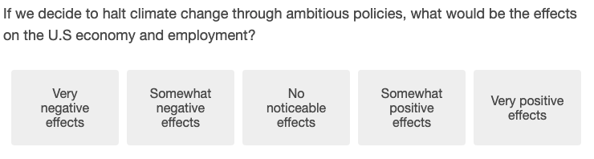
Background of respondent:
Socio-demographics, political views, energy use, consumption habits.
Open-ended question:
Main considerations about climate change; supported climate policies.
Video Treatment
No Video
Climate Impacts: local impacts
Climate Policy: info on 3 policies
Both: Climate Impacts + Climate Policy
Knowledge
Factual, quantitative questions on climate dynamics, factors and impacts of climate change, footprints.
Attitudes towards climate change
Likelihood of climate stabilization, effects of climate change, willingness to change own habits…

Slide 7
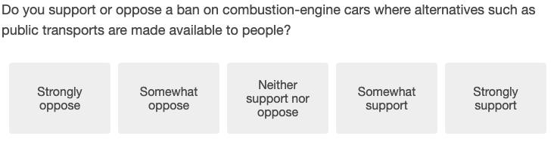
Background of respondent:
Socio-demographics, political views, energy use, consumption habits.
Open-ended question:
Main considerations about climate change; supported climate policies.
Video Treatment
No Video
Climate Impacts: local impacts
Climate Policy: info on 3 policies
Both: Climate Impacts + Climate Policy
Knowledge
Factual, quantitative questions on climate dynamics, factors and impacts of climate change, footprints.
Attitudes towards climate change
Likelihood of climate stabilization, effects of climate change, willingness to change own habits…
Attitudes towards national climate policies
Detailed attitudes on 3 important policies: ban of combustion-engine cars, green infrastructure program, carbon tax with cash transfers.
Support for various climate policies: taxes, standard, subsidies, mandatory insulation, policies to reduce beef consumption.

Slide 8
Background of respondent:
Socio-demographics, political views, energy use, consumption habits.
Open-ended question:
Main considerations about climate change; supported climate policies.
Video Treatment
No Video
Climate Impacts: local impacts
Climate Policy: info on 3 policies
Both: Climate Impacts + Climate Policy
Knowledge
Factual, quantitative questions on climate dynamics, factors and impacts of climate change, footprints.
Attitudes towards climate change
Likelihood of climate stabilization, effects of climate change, willingness to change own habits…
Attitudes towards national climate policies
Detailed attitudes on 3 important policies: ban of combustion-engine cars, green infrastructure program, carbon tax with cash transfers.
Support for various climate policies: taxes, standard, subsidies, mandatory insulation, policies to reduce beef consumption.
International policies and burden-sharing
Fairness assessment of possible burden-sharing principles, support for global policies.

Slide 9
Background of respondent:
Socio-demographics, political views, energy use, consumption habits.
Open-ended question:
Main considerations about climate change; supported climate policies.
Video Treatment
No Video
Climate Impacts: local impacts
Climate Policy: info on 3 policies
Both: Climate Impacts + Climate Policy
Knowledge
Factual, quantitative questions on climate dynamics, factors and impacts of climate change, footprints.
Attitudes towards climate change
Likelihood of climate stabilization, effects of climate change, willingness to change own habits…
Attitudes towards national climate policies
Detailed attitudes on 3 important policies: ban of combustion-engine cars, green infrastructure program, carbon tax with cash transfers.
Support for various climate policies: taxes, standard, subsidies, mandatory insulation, policies to reduce beef consumption.
International policies and burden-sharing
Fairness assessment of possible burden-sharing principles, support for global policies.
Willingness To Pay, real stake questions
WTP (Yes/No on randomly drawn yearly contribution), share donated to reforestation if respondent wins $100 lottery, petition.

Slide 10
Background of respondent:
Socio-demographics, political views, energy use, consumption habits.
Open-ended question:
Main considerations about climate change; supported climate policies.
Video Treatment
No Video
Climate Impacts: local impacts
Climate Policy: info on 3 policies
Both: Climate Impacts + Climate Policy
Knowledge
Factual, quantitative questions on climate dynamics, factors and impacts of climate change, footprints.
Attitudes towards climate change
Likelihood of climate stabilization, effects of climate change, willingness to change own habits…
Attitudes towards national climate policies
Detailed attitudes on 3 important policies: ban of combustion-engine cars, green infrastructure program, carbon tax with cash transfers.
Support for various climate policies: taxes, standard, subsidies, mandatory insulation, policies to reduce beef consumption.
International policies and burden-sharing
Fairness assessment of possible burden-sharing principles, support for global policies.
Willingness To Pay, real stake questions
WTP (Yes/No on randomly drawn yearly contribution), share donated to reforestation if respondent wins $100 lottery, petition.
Trust, attitudes towards society
Trust in government and in others, redistributive tastes.

Slide 11
Background of respondent:
Socio-demographics, political views, energy use, consumption habits.
Open-ended question:
Main considerations about climate change; supported climate policies.
Video Treatment
No Video
Climate Impacts: local impacts
Climate Policy: info on 3 policies
Both: Climate Impacts + Climate Policy
Knowledge
Factual, quantitative questions on climate dynamics, factors and impacts of climate change, footprints.
Attitudes towards climate change
Likelihood of climate stabilization, effects of climate change, willingness to change own habits…
Attitudes towards national climate policies
Detailed attitudes on 3 important policies: ban of combustion-engine cars, green infrastructure program, carbon tax with cash transfers.
Support for various climate policies: taxes, standard, subsidies, mandatory insulation, policies to reduce beef consumption.
International policies and burden-sharing
Fairness assessment of possible burden-sharing principles, support for global policies.
Willingness To Pay, real stake questions
WTP (Yes/No on randomly drawn yearly contribution), share donated to reforestation if respondent wins $100 lottery, petition.
Trust, attitudes towards society
Trust in government and in others, redistributive tastes.

