Slide 2
Margins Plots US

Slide 3
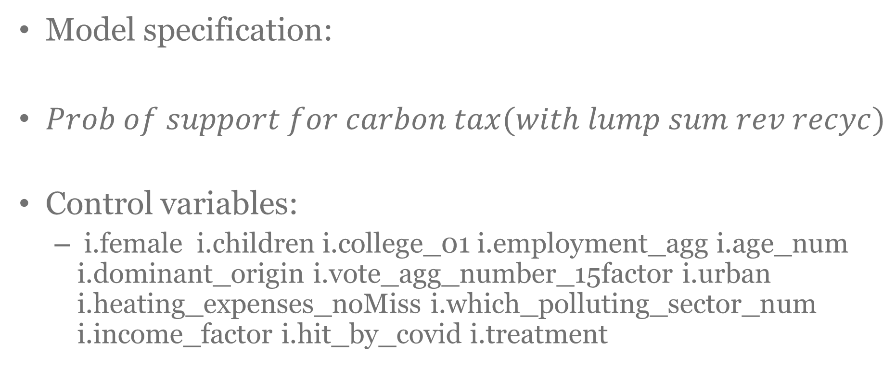
Model specification:
$Prob of support for carbon tax(with lump sum rev recyc)$
Control variables:
i.female i.children i.college_01 i.employment_agg i.age_num i.dominant_origin i.vote_agg_number_15factor i.urban i.heating_expenses_noMiss i.which_polluting_sector_num i.income_factor i.hit_by_covid i.treatment

Slide 4
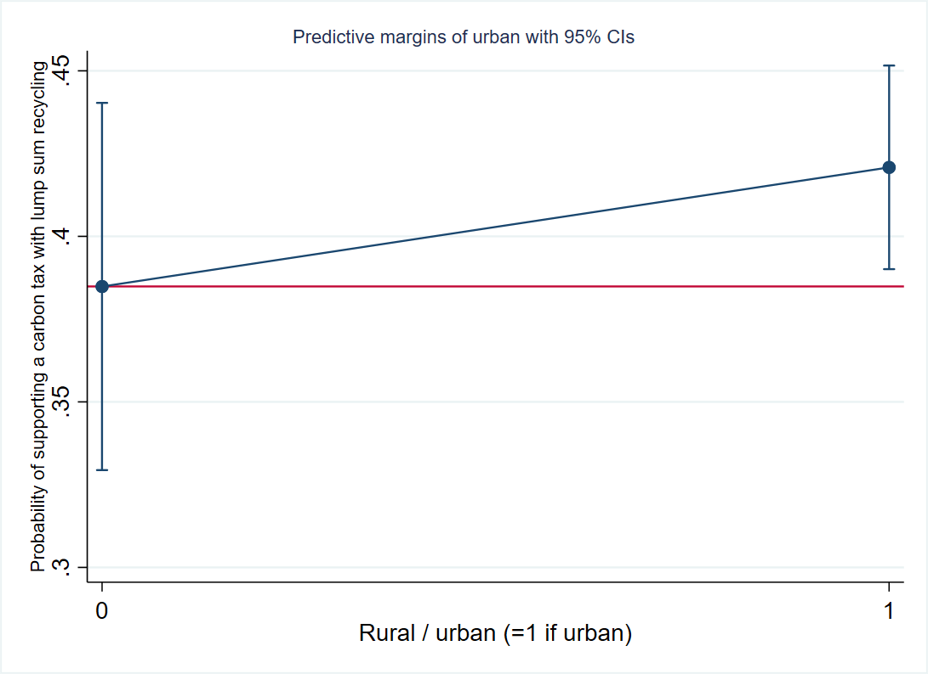

Slide 5
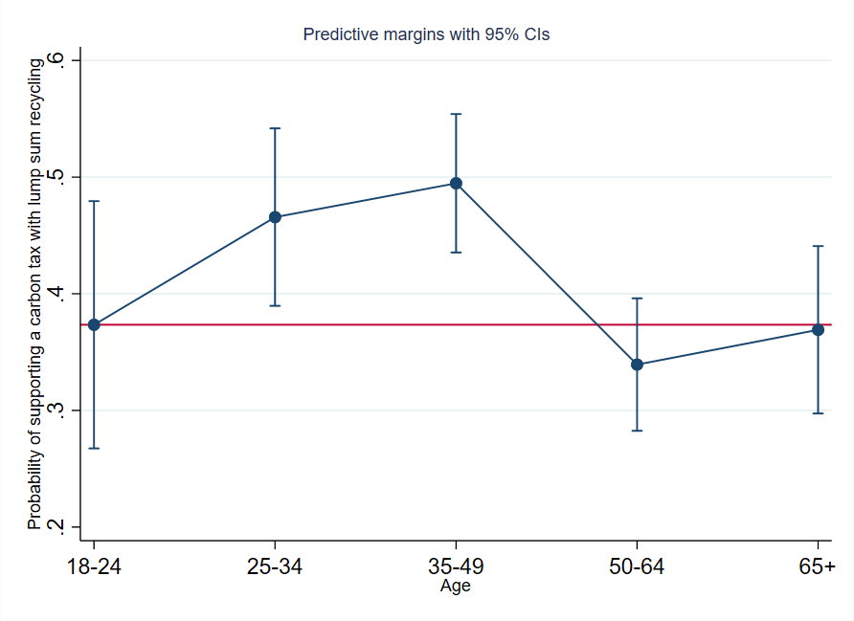

Slide 6
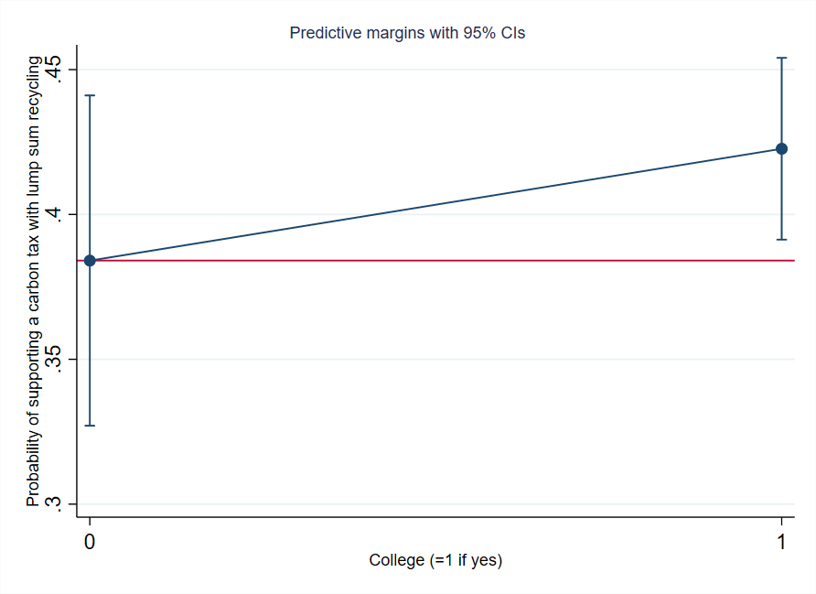

Slide 7
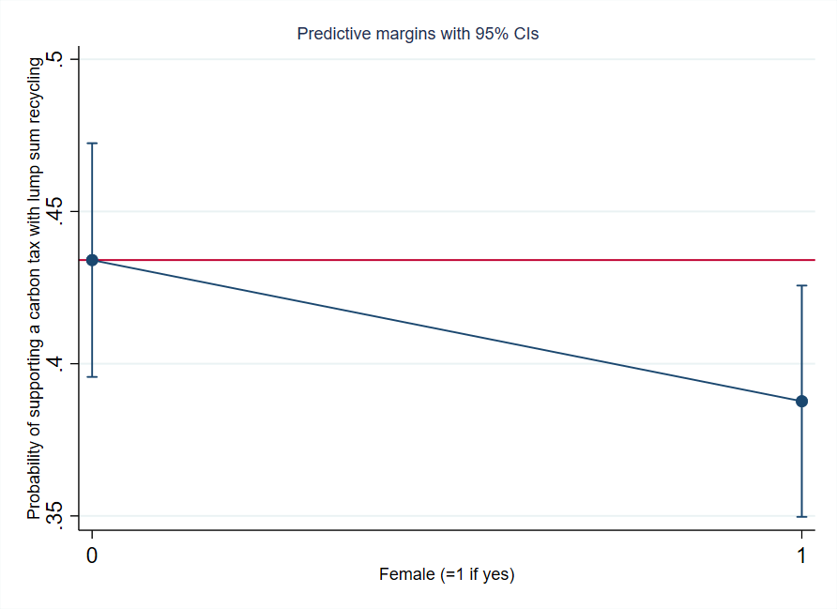

Slide 8
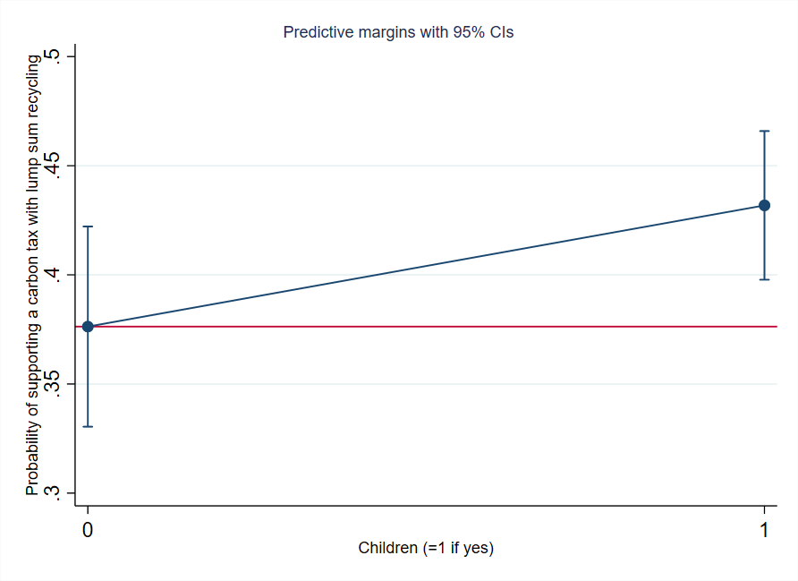

Slide 9
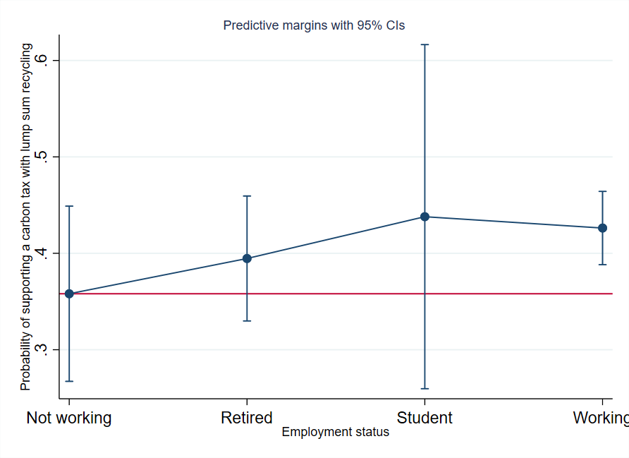

Slide 10
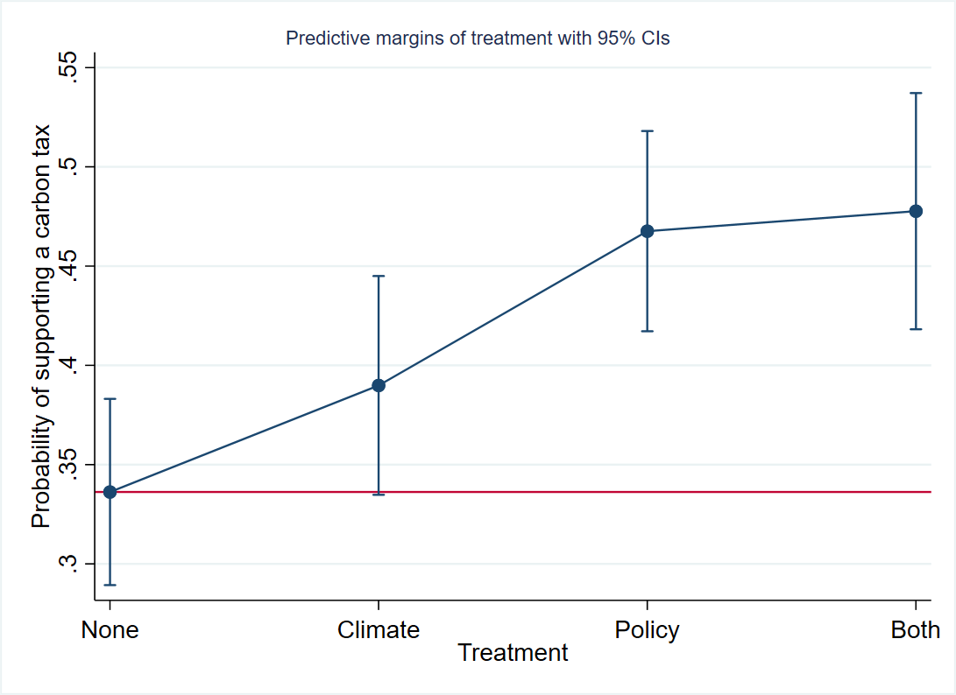

Slide 11
By income

Slide 12
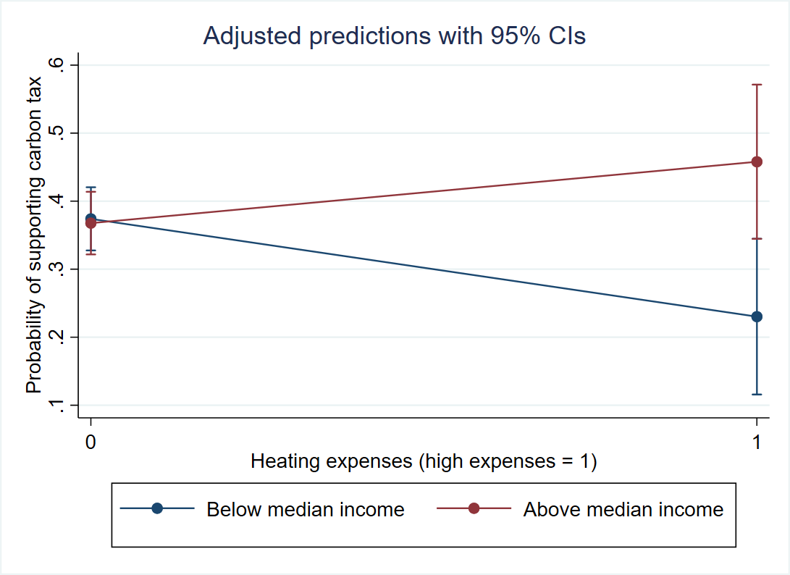

Slide 13
