Slide 1
Public Acceptability of Climate Change Mitigation Policies
Building evidence from large scale and
cross-country surveys
OECD Economics Department
1 April 2021

Slide 2
Motivation
Policies to address climate change have been difficult to implement
The political economy and public acceptability needs to play an important role in the design of climate policies
Resistance to climate change mitigation action arises largely from:
Legitimate concerns about distributional and lifestyle impacts
Misconceptions about the impacts of climate change and the effects of climate policies on the economy and the environment
Addressing concerns and misconceptions may be difficult, as they are influenced by personal attributes, country specificities and political views

Slide 3
Limitations of existing research
Scope is narrow: typically limited to a single (developed) country, focus on carbon pricing, and international surveys include only very general questions
For reviews of the surveys, see: Carattini et al. 2018, Drews and van den Bergh, 2016
Evidence is mainly descriptive: cross-country evidence remains largely descriptive.
The effectiveness of information provision and the willingness to update perceptions and beliefs following new information remains unclear
Comparability is limited: it is difficult to know if differences in people’s perceptions and preferences are driven by individual survey characteristics (e.g. format and phrasing) or by true cross-country differences
Studies on willingness to support climate policies usually do not offer an incentive relying on an actual payment and tangible actions

Slide 4
The OECD project
The OECD has started to conduct large-scale surveys across multiple countries using a homogeneous methodology to analyse country-specific perception of climate change impacts and acceptability of various climate policies
Ongoing or planned: United States, France, Denmark, India, Spain
Further countries considered: United Kingdom, Germany…

Slide 5
Project objectives
Overall goal: contribute to construct country-specific advice on policies to deal with the transition to a low-carbon economy
Mechanism: understand people’s perceptions about climate change and preferences over available climate policies
Methodology: large-scale cross-country surveys with three different and randomized groups provided with information about the impacts of climate change and related policies
~2,000 respondents/country, representative of the population

Slide 6
Main research questions
Drivers of policy support: reveal how social attitudes, values, and perceptions drive support or opposition for climate policies
Cross-country comparisons: analyze how social preferences on climate change mitigation policies differ between countries
Effects of targeted information: understand how perceptions may change after receiving new information on the effects of policies/climate change (in a video format) and how it translates into beliefs and support

Slide 7



Targeted information
Targeted information consists in 2-5min. video either informing the participant about the effects of the three main climate policies, or underlying the effects of climate change in their country
~2,000 respondents
Random assignment
29.4%
23.5%
23.5%
23.5%
Control
group
Climate impact video
Policy video
Climate impact + policy video
No video information provided
Local impacts of climate change
Ban on combustion-car engines
Carbon tax w/ cash transfers
Green infrastructure program
+

Slide 8
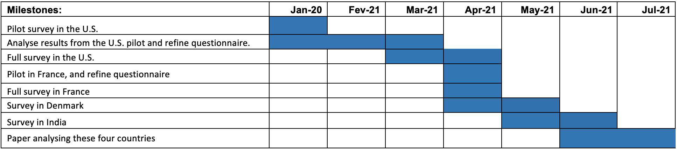
Timeline

Slide 9
Survey structure

Slide 10
Survey structure
Socio-demographics
Household composition and energy characteristics
Open-ended question about climate change considerations
Information video
Climate knowledge
Climate attitudes
Policy 1: Ban on sale of combustion-engine cars
Policy 2: Green infrastructure program
Policy 3: Carbon tax with cash transfers
Preferences for climate policies
Willingness to pay
International burden-sharing
Housing policies/Preferences for bans vs. incentives
Trust, perceptions of institutions, inequality, and the future
Feedback
Total number of questions: 110
Median survey completion time: 28’

Slide 11
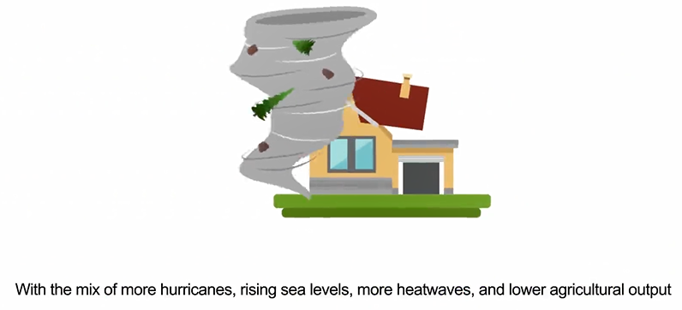

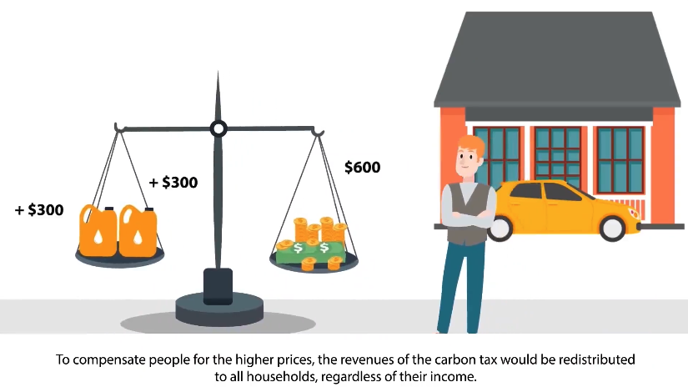
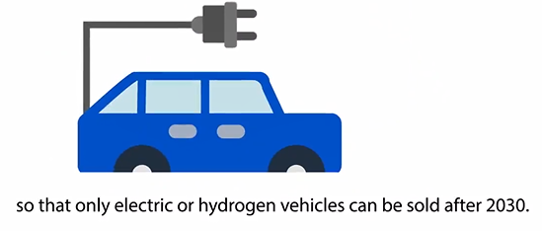
Information video examples
Local climate impact
Green infrastructure program
Ban on combustion-engine cars
Carbon tax with cash transfers

Slide 12
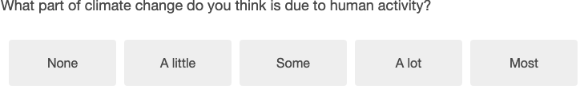
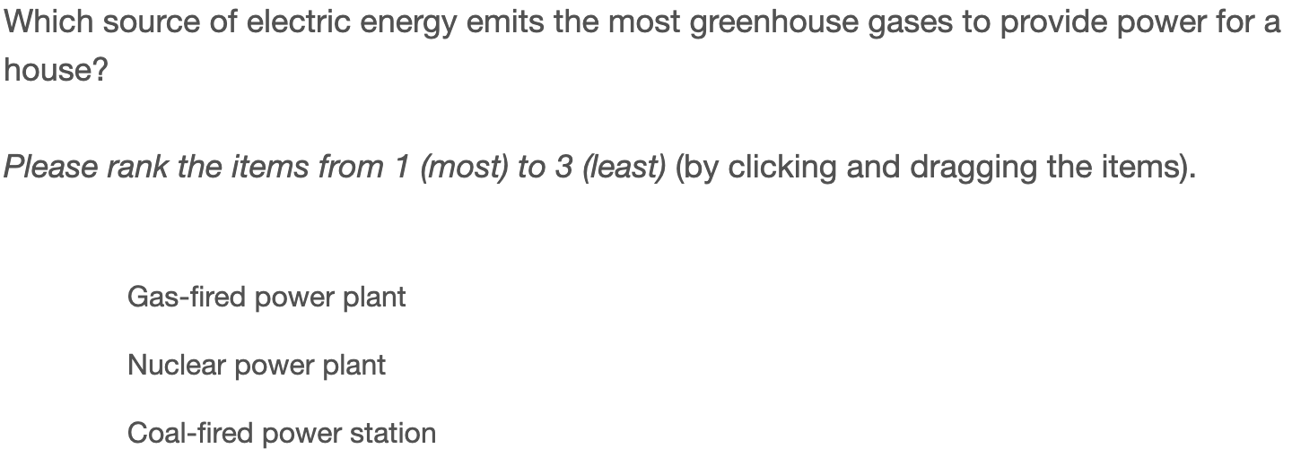
Climate knowledge examples: Understanding of the impacts of climate change

Slide 13
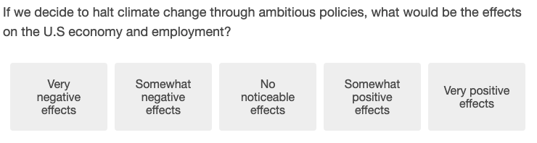
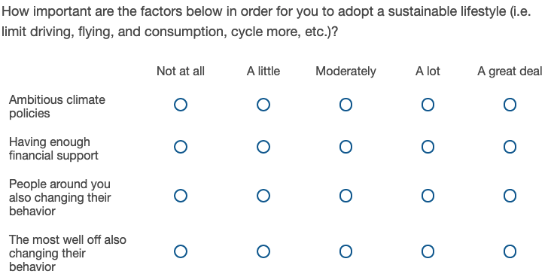
Climate attitudes examples: From climate risks to climate policies

Slide 14
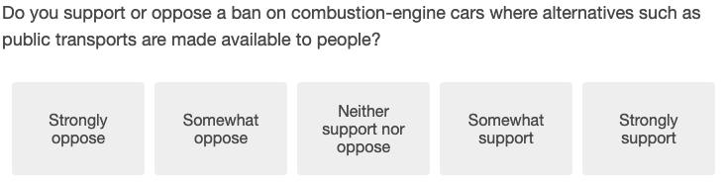
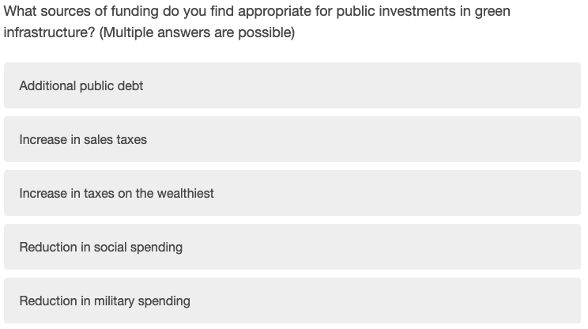
Policy preferences examples

Slide 15
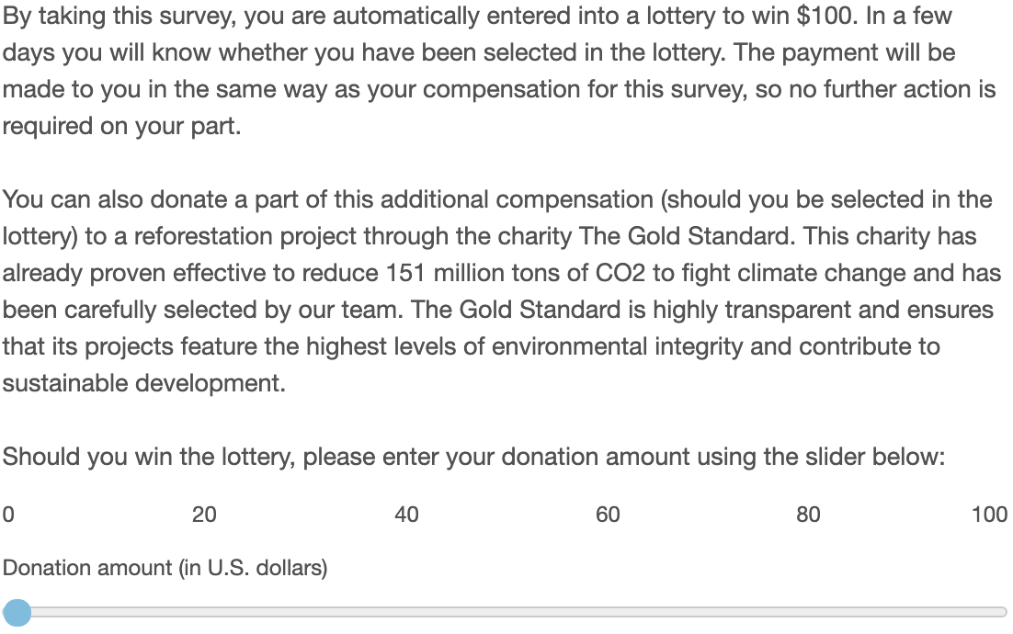
WTP example

Slide 16
Highlights from pilot survey in U.S.

Slide 17
U.S. Pilot: key results
Sample: 582 respondents, not representative along the education, ethnicity/race, vote and occupation dimensions
Causes of climate change: a majority (67%) attributes climate change to human activity
Support for policies: A majority supports each climate policy proposed, with the except of carbon taxes
Preferred use of carbon tax revenues: earmarking to green investments
Least-favored use of revenues: compensating affected firms
Effectiveness to reduce GHG emissions: carbon tax with cash transfers is seen as the least cost-effective policy to reduce emissions (57% believe it’s cost-effective) followed by a green infrastructure program (60%) and an emission limit for cars (64%)
Effect of targeted information: targeted and clear information campaigns on the mechanisms of carbon taxes can significantly increase support for this type of policy

Slide 18
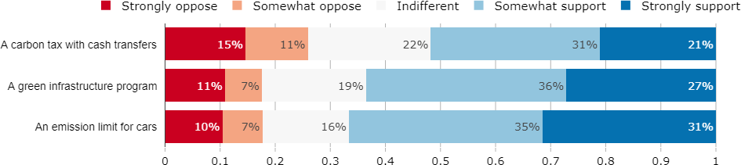
Support for main policies
Notes: 582 respondents. Representative along the gender, age, income, region and rural/urban dimensions but not representative along the education, ethnicity/race, vote and occupation dimensions. Weighted along the gender, income, region, living in a metropolitan area, age, and race dimensions

Slide 19
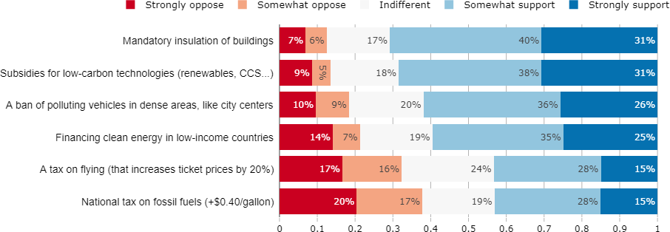
Support for different climate policies
Notes: 582 respondents. Representative along the gender, age, income, region and rural/urban dimensions but not representative along the education, ethnicity/race, vote and occupation dimensions. Weighted along the gender, income, region, living in a metropolitan area, age, and race dimensions

Slide 20
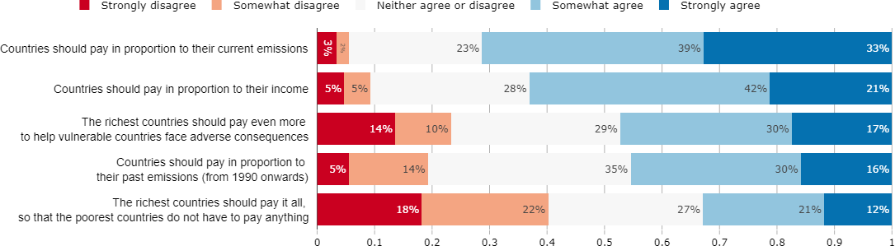
How should countries bear the costs of fighting climate change?
Notes: 582 respondents. Representative along the gender, age, income, region and rural/urban dimensions but not representative along the education, ethnicity/race, vote and occupation dimensions. Weighted along the gender, income, region, living in a metropolitan area, age, and race dimensions

Slide 21

Thank you
For more information:
laurence.boone@oecd.org

Slide 22
Research team
OECD
Laurence Boone, Chief Economist
Tomasz Kozluk, Councellor to Chief Economist
Antoine Dechezleprêtre, Senior Economist
Tobias Kruse, Junior Economist
Ana Sanchez-Chico, Junior Policy Analyst
Harvard University
Prof Stefanie Stantcheva, Economics Department
Bluebery Planterose, Social Economics Lab
ETH Zürich
Adrien Fabre, Post-Doctoral researcher

Slide 23
Literature
Alesina, A., A. Miano, and S. Stantcheva (2018). Immigration and Redistribution, NBER Working Paper, 24733, https://scholar.harvard.edu/files/stantcheva/files/alesina_miano_stantcheva_immigration.pdf
Alesina, A., A. Miano, and S. Stantcheva (2020). The Polarization of Reality, American Economic Review: Papers and Proceedings, 110, 324-328. https://scholar.harvard.edu/files/stantcheva/files/polarization_reality.pdf
Alesina, A., and S. Stantcheva (2020). Diversity, Immigration, and Redistribution, American Economic Review: Paper and Proceedings, 110, 329-334. https://scholar.harvard.edu/files/stantcheva/files/alesina_stantcheva_diversity.pdf
Carattini, S., M. Carvalho, and S. Fankhauser (2018). Overcoming public resistance to carbon taxes, WIRES Climate Change, Vol. 9 (5), pp. 1-26.
Cohn, A., E. Fehr, and M. A. Maréchal (2014). Business culture and dishonesty in the banking industry, Nature, 516, 86-89.
Douenne, T., and A. Fabre (2019). French Attitudes on Climate Change, Carbon Taxation and Other Climate Policies, Ecological Economics, 169: 106496.
Drews, S., and J.C.J.M, van den Bergh (2016). What explains public support for climate policies? A review of empirical and experimental studies, Climate Policy, Vol. 16 (7), pp. 855-876.
Rodrik, D., and R. Di Tella (2019). Labor Market Shocks and the Demand for Trade Protection: Evidence from Online Surveys, Copy at http://j.mp/2FrXwYC .

