Slide 1
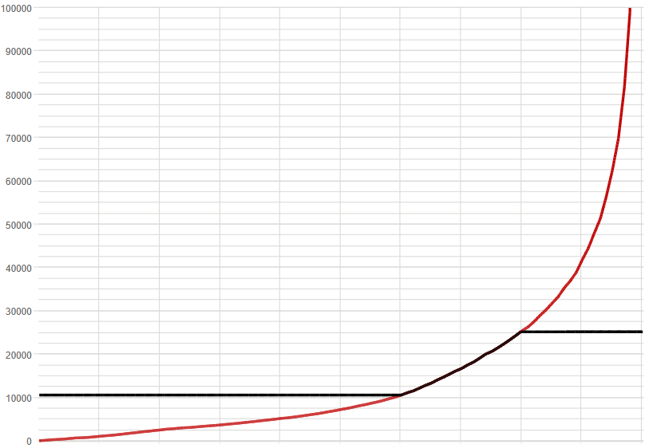
winners
losers
extreme distribution
threshold of winners

Slide 2
winners
losers
2
R
1
extreme distribution
threshold of winners
2
L
current distribution

Slide 3
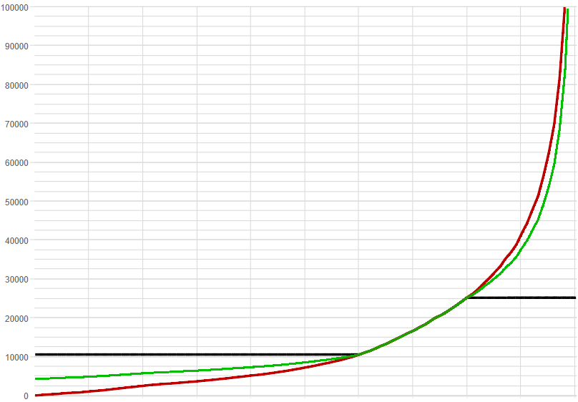
4
custom distribution
3

Slide 4
4
custom distribution
10
4
3
amount transferred

