Slide 1
Travel Booking System
for
Lumbini Peace Travels and Tours
Summer Project Proposal Documentation
Submitted By:
Bijesh Ghimire
Roll No.5460/14
Batch(2014-2018)
Submitted To:
Asian School of Management and Technology
Tribhuvan University
Gongabu, Kathmandu
Under the Supervision of:
Mr.Surya Bam
Asian School of Management and Technology

Slide 2
Contents
Introduction
Problem Definition
Scope
Objectives
Literature Review
Research Methodology
Implementation Model
Working Schedule
References

Slide 3
Introduction
Lumbini Peace travels and tours is a tourism company that travelling facilities to different places of Nepal.
The Travel Booking System is a automated system that makes the travelling much easier and flexible.
The proposed system offers online book and review of packages that helps to avoid the manual tasks of the organization.

Slide 4
Problem Definition
Booking through phone calls and manual record keeping
Time consuming for customers
No existence of such automated system previously

Slide 5
Scope
Compatible for all Operating System
For the improvement of Travel Booking System
To help other web developer being a secondary data

Slide 6
Objectives
To make manual work electronic based
Upgrading the existing system of the organization
Faster processing time and more accurate data for travel requests
Completing the future plans of the organization

Slide 7
Literature Review
In 1946, American Airlines installed the first automated booking system, the experimental electromechanical Reservisor.
The MARS-1 train ticket reservation system was designed and planned in the 10950s by the Japanese National Railways’ R&D Institute, now the Railway Technical Research Institute, with the system eventually being produced by Hitachi in 1958. It was the world’s first seat reservation system for trains.
After these gradually later online system were started being introduced.

Slide 8
Research Methodology
Data Collection
Online research through different websites .
Direct interview with Mr. Suresh Poudel, managing director of Lumbini Peace Travels and Tours

Slide 9
Research Methodology
Questionnaire:
Does the organization use any kind of desktop, mobile or web reservation system?
How the booking for a particular tour is done ?
Are you looking forward for an electronic system?
What are the drawbacks of the current system?
What are the future plans of the system?

Slide 10
Implementation Model
Proposed Implementation Model for Admin Side
Start
Site
Login
Check Database
Manage Packages
View Feedback
Manage user
Log out
Stop

Slide 11
Implementation Model
Proposed Implementation Model for Users Side
Start
Site
View Packages
Login
Give Feedbacks
Book Packages
Stop

Slide 12
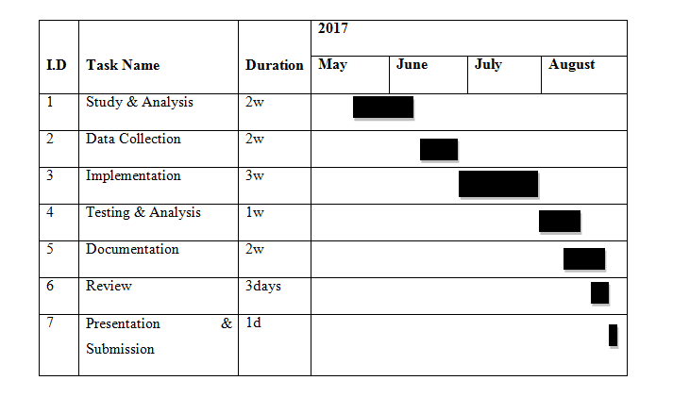
Working Schedule

Slide 13
References
https://en.wikipedia.org/wiki/Tourism [2017/06/26]
www.rezopia.com/rezopia/tour-operators [2017/06/28]
https://en.wikipedia.org/wiki/Computer_reservations_system [2017/06/28]

