Slide 1

WORKHUMAN
Answer Engine
Optimization
MARKETING TEAM BRIEFING
Q1 2026
Where We Stand. Where We're Going.
Web + Creative
Marketing
PREPARED MAY 2026

Slide 2
THE SETUP
Before January, we had no visibility into AI search.
Why this was a problem.
WHAT WAS INVISIBLE TO US
~60K
Buyers were already asking AI first.
monthly Workhuman mentions across AI surfaces
ChatGPT and Perplexity cleared 1.5M HR Tech queries each in 2026 YTD. The buyer journey shifted upstream and we could not see it.
8
AI engines untracked (ChatGPT, Perplexity, Gemini, Copilot, Meta AI, Grok, Google AI Mode, AI Overviews)
GA4 and GSC do not measure mentions.
Our entire analytics stack measures clicks. None of it captures the moments AI names us inside an answer the user never clicks through from.
50+
category competitors with no comparative read
Competitors were already optimizing.
0
data on which Workhuman content was being cited
Achievers, Bonusly, and Workday were investing in AEO content while we lacked the instrumentation to know we were behind.
Workhuman / AEO Progress
2 / 21

Slide 3



TODAY
Now we can see. And the picture is encouraging.
VISIBILITY LIFT
MENTIONS
CATEGORY RANK
+55%
1.92×
#4 / 50+
Workhuman visibility climbed from 18.97% to 29.40% in four months.
Monthly mentions nearly doubled, climbing from ~30K in Jan to ~59K in Apr.
Workhuman sits in the top tier of the HR Technology answer set.
All figures: Profound HR Technology category, Jan 1 to Apr 30 2026, monthly aggregation.
Workhuman / AEO Progress
3 / 21

Slide 4
DEFINITION
What is Answer Engine Optimization?
SEO
AEO
THE WORKING DEFINITION
AEO is the discipline of structuring content so it is retrieved, cited, and named by generative answer engines (ChatGPT, Perplexity, Gemini, Google AI Mode and AI Overviews) when a buyer asks a question.
GOAL
Rank on page 1
Stay in the answer set
KPI
Click-through rate
Citation share, SoV
Adapted from category writing by Search Engine Land, Marketing AI Institute, and Profound. Also called Generative Engine Optimization (GEO).
OPTIMIZE
The web page
The passage, the fact
THREE LAYERS OF AEO WORK
Content
Citation-ready passages, claims, named statistics
WIN
Click on your link
AI names you
Structure
Schema, headings, FAQ markup, passage atomicity
Authority
External signals AI uses to decide who to trust
DECAY
Slow
Fast as set narrows
Workhuman / AEO Progress
4 / 21

Slide 5



WHY IT MATTERS
Search behavior is changing under our feet.
Buyers ask AI before they ask Google.
8
ChatGPT, Perplexity, Gemini, and Google AI now sit between the buyer and our website.
Most answers are read, not clicked.
AI tools resolve questions inline. The traditional click is no longer the only signal of influence.
AI surfaces are
actively tracked
Answer sets are narrow and sticky.
Google AI Mode • Perplexity
ChatGPT • Google AI Overviews
Microsoft Copilot • Gemini
Meta AI • Grok
If we are not cited consistently in the answer set today, we will not be cited as it tightens tomorrow.
Workhuman / AEO Progress
5 / 21

Slide 6


OUR MEASUREMENT LAYER
How we see what AI says about us.
WHAT PROFOUND IS
WHAT PROFOUND IS NOT
An AI search observability layer.
A traffic or revenue tool.
Runs thousands of buyer-style prompts against the major LLMs every day.
Captures who is named, in what position, on which prompt.
Aggregates into visibility, share of voice, mentions, and average position.
Lets us slice by category, by competitor, by topic, and by model.
It does not measure clicks or sessions to workhuman.com. That is GA4.
It does not measure pipeline or revenue. That is HubSpot and Salesforce.
It does not optimize content for us. It tells us where we stand so we can.
It does not replace SEO or GSC. It complements them with answer-layer signal.
Workhuman / AEO Progress
6 / 21

Slide 7
HOW TO READ THE DATA
Four metrics that tell the story.
Visibility Score
29.4%
Share of Voice
3.04%
Share of all category prompts where Workhuman is mentioned at least once.
Workhuman mentions as a percent of all brand mentions in the HR Tech category.
GOOD LOOKS LIKE Healthy band: 25-35% for a top-5 category brand. 30%+ means we appear in roughly 1 of every 3 relevant answers.
GOOD LOOKS LIKE Healthy band: 3-4% in a 50+ brand category. Direct competitive measure against every brand simultaneously.
BLIND SPOT Won't tell you ranking position within the answer or who is mentioned more often.
BLIND SPOT Won't tell you which competitor is taking share. Pair with rank deltas.
Mentions Count
58,814 / mo
Average Position
4.08
Raw volume of times Workhuman is named across prompts, models, and answer surfaces.
Average ordinal place we hold when AI generates a ranked or listed answer. Lower is better.
GOOD LOOKS LIKE Healthy when growing alongside visibility. Plateau at high visibility signals prompt-set saturation.
GOOD LOOKS LIKE Healthy band: 1-3 for a top-tier brand. Position 1-3 brands are repeated in voice / read-aloud responses; 4+ are listed.
BLIND SPOT Won't tell you whether mentions are positive, neutral, or comparative. Sentiment is a Q3 wiring item.
BLIND SPOT Won't tell you list length. Position 4 of 5 is different from position 4 of 12.
Workhuman / AEO Progress
7 / 21

Slide 8
THREE MONTHS OF DATA
Visibility climbed 55% in four months.
FROM / JAN
What this means.
18.97%
In January, Workhuman appeared in roughly 1 of every 5 HR Tech answers. By April, we were in nearly 1 of every 3. This is the second-largest visibility gain among the top 10 brands in the category, behind only Workday.
Feb
22.50%
+3.53pp
Mar
25.81%
+3.31pp
WHAT DROVE THE CLIMB
Cited content gravity. Two pillar pages on workhuman.com (recognition software, engagement software) entered the category top 10 cited URLs.
TO / APR
29.40%
Position improved. Average citation position improved from 4.30 to 4.08, putting us closer to the read-aloud zone.
Steady accrual, not spike. Monthly gains of +3.5pp, +3.3pp, +3.6pp. Trend line, not anomaly.
+10.43pp absolute / +55% relative
Workhuman / AEO Progress
8 / 21

Slide 9
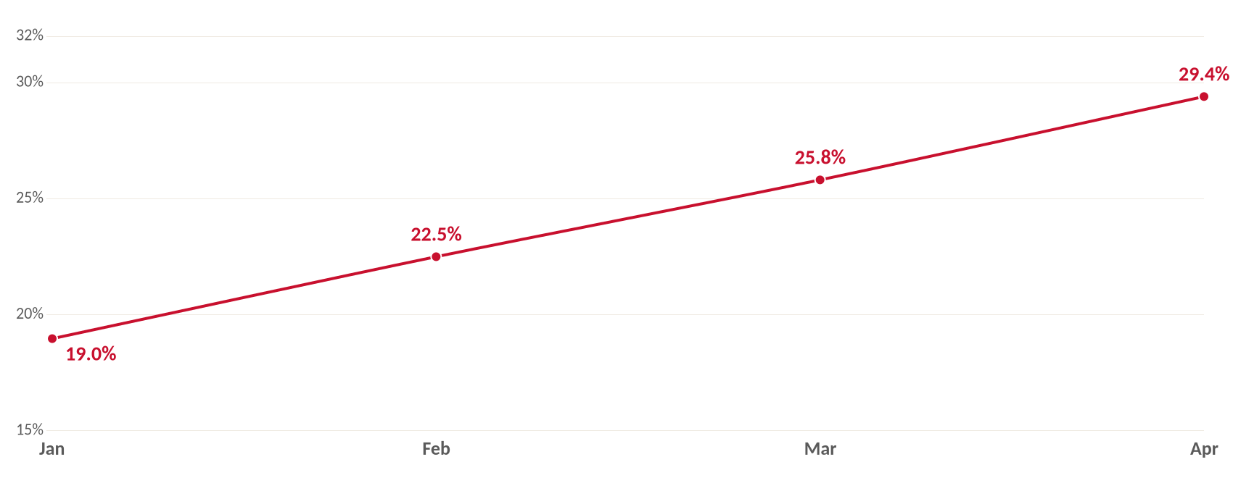
TREND / VISIBILITY
A consistent climb, month over month.
Source: Profound, HR Technology category. Monthly aggregation of daily visibility scores.
Workhuman / AEO Progress
9 / 21

Slide 10
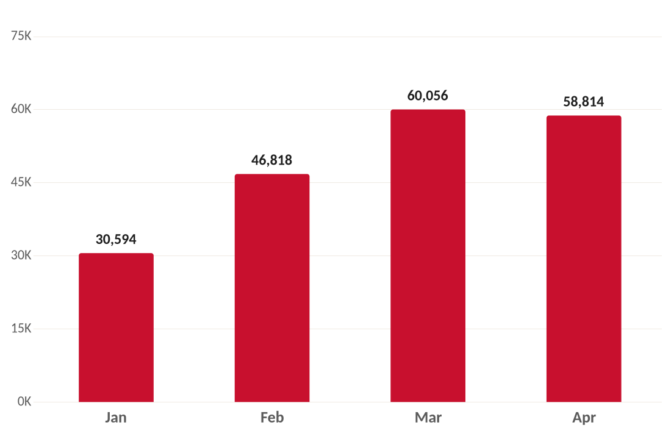
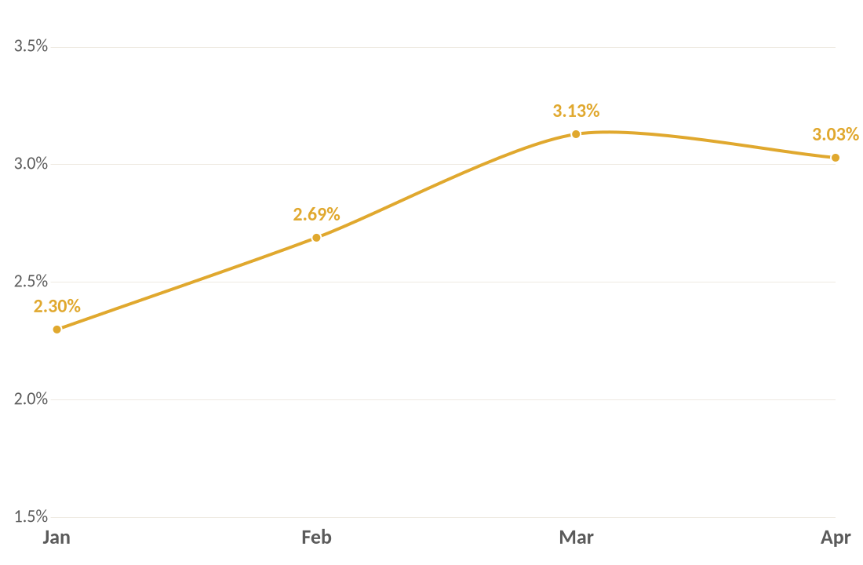
TREND / REACH
Mentions nearly doubled. Share of voice held steady.
MONTHLY MENTIONS
SHARE OF VOICE (%)
Reach grew sharply through Q1. Share of voice held steady, meaning the entire category got noisier and we kept pace.
Workhuman / AEO Progress
10 / 21

Slide 11
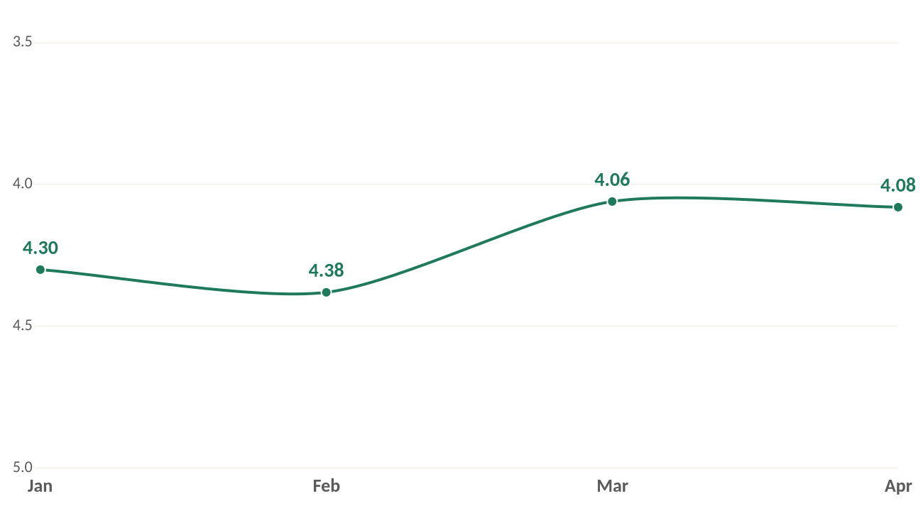
TREND / QUALITY
We are not just cited more. We are cited earlier.
AVERAGE POSITION (LOWER IS BETTER)
Why position matters.
LLMs often respond with ranked lists. Brands at positions 1 to 3 are read aloud, repeated, and remembered. Brands at positions 7+ effectively are not.
OUR Q1 GAIN
4.30 → 4.08
A small numeric move with outsized impact on which mentions get repeated.
Workhuman / AEO Progress
11 / 21

Slide 12
WHERE WE STAND
Top tier of HR Technology, within striking distance.
1
Bonusly
34.7%
2
Workday
31.2%
3
Achievers
29.9%
4
Workhuman
29.4%
5
Lattice
26.6%
6
Culture Amp
26.4%
Top 6 brands by visibility. Profound HR Technology category, 30-day rolling.
Workhuman / AEO Progress
12 / 21

Slide 13
TREND / COMPETITIVE READ
Suite vendors are now in the answer set.
HR TECH TOP 6 / APRIL 2026
The new pattern.
1
Bonusly
34.7%
POINT
Workday is the only HR suite vendor in the top tier. Three months ago they were not. They moved from outside the top 5 to #2 in a single quarter.
2
Workday
31.2%
SUITE
3
Achievers
29.9%
POINT
4
Workhuman
29.4%
WHY THIS MATTERS
POINT
Suite encroachment is harder to fight than point-solution competition. Workday's visibility is anchored to a much larger content footprint covering payroll, benefits, time, and HCM. As they enter recognition prompts, they bring that gravity with them.
5
Lattice
26.6%
SUITE-ADJ.
6
Culture Amp
26.4%
POINT
POINT SOLUTION = recognition / engagement specialist SUITE = broad HCM platform
Defending recognition is no longer enough. We need to start playing in the broader HCM-adjacent prompt set.
Workhuman / AEO Progress
13 / 21

Slide 14
TREND / CONTENT GRAVITY
Achievers has 2.16× our content gravity in the category.
TOP CITED DOMAINS IN HR TECHNOLOGY / YTD CITATIONS
achievers.com
396,319
peoplemanagingpeople.com
227,039
workhuman.com
183,743
gartner.com
170,044
linkedin.com
153,478
bonusly.com
150,319
awardco.com
139,525
octanner.com
138,560
■ Direct competitor ■ Workhuman ■ Third-party / analyst / distributor
THE GAP Achievers is cited 2.16× more than Workhuman across category prompts. Their content moat is the lever AI uses to repeat them. Closing this gap is the single highest-leverage AEO play.
Workhuman / AEO Progress
14 / 21

Slide 15
TREND / TOPIC GAP
We win recognition. We are absent from AI in HR.
TOP CATEGORY TOPICS BY QUERY VOLUME / YTD
THE OPENING
Employee Recognition Software
WIN
415K
480,542
Employee Experience Software
Mixed
449,312
YTD queries on "AI in HR" topics, where Workhuman has effectively zero published content.
Employee Appreciation
WIN
432,269
AI in HR
GAP
4 OF TOP 5 BUYER PROMPTS
415,052
are about AI tools for HR. We do not show up because we have no content engineered for those queries.
Employee Experience
WIN
331,942
Build the AI in HR cluster (pillar + supporting passages + comparison artifact). It is the largest unexploited topic in our reach.
Workhuman / AEO Progress
15 / 21

Slide 16
WHAT'S WORKING
Our content is showing up where the buying questions live.
TOP BUYER PROMPTS WE APPEAR ON
WORKHUMAN.COM URLS CITED MOST
1
What are the best AI tools for modern HR processes?
/blog/employee-recognition-software/
2
Which AI-driven HR tools are most popular with large teams?
52,744 citations
Top 5 across category
3
What are reliable platforms using AI for HR decision-making?
/blog/employee-engagement-software/
4
How can I track performance data with reliable software?
37,382 citations
5
What platforms help visualize employee data effectively?
Top 8 across category
YTD citations across all eight tracked AI surfaces. Our engagement and recognition pillar pages are the workhorses.
Workhuman / AEO Progress
16 / 21

Slide 17
CHANNEL COVERAGE
We are surfacing across every major AI assistant.
Google AI Mode
Perplexity
ChatGPT
Google AI Overviews
2.4M
1.74M
1.49M
1.38M
Microsoft Copilot
Google Gemini
Meta AI
Grok
784K
766K
410K
175K
INSIGHT
Google AI Mode and Perplexity are now the highest-volume answer surfaces in our category. Our content needs to be authored for those answer formats first.
Source: Profound, total YTD queries observed across the HR Technology category, by model.
Workhuman / AEO Progress
17 / 21

Slide 18

ACTION / Q1
What we have done.
INITIATIVE 01
INITIATIVE 02
INITIATIVE 03
[ Title of completed work ]
[ Title of completed work ]
[ Title of completed work ]
WHAT WE DID
WHAT WE DID
WHAT WE DID
[ One sentence describing the action ]
[ One sentence describing the action ]
[ One sentence describing the action ]
WHY
WHY
WHY
[ The specific metric or signal it was meant to move ]
[ The specific metric or signal it was meant to move ]
[ The specific metric or signal it was meant to move ]
RESULT
RESULT
RESULT
[ What happened, quantified ]
[ What happened, quantified ]
[ What happened, quantified ]
Workhuman / AEO Progress
18 / 21

Slide 19

ACTION / Q2 AND FORWARD
What we are continuing.
NEXT 30 DAYS
[ Initiative title ]
[ One line on what it is and the metric it advances ]
NEXT 60 DAYS
[ Initiative title ]
[ One line on what it is and the metric it advances ]
NEXT 90 DAYS
[ Initiative title ]
[ One line on what it is and the metric it advances ]
Workhuman / AEO Progress
19 / 21

Slide 20


A STRATEGIC POSITION
What we are deliberately not doing.
OUR POSITION
NOT DOING / 01
[ Tactic we are choosing not to invest in ]
AEO is fundamentally
an influence game.
NOT DOING / 02
[ Metric we are choosing not to chase ]
LLMs answer questions inline. The buyer reads the answer and forms an impression of who the trusted vendors are. That impression compounds long before a click ever happens.
NOT DOING / 03
[ Distraction we are explicitly deferring ]
Workhuman / AEO Progress
20 / 21

Slide 21
WORKHUMAN / AEO PROGRESS
From visibility
to influence.
The HR Technology answer set is narrowing. Our job is to stay in it, climb within it, and convert that influence into brand demand we can measure on workhuman.com.
Questions, ideas, pushback. All welcome.

