Slide 1


Bizhamal Kozhakhan Deep Learning Spring 2026
Fake News Detection using Deep Learning

Slide 2
Problem Statement
• Fake news spreads rapidly online • Manual verification is difficult • NLP can help automate detection • Goal: classify news as Fake or Real

Slide 3
Dataset
Dataset: Fake and Real News Dataset Source: Kaggle almost 20,000 news articles Features: • title • text Labels: • 0 = Fake • 1 = Real

Slide 4
Data Preprocessing
• Lowercasing
• Remove punctuation
• Remove URLs
• Tokenization
• Padding sequences
Raw Text
↓
Cleaning
↓
Tokenization
↓
Model Input

Slide 5
Models
Models | Purpose
Logistic Regression | Baseline
LSTM | Deep Learning
DistilBERT | Transformer Exploration

Slide 6
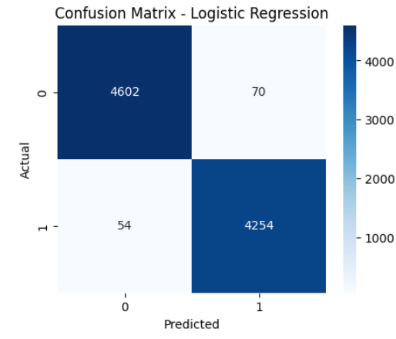
Results
Model | Accuracy
Logistic Regression | 98.64%
LSTM | 98.06%
DistilBERT | Experimental

Slide 7
Error Analysis
Common failure cases:
• Short headlines
• Ambiguous wording
• Similar vocabulary
• Lack of context

Slide 8
Streamlit Application
Features:
• Enter news article
• Click Predict
• Receive Fake/Real prediction

Slide 9
Conclusion
• NLP can detect fake news effectively
• Baseline model performed very well
• LSTM captured contextual information
• Transformers are modern NLP approaches

Slide 10
Thank You

