Slide 1










Null-Space Attack on AC Systems
DC System
AC System
Example of what h looks like:
$$z=Hx+e$$
$$z=h(x)+e$$
$$=h(V;θ)+e$$
Find: $Hc≈0$
Find:
$$h\left(x+c\right)−h\left(x\right)≈0$$
Attack to Bypass Anomaly Detector:
Attack to Bypass Anomaly Detector:
$$z_{a}=H(x+c)+e$$
$$z_{a}=h(x+c)+e$$
$≈z$
$≈z$

Slide 2
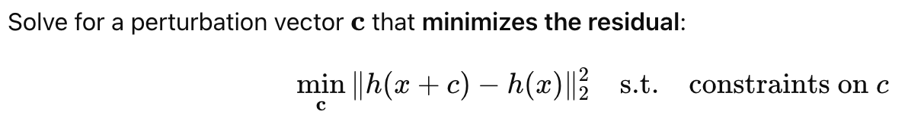
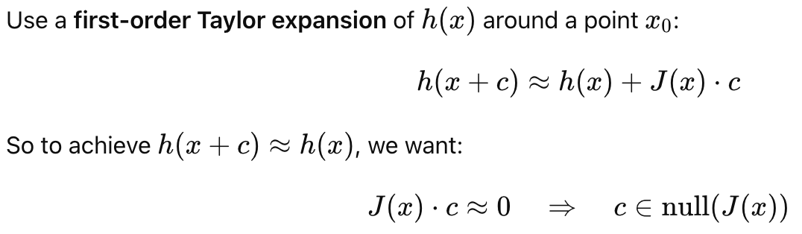

Two Approaches to Find the Attack
Goal:
Find:
$$h\left(x+c\right)−h\left(x\right)≈0$$
Method 1: Optimization
Performance: slow in large systems (e.g., 118-bus system).
Method 2: Jacobian-based Linearization
Performance: fast in large systems (e.g., 118-bus system). Descent accuracy.

Slide 3
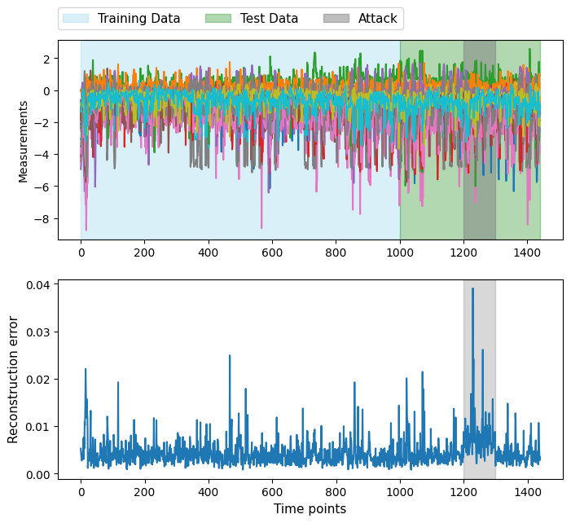
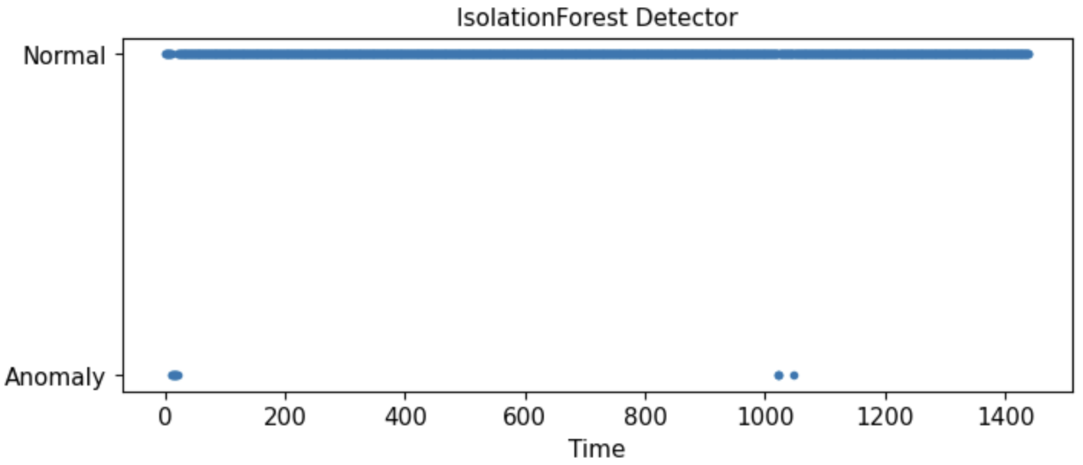
Effect of AC Attacks (Xin’s Method Can Still Detect, 14-bus AC)
ML-based anomaly still failed
Slightly degraded from 14-bus DC system

Slide 4
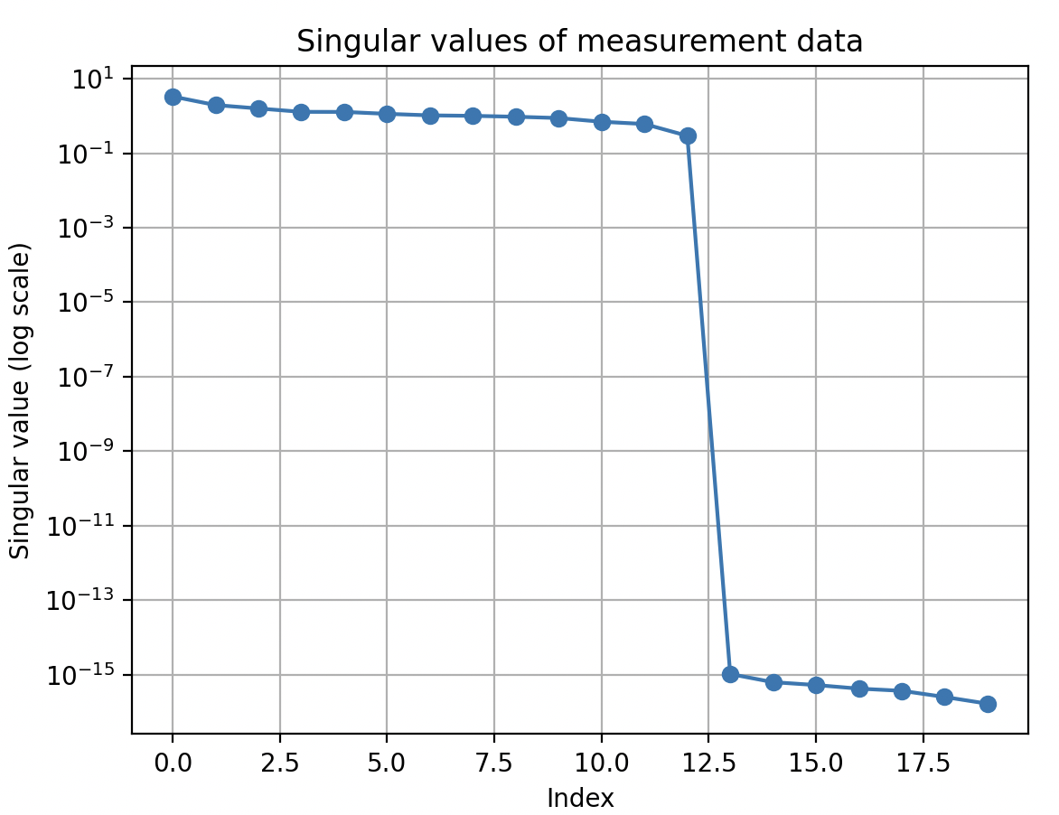
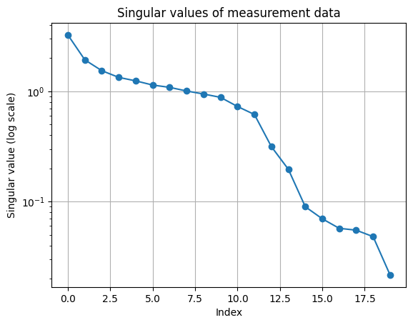
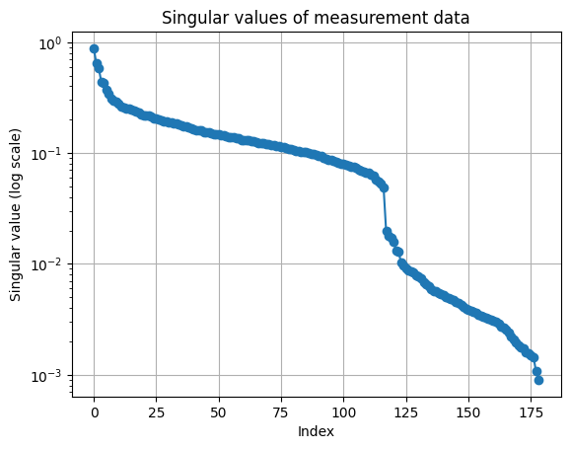

One Difference From DC System regarding Xin’s Method
14-bus DC
14-bus AC
118-bus AC
Requires: tune the threshold in Xin’s method
In contrast to DC, the AC system uses a nonlinear mapping z=h(x), where the measurements lie on a 13-dimensional nonlinear manifold rather than a flat subspace. This causes the singular values to decay more gradually, with the remaining values still significantly above zero (e.g., >1e-1), reflecting the curvature and variation of the manifold in the full measurement space.

Slide 5
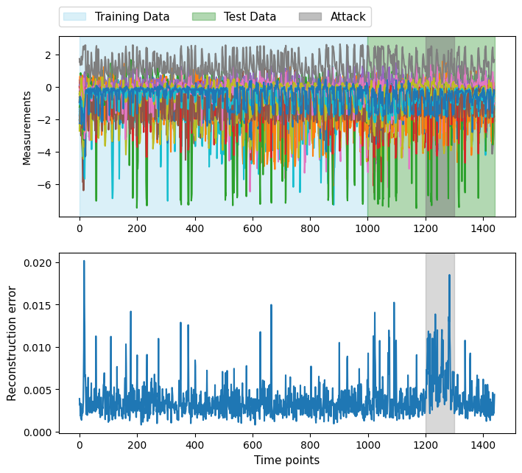
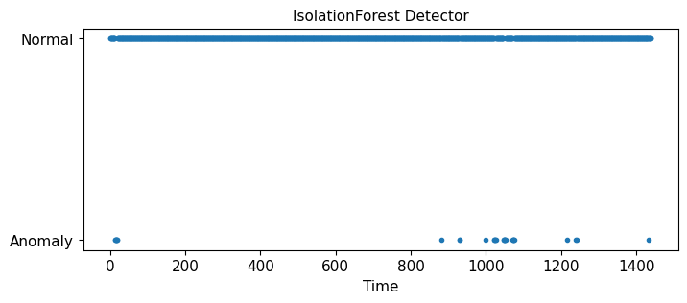
Performance on Other Systems
30-bus AC System
ML-based anomaly still failed

Slide 6
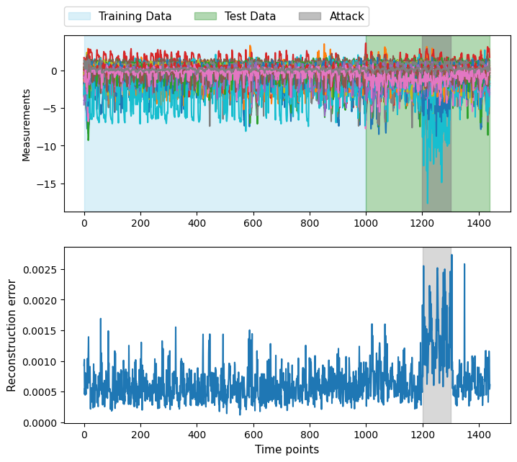
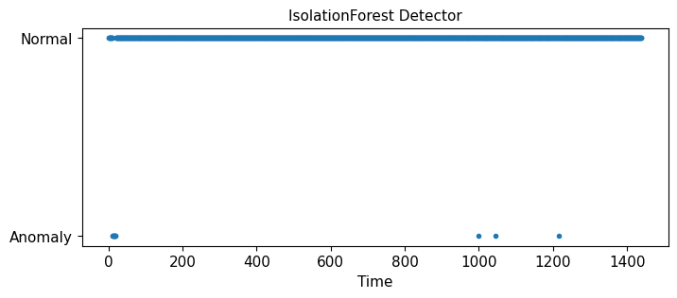
Performance on Other Systems
57-bus AC System
ML-based anomaly still failed

Slide 7
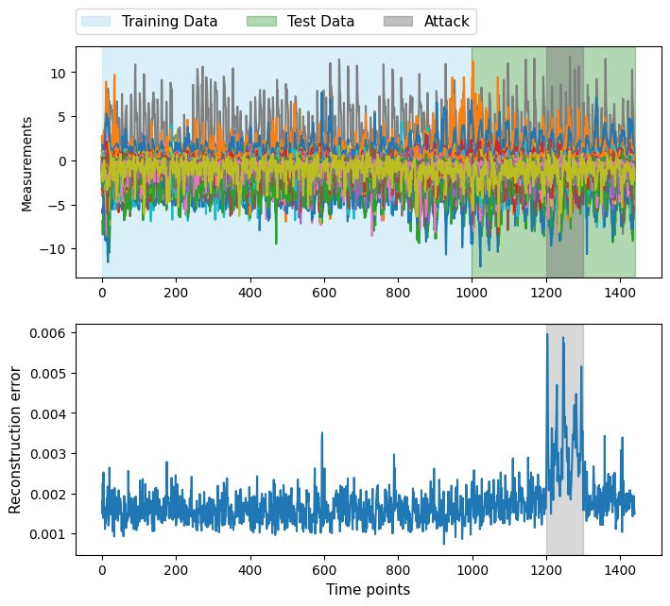
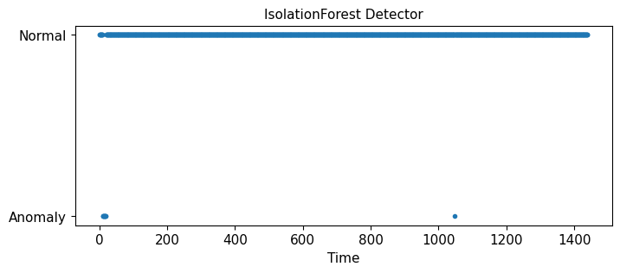
Performance on Other Systems
118-bus AC System
ML-based anomaly still failed

