Slide 1
Getting Started with AngularJS
Maryland Meetup 10/8/14
Bob Evans, Manager Software Engineering

Slide 2
Who am I?

Slide 3
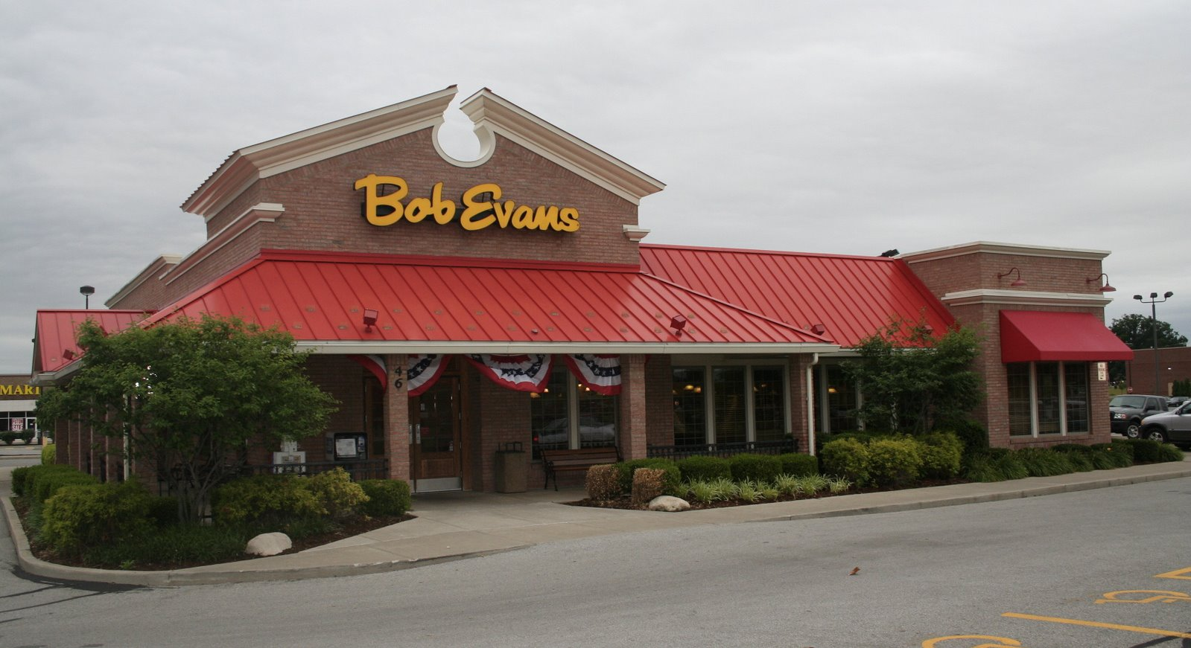
Sorry guys, no free sausage today

Slide 4
Fun Facts
Husband for 5+ years
Father for 4+ months
Charm city resident
Obsessed baseball fan, #wewontstop
400+ live shows attended and counting, reason I know this? I keep a google doc
JS Lover

Slide 5
AngularJS

Slide 6
What is AngularJS?
Superheroic JavaScript MVW Framework
Initial release in 2009
Usage exponential surpassed Ember/Backbone(Usage Stats)
Two way data bindings reduce code
Directives
Separation between controller and view make it easy to test
$scope is the power of the controller(view model)
Use $watch for changes in model
Easy to test via dependency injection

Slide 7
Highlights of demo
Scaffolding and bootstrapping with Yeoman + angular generator
Controllers
Services and reason for them
Constants
$http provider
Simple grunt tasks
Unit testing with code coverage

Slide 8
Yeoman for scaffolding
Easily install a stack with yeoman + angular generators
http://yeoman.io/
https://github.com/yeoman/generator-angular
http://yeoman.io/codelab/install-generators.html
http://yeoman.io/codelab/scaffold-app.html

Slide 9
Demo, DO IT LIVE!
Notes:
Yo
Grunt serve
Work your way back on the new code
- routes
- show ng-repeat
- http
- service to share code
- constants

Slide 10
Homework
Dependency Loading
Async: Require.js or Browersify
Sync: Wiredep
Pros/Cons
Building a dist
Usemin
Rev
Html2js
Ngmin
Closure compiler
Htmlmin
Functional Testing: Protractor
Alternate Build System: Gulp.js
Other Suggestions?

Slide 11
Resources
Official docs: https://docs.angularjs.org/api
YouTube ng-conf videos: https://www.youtube.com/user/ngconfvideos
Egghead: https://egghead.io/
https://plus.google.com/+AngularJS/posts
Who to follow: @mhevery, @jeffbcross, @igorminar, @briantford, etc
Core team: https://github.com/orgs/angular/people

