Slide 1
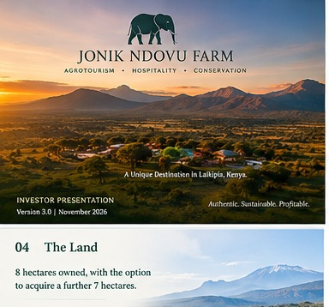
JONIK
NDOVU FARM
A hospitality-led agro-tourism destination in Laikipia, Kenya
INVESTOR PRESENTATION
VERSION 3.0 | OCTOBER 2026
12–15 units • US$2.4m total capital requirement

Slide 2
01 Executive Summary
Investment brief
The current developer-surveyed plan is 12–15 accommodation units. The total capital requirement is US$2.4 million, including the proposed acquisition of approximately 7 additional hectares.
JONIK NDOVU FARM • VERSION 3.0 • CONFIDENTIAL WORKING DRAFT

Slide 3
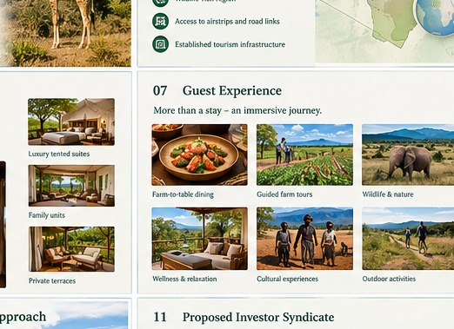
02 The Vision
Concept
A small-scale, memorable destination where boutique hospitality, farm-informed food, agricultural experiences and the landscape create one coherent guest proposition.
JONIK NDOVU FARM • VERSION 3.0 • CONFIDENTIAL WORKING DRAFT

Slide 4
03 Land Position
Land
8 hectares are stated as owned. Up to approximately 7 additional hectares may be acquired, subject to price, title, access and diligence. Approximately 15 hectares is the potential ultimate footprint—not a secured current land area.
JONIK NDOVU FARM • VERSION 3.0 • CONFIDENTIAL WORKING DRAFT

Slide 5
04 Product & Guest Experience
Offer
• Boutique accommodation with privacy and nature connection
• Farm-to-table dining and seasonal produce
• Guided farm and nature experiences
• Wellness, retreats or events only where demand and approvals support them
JONIK NDOVU FARM • VERSION 3.0 • CONFIDENTIAL WORKING DRAFT

Slide 6
05 Development Range
Capacity
12 units: conservative base case for initial model. 15 units: expansion sensitivity. Final unit mix, siting and density must follow survey, planning, market testing and operator input.
JONIK NDOVU FARM • VERSION 3.0 • CONFIDENTIAL WORKING DRAFT

Slide 7
06 Why This Could Work
Thesis
• Clear boutique positioning
• Hospitality as the primary revenue engine
• Agriculture supports authenticity and guest activities
• Opportunity to build local supply-chain and employment pathways
• Phased delivery can be assessed to manage capital exposure
JONIK NDOVU FARM • VERSION 3.0 • CONFIDENTIAL WORKING DRAFT

Slide 8
07 The Capital Ask
Capital
US$2.4 million total, inclusive of proposed land acquisition. The allocation across land, construction, infrastructure, FF&E, professional fees, contingency, pre-opening and working capital must be reconciled to a QS cost plan.
JONIK NDOVU FARM • VERSION 3.0 • CONFIDENTIAL WORKING DRAFT

Slide 9
08 Sources & Uses — Work in Progress
Budget
A final budget must reconcile exactly to US$2.4m and include acquisition costs, contingency and working capital. Current spreadsheet deliberately flags unverified categories rather than presenting fabricated cost estimates.
USE THE XLSX SOURCES & USES TAB TO ENTER VERIFIED COSTS — DO NOT SHARE PLACEHOLDER COSTS AS FACT.
JONIK NDOVU FARM • VERSION 3.0 • CONFIDENTIAL WORKING DRAFT

Slide 10
09 Two Development Paths
Options
PHASED: deliver a complete guest-ready first phase and expand when demand supports it. FULL BUILD: deliver 12–15 units in one programme. Compare on cost certainty, funding sufficiency, guest experience, cash flow and downside risk before choosing.
JONIK NDOVU FARM • VERSION 3.0 • CONFIDENTIAL WORKING DRAFT

Slide 11
10 Financial Case — Validation Required
Model
A 10-year formula-based working model is included. Occupancy, ADR, ancillary revenue, cost ratios and opening timing are placeholders—not forecasts. Replace with market evidence, operator inputs, tax advice and QS costs before investor reliance.
JONIK NDOVU FARM • VERSION 3.0 • CONFIDENTIAL WORKING DRAFT

Slide 12
11 Investor Structure
Structure
Target a lead investor or strategic partner, supported by a small aligned co-investor group. Equity/debt mix, valuation, governance, return waterfall and exit terms remain open and must be negotiated with advisers.
JONIK NDOVU FARM • VERSION 3.0 • CONFIDENTIAL WORKING DRAFT

Slide 13
12 Risk & Mitigation
Risk
Land/title: legal diligence. Cost: QS cost plan and contingency. Demand: competitor study and downside scenarios. Operations: operator plan and staffing budget. Environment/approvals: early specialist advice. Funding: staged drawdowns and sufficient working capital.
JONIK NDOVU FARM • VERSION 3.0 • CONFIDENTIAL WORKING DRAFT

Slide 14
13 Impact & Stewardship
Impact
Set measurable goals for local hiring/procurement, water and energy management, waste, biodiversity and community engagement. Report outcomes only when targets, baselines and delivery responsibility are agreed.
JONIK NDOVU FARM • VERSION 3.0 • CONFIDENTIAL WORKING DRAFT

Slide 15
14 Fundraising Plan
Execution
Days 1–30: lock facts and diligence evidence. Days 31–45: build a qualified pipeline. Days 46–60: targeted outreach. Days 61–75: meetings and diligence. Days 76–90: advance lead discussions and structure.
JONIK NDOVU FARM • VERSION 3.0 • CONFIDENTIAL WORKING DRAFT

Slide 16
15 Immediate Next Steps
Next
1. Verify title and land acquisition terms.
2. Commission survey and QS cost plan.
3. Validate access, water, power, wastewater and approvals.
4. Commission market/competitor work.
5. Compare phased and full-build models.
6. Prepare controlled investor data room.
JONIK NDOVU FARM • VERSION 3.0 • CONFIDENTIAL WORKING DRAFT

Slide 17
16 Closing
Close
Jonik Ndovu Farm
A distinctive destination built around hospitality, agriculture and nature.
US$2.4m total capital requirement • 12–15 units
Confidential working draft — all assumptions subject to diligence.
JONIK NDOVU FARM • VERSION 3.0 • CONFIDENTIAL WORKING DRAFT

