Slide 1
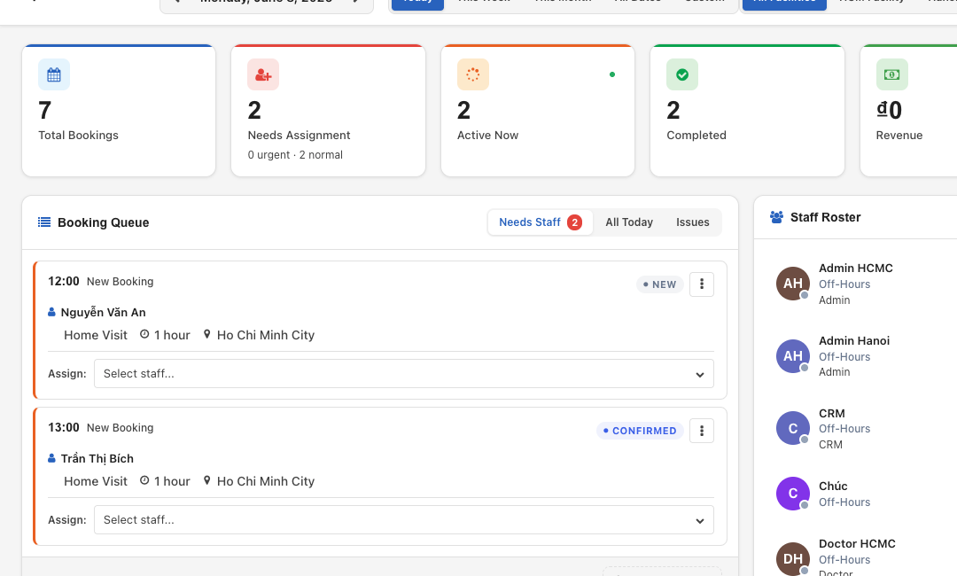
CareJioX
One operating system for connected care delivery
Bring enquiries, bookings, field teams, clinical work and revenue into one accountable journey.
CARE DELIVERY • OPERATIONS • CLINICAL • FINANCE
Notes:
Open on the customer’s operating reality: every handoff matters. CareJioX connects the front door, the service workflow, field delivery and finance. Source image: docs/user_manual/img/ops_01_dashboard.png. Screenshot shows illustrative demo data and a white-labelled deployment.

Slide 2
THE OPERATIONAL CHALLENGE
Fragmented tools make every care handoff harder
When teams work across inboxes, spreadsheets, paper notes and disconnected finance systems, the person receiving care becomes the integration layer.
01
02
03
04
Enquiries wait
Schedules drift
Care records lag
Revenue leaks
Messages arrive in different places, making ownership and follow-up difficult to see.
Bookings, availability and assignment decisions fall out of sync as the day changes.
Field activity and clinical observations reach the office late or without context.
Completed work, invoices, collections and outstanding balances require manual reconciliation.
CareJioX
02
Notes:
Use this slide to invite the audience to recognize their own process. These are category-level operational risks, not claims about a specific customer.

Slide 3
ONE CONNECTED WORKFLOW
CareJioX keeps the entire service journey in one workflow
A single operational thread connects the first conversation to delivered care and financial closure.
01
02
03
04
05
06
Connect
Book
Assign
Deliver
Document
Close
Capture enquiries and conversations.
Create the service and confirm details.
Match the right team and capacity.
Guide field work and live status.
Record notes, vitals and outcomes.
Invoice, collect and follow up.
CareJioX
03
Notes:
This is the core story of the deck. The platform is organized around the lifecycle of care delivery rather than disconnected departmental applications.

Slide 4
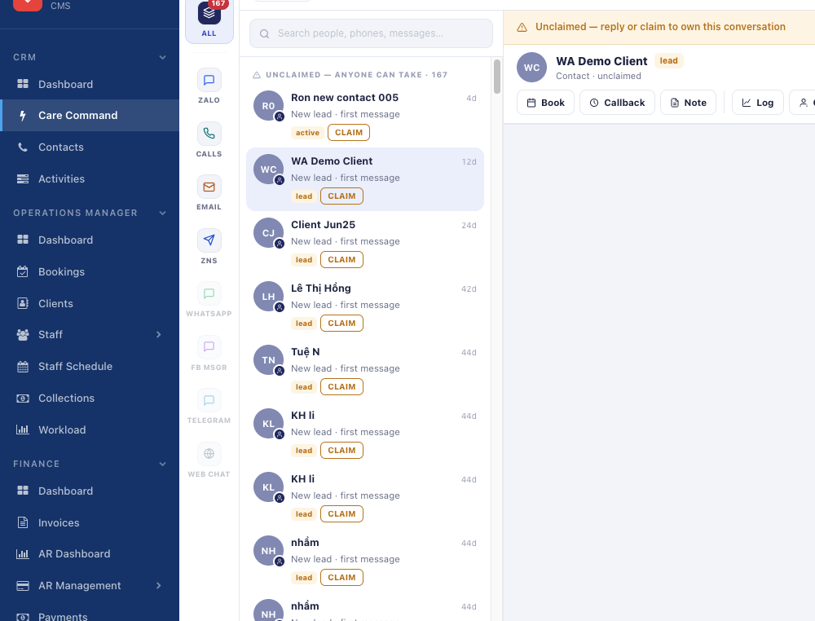
CARE COMMAND
Every conversation becomes a visible work item
Bring channel activity into the same care workflow—not another isolated inbox.
One team view
See channel activity, ownership and follow-up in a shared workspace.
Actionable triage
Make work that needs a reply or callback visible before it goes cold.
Extensible channels
Connect provider adapters without changing the core conversation model.
Product screenshot • illustrative demo data
CareJioX
04
Notes:
Care Command is the omnichannel work layer. Keep the wording honest: supported providers depend on configured adapters and provider approvals. Source image: a sales crop of docs/strategy/reports/care-command-phase1-evidence/02-chat-thread.png.

Slide 5
OPERATIONS CENTER
Operations see the day as it changes
Bookings, staffing and service status stay visible from one command desk.
Run the booking queue
See what is new, active, complete or still needs assignment.
Assign with context
Coordinate staff, rosters, schedules and workload.
Track the lifecycle
Follow accepted, in-progress and completed services in real time.
Product screenshot • illustrative demo data
CareJioX
05
Notes:
Source: docs/user_manual/content/03_operations.md and docs/user_manual/img/ops_01_dashboard.png. Avoid discussing the AI Performance Coaching product; it is not part of this deck.

Slide 6
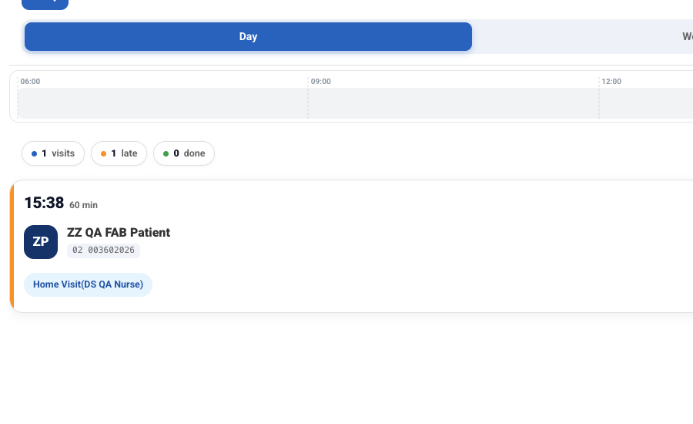
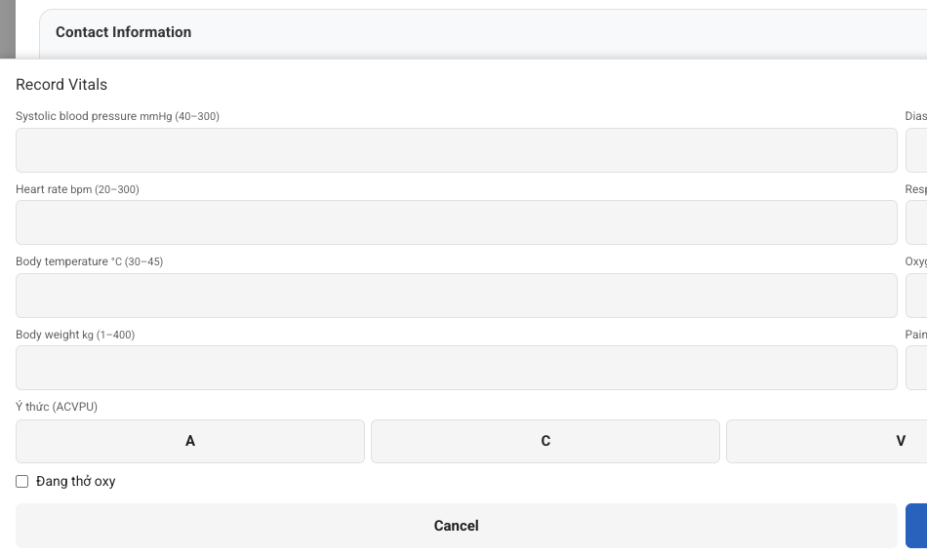
MOBILE DELIVERY AND STRUCTURED CARE
Field teams carry the workflow—not the paperwork
The visit in the nurse’s hand
Clinical observations at the point of care
Accept, start and complete assigned visits from a bilingual progressive web app designed to keep working through weak connectivity.
Capture vitals and care activity within the service record so the office receives context, not disconnected notes.
CareJioX
Product screenshots • illustrative demo data
06
Notes:
Source: docs/user_manual/content/06_mobile.md and telemonitoring Phase 2 evidence. The offline PWA behavior is documented in the repository. Images contain illustrative demo data.

Slide 7
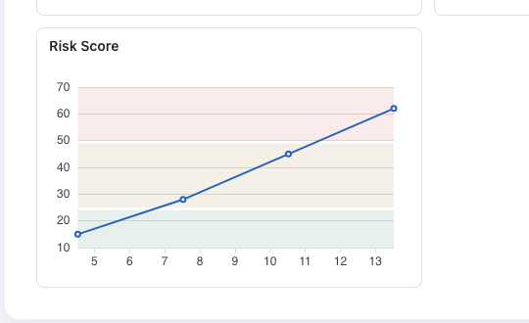
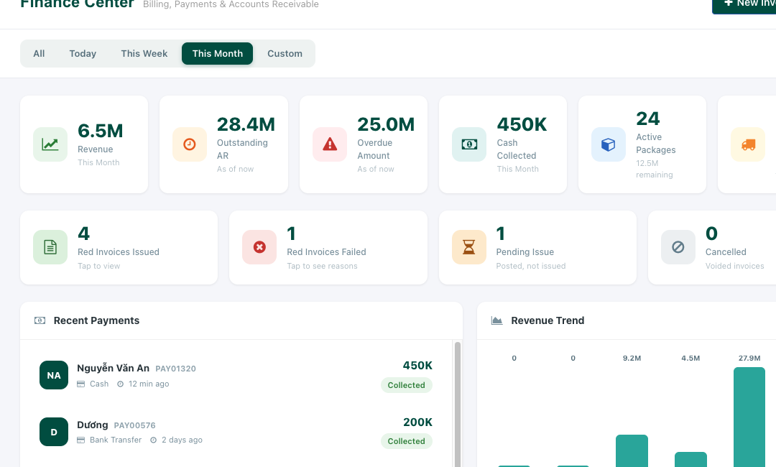
ACCOUNTABILITY ACROSS CARE AND CASH
Clinical visibility and financial control share the same operational truth
Structured risk and follow-up
Revenue, payments and receivables
Connect care plans, observations, medications, incidents and monitoring to prioritized work and accountable follow-up.
Move completed services into invoicing, packages, payments, collections, receivables and Vietnamese VAT workflows.
CareJioX
Product screenshots • illustrative demo data
07
Notes:
Clinical source: a sales crop of docs/strategy/reports/twin-phase3-evidence/04-risk-trajectory-chart.png and platform design documents. Finance source: docs/user_manual/content/04_finance.md and fin_01_dashboard.png.

Slide 8
BUILT TO FIT THE OPERATING MODEL
A practical platform for care providers and technology partners
CareJioX combines a modular Odoo 19 foundation with healthcare-specific workflows that can be configured and extended around each deployment.
01
Modular by design
02
Ready for field reality
Adopt the capabilities needed now and add channels, clinical modules, portals or integrations over time.
Bilingual workflows, a progressive web app and offline synchronization support mobile teams.
03
Controlled access
04
Integration-friendly
Role, company and catchment-aware access keeps operational responsibilities clearly separated.
Provider adapters and API-oriented architecture give partners clear extension points without rewriting the care journey.
CareJioX
08
Notes:
Technical basis: docs/strategy/DESIGN.md. Deployment, hosting, certification and specific integrations should be scoped per customer engagement rather than assumed.

Slide 9
CareJioX
See your care journey running as one.
Start with a workflow-led demonstration.
Map your channels, service lifecycle, clinical records and finance handoffs.
Leave with a scoped pilot and integration plan.
Notes:
Close with a specific next step: a tailored workflow demo, followed by a focused pilot. Add your preferred contact details before external distribution if required.

