Slide 1
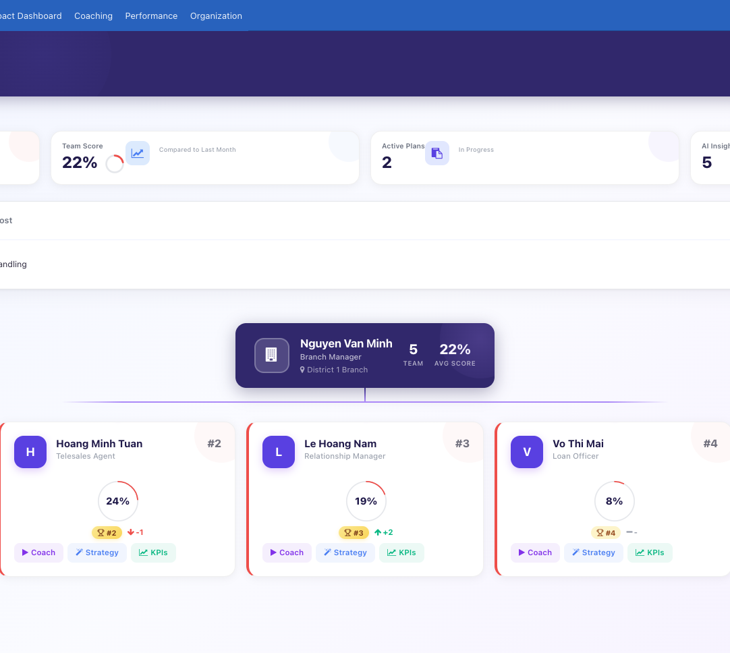
PerformX
Turn performance data into better coaching
Help managers focus attention, prepare stronger conversations and turn each session into measurable action.
PRIORITIZE • PREPARE • COACH • COMMIT • TRACK
Notes:
PerformX is a separate AI Performance Coaching proposition. Open with the management outcome: better, more consistent coaching driven by the performance context already available. Source image: .bfsi_poc/screens/uat_10_command_center.png; illustrative demo data.

Slide 2
THE OPERATIONAL CHALLENGE
The dashboard is not the difficult part
Managers can usually see the numbers. The harder job is deciding where to intervene, understanding what is driving the gap and sustaining follow-through.
01
02
03
04
Too much signal
Uneven preparation
Weak follow-through
Limited visibility
Performance data is available, but attention is not prioritized around the people and behaviors that matter most.
The quality of a coaching conversation depends heavily on each manager’s time and experience.
Good conversations fade when commitments are not linked to measures, owners and check-ins.
Leaders struggle to see whether coaching activity is changing performance over time.
PerformX
02
Notes:
Keep the positioning human: PerformX assists managers; it does not replace judgment or the relationship between manager and employee.

Slide 3
ONE CONNECTED WORKFLOW
PerformX closes the loop between insight and improvement
Each coaching cycle begins with evidence and ends with a visible commitment that can be reviewed against performance.
01
02
03
04
05
06
Prioritize
Diagnose
Prepare
Coach
Commit
Track
Surface who needs attention and why.
Connect KPI gaps to likely behaviors.
Draft themes, questions and a session plan.
Guide a focused manager-led conversation.
Turn discussion into KPI-linked actions.
Review progress, trends and follow-up.
PerformX
03
Notes:
This is the core PerformX loop. AI can support diagnosis, preparation and drafting, while the manager remains responsible for the conversation and decision.

Slide 4
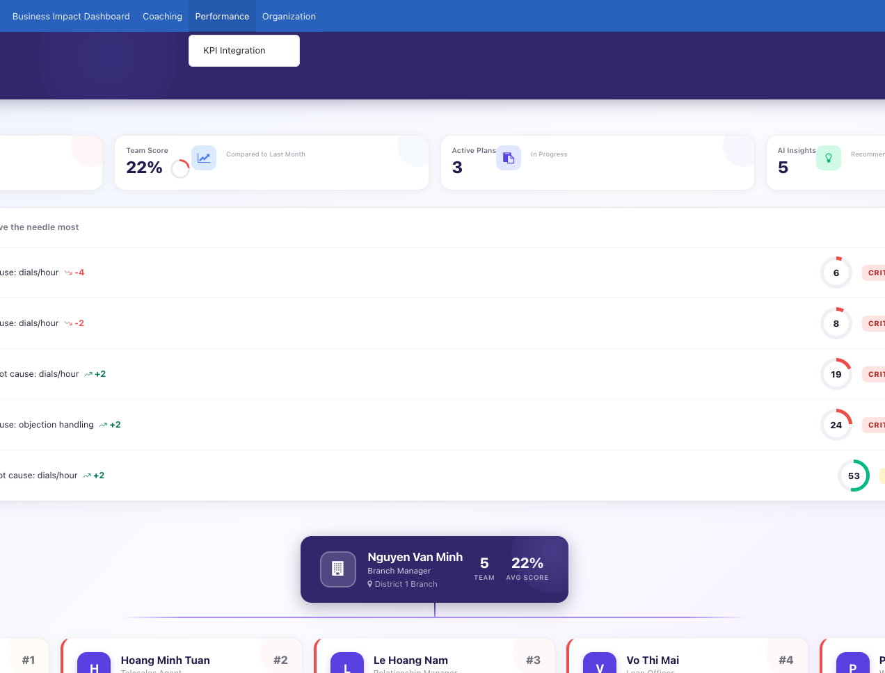
PERFORMANCE COMMAND CENTER
Direct coaching attention where it can move results
Move from a static ranking to a prioritized coaching queue with visible root-cause context.
Manager focus
Rank attention using performance context, coaching priority and current plans.
Team visibility
Review scores, trends and organizational context without losing the individual.
Clear next action
Move directly from an identified gap into strategy, coaching or KPI review.
Product screenshot • illustrative demo data
PerformX
04
Notes:
Source image: .bfsi_poc/screens/uat_20_performance.png. All people and metrics shown are illustrative demo data.

Slide 5
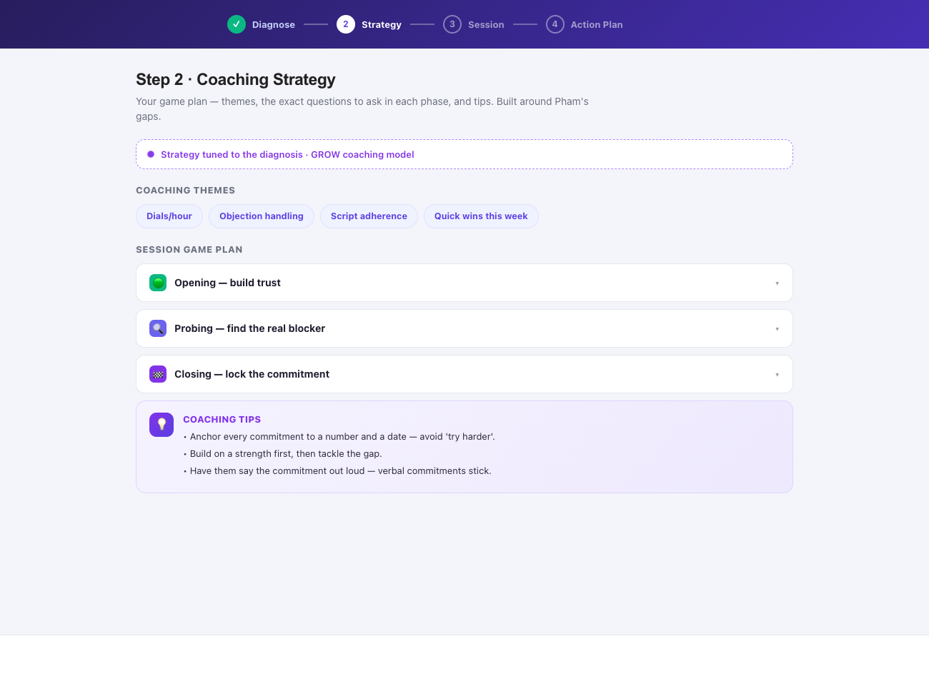
AI-ASSISTED COACHING STRATEGY
Give every manager a stronger preparation ritual
Transform a performance diagnosis into themes, probing questions and a structured session game plan.
Contextual preparation
Ground the strategy in the employee’s KPI gaps and the selected coaching objective.
Consistent structure
Support opening, probing and closing phases while preserving the manager’s own voice.
Human control
Managers review and adapt suggested themes, questions and tactics before the session.
Product screenshot • illustrative demo data
PerformX
05
Notes:
Source image: .bfsi_poc/screens/uat_02_strategy.png. Describe AI as an assistant and drafting aid, not an autonomous performance decision-maker.

Slide 6
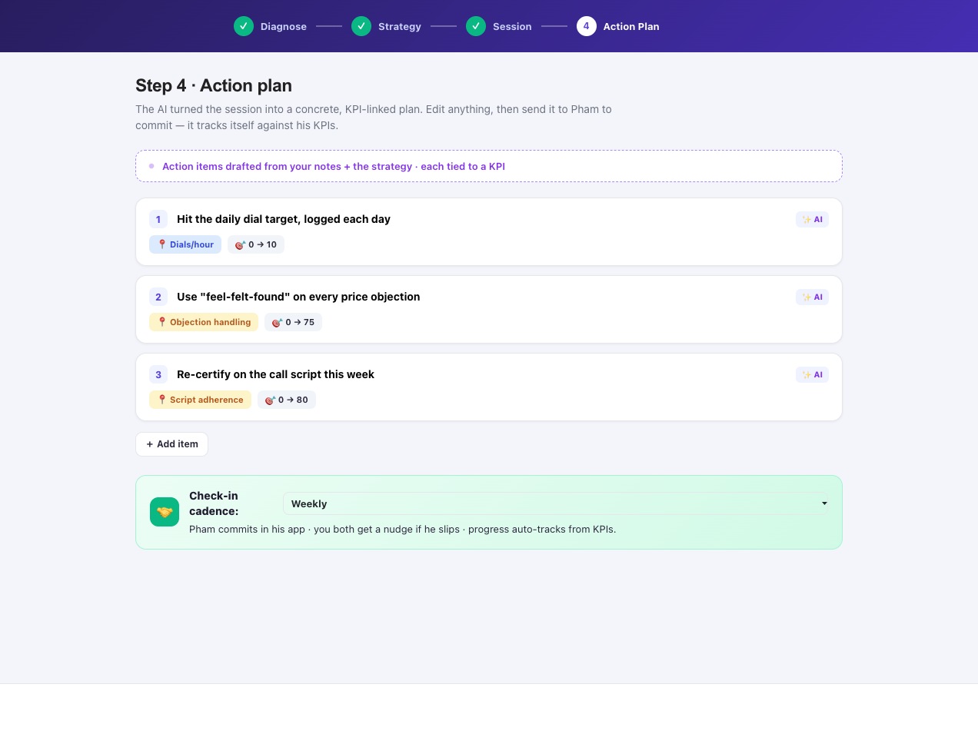
KPI-LINKED ACTION PLAN
Turn the conversation into accountable action
Capture concrete commitments, link each one to a measure and set the rhythm for follow-up.
Specific commitments
Convert notes and strategy into actions that can be edited and agreed together.
Measures and targets
Tie each action to the relevant KPI or behavior rather than a vague intention.
Visible cadence
Set check-ins, track plan status and keep progress accessible to the right roles.
Product screenshot • illustrative demo data
PerformX
06
Notes:
Source image: .bfsi_poc/screens/uat_04_actionplan.png. Emphasize that the manager reviews and approves action items before they are sent.

Slide 7
DESIGNED FOR ENTERPRISE ADOPTION
Flexible AI deployment without giving up governance
PerformX is built on Odoo 19 Community Edition and supports configurable AI providers, role-aware workspaces and structured performance records.
01
Provider choice
02
Role-aware experience
Configure OpenAI, Mistral or a local Ollama deployment according to organizational requirements.
Tailor views and actions for employees, managers and regional leadership.
03
Structured records
04
Human accountability
Keep KPIs, strategies, sessions and action plans connected as auditable business objects.
Use AI to prepare and assist while managers retain approval and ownership of coaching decisions.
PerformX
07
Notes:
Source: addons/hr_development_ai/__manifest__.py, security groups and DEMO_GUIDE.md. Do not promise a compliance certification unless separately verified.

Slide 8
PerformX
Make every coaching conversation count.
Start with a role- and KPI-led demonstration.
Connect one team’s performance signals and coaching workflow.
Pilot the full loop from prioritization to measurable follow-up.
Notes:
Close on a focused pilot: one team, one KPI framework and one coaching cadence. Add preferred contact details before external distribution if needed.

