Slide 1

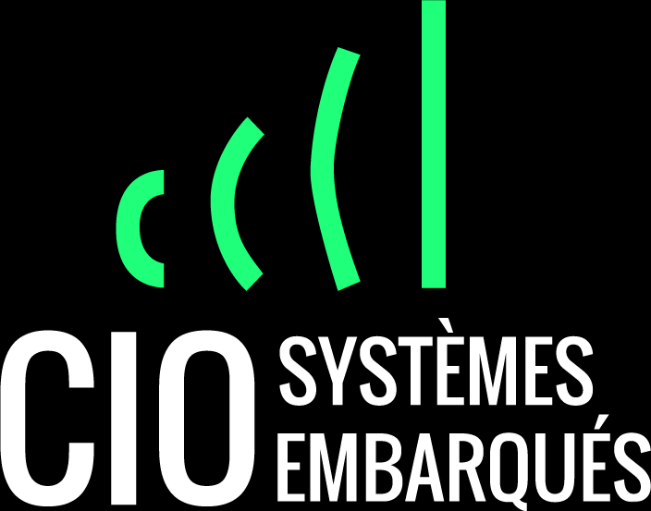
Demonstration Project
USB Link between Android tablet and VCOM device
Notes:
https://www.freepik.com/free-vector/digital-marketing-landing-page_5467432.htm#page=1&query=marketing&position=8

Slide 2

Content
CIO Presentation
Context introduction
Software Requirements
Development process
Delivery definition
Notes:
https://www.freepik.com/free-vector/social-media-marketing-efficiency-promotion-report-mobile-phone-with-loudspeaker-data-graph_4102840.htm#page=5&position=4

Slide 3






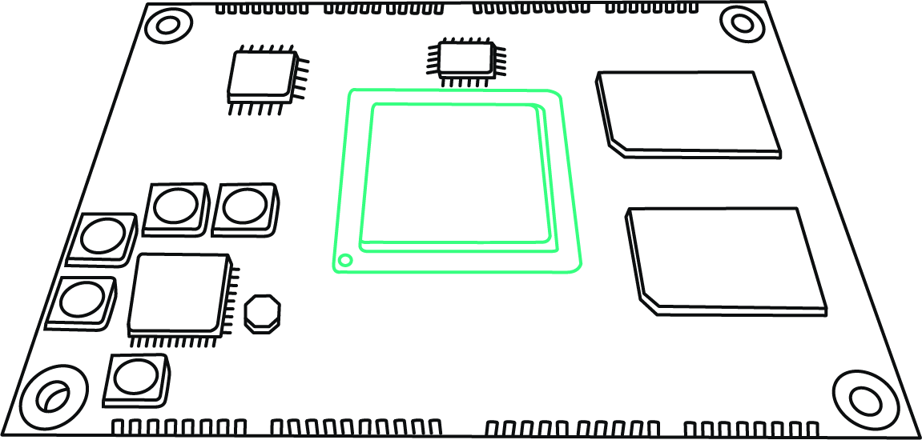
Présentation : CIO systèmes Embarqués
Specialized in embbeded systems (Software and Electronic)
Web site ciose.fr, contact : selso.liberado@ciose.fr
Founded : 1991
ISO9001 since 2019
1991
2000
2005
2013
2014
2015
2019
Création d’un bureau d’étude en informatique
Introduction de la compétence
Linux
Création d’un bureau d’étude en électronique
Développement du COM Hera
Ajout du nom commercial
CIOSE
Introduction de la compétence FPGA
ISO 9001
Sûreté de fonctionnement
Sécurité des systèmes

Slide 4




Présentation : CIO systèmes Embarqués
Low level development
BootLoader, drivers, BSP, Bare Metal
High level developement
GUI application
QT, visual C++, Androïd, iOS
Electronic studies
Signal processing
Audio, vidéo, DSP, FPGA

Slide 5
Requirements : context
The project is only intended to demonstrate ‘Proof of Concept’ (‘POC’).
The consultant must reuse the supplied source.
We have created a sketch for the solution implementation.

Slide 6
Requirements : Software requirements
The Mobile application reads and writes register to the device : Mobile is master, Device is slave.
All the protocol layer is implemented in the library, and reused in the mobile application and device.
The protocol is cleary divided in layers (device interface, frame R/W, register R/W).
Reliability : any connection loss is detected and can be re-established without restarting GUI/Device.
Performance : the connection must be established within 100 ms, and baudrate limited by the device performance (about 1 Mb / sec).
If the host does not support OTG, a notification is displayed when trying to enumerate devices.
Androit tablet
Samsung Galaxy Tab 10
GUI
Wrapped library
Coded in C
USB LINK
STMCube USB HAL
Application
STM 32 Nucleo

Slide 7
System design Presentation
Androit tablet
Samsung Galaxy Tab 10
The GUI allows to test communication with the device throuh the library
The library implement a simple protocole (register R/W). Coded in C.
Wrapper allows integration with the final application.
The device is a non modified STM32 Nucleo F439ZI
We use the USB available interface for both tablet and device.
GUI
Wrapped library
Coded in C
USB LINK
STMCube USB HAL
Application
STM 32 Nucleo

Slide 8
Design Presentation : about the Mobile Application
Mobile application, not webapp
Developped with Visual studion 2017
Using Microsoft Xamarin (C#)
Used the sub component Xamarin.forms
Library integration using Swig : (generate C# wrapper).

Slide 9
Design Presentation : the library
Developped using C only.
Multi-platform compatibility (linux, windows)
Developped using QtCreator (PC) and Visual Studio 2017 (Android).
Standard calls are used for device access.

Slide 10
Design Presentation : about the device
Nucleo STM32F439ZI
Developped using Atollic (STMCube IDE), STMCube MX, STMCube stack,
Using C99 standard
USB interface: VCOM port emulation.

Slide 11
What’s already done ?
Library Wrapper : completed.
Device : completed. It acts as a USB device.
Mobile application :
GUI done,
library integration,
Package Usb serial for Android was added for device recognition & CDC communication creation (but finally not used).
We managed to Write/Write to the device Using USB Android API
We did a Proxy socket Server, it services the dlLL request
Library :
protocol implemented, with a pseudo device for test purpose (tested in the mobile app)
16/12/2020 we did a client for sending request to the proxy. Working.
17/12/2020 : We did it ! With the official libusb embbeded in the API.
We have all sofware hosted on Github. It must be re-used.

Slide 12
So what’s missing ? 18/12/2020 – All complete
We tried to pass the « fd » descriptor to the library : but an error occures (ENOENT)
Find the correct way to interact with the library :
Preferred way : pass the Fd descriptor created in the C# context to the library that does all the job (search for the FIXME in the code).
Debug the usbdev device
Debug the libub device : 18/12/2020 FIXED !
Accepted way :
implement device’s R/W access in the C# context, use library calls for frame formating (write code) ⬅ We done this work and its working, so no need for you help.
Implement a proxy server on the Android Side That services USB request ⬅ We done this work.
Refused way :
bypass library and totally rewrite protocol in C#,
root the tablet.

Slide 13
Developpement process : material & software
As the the material is very common we hope that you have what is required, but it can be discussed :
Android Tablet (samsung galaxy tab 10, iWork, Lenovo…)
STM32 Nucleo
Direct male/male uUSB, or classic data uUSB câble with male to female adaptor.
Software : we just add you to the repo github.
Licence expected : LGPLv2

Slide 14
Développement process : delivery
Code repository up to date
APK and binary delivered (release mode).
A report with all depedency listed an notes for explaining choices
Test report & some test benchmark.

Slide 15
Développement process : validation
Code review
Rebuild solution
Test.

