Slide 1
Blazor: C# in the Browser

Slide 2

About Me
Brian Jablonsky
10+ years of professional experience
.NET Developer
Microsoft MVP
Co-organizer of NYC .NET Dev User Group
@brian_jablonsky
https://github.com/bjablonsky

Slide 3
Overview
Getting Started with Blazor
How Blazor Works
Blazor Server
Blazor WebAssembly
Building a Blazor App
FAQ
Questions

Slide 4
What is Blazor?
A .NET web framework that runs in the browser
Lets you build interactive web UIs using C# instead of JavaScript
Uses C#, Razor, HTML, and CSS to author components
Browser + Razor = Blazor

Slide 5
Why Use Blazor?
Full Stack development using C# and .NET instead of JavaScript
Benefit from .NET advantages:
High performance, scalability, maintainability, cross platform
Use Rider
Leverage the existing .NET ecosystem of .NET libraries
Share app logic across server and client
Server-side or client-side UI rendering

Slide 6
Setup
WebAssembly compatible browser
https://platform-status.mozilla.org/#web-assembly
.NET Core 3.1 SDK
https://dotnet.microsoft.com/download/dotnet-core/3.1
Rider 2020.2
https://www.jetbrains.com/rider/download/

Slide 7
How Does Blazor Work?
A component
A Blazor hosting model

Slide 8
Components
Fundamental building block of web apps
Components are self-contained UI
Includes HTML and logic to inject data or respond to events
Can be nested, reused, and shared between projects
Written using C#/Razor and HTML

Slide 9
Blazor Hosting Models
Blazor Server
Blazor WebAssembly

Slide 10
Blazor Server
Decouples component rendering logic from how UI updates are applied
Hosts Blazor components on the server and handles UI updates via SignalR
Available in .NET Core 3.0

Slide 11
How Blazor Server Works
Traditional server-side rendering
Browser
Server
UI
Web Worker
ASP.NET Core
HTTP

Slide 12
How Blazor Server Works
Server-side rendering using SignalR
Browser
Server
Browser
UI
Web Worker
ASP.NET Core
SignalR
Blazor

Slide 13
Demo – Blazor Server
Notes:
BlazorDemo1

Slide 14
Blazor WebAssembly
Hosts Blazor components in the browser using a WebAssembly-based .NET runtime
True SPA
Utilizes client resources
Supports offline, static sites, PWA
Available in .NET Core 3.1.300

Slide 15
How Blazor WebAssembly Works
Client-side rendering
Browser
UI Thread
Blazor

Slide 16
WebAssembly Crash Course
WebAssembly (wasm) is a binary instruction format for a stack-based virtual machine
New type of code that can be run in a browser
Developed out of performance problems from JavaScript

Slide 17
WebAssembly Crash Course
WebAssembly Goals:
Fast, efficient, and portable
Wasm code can be executed at near-native speed in the browser
Readable and debuggable
Wasm code is a low-level assembly language but is in a human-readable text format
Secure
Designed to run in a safe, sandboxed execution environment like JavaScript in the browser

Slide 18
WebAssembly Crash Course
The web platform consists of two parts:
A virtual machine to run code
Set of APIs to control the browser
Traditionally, the browser’s VM has only been able to load JavaScript
WebAssembly adds an additional VM to run a compact binary format

Slide 19
WebAssembly Crash Course
WebAssembly is not meant to replace JavaScript
Intended to be a compilation target of source languages
WebAssembly can’t directly access the DOM
C/C++/C# source code
wasm module
HTML
Wasm compiler
JavaScript “glue” code

Slide 20
How Blazor WebAssembly Works
C# and Razor code files are compiled into .NET assemblies
Assemblies and .NET runtime are downloaded on the browser
Blazor uses JavaScript to bootstrap the .NET runtime (Mono) loading the required assembly references
Blazor allows DOM manipulation/browser API calls from the .NET runtime via JavaScript interoperability

Slide 21
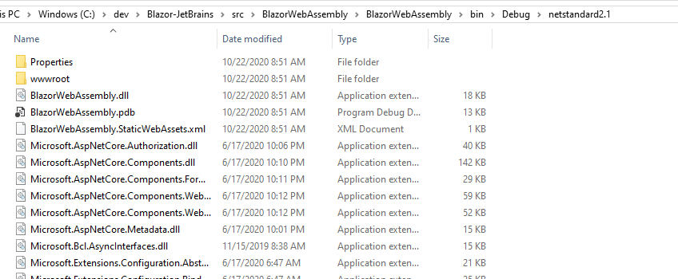
How Blazor WebAssembly Works
C# and Razor code files are compiled into .NET assemblies

Slide 22
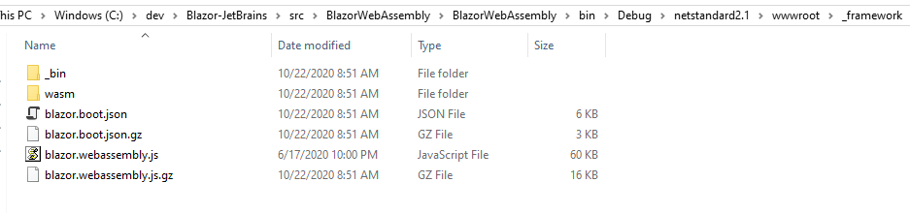
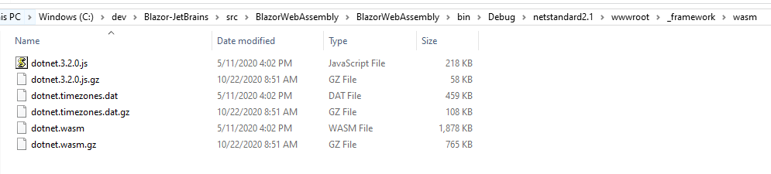
How Blazor WebAssembly Works
Assemblies and .NET runtime are downloaded on the browser

Slide 23
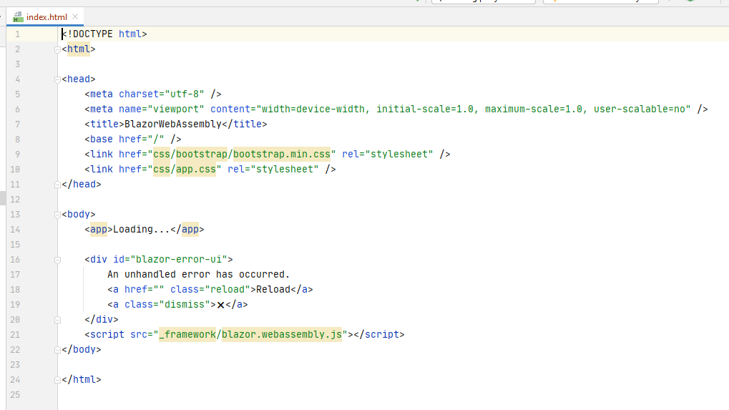
How Blazor WebAssembly Works
Blazor uses JavaScript to bootstrap the .NET runtime loading the required assembly references

Slide 24
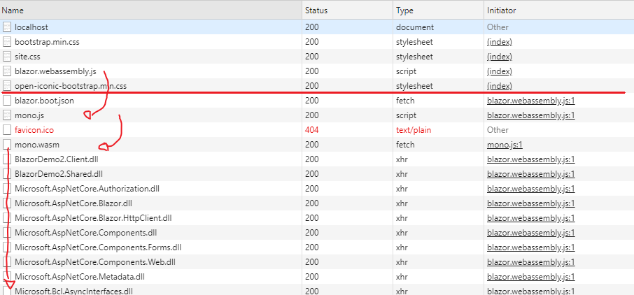
How Blazor WebAssembly Works
Blazor uses JavaScript to bootstrap the .NET runtime loading the required assembly references

Slide 25
How Blazor WebAssembly Works
Blazor allows DOM manipulation/browser API calls from the .NET runtime via JavaScript interoperability
C#
Render Tree
Blazor JavaScript
Change DOM
DOM
C#
Event Trigger
Process Event
Blazor JavaScript
Change DOM
DOM
UI Differences

Slide 26
Demo – Blazor WebAssembly
Notes:
BlazorDemo2

Slide 27
Hosting Model Tradeoffs
Blazor WebAssembly | Blazor Server
Larger download size | Smaller download size
Slower load time | Faster load time
Code is run on the client | Code never leaves the server
Runs a stripped-down version of Mono | Runs on full-featured .NET Core runtime
Lower latency | Higher latency
Supports offline support (PWA) | No offline support
Consumes fewer server resources | Consumes more server resources
Requires WebAssembly compatible browser

Slide 28
FAQ
Does Blazor WebAssembly compile my entire .NET assembly into WebAssembly?
No*
Only .NET runtime is compiled into WebAssembly
* There might be support for full static ahead-of-time compilation into WebAssembly in the future

Slide 29
FAQ
Won’t the app size be huge for the .NET runtime?
Not really
dotnet.wasm is ~1.8MB (~765KB compressed), mscorlib.dll is ~4.1MB (~1.4MB compressed)
Blazor team is currently working on reducing the size

Slide 30
FAQ
Can I use Blazor without a .NET backend?
Yes, Blazor WebAssembly can be used with any backend (or not!)
And no, Blazor Server requires ASP.NET Core

Slide 31
FAQ
What about performance of Blazor Server?
Under load, a VM with 1 vCPU and 3.5GB RAM handled >5,000 concurrent users
Main bottle neck is server’s memory
Use Azure SignalR Service to quickly and easily scale out
https://devblogs.microsoft.com/aspnet/blazor-server-in-net-core-3-0-scenarios-and-performance/

Slide 32
Demo – Building a Blazor Web App
Notes:
BlazorDemo2

Slide 33
Additional Information
Slides and demos
https://github.com/bjablonsky/JetBrains-Blazor
Blazor.net
http://blazor.net/
Rider 2020.2
https://www.jetbrains.com/rider/download/
Awesome Blazor
https://github.com/AdrienTorris/awesome-blazor
Blazor Performance
https://devblogs.microsoft.com/aspnet/blazor-server-in-net-core-3-0-scenarios-and-performance/

