Slide 1
Building a Static Web App With Blazor and Azure
https://github.com/bjablonsky /BuildingAStaticWebAppWithBlazorAndAzure-TechBash2022

Slide 2

About Me
Brian Jablonsky
10+ years of professional experience
.NET Developer
Former Microsoft MVP
Currently @Microsoft
Co-organizer of NYC .NET Dev User Group
@brian_jablonsky
https://github.com/bjablonsky

Slide 3
Overview
What is a static web app?
Why build a static web app?
Azure Static Web Apps
Building a static web app using Blazor
Create and deploy Azure Static Web App
Adding an API
Adding Auth
What’s next?

Slide 4
What is a static web app?
Static web apps are web apps that consist of static files such as HTML, CSS, images, and client-side JS being served from an endpoint
Basically, a web app without any server-side scripting or reliance on a backend server

Slide 5
Why build a static web app?
Not all web apps are complicated
Some web apps are infrequently updated and have static content
Some web apps have simple data requirements
Some web apps can be supported by an existing API or serverless functions
Some web apps are not dependent on server-side rendering

Slide 6
Benefits of a static web app
Improved security
Improved speed and performance
Fewer system dependencies
Cost savings for hosting
Ability to scale quickly and cheaply

Slide 7
Drawbacks of a static web app
Data-driven applications need to consume data typically delivered by a backend server
Auth can be a concern
Complex applications might not work

Slide 8
Azure Static Web Apps
Azure service that automatically builds and deploys full stack static web apps to Azure from a code repository
Has CI/CD built-in
Built-in web hosting
Back-end routing rules
Support for APIs
Support for modern web stacks

Slide 9
Hosting Plans
Feature | Free Plan | Standard Plan
Web Hosting | ✔ | ✔
GitHub/ADO Integration | ✔ | ✔
Globally Distributed Content | ✔ | ✔
Free, auto-renewing SSL Cert | ✔ | ✔
Staging Environments | 3 per app | 10 per app
Max App Size | 500MB total per app, 250MB per deployment | 2GB total per app, 500MB per deployment
Custom Domains | 2 per app | 5 per app
APIs via Azure Functions | Managed | Managed or BYO Functions App
Auth Provider Integration | Pre-configured | Pre-configured or Custom registrations
Assign Custom Roles with Functions |  | ✔
Private Endpoints |  | ✔
SLA | None | ✔

Slide 10
Cost
Feature | Free Plan | Standard Plan
Price | Free | $9/app/month
Included bandwidth | 100GB | 100GB
Bandwidth overage | N/A | 0.20/GB per subscription
Enterprise-grade edge | N/A | $17.52/app/month

Slide 11
Supported languages/runtimes
Frontend frameworks
Blazor
Angular
Next.js
Nuxt
React
Vue.js
Frontend static site generators
Gatsby
Hugo
VuePress

Slide 12
Supported languages/runtimes
Backend API via Azure Functions
C#
Java
JavaScript
PowerShell
Python

Slide 13
Building a static web app using Blazor
Blazor is a full featured frontend framework
Two Blazor hosting models:
Blazor WebAssembly
Blazor Server
Blazor Server is not supported since it’s server-side rendered and requires a backend server
We’ll be using Blazor WebAssembly
ASP.NET Core Hosted not supported

Slide 14
Build a Blazor WebAssembly Demo App

Slide 15
Create and Deploy Azure Static Web App

Slide 16
Adding an API

Slide 17
Adding auth

Slide 18
What’s Next?
Integrate custom authentication
Integrate other APIs via API Management, Azure App Service, or Azure Container Apps
Add custom routing
Add custom domains
Add staging environments

Slide 19
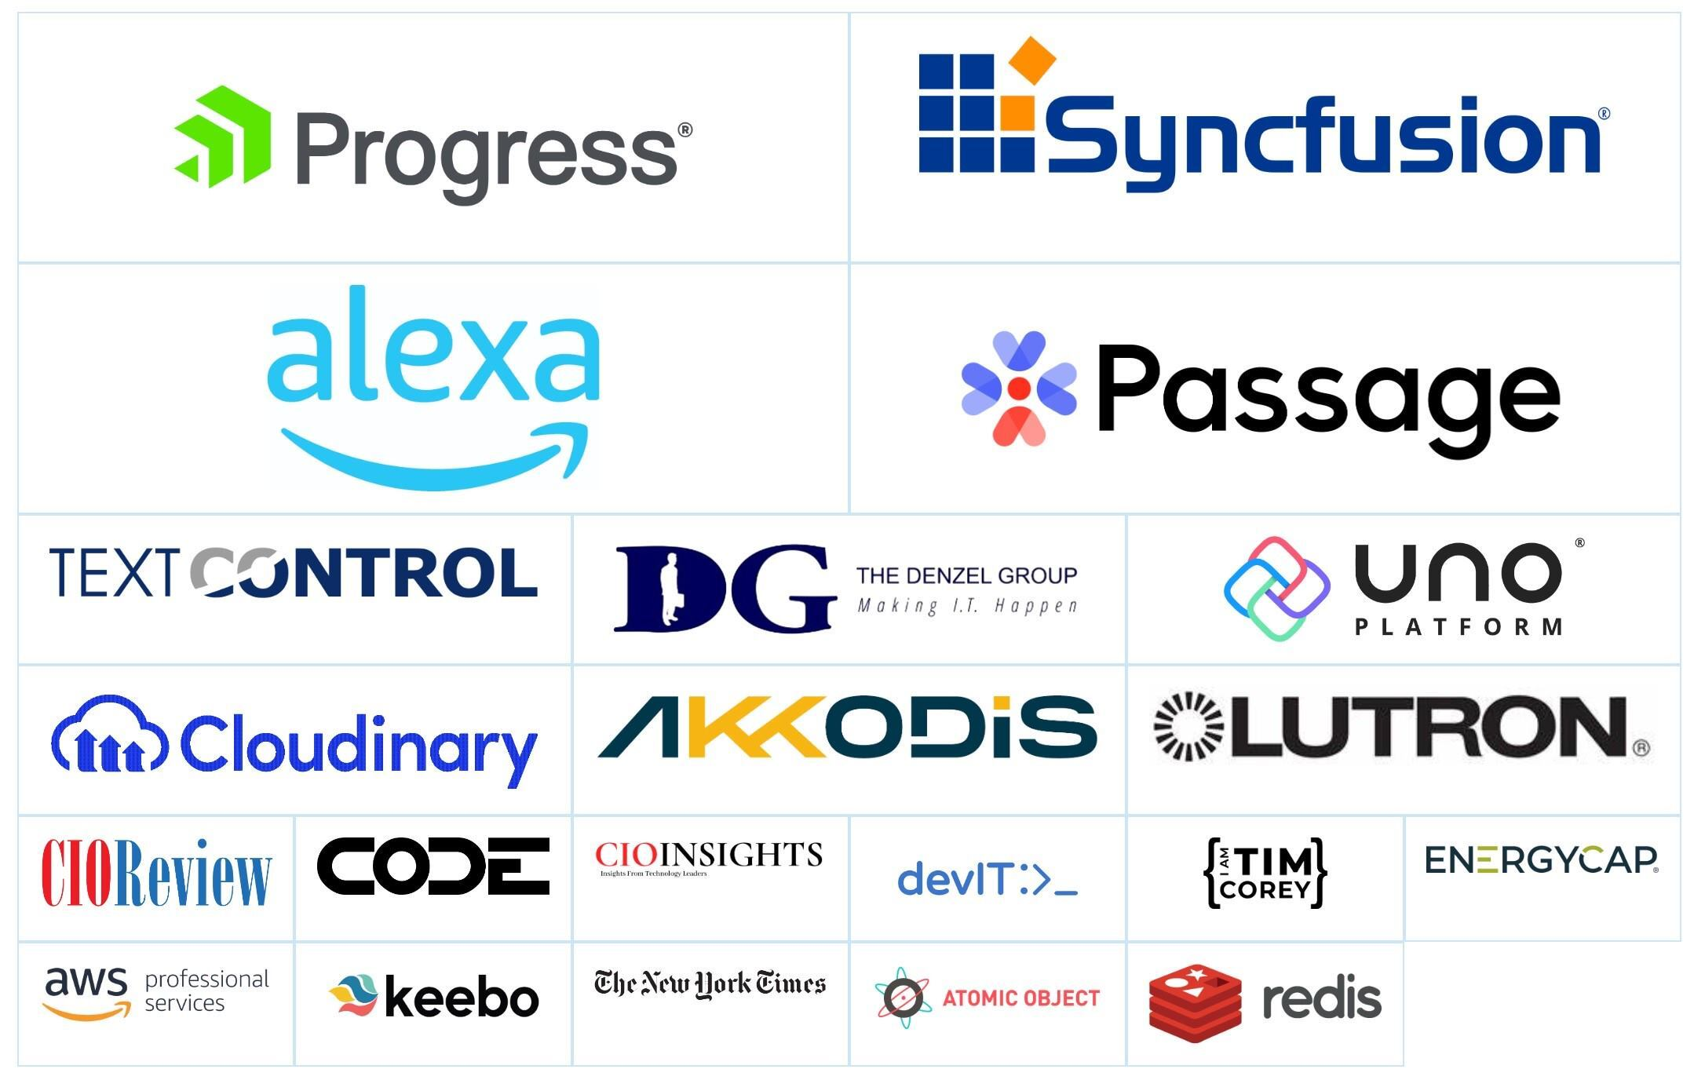
Thanks To Our Sponsors!

Slide 20
Additional Information
Link to slides and source code
https://github.com/bjablonsky/BuildingAStaticWebAppWithBlazorAndAzure-TechBash2022
Azure Static Web Apps Docs
https://learn.microsoft.com/en-us/azure/static-web-apps/
Azure Static Web Apps Learning Module
https://learn.microsoft.com/en-us/training/paths/azure-static-web-apps/
Survey
https://forms.office.com/r/qucWfrzpTy

