Slide 1
GitHub Actions: Workflows in Your Repo
https://github.com/bjablonsky/GitHubActions-devup2022

Slide 2

About Me
Brian Jablonsky
10+ years of professional experience
.NET Developer
Former Microsoft MVP
Currently @Microsoft
Co-organizer of NYC .NET Dev User Group
@brian_jablonsky
https://github.com/bjablonsky

Slide 3
Overview
What are GitHub Actions?
How GitHub Actions Work
Demo: Creating a simple CI/CD Pipeline
Going Beyond a Simple Workflow

Slide 4
What are GitHub Actions?
An easy way to automate your software workflows straight from GitHub and your repo
Event-driven
Can be scheduled or triggered by an event
GitHub Actions are workflows that contain one or more jobs
Create your own workflows or use and customize community created Actions and workflows
Workflows are stored as code in your GitHub repo

Slide 5
Just Another CI/CD Tool?
While great for CI/CD, it can do a lot more
Supports a variety of workflow events:
Pull request
Push
Create or delete a branch or tag
Deployment
Create or update a Wiki page (Gollum)
Issues
Schedules
And more!

Slide 6
Should I Migrate to GitHub Actions?
You don’t need to migrate your existing CI/CD workflow to GitHub Actions
You can use GitHub Actions in conjunction with your existing CI/CD and workflow tools

Slide 7
How GitHub Actions Work
Create a workflow
Execute the Workflow in a Runner based off an event

Slide 8
How GitHub Actions Work
Workflows
A configurable automated process set up in your repo
Workflows are made up of one or more jobs
Can be scheduled or activated by an event
YAML file that defines your workflow and lives in the root of your GitHub repo in the .github/workflows directory

Slide 9
How GitHub Actions Work
Jobs
A set of steps that execute on the same runner
Can define dependency rules for how jobs run in the Workflow
Jobs can run in parallel or sequentially

Slide 10
How GitHub Actions Work
Steps
An individual task that can run commands (called actions)
Each step of the job is executed on the same runner

Slide 11
How GitHub Actions Work
Actions
Standalone commands
Create your own actions or use and customize actions from the community

Slide 12
How GitHub Actions Work
Runners
Any machine with the GitHub Actions runner application installed
Can be hosted by GitHub or can host your own
Runners wait for an available job, then executes a job’s actions and reports the progress/logs/results back to GitHub
Runners can run one job at a time

Slide 13
GitHub Actions Limits
Job execution time: <6 hours (does not apply to self-hosted runners)
Workflow run time: <35 days
Job queue time: <24 hours (does not apply to self-hosted runners)
API requests: <1000 requests
Concurrent jobs: (does not apply to self-hosted runners)
Free plan: 20 total concurrent jobs, max of 5 macOS jobs
Pro plan: 40 total concurrent jobs, max of 5 macOS jobs
Team plan: 60 total concurrent jobs, max of 5 macOS jobs
Enterprise plan: 180 total concurrent jobs, max of 50 macOS jobs
Job matrix: <256 jobs per workflow run

Slide 14
GitHub Hosted Runner
Windows and Linux
2-core CPU, 7GB RAM, 14GB SSD
Windows supported versions: Windows Server 2019, Windows Server 2022
Linux supported versions: Ubuntu 18.04, Ubuntu 20.04, Ubuntu 22.04
macOS
3-core CPU, 14GB RAM, 14GB SSD
support versions: macOS Catalina 10.15, Big Sur 11, Monterey 12

Slide 15
GitHub Actions Pricing
Public repositories: Free
Private repositories:
Free: 2,000 minutes included/per month/per account
Pro: 3,000 minutes included/per month/per account
Team: 3,000 minutes included/per month/per account
Enterprise: 50,000 minutes included/per month/per account
OS runner minute multiplier
Linux: 1
macOS: 10
Windows: 2
Charged to account that owns the repo
Overage costs: $0.008/minute

Slide 16
GitHub Actions Pricing
Public repositories: Free
Private repositories:
Free: 500MB included/per account
Pro: 1GB included/per account
Team: 2GB included/per account
Enterprise: 50GB included/per account
Charged to account that owns the repo
Overage costs: $0.25/GB

Slide 17
Creating a CI/CD Pipeline

Slide 18
Creating a CI/CD Pipeline
Make sure GitHub Actions is enabled in your repo

Slide 19
Creating a CI/CD Pipeline
Create workflow YAML file in .github/workflows in the root of your repo

Slide 20
Creating a CI/CD Pipeline
In your workflow file:
Name your workflow
name: Build and deploy an ASP.NET Core app to Azure Web Apps

Slide 21
Creating a CI/CD Pipeline
In your workflow file:
Define an event section so GitHub Actions knows when to fire it off
name: Build and deploy an ASP.NET Core app to Azure Web Apps
on:
push:
branches: [ main ]

Slide 22
Creating a CI/CD Pipeline
In your workflow file:
Create a jobs section and name the job
name: Build and deploy an ASP.NET Core app to Azure Web Apps
on:
push:
branches: [ main ]
jobs:
build-and-deploy:

Slide 23
Creating a CI/CD Pipeline
In your workflow file:
Define what runner to use
name: Build and deploy an ASP.NET Core app to Azure Web Apps
on:
push:
branches: [ main ]
jobs:
build-and-deploy:
runs-on: ubuntu-latest

Slide 24
Creating a CI/CD Pipeline
In your workflow file:
Create the steps to checkout and build/test your project
…
jobs:
build-and-deploy:
runs-on: ubuntu-latest
steps:
- name: Checkout code
uses: actions/checkout@v2
- name: Setup .NET Core
uses: actions/setup-dotnet@v1
with:
dotnet-version: ‘3.1.x’
- name: Install dependencies
run: dotnet restore ./src/GitHubActionsExample.sln
- name: Build
run: dotnet build --configuration Release --no-restore ./src/GitHubActionsExample.sln
- name: Test
run: dotnet test --no-restore --verbosity normal ./src/GitHubActionsExample.sln

Slide 25
Creating a CI/CD Pipeline
Build!

Slide 26
Creating a CI/CD Pipeline
In your workflow file:
Create the steps to publish your project
jobs:
build-and-deploy:
runs-on: ubuntu-latest
steps:
…
- name: Publish
run: dotnet publish -c Release -o './myapp' ./src/GitHubActionsExample.sln

Slide 27
Creating a CI/CD Pipeline
In your workflow file:
Create the steps to deploy your project
jobs:
build-and-deploy:
runs-on: ubuntu-latest
steps:
…
- name: Publish
run: dotnet publish -c Release -o './myapp' ./src/GitHubActionsExample.sln
- name: Run Azure webapp deploy action using publish profile credentials
uses: azure/webapps-deploy@v2
with:
app-name: ‘GitHubActionsPCC2021'
publish-profile: ${{ secrets.AZURE_WEBAPP_PUBLISH_PROFILE }}
package: './myapp'

Slide 28
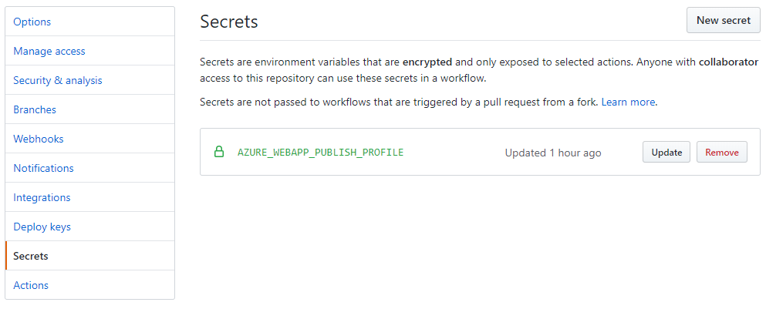
Creating a CI/CD Pipeline
In your GitHub repo, add a secret for the publish profile

Slide 29
Creating CI/CD Pipeline
Deploy!

Slide 30
Going Beyond a Simple Workflow
Utilize environment variables for configurable workflows
Use build matrixes to test across multiple systems/platforms/languages
Create complex workflows that utilize existing workflows and jobs

Slide 31
Going Beyond a Simple Workflow
Create workflow templates
Cache dependencies and store artifacts to make your workflow run more efficient
Host your own runners

Slide 32
Going Beyond a Simple Workflow
Build your own Actions
Currently supports Docker and JavaScript
Docker containers run on Linux
JavaScript can run on Linux, macOS, and Windows

Slide 33
Additional Information
Link to slides and source code
https://github.com/bjablonsky/GitHubActions-devup2022
GitHub Actions Docs
https://help.github.com/en/actions
GitHub Actions Learning Lab
https://lab.github.com/githubtraining/github-actions:-hello-world

