Slide 1
GitHub Actions: Workflows in Your Repo

Slide 2

About Me
Brian Jablonsky
@brian_jablonsky
https://github.com/bjablonsky
Microsoft MVP
Co-organizer of NYC .NET Dev User Group
.NET Developer
10+ years of professional experience

Slide 3
Overview
What are GitHub Actions?
How GitHub Actions Work
Demo: Creating a simple CI/CD Pipeline
Going Beyond a Simple Workflow

Slide 4
What are GitHub Actions?
An easy way to automate your software workflows straight from GitHub and your repo
Actions are individual tasks that you can combine to create jobs and customize your workflow
Create your own Actions or use and customize community created Actions
Workflows are code stored in your GitHub repo

Slide 5
Just Another CI/CD Tool?
While great for CI/CD, it can do a lot more
Supports a variety of workflow events:
Push/Pull request/PR comments
Create/delete a branch or tag
Deployment
Fork
Gollum (creates or updates a Wiki page)
Issues
Releases/Milestones
Schedules
And more!

Slide 6
Should I Migrate to GitHub Actions?
You don’t need to migrate your existing CI/CD workflow to GitHub Actions
You can use GitHub Actions in conjunction with your existing CI/CD and workflow tools

Slide 7
How GitHub Actions Work
Build Action(s)
Create a Workflow based off Event(s)
Workflows are made up of Job(s)
Jobs are made up of Action(s)
Execute the Workflow in Runner(s)

Slide 8
How GitHub Actions Work
Actions
Individual tasks that you can combine as steps to create jobs and workflows
Use your own actions or use and customize actions from the community
To use in a workflow, you must include it as step

Slide 9
How GitHub Actions Work
Jobs
A set of steps that execute on the same runner
Can define dependency rules for how jobs run in the Workflow
Jobs can run in parallel or sequentially

Slide 10
How GitHub Actions Work
Workflows
A configurable automated process set up in your repo
Workflows are made up of one or more jobs
Can be scheduled or activated by an event
YAML file that defines your workflow and lives in the root of your GitHub repo in the .github/workflows directory

Slide 11
How GitHub Actions Work
Runners
Any machine with the GitHub Actions runner application installed
Can be hosted by GitHub or host your own
Runners wait for an available job, then executes job’s actions and reports the progress/logs/results back to GitHub
Runners can run one job at a time
GitHub hosted runner:
2-core CPU, 7GB RAM, 14GB SSD
Windows supported versions: Windows Server 2019
Linux supported versions: Ubuntu 20.04, Ubuntu 18.04, Ubuntu 16.04
macOS support versions: macOS Catalina 10.15

Slide 12
GitHub Actions Limits
Job execution time: <6 hours (does not apply to self-hosted runners)
Workflow run time: <72 hours
Job queue time: <24 hours (does not apply to self-hosted runners)
API requests: <1000 requests
Concurrent jobs: (does not apply to self-hosted runners)
Free plan: 20 total concurrent jobs, max of 5 macOS jobs
Pro plan: 40 total concurrent jobs, max of 5 macOS jobs
Team plan: 60 total concurrent jobs, max of 5 macOS jobs
Enterprise plan: 180 total concurrent jobs, max of 50 macOS jobs
Job matrix: <256 jobs per workflow run

Slide 13
GitHub Actions Pricing
Public repositories: Free
OS runner minute multiplier
Linux: 1
macOS: 10
Windows: 2
Private repositories:
Free: 2,000 minutes included/per month/per account
Pro: 3,000 minutes included/per month/per account
Team: 3,000 minutes included/per month/per account
Enterprise: 50,000 minutes included/per month/per account
Charged to account that owns the repo
Overage costs: $0.008/minute

Slide 14
GitHub Actions Pricing
Public repositories: Free
Private repositories:
Free: 500MB included/per account
Pro: 1GB included/per account
Team: 2GB included/per account
Enterprise: 50GB included/per account
Charged to account that owns the repo
Overage costs: $0.25/GB

Slide 15
Demo

Slide 16
Creating a CI/CD Pipeline
Make sure GitHub Actions is enabled in your repo

Slide 17
Creating a CI/CD Pipeline
Create workflow YAML file in .github/workflows in the root of your repo
Name your workflow
name: Build and deploy an ASP.NET Core app to Azure Web Apps
Define an event section so GitHub Actions knows when to fire it off
on:
push:
branches: [ master ]

Slide 18
Creating a CI/CD Pipeline
In your workflow file, build the project
Create a jobs section
jobs:

Slide 19
Creating a CI/CD Pipeline
In your workflow file, build the project
Name the job
jobs:
build-and-deploy:

Slide 20
Creating a CI/CD Pipeline
In your workflow file, build the project
Define what runner to use
jobs:
build-and-deploy:
runs-on: ubuntu-latest

Slide 21
Creating a CI/CD Pipeline
In your workflow file, build the project
Create the steps to checkout and build/test your project
jobs:
build-and-deploy:
runs-on: ubuntu-latest
steps:
- name: Checkout code
uses: actions/checkout@v2
- name: Setup .NET Core
uses: actions/setup-dotnet@v1
with:
dotnet-version: ‘3.1.x’
- name: Install dependencies
run: dotnet restore ./src/GitHubActionsExample.sln
- name: Build
run: dotnet build --configuration Release --no-restore ./src/GitHubActionsExample.sln
- name: Test
run: dotnet test --no-restore --verbosity normal ./src/GitHubActionsExample.sln

Slide 22
Creating a CI/CD Pipeline
Build!

Slide 23
Creating a CI/CD Pipeline
In your workflow file, publish the project
Create the steps to publish your project
jobs:
build-and-deploy:
runs-on: ubuntu-latest
steps:
…
- name: Publish
run: dotnet publish -c Release -o './myapp' ./src/GitHubActionsExample.sln

Slide 24
Creating a CI/CD Pipeline
In your workflow file, deploy the project to Azure Web Apps
Create the steps to deploy your project
jobs:
build-and-deploy:
runs-on: ubuntu-latest
steps:
…
- name: Publish
run: dotnet publish -c Release -o './myapp' ./src/GitHubActionsExample.sln
- name: Run Azure webapp deploy action using publish profile credentials
uses: azure/webapps-deploy@v2
with:
app-name: 'GithubActionsTest-NYC'
publish-profile: ${{ secrets.AZURE_WEBAPP_PUBLISH_PROFILE }}
package: './myapp'

Slide 25
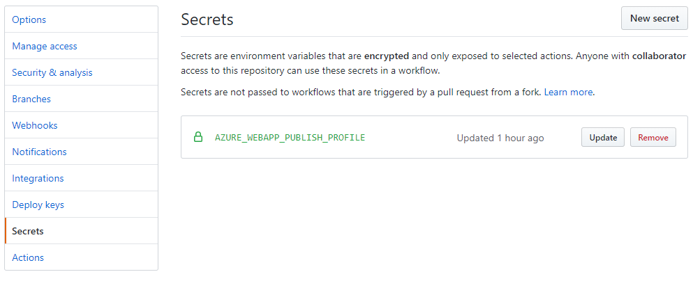
Creating a CI/CD Pipeline
In your GitHub repo, add a secret for the publish profile

Slide 26
Creating CI/CD Pipeline
Deploy!

Slide 27
Going Beyond a Simple Workflow
Utilize environment variables for configurable workflows
Use build matrixes to test across multiple systems/platforms/languages
Create complex workflows that utilize existing workflows and jobs

Slide 28
Going Beyond a Simple Workflow
Create workflow templates
Cache dependencies and store artifacts to make your workflow run more efficient
Host your own runners

Slide 29
Going Beyond a Simple Workflow
Build your own Actions
Currently supports Docker and JavaScript
Docker containers run on Linux
JavaScript can run on Linux, macOS, and Windows

Slide 30
Additional Information
Link to slides and source code
https://github.com/bjablonsky/GithubActions
GitHub Actions Docs
https://help.github.com/en/actions
GitHub Actions Learning Lab
https://lab.github.com/githubtraining/github-actions:-hello-world

