Slide 1
Blazor
C# in the Browser
Brian Jablonsky

Slide 2

About Me
Brian Jablonsky
@brian_jablonsky
https://www.brianjablonsky.com/
https://github.com/bjablonsky
.NET Developer
9+ years of professional experience
Co-organizer of NYC .NET Dev User Group

Slide 3
Overview
Getting Started with Blazor
Blazor Server
Blazor WebAssembly
Code Examples
Roadmap
FAQ
Questions

Slide 4
What is Blazor?
A .NET web framework that runs in the browser
Lets you build interactive web UIs using C# instead of JavaScript
Uses C#, Razor, HTML, and CSS to author components
Browser + Razor = Blazor

Slide 5
Why Use Blazor?
Full Stack development using C# and .NET instead of JavaScript
Benefit from .NET advantages:
High performance, scalability, maintainability, cross platform
Use Visual Studio
Leverage the existing .NET ecosystem of .NET libraries
Share app logic across server and client
Server-side or client-side UI rendering

Slide 6
Setup
WebAssembly compatible browser
https://platform-status.mozilla.org/#web-assembly
.NET Core 3.0 SDK
https://dotnet.microsoft.com/download/dotnet-core/3.0
Visual Studio 2019 or Visual Studio Code
https://visualstudio.com/
Blazor WebAssembly template
dotnet new -i Microsoft.AspNetCore.Blazor.Templates::3.0.0-preview9.19465.2

Slide 7
Setup
Visual Studio Code/command line
dotnet new blazorwasm -o WebApplication1
-- or --
dotnet new blazorserver -o WebApplication2
dotnet build
dotnet run

Slide 8
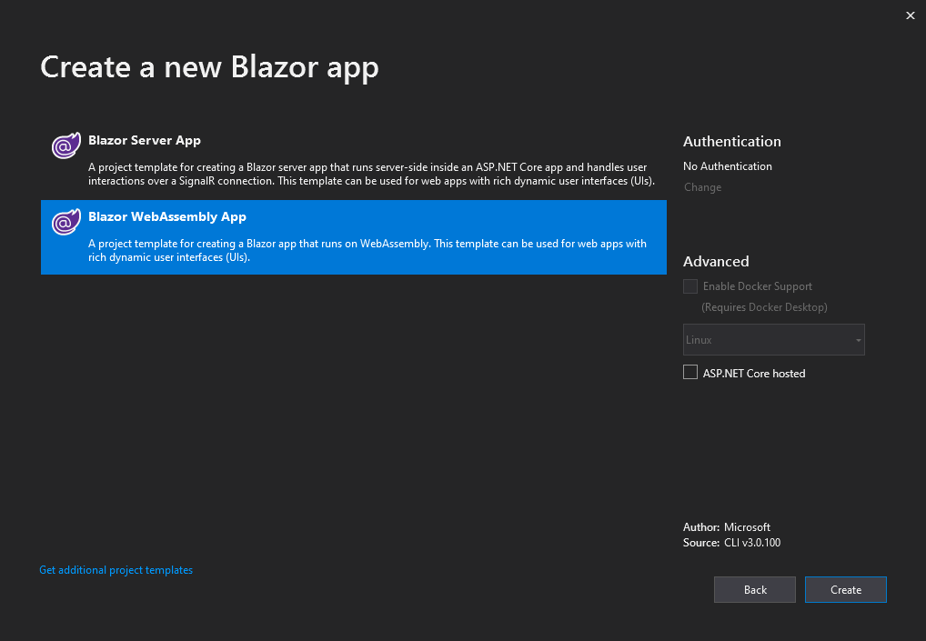
Setup
Visual Studio 2019

Slide 9
How Does Blazor Work?
A component
A Blazor hosting model

Slide 10
Components
Fundamental building block of web apps
Components are self-contained UI
Includes HTML and logic to inject data or respond to events
They can be nested, reused, and shared between projects
Written using C#/Razor and HTML

Slide 11
Two Blazor Hosting Models
Blazor Server
Blazor WebAssembly

Slide 12
Blazor Server
Hosts Blazor components on the server and handles UI interactions via SignalR
Available in .NET Core 3.0
Smaller download size
Faster load time
Runs on full featured .NET runtime (.NET Core)
Code never leaves the server

Slide 13
How Blazor Server Works
Traditional client-side rendering
Browser
UI Thread
Blazor

Slide 14
How Blazor Server Works
Traditional server-side rendering
Browser
UI
Web Worker
Blazor

Slide 15
How Blazor Server Works
Server-side rendering using SignalR
Browser
dotnet
ASP.NET Core
SignalR
Blazor

Slide 16
Demo – Blazor Server
Notes:
BlazorDemo1

Slide 17
Blazor Server Tradeoffs
Latency
No offline support
Consumes more resources

Slide 18
Blazor WebAssembly
Hosts Blazor components in the browser using a WebAssembly-based .NET runtime
In preview
True SPA
Utilizes client resources
Supports offline, static sites, PWA

Slide 19
WebAssembly Crash Course
WebAssembly (wasm) is a binary instruction format for a stack-based virtual machine
New type of code that can be run in a browser
Developed out of performance problems from JavaScript

Slide 20
WebAssembly Crash Course
WebAssembly Goals:
Fast, efficient, and portable
Wasm code can be executed at near-native speed in the browser
Readable and debuggable
Wasm code is a low-level assembly language but is in a human-readable text format
Secure
Designed to run in a safe, sandboxed execution environment like JavaScript in the browser

Slide 21
WebAssembly Crash Course
The web platform consists of two parts:
A virtual machine to run code
Set of APIs to control the browser
Traditionally, the browser’s VM has only been able to load JavaScript
WebAssembly adds an additional VM to run a compact binary format

Slide 22
WebAssembly Crash Course
WebAssembly is not meant to replace JavaScript
Intended to be a compilation target of source languages
WebAssembly can’t directly access the DOM
C/C++/C# source code
wasm module
HTML
Wasm compiler
JavaScript “glue” code

Slide 23
How Blazor WebAssembly Works
C# and Razor code files are compiled into .NET assemblies
Assemblies and .NET runtime are downloaded on the browser
Blazor uses JavaScript to bootstrap the .NET runtime (Mono) loading the required assembly references
Blazor allows DOM manipulation/browser API calls from the .NET runtime via JavaScript interoperability

Slide 24
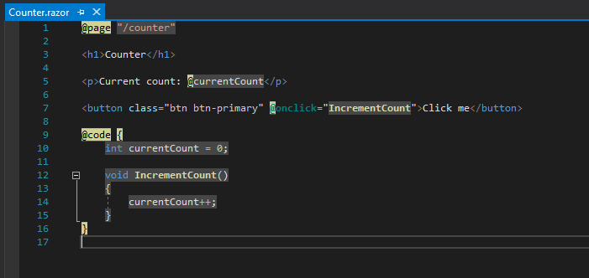
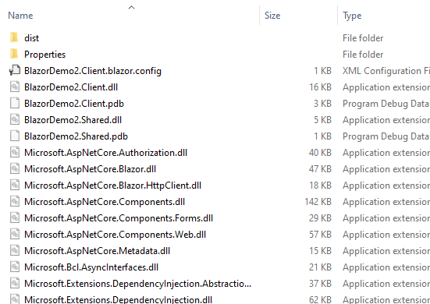
How Blazor WebAssembly Works
C# and Razor code files are compiled into .NET assemblies

Slide 25

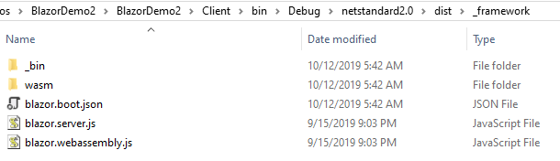
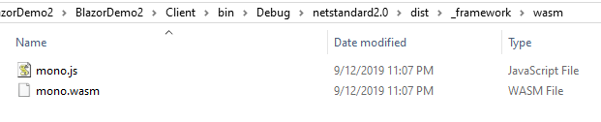
How Blazor WebAssembly Works
Assemblies and .NET runtime are downloaded on the browser

Slide 26
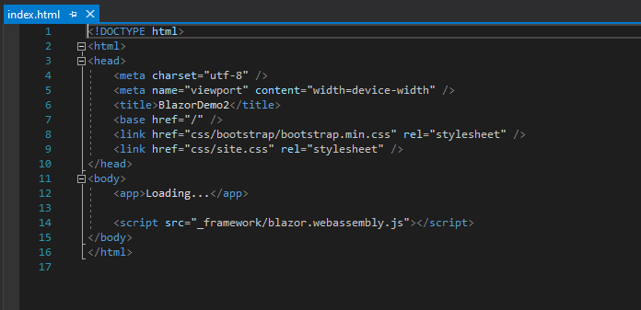
How Blazor WebAssembly Works
Blazor uses JavaScript to bootstrap the .NET runtime loading the required assembly references

Slide 27
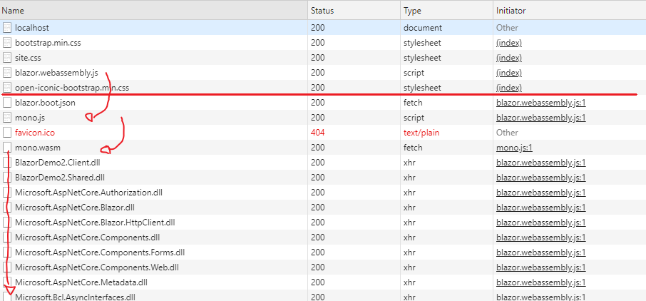
How Blazor WebAssembly Works
Blazor uses JavaScript to bootstrap the .NET runtime loading the required assembly references

Slide 28
How Blazor WebAssembly Works
Blazor allows DOM manipulation/browser API calls from the .NET runtime via JavaScript interoperability
C#
Render Tree
Blazor JavaScript
Change DOM
DOM
C#
Event Trigger
Process Event
Blazor JavaScript
Change DOM
DOM
UI Differences

Slide 29
Demo – Blazor WebAssembly
Notes:
BlazorDemo2

Slide 30
Blazor WebAssembly Tradeoffs
Larger download size
Requires WebAssembly which requires modern browsers
Some performance issues with CPU intensive tasks since it uses .NET IL interpreter
Still in preview

Slide 31
Roadmap
March 2017 – WebAssembly announces 1.0
August 2017 – Mono announces prototype WebAssembly
February 2018 – Blazor is publicly available
March 22, 2018 – Blazor 0.1.0 is released
September 23, 2019 – Blazor Server is released with .NET Core 3.0

Slide 32
Roadmap - Future
Blazor WebAssembly
May 2020

Slide 33
Roadmap - Future
Blazor PWA
Build Progressive Web Apps using Blazor WebAssembly
Progressive Web Apps are web apps that uses modern web capabilities to deliver app-like end user experiences
Work offline, receive push notifications, fast and responsive, OS installable, and secure
Targeting preview with .NET 5 (November 2020)

Slide 34
Roadmap - Future
Blazor Hybrid
Native apps that run natively on the device and have access to all the native capabilities of the device but use web technologies to render UI using Blazor
Native .NET can render to Electron for desktop apps or WebView for mobile apps
Doesn’t use Blazor WebAssembly but rather
Targeting preview with .NET 5 (November 2020)
https://aka.ms/blazorelectron

Slide 35
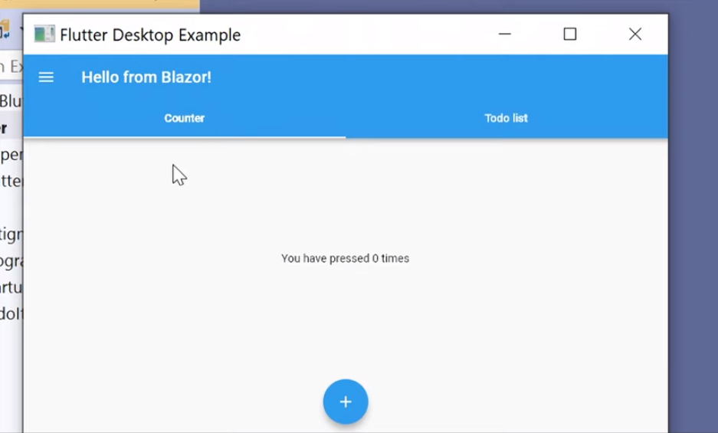
Roadmap - Future
Blazor Native
Blazor’s rendering layer was built with extensibility in mind
Rendering layer could render native controls instead of HTML
Currently exploring different options
http://aka.ms/blutter

Slide 36
FAQ
Does Blazor WebAssembly compile my entire .NET assembly into WebAssembly?
No*
Only .NET runtime is compiled into WebAssembly
* There might be support for full static ahead-of-time compilation into WebAssembly in the future

Slide 37
FAQ
Won’t the app size huge for the .NET runtime?
Not really
Mono.wasm is ~1.8MB (~850KB compressed), mscorlib.dll is ~1.4MB (~600KB compressed)
Blazor team is currently working on reducing the size by using custom profile

Slide 38
FAQ
Can I use Blazor without a .NET backend?
Yes, Blazor WebAssembly can be used with any backend (or not!)
And no, Blazor Server requires ASP.NET Core

Slide 39
FAQ
What about performance of Blazor Server?
Under load, a VM with 1 vCPU and 3.5GB RAM handled >5,000 concurrent users
Main bottle neck is server’s memory
Use Azure SignalR Service to quickly and easily scale out
https://devblogs.microsoft.com/aspnet/blazor-server-in-net-core-3-0-scenarios-and-performance/

Slide 40
Demos

Slide 41
Demo – Components

Slide 42
Demo – Code Behind

Slide 43
Demo – Shared Components

Slide 44
Demo – Routes

Slide 45
Demo – Two Way Data Binding

Slide 46
Demo – Authentication

Slide 47
Questions
?

Slide 48
Additional Information
Slides and demos
https://github.com/bjablonsky/NYCCC19-Blazor
Blazor.net
http://blazor.net/
Awesome Blazor
https://github.com/AdrienTorris/awesome-blazor
Blazor Performance
https://devblogs.microsoft.com/aspnet/blazor-server-in-net-core-3-0-scenarios-and-performance/
Blazor Hybrid
https://aka.ms/blazorelectron

