Slide 1
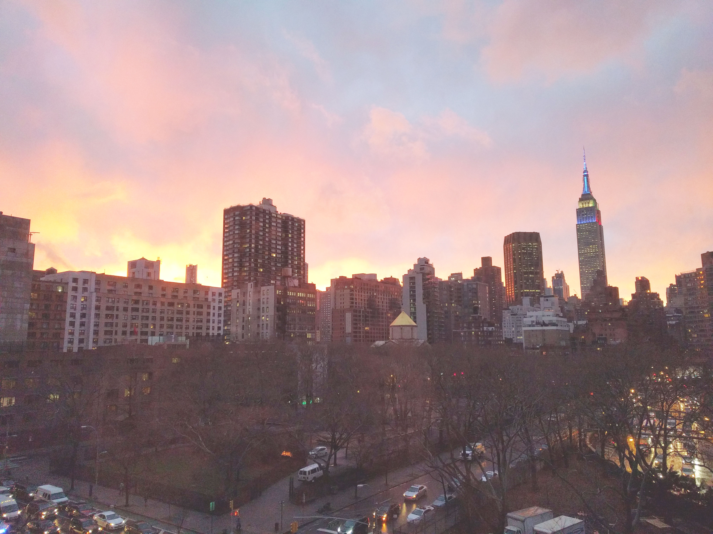


Slide 2
News
Happy New Year!
Follow us on Twitter: @NYCDotNetDevs
Follow us on Instagram: https://www.instagram.com/nycdotnetdevs/
http://www.nycdotnetdevs.com/
http://www.nycdotnetdevs.org/

Slide 3
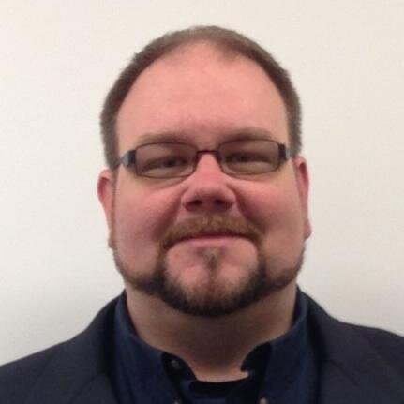
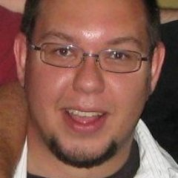
Announcements
Introducing your new co-organizers
Erik Noren
@eriknoren
Brian Jablonsky
@brian_jablonsky

Slide 4
Announcements
Orchard Harvest Conference 2017
Orchard is an open source .NET CMS
Tuesday, February 21 – Wednesday, February 22
TKP New York Conference Center 109 West 39th Street New York, NY 10018
orchard@microsoft.com
@orchardcms
Use code NYCDOTNET for a discount!

Slide 5
Announcements
Call for presentations!
Have an idea/topic for a presentation?
Want to give a presentation?
Need a topic for February!
Next meeting: Thursday, February 16th

Slide 6
Swag
Enter the raffle for a chance to win a free pass to Orchard Harvest Conference 2017!
(No purchase necessary. Void where prohibited or restricted by law. Raffle open to all legal residents of the planet earth. Seriously, why are you reading this?)

Slide 7
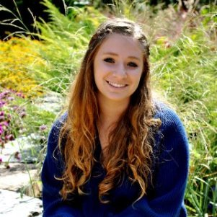
Heather Shapiro
@microheather
Technical Evangelist at Microsoft
Data Science Fanatic
Duke Alum
Sloth Lover

